Slide 1


Red PILL or blue pill
Document Database Modeling for Relational Modelers
https://www.theguardian.com/film/2019/jan/21/from-red-pills-to-red-white-and-blue-brexit-how-the-matrix-shaped-our-reality
Notes:
The blue pill allowed Neo to remain in the fabricated world he had known as reality. The red pill allowed him to be located and extracted from the alien grid and put into real reality. The red pill represented the willingness to learn a potentially unsettling and life-changing truth.
Will this presentation reveal a new way of modeling for NoSQL databases that breaks from everything you’ve been told and learned about relational modeling and normalization?
Stay tuned

Slide 2
Speaker bio
Bill Coulam
EST 1995
  Consultant and employee in San Francisco, Denver, Houston, Virginia and Utah
  Telecom, energy, fitness, property insurance, healthcare, for-profit, non-profit
  Software engineer to data engineer, data modeler
  data and database architect for over 25 years (senior, principal & enterprise)
Speaker at oracle conferences and local seminars since 2001
Currently senior data architect at FMG Global in Rhode island (largest commercial property insurer on the planet)
Notes:
In my career I have spent over 20 years modeling for Oracle and Postgres, and almost 5 years modeling for NoSQL databases and JSON columns in Oracle and Postgres.
Having spent time on both sides of the fence, I have some thoughts to share with yout.

Slide 3
consult, model, train, analyze, tune
dbsherpa.com

Slide 4


agenda
Relational design [5]
Document desigN
Warnings [5]
Checklist [5]
Modeling guide [10]
Engineering guide [5]
  Mongodb tips [5]
Q&A [10]
Notes:
Graph, key-value, object store, columnar/wide-column all have their place, but they are more niche databases.
The entire presentation is meant to cover the two most popular data management modeling approaches, and compare and contrast them. Unfortunatey, that’s a three hour presentation.
So I’ll have to assume all of you are already familiar with relational modeling. We’ll fly through that and drop a few nuggets of wisdom.
I’ll spend the majority of the time on guiding principles and tips, in hopes of helping you short-cut the learning curve of transitioning from relational to document modeling
We’ll lean heavily on on learning from the hard-lessons of others who have preceded you.
Towards the end, if time allows, we’ll have a frank, town-hall chat about your experiences and questions on document modeling.

Slide 5
Relational Design
The Design Process
Research entities
Research attributes
Research relationships
Research cardinality and optionality
Research business & data rules
Create conceptual/logical model
Normalize and apply naming standard
Create physical model and apply naming standard. Any denormalizations + temporal?
Check the model into the project repository
Have the model reviewed and address issues
Implement and test the model in the target database
Generate DDL and check in project repository
Publish the model diagrams and data dictionary
Send email to bill.coulam@dbsherpa.com for full article
Notes:
There are other flavors of information models, including hierarchical, network, and document-based. But the vast majority of business-critical databases are relational, for good reason. Traditional relational databases are excellent at storing single sources of truth efficiently, and being able to support ad-hoc queries that were unknown at design time.
We’ll slip through the next few slides on relational database design. These are meant to be a quick refresher on the sequence of necessary steps in modeling for relational, so that our memory is fresh when we examine the document database modeling process.
Whenever you see this “Send email to bill.coulam@dbsherpa.com” it means this slide is an excerpt from a much larger white paper, part of the set of documentation – my doctor’s black bag of tools if you will – that I bring with me to new employers and clients. This one paper alone could be broken into a two-day course.

Slide 6
Relational design
Guiding Principles
Know Your Data
Model First, Cleanly and Thoroughly
Duplication is a Disease
Name Things Well
Keep it Simple
Protect Your Data
Unleash Your Database
Design to End Goals from Day 1
Send email to bill.coulam@dbsherpa.com for full article
Notes:
Over two decades of modeling enterprise-grade systems for various industries can be distilled into this set of guiding principles.
This is my favorite thing to teach. If the guiding principles are understood, everything goes better in designing for and utilizing your database. Other than “Duplication is a Disease” all of these guiding principles also pertain to Document modeling.

Slide 7
Relational design
Business Analysis for Data Modeling
Taking the time to really understand the data is THE most important aspect of designing an enterprise-grade, resilient, accurate, secure database
Notes:
I’d like to stop for a second to highlight the first one: Out of all the modeling principles knowing your data well is THE most important aspect of doing a great job as a data modeler or architect. Document everything you learn and know about your data in table and column comments, then let your data cataloging tool (be it homegrown or 3rd party) read the documentation, discern lineage, and map the data for everyone to be able to easily find it, learn about it, and report upon it.
Unfortunately, the industry has been skipping over this principle, the other principles, and modeling in general for over a decade now. Software engineers have had a few classes involving MongoDB at school, and emerge calling themselves full-stack developers; they believe they know how to store and retrieve data. The lack of attention and rigor to get data modeled right, at the source, has resulted in an absolute dumpster fire industry-wide of massive amounts of poor quality data being tossed over the wall, or pushed to the backend data engineers to deal with. Combined with the ever increasing sources of data, and the logarithmically increasing quantity of data, and you have the perfect storm. I’d estimate a scores of billions have been wasted on moving, coping, transforming and massaging these steaming piles of questionable data, which is part of the reason why data engineering and cataloging is so hot right now. Everyone’s got a giant mess on their hands. The poor data scientists can’t even begin to do their job of modeling for AI and ML because they’re inheriting data swamps, lakes and lakehouses where you can’t find anything, if you can nobody knows what it means or why little to nothing is consistent or accurate.
Having exhausted all the money thrown at backend fixes, I think executives will see the emperor has no clothes and shift left*, finally turning their attention back to the systems that capture or generate the original data. I think data modeling in general, designing a good foundation from the start, will become a hot topic in the next five years.
* Shift left is the practice of moving testing, quality, and performance evaluation early in the development process, often before any code is written.

Slide 8
Relational design
Business Analysis for Data Modeling
Example Questions for Entities & Sets:
Will that report be paginated, or will you want the entire query results at once?
How many records do you initially anticipate in the table behind that screen?
How much will that grow per day/month/year?
Which fields identify a unique instance of this record?
How long does the customer/business anticipate the data should stay online and accessible? Once the retention period is past, could the data be deleted, or must it be soft-deleted (inactivated), put in historical tables, or moved to a near-line storage medium?
Could this app and its end users tolerate eventual consistency, or do they demand immediate accuracy?
What questions and queries are anticipated on this data the app will store?
Is the creation and last modification user and timestamp sufficient, or do we need to record metadata and before/after values for every change?
What response times are acceptable for this event/action/report/page request?
Have you identified enough detail about the entity to satisfy requirements? (think of a used car app where only the VIN, miles, condition, make, model and year need to be known to post, but there might be far more optional and required fields to make the app usable)
Notes:
I feel so strongly about getting to know the data you’re working with, I’ve included a bare-bones set of sample questions that the modeler should be asking (among others), just in case this sample set may be of use to you when you get back to your workplace.
These are some questions that should be asked about entities and data sets.

Slide 9
Relational design
Business Analysis for Data Modeling
Example Questions for Fields:
What is the maximum amount of characters allowed in that field?
Is that field optional or required?
  Is it required only upon certain condition(s)?
  Should it be empty upon certain condition(s)?
Should the data be normalized to uppercase on the backend (think addresses), or stored exactly as the user typed it in?
What are the allowable values for that radio/checkbox/listbox field?
Is there a required format, or set of allowable formats, for the values in the field that should be checked by the client, the database, or both?
Will that textbox text ever be searched or mined, or will it just be displayed for other users to read?
How many digits of precision are required for that number?
Is date sufficient, or should time be recorded as well?
Will that field/label need to support other languages?
Does that field need to be masked during entry, or encrypted at rest or in transit across the network?
Notes:
These are some questions that should be asked about fields and attributes

Slide 10
Relational design
Business Analysis for Data Modeling
Example Questions for Relationships:
What are the business rules surrounding how many children or parents are allowed?
Is the relationship optional or required? Is the required…ness dependent on certain conditions?
Is the relationship transferrable? (can it move from one owner to another)
Where the relationship is recursive (for example employees managed by senior employees), are there business rules about when the field containing the FK value can be filled, or when it should be empty? (for example an employee may not be supervisor of themselves)
…and so forth
Notes:
These are some questions that should be asked about relationships

Slide 11
Relational design
Sample Model: Identity
Notes:
With a relational database, you break each collection of related information into small, independent, atomic components, like customer, address, account, account_type, order, order_item, item, item_part, etc. You are focused on and designing for the sake of the data. This is also known as “shredding”, where the modeler simplifies, distills and teases apart the data into tables that represent real world things, classifications, and relationships between things. This is known as normalization. There are many benefits to this. One of them is being able to join the data “on read”, mixing and matching whatever data is needed to satisfy ad-hoc queries. The ability to answer new questions without having to re-organize the underlying data is very powerful. Another benefit is cleanliness. An authoritative piece of information (the “master”) is only kept in one place, not 3, 10 or 40 places. If the name of that thing, or one of its attributes changes, it only has to be changed in one place, because it is only linked by reference, using a foreign key to point from the child to the parent where all the master information on the parent is kept. If done right, data is clean and consistent and trustworthy, all the time.

Slide 12

Homework: A simple library checkout application
You have been asked to model the data structures for a library check-out system.
Have a look at the following checkout receipt and write down the entities, attributes and relationships that you foresee the system needing.
Then write down any questions that come to mind as you are teasing those out of this receipt and asking yourself if you understand everything about the needs of this system.
DO NOT PROCEED TO THE NEXT SLIDE.
ACTUALLY DO THIS EXERCISE.
Bonus: Create a conceptual (subject area) model, a logical model, and a physical model before the next slide
Notes:
Let’s take a simple, real-world document, a library checkout receipt, and apply normalization and data modeling principles, to come up with a proposed conceptual, logical and physical data model that could be implemented in less than an hour to create a library checkout system.

Slide 13
Homework: A simple library checkout application
Entities & Attributes:
Receipt (Library, Patron Barcode, [Item], Timestamp in local TZ)
Library (Name, URL, Phone)
Patron (Barcode)
Item (Barcode, Type, Title, Due Date)
Relationships:
Library issues a card to a patron. When checking out items, patron receives a receipt. Receipt lists 1..25 items
Rules:
Books and Audiobooks are due in 3 weeks
Videos are due in 1 week
Patron may checkout a maximum of 25 total items
Questions (small sample):
Would you like to store and display the item type?
How old must a patron be to own a card?
Can the card be used at other city libraries?
Is Barcode always numeric? Can it start with 0’s? Does it have a fixed length?
Notes:
I’ve highlighted the entities in purple to help you see the “trees” in the forest, so to speak.
The attributes are found displayed within, or associated to each entity. Sometimes what you see in a physical example like this, or in a mockup or use-case or user-journey story, is not the full set of attributes the analyst, product owner, or business subject matter expert expects. They are often aware of more entities that belong to the system, more attributes that are needed, or typically not displayed due to edge cases. You’ve got to dig and be great at being curious and asking questions, to be sure. If you have a sharp analyst that already does this for you, fantastic; that makes your job far easier.

Slide 14
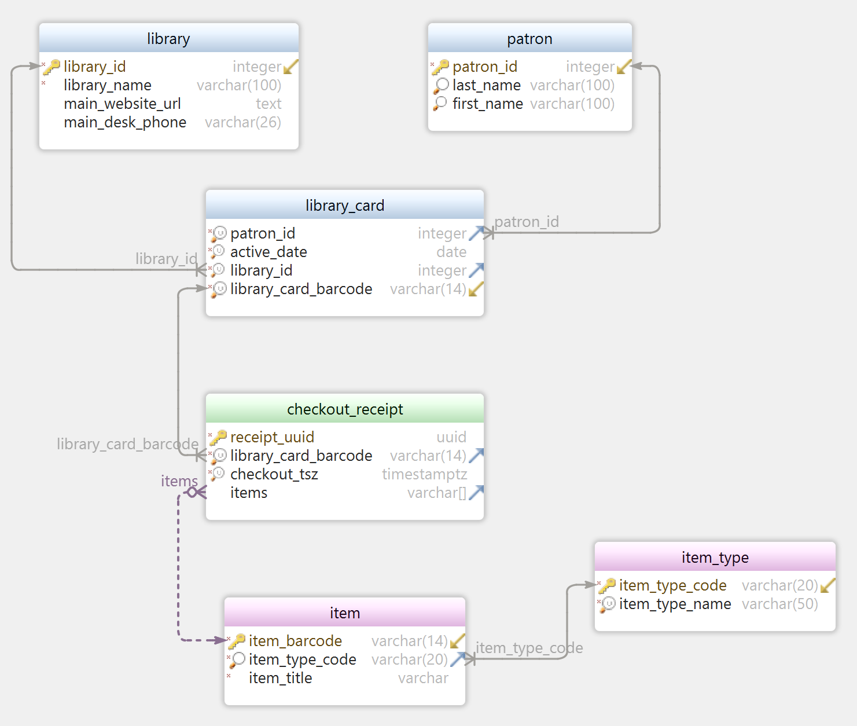
Homework: A simple library checkout application
What is missing?
Do you anticipate problems with this model as you walk a patron through getting a library card and checking out a mix of items?
Notes:
Here is a first draft approach to modeling just the entities or attributes we see or anticipate. Is it good? Is it complete?

Slide 15
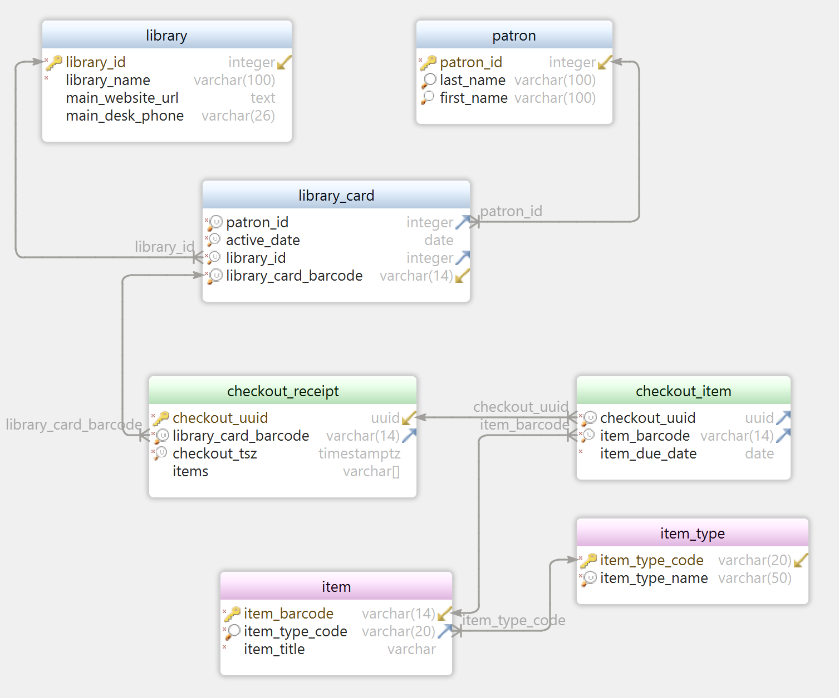
Homework: A simple library checkout application
What about this model?
Due dates are now handled cleanly.
Searching for items in currently checked out inventory is easy.
What holes can you still see?
Notes:
What about this draft, is there more we could or should be asking?
Does it handle the basic scenario of
a patron presenting a card (which has already been activated as part of a different process in the library)
and checking out one or more items
and receiving a receipt with a due date next to each item
??

Slide 16
Relational Design
Physical Model Standards Checklist
Each table, view, materialized view and column has a clear and useful explanation filled by a comment statement
Each table has a single column surrogate (primary) key constraint
Each table has a unique (natural) key constraint, unless duplicates are expected and welcomed
Each table conforms to third normal form
Each table and column name should conform to the Naming Guide
Valid value lists are kept in parent reference/lookup tables, not enums or check constraints
Tables include the four standard audit columns
Tables may not include personally identifiable or sensitive data
Downstream teams (typical DW, BI and Analytics) or data contracts have been notified of any changes being made to data, interfaces, APIs, or agreements
Parent primary key values found in child tables are protected by an explicit foreign key on the child column(s). Each foreign key constraint is supported by an index. Each foreign key column name matches its parent key column name.
Send email to bill.coulam@dbsherpa.com for full article
Notes:
This set of standards comes from a one-page doc that I use to summarize ALL the detailed docs on design, naming and physical modeling.
A single page checklist is far easier on the eyes, psyche and morale of developers than a 93 page treatise on modeling.
In the actual checklist, each item is a hyperlink, where the new employee, or a freshman engineer, can click the link to be taken to the section in the larger instructional docs, where they can learn all the details and nuances of that checklist item.

Slide 17
Relational Design
Physical Model Naming Recommendations
Tables: Each entity (table) name is singular, not plural
Tables: Use a common prefix for related tables to create a logical grouping
Tables: Use a type suffix to designate table type*, when applicable, like AUD, HIST, TYPE, STG, etc.
DB Objects: Use a suffix to designate the object type* (i.e. FK, PK, IX, SQ, VW, MV)
Indexes: Utilize the index type suffix* to identify index attributes and implementation (i.e. unique, function-based, b-tree, brin, gin, etc.)
Constraints: If not using default constraint names, ensure the name is readable
Triggers: Utilize the type suffix* to indicate the firing events and timing
* See the Naming Guide for recommended type codes, format and abbreviations
Send email to bill.coulam@dbsherpa.com for full article
Notes:
This set of recommendations comes from page two of that same one-page doc mentioned earlier. ;-)

Slide 18
Relational Design
Physical Modeling Recommendations
Manually populated surrogate keys should avoid using numbering ranges or schemes
Surrogate keys should have no intrinsic business meaning
Tables should avoid columns of repeated attributes (email1, email2, email3) or array columns that hold multiple values
  Separate repeating attributes into a child table with a type indicator to distinguish between them
All SQL/DDL/migration scripts should be readable and well-formatted
  (Most IDEs will have an option to auto-format DDL and DML, making this easy to achieve)
Send email to bill.coulam@dbsherpa.com for full article
Notes:
This set of recommendations comes from page two of that same one-page doc mentioned earlier. ;-)

Slide 19
Relational Design
Physical Modeling Considerations
How much data will there be? Will size and concurrency demand a partitioning scheme to meet performance goals?
How long will it be kept?
Will old data be soft-deleted, shuffled to historical tables, archived or simply removed?
Will privileged users or reports want, or need to access soft-deleted, shuffled or archived data? How often?
How will deletions/truncations take place when pruning?
Send email to bill.coulam@dbsherpa.com for full article
Notes:
This set of recommendations comes from page two of that same one-page doc mentioned earlier. ;-)

Slide 20
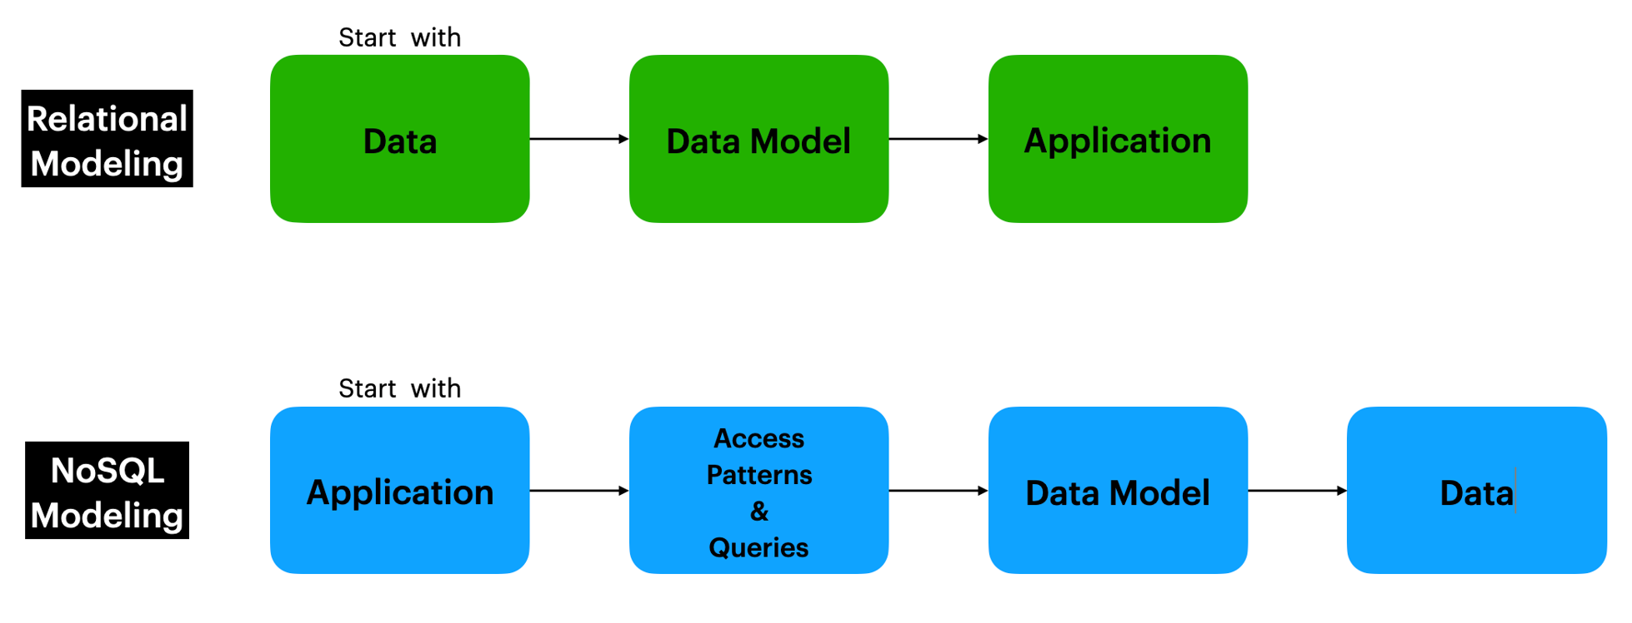
Side-by-side Comparison
Design Approach
Notes:
If I had to pick one slide to summarize this presentation, it would be this one.
If relational design is all about modeling for the sake of clean, consistent, high-quality data, NoSQL or document database design is all about modeling for fast queries and scalable applications.
With relational you start working out the data and eventually build applications on top of that.
With document you start with the application and its queries, and eventually arrive at the data that needs to be kept and read.
Let’s stop to digest that for a bit.
Short Version:
Relational design is data-centric, and can be seen as sacrificing some speed, partionability and engineer-friendliness
Document design is query-centric, and unless approached with more rigor than relational, sacrifices data quality and consistency, leaving a tangled, enterprise-wide mess.
Long Version:
A document database was originally meant to store and serve up…wait for it…documents, things you would ordinarily print out, file, email to others, see in magazines or news websites, etc. It was highly contextual information, all glommed together in one place. Data is typically joined “on write” when the document is first written. This is known as de-normalization. You don’t have to pull the various fields for the object/document from multiple tables in order to serve up the article. Instead all the fields and context required to satisfy a query are already pre-determined, pre-joined, nested, embedded and available in one I/O operation. This means document databases are blazingly fast, and lend themselves easily to sharding and satisfying the needs of web scale problems (Big Data and IoT), because all the information needed is in one place, not scattered across tables, disks and nodes. Unfortunately, if the application requirements change about what the document should contain, the document may have to be modified (leaving holes in prior or future versions of the document and you needing to write exception-handling code and reports to deal with the holes); or worse the document may need to be entirely re-organized to satisfy the new query.
In a real sense, a document database is like an anti-relational data store. Instead of shredding, a document data model brings lots of information together. And unfortunately, with this practice of gluing everything you need into one place, it also means that a given piece of authoritative information will be found in many, many places in a document database. If the name of the thing, or one of its attributes ever changes, you now have to build code to keep it updated everywhere it is found, and code to keep track of all the duplicated fields. Because it takes time to find all the duplicates and update them, and “a’int nobody got time for that” in this day and age, document and NoSQL databases in general, do not offer consistency. They offer data that is eventually consistent. Unfortunately the side effects of duplicated, usually inconsistent data is often not understood at all, and punted down the road to the downstream consumers of the ratty source data. NoSQL databases, in the wrong hands, often end up a big steaming pile of undocumented, unreliable problem data upon which the business will teeter and fall, or at least shoot itself in the legs and feet a few times.

Slide 21
Document Design
“It is true that lack of schema increases agility for the engineer who owns putting data into the system. However, it kicks the problem down to the readers of the data, who are usually an order of magnitude greater in number and often don’t have the context about the state of the data when it was written. These users are usually the ones who are generating value from that data and should have as few roadblocks as possible.
To give an analogy, imagine libraries saying they are doing away with the Dewey Decimal System and just throwing the books into a big hole in the ground and declaring it a better system because it is way less work for the librarians. There is a time and place for semi-structured data, because sometimes you don’t know the shape of some of the data ahead of time or it is sparsely populated. But if you truly don’t understand any of the data coming [in] or what it will look like, then what good is it?
The truth is that there is always schema. The data always makes sense to someone. That someone should take the time to encode that knowledge into the platform so it is usable by the next people. If it is a mix of data that is understood and some that is changing rapidly, put the latter into a semi-structured column in a database, then figure out what columns to project out of it later.”
- Rick Negrin, VP of Product Management, Singlestore
Notes:
https://www.singlestore.com/blog/why-nosql-databases-wrong-tool-for-modern-application/
The hole-in-the-ground library management system is a great analogy that is sadly happened at companies all over the world, curated by young developers who have never seen data done well. I see it as our mission, the old codgers from the last three decades, our mission is to educate and enlighten.
That last sentence in this quote is really what this presentation is all about. If a document column, or a document database makes the most sense for your problem at hand, how is it done well to avoid as many of the dangers and pitfalls as possible? Dangers and pitfalls we will now briefly cover before getting into the best practices.

Slide 22
document design
Warnings from the “Trenches”
"In many ways, up-front data design with NoSQL databases can actually be more important than it is with traditional relational databases... Beyond the performance topic, NoSQL databases with flexible schema capabilities similarly require more discipline in aligning to a common information model... The flexible schema is a great innovation for quick evolution of your data model, and yet it requires discipline to harvest the benefits without experiencing major data quality issues and frustrations as a result.”
- Ryan Smith, Information Architect at Nike (now Sr. Mgr Data Lake Product and Program Management with AWS)
Notes:
I love this quote from my friend and someone I look to as a mentor, Ryan Smith. He interviewed me for Sr. Data Architect at Nike and offered me a job, that I sadly did not take. I first heard him speak in 2014 and the topic was much like today’s “How to model for NoSQL and not feel like you’re selling your soul.” He and that project went on to successfully redesign Nike’s entire product model from scratch, utilizing document technology wisely. He says… {read quote}
Far too many developers choose document databases because it is familiar, or because it works with friendly JSON, or because they don’t know SQL. Little do they understand that much of what a relational database does, and what relational DBAs do, is now dumped on the dev’s shoulders (and not knowing this, critical tasks are missed.) When Ryan and I mention rigor and discipline, we are talking about the developer inheriting the tasks and responsibilities of the traditional DBA and RDBMS. This includes careful design and weighing between referencing and emedding, syncing between master data and child duplications, migrations, versioning, validation, handling of updates, and code adjustment. Most of this now has to be coded in the application or admin/CI/CD tooling, instead of letting the database or DBA handle it.

Slide 23
document design
Warnings from the “Trenches”
Flexibility is its greatest feature and its greatest drawback
Best used as a denormalized cache of structured/relational content for lightning fast reads
ACID transactions and bulk updates are supported, but slow
Devs have to manage relationships and data integrity, instead of DBAs
No support for SQL language or tools. Reporting out of document DBs is difficult.
Do not try to make a document DB look relational (normalized). If the data is structured (80 to 90% of business data is), start with relational. Use a JSON column for the unstructured bits.
Data modeling and data management for document DBs demands MORE rigor from devs, not less
Notes:
The next three slides are a summarization of two months of off and on research, reading everything findable on the web about “what we learned about moving to document or Mongo”, or “why we left Mongo and went back to relational”
This is wisdom from those who have “been there, done that”

Slide 24
document design
Warnings from the “Trenches”
Intentionally plan, research and consider the performance and quality implications of object composition/projection (embed) vs. object references
Aggregation pipelines and searching across collections is difficult to grok and implement, even for seasoned document DB devs.
All the duplication and denormalization must be meticulously kept in sync (it usually is not)
You will probably need another layer ON TOP of your document DB to extract business intelligence value out of the document data. Budget and plan for this additional layer (server, software, tools, people and maintenance)
Use replace, not update (forces index re-write)
Notes:
To continue with our list of sage wisdom from a number of gurus who have “been there and done that”…

Slide 25
document design
When is Document the Right Choice?
Personal projects, rapid prototyping and POC’s where little is known about the eventual application and requirements change frequently
Data is unstructured or semi-structured
Content and context are dynamic (different shape per record)
If every nano-second counts and IOs must be kept to a bare minimum
The following do not count as good reasons: Because I used it at school. Because it just works with JSON. Because my last company used it. Because I don’t know SQL. Because joins are slow and awful.
Send email to bill.coulam@dbsherpa.com for full article
Notes:
OK, we’re done with the dangers and pitfalls and warnings from scores of gurus on how to avoid them.
Is a document DB ever the right choice?
Yes, for the right application.
unstructured: sets of unknown fields (at design time), content is only discerned when the document is written (schema-on-write)
semi-structured: some known fields combined with rich objects or arrays of fields whose quantity and composition is not known at design-time
https://www.indiehackers.com/post/maybe-you-should-never-use-mongodb-6410ac1a25 (read through the comments)
https://www.reddit.com/r/mongodb/comments/e6pm3g/why_does_mongodb_get_so_much_hate/
https://www.codemag.com/article/1309051
https://www.simplethread.com/was-mongodb-ever-the-right-choice
https://www.shanestillwell.com/2017/01/14/lessons-learned-using-mongodb/

Slide 26
document design
Common Uses Cases for Document
Personalization Subsystems
User Preferences
Site Preferences (white-label framework for custom content, themes, color, logo, style, etc.)
Data that changes very little or not at all after it is written (WORMy data)
e.g. wide/denormalized IoT records that are never or rarely updated
activity, system, and error logs
time-series
payment processing
Aggregated Enterprise Caches
Single view (like Customer360)
Enterprise Data Hub
Notes:
Evangelists from DocumentDB, MongoDB, and CouchDB would have you believe you can put everything in a document persistence engine.
This is not true.
Document databases are best where extreme flexibility is required, extreme scalability, or denormalized wicked-fast read-optimized caches
Like these common use cases

Slide 27
document design
OK, so you are aware of all the pitfalls and dangers and you are sure that a document solution is still the right choice.
What now? How do I design and build to a document information model in all the right ways?
We’ll look at
  JSON document column (briefly)
  JSON document database
Notes:
Selected Sources:
https://www.mongodb.com/blog/post/6-rules-of-thumb-for-mongodb-schema-design-part-1
https://www.mongodb.com/blog/post/6-rules-of-thumb-for-mongodb-schema-design-part-2
https://www.mongodb.com/blog/post/6-rules-of-thumb-for-mongodb-schema-design-part-3
https://towardsdatascience.com/design-patterns-for-mongodb-894767315905
https://www.digitalocean.com/community/tutorials/how-to-design-a-document-schema-in-mongodb (part 10/16, a really good How-to series)
https://www.codemag.com/article/1309051
https://www.mongodb.com/developer/article/schema-design-anti-pattern-summary/
https://www.mongodb.com/blog/post/building-with-patterns-a-summary
https://hackolade.com/help/BenefitsofmodelingapplytoNoSQLan.html
https://hackolade.com/help/Query-drivendatamodelingbasedona.html
https://www.youtube.com/watch?v=bxw1AkH2aM4
https://devopedia.org/data-modelling-with-mongodb

Slide 28
JSON COLUMN
Keep the structured data as regular columns
Put the flexible stuff, the fields that could change shape per record, in the JSON column
Oracle (21c+) | Postgres (9.4+)
create table purchase_order (po_id integer not null, po_ts timestamp with time zone not null, po_doc json, constraint purchase_order_pk (po_id) primary key); | create table if not exists purchase_order (po_id bigint not null, po_ts timestamptz not null, po_doc jsonb, constraint purchase_order_pk(po_id) primary key);
AskTom JSON in the Database “Office Hours” site
Notes:
Unless you have one of the common cases for a document DB mentioned two slides ago, I honestly feel that the semi-structured is approach is the right way to handle flexible schema demands, 98% of the time. You leave the structured data in relational form, and isolate the unstructured/flexible stuff in its own JSON column. In Oracle that is the new JSON data type. In Postgres it is JSONB (there is an older JSON type, but it is not used anymore as the JSONB type is more performant, versatile and indexable.
Oracle example adapted from https://docs.oracle.com/en/database/oracle/oracle-database/21/adjsn/json-in-oracle-database.html
Postgres example built from Oracle adaptation
You could put JSON data in Oracle CLOB columns pretty early on. With each release, 10, 11, 12, the native support for operators and functions that allowed you to validate, manipulate and query JSON got better. With 21c Oracle introduced the native binary format JSON data type.
Postgres has had JSON since 9.2, and the better, binary version, JSONB, since 9.4. Like Oracle, each release of Postgres sees better support for JSON validation, manipulation and query.

Slide 29
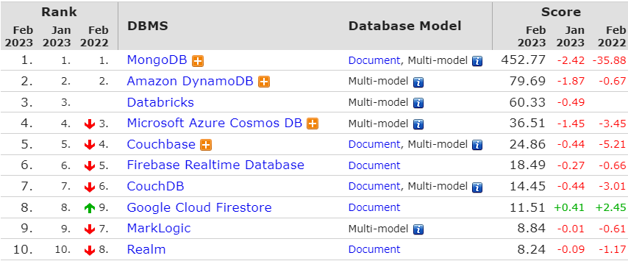
JSON Document Database
(most of what follows is heavily skewed to MongoDB and mongoDB Atlas)
https://db-engines.com/en/ranking/document+store
Notes:
One of the reasons the next 40 slides are all skewed to Mongo is that it is the most popular document database in the world, according to db-engines.com, by 6X the next most popular.
Another reason is I’ve only ever seen failed MongoDB projects that ended up being rewritten back into relational.
The third is it’s the only document DB that I’ve ever had access to in the companies where I’ve worked.
I’ve researched AWS DocumentDB heavily, but never built to DocumentDB, DynamoDB, Couchbase or Couch DB

Slide 30
Side-by-side Comparison
Data Objects and Elements
Relational Database/Data | Document Database/Data
Database | Database
Table | Collection
Index | Index
Row | Document
View | View
Column | Field
Join | Embed or Link
Notes:
Before we proceed, I found it handy to have a map between the relational and document database worlds.
If you can remember that a collection of documents with fields is roughly the same as tables of rows with columns, you’re good to go. The hard part to wrap your head around is that the schema, the structure of the collection, is not pre-defined. It comes into existence when the document is written into the collection.

Slide 31
Document design
Guiding Principles
Know Your Data & Your Application
  Must know data needs and access patterns
Model First, Cleanly and Thoroughly
Duplication is Welcome
  But design real-world objects that naturally contain and embed other data
Name Things Well
  Stick with snake_case
Keep it Simple
Protect Your Data
  Use JSON Schema for validation
Unleash Your Database
  But balance read and write performance with consistency
Design to End Goals from Day 1
Send email to bill.coulam@dbsherpa.com for full article
Notes:
The following slides are based on only 4 years of implementing JSON columns in Postgres, JSON documents in MongoDB and MongoDB Atlas, and a month or two of research and training. So I have much to learn in the document modeling space, and will happily accept any corrections or additions you offer.
You will notice these principles seem familiar. Data modeling for a document database require the same principles as relational modeling. The one relational modeling principle that doesn’t apply is “Duplication is a Disease”. Duplication, embedding, and denormalization are embraced and encouraged within document and other NoSQL databases as a means to wicked fast performance. Nevertheless, the troubles with duplication do not magically disappear and must be coded for and handled with great care and wisdom.
Document databases are often named in a hyphenated manner. And collections are often named with CamelCase. But almost every document database guru I learned from, including MongoDB’s own trainers, use lower snake_case for field names within a document. I feel it is easier to just use snake_case for everything.
Not every shop can use JSON Schema. And validation implies rigid structure, which is kind of anathema to document databases. But use JSON Schema when you can, thereby letting the least common denominator (the database) be in charge of automatically protecting the data, rather than relying on a human to remember and code it up.

Slide 32
Document DB Modeling Guide
Schema Design Rules of Thumb
One: Favor embedding unless there is a compelling reason not to
Two: Needing to access an object on its own is a compelling reason not to embed it
Three: Arrays should not grow without bound. If there are more than a couple of hundred documents on the “many” side, don’t embed them; if there are more than a few thousand documents on the “many” side, don’t use an array of ObjectID references, instead link to the parent doc ID in the “many” side. High-cardinality arrays are a compelling reason not to embed.
Four: Don’t be afraid of application-level joins: if you index correctly and use the projection specifier then application-level joins are barely more expensive than server-side joins in a relational database.
Five: Consider the write/read ratio when denormalizing. A field that will mostly be read and only seldom updated is a good candidate for denormalization: if you denormalize a field that is updated frequently then the extra work of finding and updating all the instances is likely to overwhelm the savings that you get from denormalizing.
Six: As always with MongoDB, how you model your data depends – entirely – on your particular application’s data access patterns. You want to structure your data to match the ways that your application queries and updates it.
Adopted from https://www.mongodb.com/blog/post/6-rules-of-thumb-for-mongodb-schema-design
and https://www.youtube.com/watch?v=leNCfU5SYR8
Notes:
Before we jump into designing collections and their documents, some overarching rules of thumb may be helpful to study and retain.

Slide 33
Document Design
Physical Model Standards Checklist
Analysis
Performed full analysis of the application/service problem domain, business context, and data elements. What is the data, and how will the application use it?
  List of foreseeable data queries and operations (and preferably the interface or API surrounding each)
  List of data requirements: consistency, response time expected of each query and operation, quality, security & privacy, retention, expected volume and CRUD velocity, expected growth, expected peak usage and duration
Database
Each database is named using lowercase words separated by hyphens, typically ending in -db or -service or -store
Send email to bill.coulam@dbsherpa.com for full article
Notes:
The following four slides are the “one page” document modeling checklist I provide to the engineers on my teams. In the actual doc each checklist item is a hyperlink to a much larger doc that gives the detailed explanation for those new to the company, or document modeling in general.
Email me for the Document Modeling guide, which has a full explanation of the phases of modeling and the sequence in which they are done, as well as the “why” and details behind each step. This checklist attempts to distill all of that into a more digestible “one-page checklist”, for those new to document design, or needing a refresher.

Slide 34
Document Design
Physical Model Standards Checklist
Collections
Each collection is named using snake_case
Draft and publish a Collection-Relationship Diagram within your modeling tool
Each collection should have a verbose and useful description persisted in the modeling tool*
Create a unique index for each collection’s natural key (an entity that permits and welcomes duplicates is very rare)
Each collection should have a field to track schema versioning. We recommend “schema_version” for this field. It is clear and concise.
Each choice to embed subdocuments, or link them using a document ID reference, has been deliberately and carefully pondered
Is there any denormalization that needs to happen to support read requirements?
  Document the plan and code to keep the denormalized fields updated if the master changes
The common document design patterns have been considered and used where applicable.
Send email to bill.coulam@dbsherpa.com for full article
Notes:
Email me for the Document Modeling guide, which has a full explanation of the phases of modeling and the sequence in which they are done, as well as the “why” and details behind each step. This checklist attempts to distill all of that into a more digestible “one-page checklist”, for those new to document design, or needing a refresher. The actual, integrated checklist has hyperlinks for each item leading to the detailed section in the Document Modeling guide that explains it all
*Whatever you found out or came to know about the nature and purpose of the entity during analysis should be preserved where it can be easily found and maintained over time. Ideally this will be saved in the database itself, or a document modeling tool where the model is saved in the project’s repository. If these aren’t viable, at the very least save the description in the Design doc, and inline comments in the code file that defines the collection.

Slide 35
Document Design
Physical Model Standards Checklist
Fields
Each field follows the Naming Guide,
Generic field names are not allowed (except for the automatic “_id” field)
  Keep it short, but readable and intuitive
  Use standard domain abbreviations when applicable (_code, _id, _date, _num, _name, etc.)
Each field has been researched until understood, and the following attribute prompts can be filled in:
  Data type
  Length (open vs restricted for business rules or regulations; min length, max length)
  Optionality (is it always required, or can it ever be empty?)
  Cardinality (how many of X are likely, what is the maximum of X possible?)
  Sensitivity (personally, legally or financially? which roles are allowed to vew/modify?)
  Default value?
  Valid values (including source of master valid values list)
    Numeric: how many digits of precision, if any?
    Date/Time: Just the date, or should full timestamp be kept?
  Used as a filter or sort element? (see Secondary Indexes section)
  Normalization and formatting rules? (like addresses, phones, SSNs and emails)
Send email to bill.coulam@dbsherpa.com for full article
Notes:
Email me for the Document Modeling guide, which has a full explanation of the phases of modeling and the sequence in which they are done, as well as the “why” and details behind each step. This checklist attempts to distill all of that into a more digestible “one-page checklist”, for those new to document design, or needing a refresher.

Slide 36
Document Design
Physical Model Standards Checklist
Data Integrity
Ensure data integrity and consistency are protected. Use JSON Schema validation to validate the rules and formatting in the Fields section above
Secondary Indexes
Ensure each collection has one or more indexes which support the expected queries upon that collection.
Views
Complex queries and aggregation pipelines have been made re-usable by being placed behind a view*.
Scaling Options
Have considered replication vs sharding* vs vertical expansion as scaling solutions for the service
Send email to bill.coulam@dbsherpa.com for full article
Notes:
Email me for the full Document Modeling guide, which has a full explanation of the phases of modeling and the sequence in which they are done, as well as the “why” and details behind each step. This checklist attempts to distill all of that into a more digestible “one-page checklist”, for those new to document design, or needing a refresher.
* Views: If the runtime read performance is not acceptable, consider keeping the pipeline inside a function that creates an on-demand materialized view (a collection of the query results stored on disk)
* Scaling: Typically is best to start with nothing unless scaling is clearly required. All options require more resources to pull off. Replication is more often used for heavily-read systems where the amount of data is < 1TB. Sharding is more often used when data grows steadily or exponentially past the 1TB fuzzy threshold.

Slide 37
Document DB Modeling Guide
The Design Process
Analyze and document the application prior to modeling
Design the model: distill and model the documents and their relationships
  Separate logical groups and distinct data requests into collections.
  Build a draft of each collection as a modeled document, crafting each field, reference, array and embedded subdocument
  Apply common modeling patterns, as applicable
  Build and publish a CRD (Collection-Relationship Diagram) for comment and correction
Protect the model: build a JSON Schema validator for each document
Implement the model
  Design, configure and create the database
  Create the collections, views and indexes
  Test and measure with sunny data, dirty data and production loads.
Version the model: iterate on the documents and indexes until application requirements are met
See https://www.youtube.com/watch?v=DUCvYbcgGsQ
Notes:
The following “Document DB Modeling Guide” slides are a slimmed down version of a 16 page guide I bring to my employers and clients when I come in to work with them and train their teams.
Document databases allow you to store documents of different shapes (fields, schema, datatypes, versions, etc.) in the same collection. This
flexibility is empowering and exciting, finally freed of tyrannical relational DBAs, their stiff databases, joins and SQL. And yet, taking advantage of
this flexibility is generally a bad idea and results in a tangled mess of a collection.
Carefully making choices between the pros and cons of a database engine is where the schema designer earns their paycheck. Doing this well
can save the business millions in regrettable re-work down the road. Doing this well requires a deep understanding of the data, data
meaning, business context, application usage, expected queries and operations, etc. It is a balancing act between application
requirements, database capabilities, and limitations.
“Customers that succeed at scaling, really spend time thinking about schema and [how that affects] performance.” - Justin LaBreck (MongoDB
solution architect)
This document is an attempt to aggregate some of the collected wisdom of NoSQL practitioners, to skip the hard lessons, and learn to do the
data modeling balancing act skillfully, the first time.
The next set of slides will dive deeper into these five phases of modeling for documents.

Slide 38
Document DB Modeling Guide
Analyze and Document
Research your data AND your application’s data needs
Can begin coding without a perfect understanding. Evolve the schema as more is learned.
Interview those who know the most about what the application should do. Obtain:
  current and future functionality to determine the CRUD operations required, what data will be involved in each, and the relative significance of each
  is the field optional or required. If required, is there a default value, list of valid values and a valid format?
  response time, quality and security expectations/contracts
  data retention policies and parameters
  data volume - how much of each document and field is expected and growth projections
  data velocity - how fast will the data arrive, and expected concurrency
  data variety - structured, unstructured, mix of both? binary fields? huge text fields? datatypes?
  data workloads - usage patterns, expected growth trends, peak usage times and duration, size and shape of user base
Armed with this info, wise decisions can be made about your database and collections
Notes:
Just as it is with relational modeling, you need to know your data. Only with document modeling, you have more flexibility and can begin coding
without a perfect understanding of every data element. As the project progresses, facts will come to light, assumptions will be blown out of the
water during testing or initial release, and the schema will have to evolve to accommodate the revealed realities. These adjustments are painful,
but in document modeling that pain is shifted from the database tier to the application, where developers feel more comfortable and capable of
adjusting.
Instead of the main goal being a perfect, normalized representation of all the data the application will ever need, you are shooting for a complete
picture of which queries and operations the application will use immediately and in the foreseeable future, and design the documents and indexes
accordingly.
Analysis prior to document modeling is concerned more with how the application will use that data, which informs decisions on embedding vs.
linking, replication, sharding, and indexing.
The domain experts can be found throughout a given enterprise, but are often internal subject matter experts in QA, Product, Business Analysis, or executive leadership. Another expert can be the legacy
application being replaced, which has database and server logs and statistics.

Slide 39
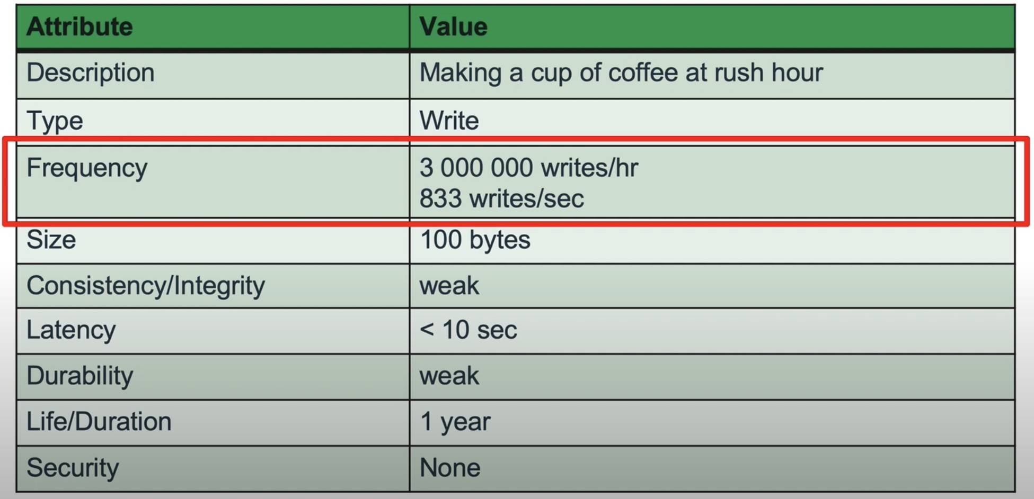
Document DB Modeling Guide
Analyze and Document
Here is an example of the detailed documentation produced by a MongoDB consultant as they analyzed system needs behind the writes of a single collection for a fictional nationwide coffee chain:
These details, along with similar analysis for all the other operations and queries in the system, were used to estimate database disk and growth figures, as well as decide between replication (< 1TB) and sharding (> 1TB)

Slide 40
Document DB Modeling Guide
Design the Model: Collections
We are not really document modeling; we are designing the schema for documents in a collection
Technically every document written to a collection can be of a different shape and not conform to any schema.
  But that is a terrible, horrible, no-good, very bad idea. Just because you can, doesn’t mean you should.
We identify and map out distinct queries and access patterns, entities, attributes, relationships and rules. This informs our first pass at designing the collections.
  Make a best guess as to which entities should become their own collection, and which should be treated as embedded subdocuments
  Implement this design as a first-level unit test, code to it, then begin iterating through user-acceptance and testing, noting areas for improvement. Repeat until you have a creamy-smooth, super-fast model
Notes:
It is a bit of a misnomer to use the term “document modeling.” Although this series of guides centers around the concept of document modeling, in reality we aren’t designing documents; we are designing the schema for documents in a collection.
Technically you “design” the document when it is inserted to the collection; this is known as “schema-on-write” and allows every document in a collection to be different from each other. But that is a terrible idea. Just because you can, doesn’t mean you should. Instead we do the analysis, design the schema and implement the design when we create the collection and specify the validation, thus ensuring that each new document conforms to the intended schema for the collection.
So the first step after analysis, just like in relational modeling, is to identify the distinct entities, their attributes (fields) and the relationships between entities. Unlike relational you also identify and map out the distinct queries and data access patterns. Armed with these two pieces of information, make an initial pass at identifying, naming and diagramming the collections your database will hold, along with an initial best guess as to which entities will become their own collection, and which will be embedded as subdocuments.
The next step(s) is to iterate, working through the findings in the analysis, and the tips in this document on modeling relationships to manage application goals, to end up with a creamy-smooth model.

Slide 41
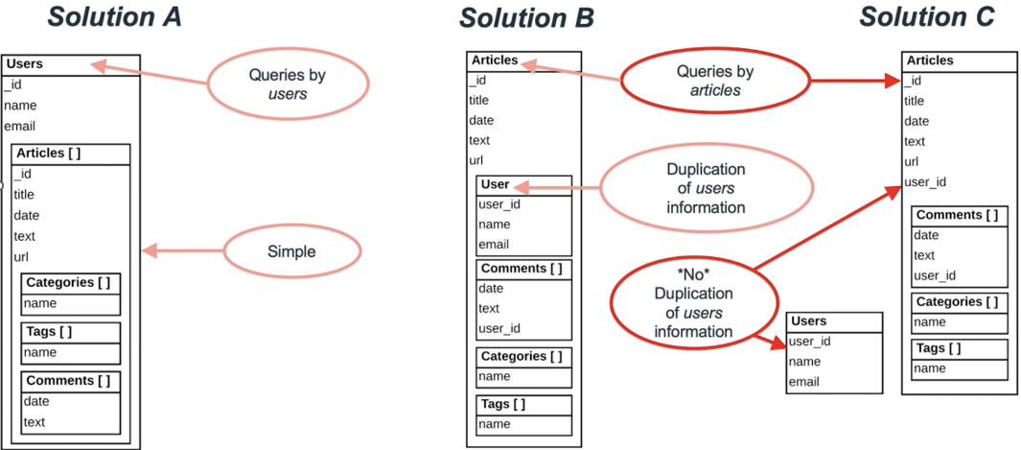
Document DB Modeling Guide
Design the Model: Collections
Here is an example of iteration through three solutions until settling on one that matched system needs:
From MongoDB University training videos
Notes:
Here is an example of iteration through three solutions until settling on one that matches requirements.
In the first attempt, the designer went with Users as the primary entity behind the collection. An authoring user may have 0 to many articles. And each article has a list of categories and tags assigned to it, to make searching, matching and grouping easier. And each article may have 0 to many comments.
This design has severe drawbacks, like having to search through every Users document to find the articles available in the system, for one.
So in the second attempt, realizing the main data access need is to search through and display articles, the designer went with Articles as the main entity. Each article is written by a user, as seen in the single User subdocument per Article. And we see again the list of categories, tags and comments attached to each article. This iteration still has a problem in that any attempt to find users, or display a drop-down of users in some UI widget, would have to search through all the articles to assemble the list of authoring users and commenting users.
Articles are written by users. Articles probably cannot exist in this system without having an associated user as the author. But can we see that this is a real-world object? that articles are composed of, or made up of, tags (yes), categories (yes), comments (yes), users (probably not).
So in the third iteration, the designer chose to make Users their own collection, so they can be queried independently of Articles, using “user_id” reference values in the Articles and Comments to point back to the Users collection for further metadata on each user. If the most frequent use of $lookup to Users was to get the user’s name components, they could be duplicated (denormalized) into the articles and comments, right next to user_id, so that most of the time, no join to the master Users collection is necessary.

Slide 42
Document DB Modeling Guide
Design the Model: Collections
Collections are best used to represent logical groupings, critical queries, or core business entities, and are roughly equivalent to distinct tables – or more accurately, materialized views – in a relational database. So…
Model real-world objects. Keep data together that belongs together.
For example, in a classical data modeling exercise, the instructor pulls out a business card and shows you how the info on a card can be shredded into a person, account, company, address, and contact tables. In a document database which scans and stores business cards received at a conference, you might choose to keep all data on the business card together (as subdocuments embedded in the business card document). This is an example of modeling the document to represent the real world object.
Notes:
That little modeling exercise, lifted from the MongoDB trainings, leads us to this slide.

Slide 43
Document DB Modeling Guide
Design the Model: Collections
Better to have a large set of distinct collections, than a single collection holding the ocean.
However, too many collections (thousands or more) creates too many namespaces deep in the WiredTiger storage engine and makes things like replication and backup/recovery take far longer than they should.
Keeping collections dedicated to a given entity or logical grouping yields easier sharding implementation and avoids certain limitations, like the maximum of 64 indexes per collection.
Look into Capped Collections if the app only needs to utilize the most recently inserted documents.
If there will be millions of a given document, and it must be kept really small (one or two fields) on purpose, consider optimizing the document’ s design. For example, you could abbreviate or shorten the field names. Or explicitly set the value of the _id field, perhaps to the value of a natural key in the document (keep in mind it has to be unique across documents in the collection to serve as the primary key).

Slide 44
Document DB Modeling Guide
Design the Model: Fields
Document databases allow a given field to be completely different from one document to another, a string in this doc, an integer in the next, and a date in the next. Or two fields in the subdocument in the first version, then four fields with a prior field now optional, then six fields and one of them is an array in the next version. Varying datatype and shape quickly becomes an unholy mess for everyone concerned. Try to ensure that a given field has the same name and datatype across the enterprise, and within the documents in a collection.
Naming collections and fields is hard. It seems trivial, but it is hard to get right, even for modeling and engineering veterans who have been doing this for decades. If you have documented well the business purpose and meaning of the field, the name will naturally distill out of that. Follow the naming guide so that the field name is intuitive and self-explanatory. Generic names like id, text, type, name, number, etc. are problematic in the near and long term.
Notes:
Change happens, especially if the field is a complex type, like an array or object. When it does, that’s when the pain of adjusting for schema versioning begins. It is what it is. Chin up. You’ll be writing a bunch of code to accommodate the versioned document shapes.

Slide 45
Document DB Modeling Guide
Design the Model: Fields
Of course to make the best decisions possible about the field’s design and validation options, you should have already documented the research into each field’s:
data type, optionality, cardinality, sensitivity
default value (if any), valid values (and source of the master valid values list)
if numeric, how many digits of precision must be supported?
if date, should time be supported and to what level of precision?
usage - use within queries as filter or sort predicate (informs index design)
bounds - minimum and maximum length (if any)
normalization and fidelity - check or change the value upon user entry to match a case or format rule, like email and SSN formatting, or validating and uppercasing street addresses vs. accepting whatever the user feeds us
Notes:
[go over slide contents first]
Yes, it is a lot of work to “do data right”. This is how to design and build an enterprise-grade system. Doing this well, documenting all of this in a data modeling or data catalog/glossary tool, will save thousands of hours of pain, confusion, inconsistency, inaccuracy and overall system malaise down the road.

Slide 46
Document DB Modeling Guide
Design the Model: Field Datatype
Fields can be of JSON-compatible datatypes:
  string, bool, object (subdocument), array and null.
Since MongoDB uses BSON for document storage, it offers additional datatypes:
  objectId, binData, date, timestamp, double, int, decimal, long, regex, javascript, minKey, and maxKey.
Note: BSON Timestamp datatype is meant to be used internally by MongoDB. Use the BSON Date datatype instead, for all your date and time needs.
Notes:
binData has 9 subtypes that indicate how to interpret the binary data
Objectid values are 12 bytes, starting with a 4 byte object creation timestamp, a 5 byte random value (unique to each machine and process), and a 3 byte incremental counter
BSON strings are UTF-8
BSON Date is a 64-bit integer that represents the number of milliseconds since the Unix epoch (Jan 1, 1970). This results in a representable date range of about 290 million years into the past and future.
https://www.mongodb.com/docs/manual/reference/bson-types/

Slide 47
Document DB Modeling Guide
Design the Model: Surrogate & Natural Keys
Primary: In MongoDB, each document stored in a collection requires a unique _id field that acts as a primary key.
  You can manually supply the value of the _id if that makes sense for your application.
  If an inserted document omits the _id field, the MongoDB driver automatically generates it.
Natural: Let the database engine protect the integrity of the data whenever you can. Determine an identifier field, or combination of fields, that make up the natural key of the document. Create a unique index on the natural key so that duplicates are not allowed.
  This doc has more to say about unique index edge cases, like missing key field, partial indexes, unique indexes across shards, etc.

Slide 48
Document DB Modeling Guide
Design the Model: Embedding vs Referencing
Decisions on how to represent ownership, containment/composition and association is the most important job you have while modeling the schema for a document database. Your system should hum and function well if this is done correctly, along with thoughtful indexing, application-level joins, projections and pre-aggregations.
The following is the single best summary I ran across on how to decide between embedding a doc, or using doc ID references. If you memorize the seven points in this image, you’ll need very little of all the document modeling articles available on the internet:
Embed | Reference
For 1:1 and 1:few relationships When data belongs together When data is read-mostly and updated rarely | For 1:many or 1:tons relationships When data is frequently updated When data is queried independently When the array size is large: child referencing for 1:many Parent referencing for 1:tons
Notes:
MongoDB limits a document size to 16MB, which limits the amount of arrays and embedding and nesting that can be done. Nesting is limited to 100 levels, but I doubt there are many real-world objects that have more than 10 levels of nesting.
Whether to embed (denormalize) or reference (normalize) comes down to decisions based on intimate knowledge of the data, relationships to each other, its cardinality (how many), bandwidth and throughput constraints, and frequency of inserts, updates and deletes.

Slide 49
Document DB Modeling Guide
Design the Model: 1:1 Relationships
Normally straightforward and the field/subdocument is included in the collection
There may be special scenarios where the data item is broken off into its own document
  Example: user preferences that are typically read once and cached
{
_id: ObjectId
first_name: str
last_name: str
hired_date: date
manager_id: ObjectId
resume: binData
home_address: {addr_line_1: str, addr_line_2: str, city: str, state: str, zip: str}
}
Notes:
Normal: You have a birth date, a birth place, a mother. These things are related to you in a ratio of 1 to 1. Most system’s recording such personal info about you would require these bits of information to be filled in before storing a “Person” or “Patient” record. Other systems might be happy to live with an empty value until the user chooses to provide them. In any case, if there can only be 0 or 1 of a given thing, that piece of data is simply included as a field or object on the document of the entity to which it belongs.
One example might be a large set of UI preferences for a user. If preferences are read only once in a while and cached on the client, it might not make sense for the user document to be weighed down by this extra baggage everywhere user data is passed around. So the schema designer might deem it wise to put the preferences in their own document, with a reference back to the user _id that owns the preferences.
Another reason to not embed a 1:1 relationship has to do with independence. If item “B” only belongs to “A” and should disappear if “A” is ever deleted from the system (like the billing address on an order), then “B” is dependent and should normally be embedded into the document for “A”. However, if “B” is queried independently of “A” and should continue existing if “A” is ever deleted (like the SSN of a US citizen), then “B” (the SSN) should be kept in its own document, where “A” has a reference to the doc ID for “B”, or less frequently, “B” holds denormalized fields pointing to “A” for historical forensics.
Deciding on where to put each 1:1 related item is just one example of the tradeoffs that must be weighed with every document and field designed for the application.

Slide 50
Document DB Modeling Guide
Design the Model: 1:few and 1:handful Relationships
Not a lot of N, but a little of N. Typically a cardinality of 1:handful will favor embedding subdocuments.
Like a person’s known email addresses, or the names of the quality inspectors who inspected a finished product. Just a few of N is a good candidate for embedding if N doesn’t need to be queried on its own, outside the context of the containing document.
{
_id: ObjectId, product_id: ObjectId, product_name: str, produced_ts: date, serial_num: str, model_num: str,
...
qa_inspectors: [ObjectId,...]
}
“Just because you can embed a document, doesn’t mean you should embed a document.” - William Zola, MongoDB documenation
Notes:
For example, if the business needed an API to list all the quality inspectors at the company, and the only place they are found is in the finished products they inspected, then every finished product document has to be opened and scanned to get that list, then sorted and de-duplicated, which would be slow and inefficient…a bad design. In this case the quality inspectors should be kept in their own collection and referenced with an array of quality inspector doc IDs in the finished product document. This way the independent collection of QA inspectors can be indexed and queried, efficiently on its own, but referenced (as we see here), when needed.
These references to the QA inspector docs are logical foreign keys. Document databases don’t enforce foreign keys, so you will manage this relationship on your own within the application code to prevent orphans, duplication errors and invalid values. Even when you choose to reference like this, another follow-up design choice is denormalization. You may choose to duplicate certain critical fields from the quality inspector document in the array on finished product in order to eliminate application-level joins in the majority of cases. Again you have to know your application’s query and data access needs to make the best decision here.
Gathering all the info, entirely understanding the data you are working with, and how it will be used, then applying that wisdom to technical design choices, is where the craft and art of a data architect is manifest.

Slide 51
Document DB Modeling Guide
Design the Model: 1:many Relationships
If the potential quantity of N is in 10’s, to scores, to low hundreds, then it might be OK to embed in the parent document, particularly if it is just an array of doc IDs pointing to the full documents for N, or maybe sporting a denormalized field or two per reference. If you need additional information about each N in the parent doc, you use an application-level join to bring them together.
But if the cardinality may reach several hundred to thousands or more, then it is usually better to make a separate collection for the N side, and have a parent reference on the N side, especially if each one of N carries with it additional attributes or is updated a little or a lot.
Embedding a large array of objects is typically the wrong choice, creating bloated documents that are wrong for document databases on several fronts. Remember the 16MB limit per document if embedding large arrays of sub-documents, or arrays that can grow without bound.

Slide 52
Document DB Modeling Guide
Design the Model: 1:tons Relationships
“Tons” might be considered 10K, 100K or even 1M+ records that belong to the parent entity. Some MongoDB consultants and authors refer to this cardinality as 1:squillions (a word they invented). If there could be tons of N, say the historical call records for each customer in a mobile phone company, you would definitely NOT embed the call records within the customer, or even use child referencing (an array of call record document IDs kept within the customer), no matter how efficient. Can you imagine how often each customer record would have to be updated upon each new call, and the attendant index maintenance? The horror.
With tons of N, you would typically reference the parent customer document within the child document. Using the example above, each of the millions of call record documents would contain a customer document ID pointing back to the customer that originated the call.
{_id: ObjectId
customer: ObjectId
called_tn: str
call_seconds: int
...}

Slide 53
Document DB Modeling Guide
Design the Model: Denormalization
Normalization is the process of breaking information down into its most atomic units and ensuring each piece of data is mastered in only one place and not duplicated. Each point of duplication is another chance for mistakes to be made and data to get out of sync with the master source.
Denormalization is the process of duplicating data in strategic places to improve performance and optimize read operations.
In the world of NoSQL and document DBs, denormalization is expected and acceptable. And yet the dangers posed by denormalization don’t go away. Duplications must be managed by humans, code (and tests) to ensure it stays in sync with the master document or data source.
If updates to that attribute happen frequently, then it greatly reduces the attractiveness of denormalizing.
The more duplication, the more spinning plates must be maintained, the more likely errors will happen, the more data gets out of sync, and your company gets “never consistency.”
Notes:
If you weren’t already aware, Normalization is the process of breaking information down into its most atomic units and ensuring each piece of data is mastered in only one place and not duplicated. Each point of duplication is another chance for mistakes to be made and data to get out of sync with the master source.
Denormalization is the process of duplicating data in strategic places to improve performance and optimize read operations.
In the world of NoSQL and document DBs, denormalization is expected and acceptable. And yet the dangers posed by denormalization don’t go away. Each decision to duplicate data in more than one place must still be made carefully. If you duplicate an attribute (aka column, field, data), it must be managed by humans, code (and tests) to ensure it stays in sync with the master document or data source. If the master is changed, then all instances in duplicates must be updated as well. If updates to that attribute happen frequently, then it greatly reduces the attractiveness of denormalizing. The more duplication, the more spinning plates have to be maintained, the more likely errors will happen, data gets out of sync and your company gets “never consistency.” So as you consider the possibilities below, tread with understanding and professional caution for each field you choose to denormalize.

Slide 54
Document DB Modeling Guide
Design the Model: Denormalize from Child to Parent
If the application demands it, you can choose the most frequently needed attributes in the child document and include them in the embedded subdocument in the parent.
  The requirements demand <1s lookup of the customer’s last 12 months of purchases. We can keep an array of purchase_id references within each customer document.
But if the application also typically needs the purchase date and time, and purchase total, and those rarely (if ever) change, we could denormalize (duplicate) those values from the purchase collection, and include those attributes with each purchase_id in the array for each customer.
  We would replace the array of purchase_id’s with an array of subdocuments, each containing purchase_id, purchase_ts, and purchase_total values in each subdoc.
However, just because we are fairly certain a denormalized field won’t change does not mean that it won’t. You must still write code to ensure that the purchase_total and purchase_ts are updated, if they ever change in the master purchase document.
Denormalization is only a good idea if the ratio of reads far outweighs the frequency of updates.

Slide 55
Document DB Modeling Guide
Design the Model: Denormalize from Parent to Child
This modeling option is rarely a good idea, unless you are certain the field being duplicated from the parent to the child document will never change, or if the quantity of documents in the child collection is small. If the field in the parent source document ever does change, you may have to update every child document where that value is found, which can be a very expensive operation if the child collection is in the millions or billions. {story}
One example where putting parent fields on the child makes sense is when the child document is an historical record of how things stood at the point in time of document creation, like an event, log, or IoT sensor reading. Historical records are rarely, if ever, touched after their initial write, so this would be a good candidate for denormalization so the various parents don’t have to be joined at read-time. It is also the best use case I know of where a document DB is the perfect solution.
Notes:
Denormalization Horror Story
This happened to an energy software company I worked for in Houston. A set of industry standard codes that had not changed in decades, suddenly was mandated to change. Because the previous data architect had chosen to use the natural key (the actual code) on the child records instead of the surrogate key (the ID), we had to sheepishly inform our clients (who contractually counted on multiple 9’s of uptime) that they would need to take 12 to 20 hour downtime to do the several billion row update. If we had not denormalized the code into the child records, the update would have been a millisecond operation on the one parent record. That was a big, embarrassing whoops moment (glad it wasn’t my fault or I would have been fired). If it weren’t for their dependence on our software, this one decision would have lost all our clients and destroyed our company.

Slide 56
Document DB Modeling Guide
Design the Model: Bi-directional Relationships
This is a form of denormalizing that places references to the child in the parent document, and a reference to the parent document in the child. You can take it a step further by including critical fields from the referenced document so the reference doesn’t have to be joined until a less- frequently needed field is required.
This is known as a circular relationship in relational modeling and is an abomination. But it is do-able in document schema modeling if the needs of the application demand it.

Slide 57
Document DB Modeling Guide
Design the Model: Many:Many Relationships
Unlike relational, an associative entity is not required to model N:N relationships. You can embed an array of references (and denormalized fields) for one entity in the other and vice versa.
// customer document schema
{
_id: ObjectId,
customer_account_num: str,
customer_first_name: str,
customer_last_name: str,
...
wishlist: [{product_id: ObjectId, product_name: str, added_to_wishlist_ts: date},
...]
}
Notes:
In relational modeling a N:N (many to many) relationship is stored in a table that has many names. Often referred to as a junction table, many-to-many resolver, or more simply, an associative entity. Such a table is used to model lists of allowed values, or associate lots of one core business entity (like customers) to lots of another business entity (like products). The intersection of the products a customer has looked at and indicated an interest in, like a wishlist, is the many-to-many relation.
Well, modeling for a document DB like Mongo doesn’t require an associative table. You can use embedding, referencing and denormalization to model this. In this example of a wishlist, you would examine your application’s needs and access patterns and probably put an array of desired product _id’s, and frequently used product fields, right on the customer document. I’m not saying this a great idea; just an example of modeling N:N relationships.

Slide 58
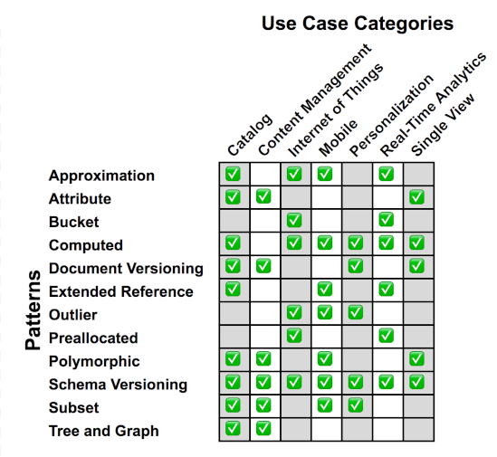
Document DB Modeling Guide
Homework: Common Design Patterns
Approximation: Fewer writes and calculations by saving only approximate values.
Attribute: On large documents, index and query only on a subset of fields.
Bucket: For streaming data or IoT applications, bucket values to reduce the number of documents. Pre-aggregation (sum, mean) simplifies data access.
Computed: Avoids repeated computations on reads by doing them at writes or at regular intervals.
Document Versioning: Allows different versions of documents to coexist.
Extended Reference: Avoid lots of joins by embedding only frequently accessed fields.
Outlier: Data model and queries are designed for typical use cases, and not influenced by outliers.
Pre-Allocation: Reduce memory reallocation and improve performance when document structure is known in advance.
Polymorphic: Useful when documents are similar but don't have the same structure.
Schema Versioning: Useful when schema evolves during the application's lifetime. Avoids downtime and technical debt.
Subset: Useful when only some data is used by application. Smaller dataset will fit into RAM and improve performance.
Tree: Suited for hierarchical data. Application needs to manage updates to the graph.
Matrix and summarization from MongoDB training led by Daniel Coupal.
Notes:
This matrix is pulled from Justin LaBreck and Daniel Coupal’s MongoDB training on common design patterns. Far too long of a course to introduce here.
https://www.youtube.com/watch?v=bxw1AkH2aM4 – Advanced Schema Design Patterns
https://www.youtube.com/watch?v=2ZRbJnaIqAI- 12 Patterns for Extreme MongoDB Performance and Scalability
https://www.youtube.com/watch?v=DUCvYbcgGsQ - A Complete Methodology of Data Modeling for MongoDB

Slide 59
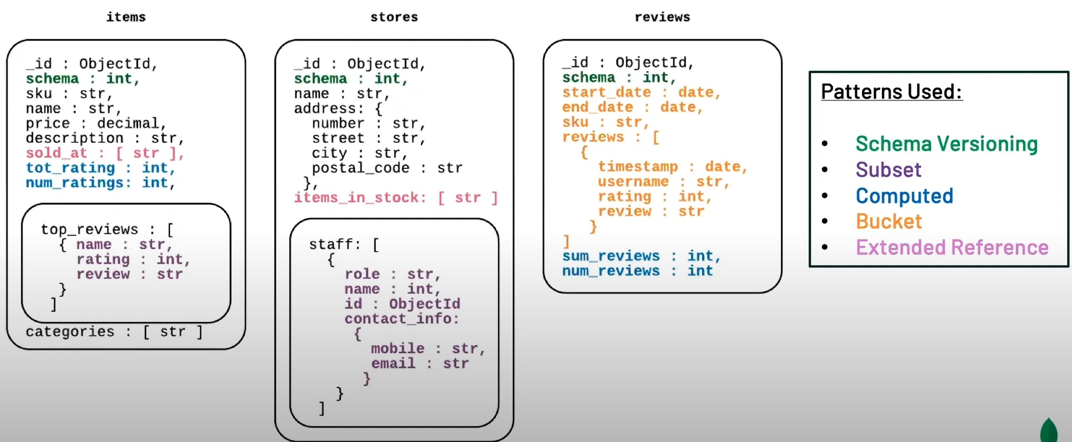
Document DB Modeling Guide
Homework: A 10-minute Modeling Example
https://youtu.be/3GHZd0zv170?t=1550 (video timepoint goes to example of modeling from requirements for a fictional company)
Notes:
This is a fictional modeling exercise put on by MongoDB modeling trainers. Highly recommended. Since a “picture is worth a thousand words”, this short 10 minute step-through of building a document model may be the most valuable part of this presentation on document modeling. Notice how business/application analysis leads to an operational model, then a list of entities and fields, then a collection-relationship diagram (seen here), finally an iterative improvement of an initial document model as various considerations from the analysis are applied

Slide 60
Document DB Modeling Guide
Protect the Model
Much like strong typing and constraints in relational databases, document databases provide features that protect the data from missing/garbage/wild values.
Use JSON Schema to validate field type and valid values.
One can add JSON Schema validation to new and existing collections:
new collections: db.createCollection() with validator option
existing collections: db.runCommand( callMod command with validator option)
Note: existing documents do not undergo validation checks until modification.
validationLevel of the validator should be strict. The use of moderate is only necessary when adding to existing document databases with problems.
validationAction of the validator should be error. The use of warn, allowing non-conforming data into the database, must be well-justified to pass architect review.

Slide 61
Document DB Modeling Guide
Implement the Model
Use a tool like Hackolade, DbSchema or Moon Modeler to design the schema of your collections
Save the model to your project’s github repo, perhaps /db/model folder
Generate the collection creation statements with JSON validators and save script to github repo, perhaps /db/migrate folder
Implement a CI/CD tool to automatically see the new file, wait for approvals, run tests with seed data, and migrate the file up the lanes, eventually to production
Notes:
CI/CD and DevOps/DataOps is where I am weakest. Feel free to add your company’s conventions and tools here for how to move a database script from dev, to QA, to Staging or UAT, and then to Prod.

Slide 62
Document DB Modeling Guide
Version the Model
As the system requirements change, you will receive tasks to change the data model
Open the model file in your modeling tool and update the schema design, updating the number in the schema_version field.
Save the updated model back to /db/model. Can now see all changes to the data model over time, who did them, why and which change tickets the modification was tied to.
The code that writes the documents will also need to be modified to accommodate the changes
Notes:
This is also an are of document DB usage I am not highly skilled in.
Feel free to replace this slide with one of your own.

Slide 63
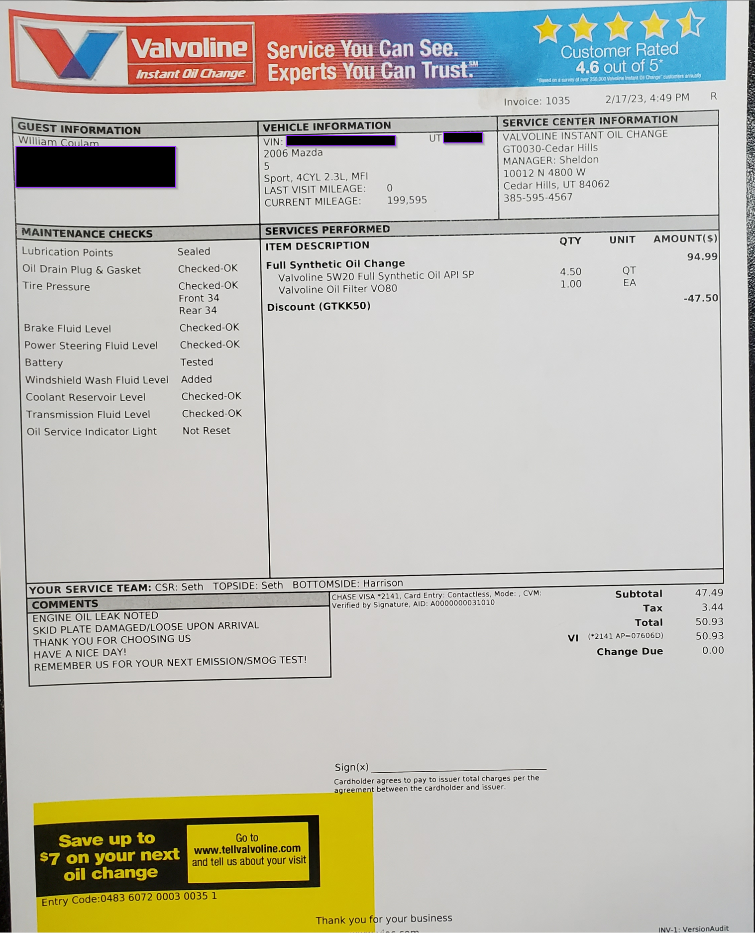
Document db modeling guide
Homework: Model an Invoice
Grab an invoice from your file cabinet, and imagine you’ve been tasked with modeling a document database with a handful of collections to tame and corral the data on the invoice.

Slide 64
Document DB Engineering Guide
Transactions and Atomicity
If the rule of thumb in the Document section above has been followed, and each document contains all the data it will need (no lookups required), then Mongo is able to easily comply with industry-standard ACID transactions and ensure the whole CRUD operation is completed in one go, or not at all.
As of version 4.0, MongoDB supports multi-document transactions on replica sets.
As of version 4.2 MondoDB supports distributed transactions, which adds support for multi-document transactions on sharded clusters. If you use this feature, test assumptions thoroughly, because new offerings are typically not 100% bug-free until two major releases later.

Slide 65
Document DB Engineering Guide
Views
Read-only views in MongoDB were introduced with version 3.4.
DBAs can define non-materialized views that expose only a subset of data from an underlying collection, i.e. a view that filters out entire documents or specific fields, such as Personally Identifiable Information (PII) from sales data or health records.
As a result, risks of data exposure are dramatically reduced. DBAs can define a view of a collection that's generated from an aggregation over another collection(s) or view.
https://www.linkedin.com/in/billcoulam/https://www.linkedin.com/in/billcoulam/

Slide 66
Document DB Engineering Guide
Indexes
MongoDB auto-creates a unique index on the _id field
Additional indexes should be designed and created to support fields that are frequently queried, or used for filtering and sorting
Limit of 64 indexes per collection (but once you approach 15 to 20 indexes, performance degradation becomes noticeable)
Remember: The leading field in an index can satisfy queries that require that field, as well as the other fields in the index. For example:
db.orders.createIndex( {“order_id": 1, "user_id": 1, "created_at": 1} )
can support queries that filter on
order_id
order_id + user_id
order_id + user_id + created_at
but cannot support queries that filter on
user_id
created_at
user_id + created_at
Notes:
Creating the appropriate indexes implies that you have done the work to gather and map out the expected queries of the system, in particular the keys or filters that will be used to quickly narrow down the matching documents.
One aid to keeping indexes to a minimum is remembering that the leading field in an index can satisfy queries that require that field, as well as the other fields in the index.

Slide 67
Document DB Engineering Guide
Indexes
MongoDB supports indexes of the following type:
default _id index: unique (will auto-create if you forget to include it in the collection creation statement)
single field index: simple index on one field. Can be ascending or descending.
compound index: index on two or more fields
multi-key index: automatically indexes the contents of arrays, if one of the fields being indexed is an array
geospatial index: for coordinates. Two types: 2d indexes that uses planar geometry when returning results and 2d sphere indexes that use spherical geometry to return results.
text index: like full text search engines, does not store stop words. Stems and stores root words.
hashed index: used to index the hashed value of a field, to support sharding
Notes:
Rather than duplicate all the syntax and usage notes of each index type here, the reader is encouraged to study each type, becoming familiar with all the index tools in the Mongo toolbelt, thus encouraging wiser choices.
Keep in mind that just like relational indexes, each additional index slows down document write performance a little more, and takes space on disk and in memory. Adjust capacity plans accordingly.
If the query is case-insensitive, the index must support case-insensitive queries. Both the index and the query must use the same locale and strength parameters of the collation property.

Slide 68
Document DB Engineering Guide
Indexes
The indexes may utilize one of the following index properties:
partial index: documents included in the index only when certain conditions are met
sparse index: documents included in the index only if the indexed field is present in the document
TTL index: time-to-live, special indexes that automatically remove documents from a collection after a certain amount of time
* Keep in mind that just like relational indexes, each additional index slows down document write performance a little more, and takes space on disk and in memory. Adjust capacity plans accordingly.
Note: If the query is case-insensitive, the index must support case-insensitive queries. Both the index and the query must use the same locale and strength parameters of the collation property.

Slide 69
MongoDB Tips
Mongo is not a JSON database. Mongo is a BSON database, with ObjectIds, native date objects, more numeric types, geographic primitives, and an efficient binary type that JSON does not support.
  Storage is in BSON
  Queries are BSON
  Results are BSON
  Even the wire protocol is BSON
  …in other words, get to know how BSON differs from JSON to understand how to work well with it
Unless you are reaching BigData volume/velocity, slow queries in Mongo are typically due to missing indexes.
  Just like relational, additional indexes cause slower writes and updates due to index maintenance, so weigh additional indexes against response time goals
If the application is read-mostly, consider replication as a means of reaching response-time goals
Harden MongoDB, eliminating attack vectors:
  Install MongoDB with the {company}-preferred method of authentication (default install used to require none)
  Set javascriptEnabled:false in the config file
  {Consult with DevOps/CloudOps; they usually know how to do this}
Notes:
As I culled through the scores of articles and presentations used to write the docs on data design for document databases, several articles had sections on “here’s what we learned the hard way.” I felt these were too valuable to ignore, so I began a collection and copied it here, and noted a handful of the best articles in the Sources list.
Selected Sources:
https://www.infoq.com/articles/Starting-With-MongoDB/ (2018 article)
http://devblog.me/wtf-mongo (2014 article, YMMV)
https://www.mongodb.com/developer/article/everything-you-know-is-wrong/ (Mongo cheerleading doc)
https://spencerjones.blog/why-not-mongo/
https://medium.com/@jonvines/lessons-learned-using-mongodb-dac6431aad04
https://www.youtube.com/watch?v=Wk5YremZy8M
https://rockset.com/webinars/scaling-mongodb-talk/

Slide 70
MongoDB Tips
Ensure collation is set to accent-insensitive and case-insensitive (for sorting and searching)
Avoid large documents, deep nesting and large arrays
  Try to keep documents under 1MB, nesting no more than 2 levels below the parent document
  Arrays need to be reasonably simple or they quickly create friction (become too complex to grasp or code to, and use without error)
  If the array is going to be amended or re-arranged frequently, re-design to not use an array, or consider a relational DB instead
Relational databases have an optimizer. With Mongo, you are the query optimizer.
  There is a rudimentary explain() that can show if indexes are used or not.
  Learn how to match, project, join and sort in the most optimal manner for MongoDB aggregations to run quickly.
  Ensure that sorting is the last step. Ensure there is an index to support the sort.
    Mongo will throw an error when the 100MB memory limit for sorting is exceeded. If this is commonplace, use allowDiskUse option to utilize temporary files for sorting and pipeline aggregation.
  Ensure there is an index on any reference columns (document ID referring to another document, aka lookups)
  Ensure production code that uses $limit() uses $sort() first

Slide 71
MongoDB Tips
Set journal.enabled in the config file and ensure the commit interval matches the business' tolerance for data loss
Use the multi:true option in document.update() to ensure all documents that match the criteria are updated. {VERIFY. This was true in 2018; prefer document.updateMany() now}
  The “multi” parameter in update() defaults to false and therefore only one document will be updated.
Key order in a Mongo document matters.
  Key order doesn’t matter in JSON, but Mongo uses BSON under the covers, where order does matter, e.g. { a: 1, b: 2 } does not match { b: 2, a: 1 }.
Be very careful with and do your research on null and undefined within the latest Mongo documentation.
  Prefer $exists over requiring the presence of a field with a null value for backward compatibility
  { $eq: true} is not the same thing as {$ne: false}
Use db.setProfilingLevel(1, 100); to enable slow query logging (100 means queries that exceed 100ms; adjust this threshold as you see fit). {VERIFY. A 2018 doc says this is now enabled by default.}

Slide 72
MongoDB Tips
Use encryption to protect sensitive data at rest or in transit
  Mongo features client-side field-level encryption (FLE) so data can be encrypted in-transit
  Mongo features server-side encryption so data is encrypted at rest.
Mongo features change streams
Become familiar with the concepts and options in these three documents: aggregation framework, read concerns, and write concerns.
Use Atlas to identify problem areas and hotspots
  Navigate to the Performance Advisor (available in M10 clusters and above) or the Data Explorer (available in all clusters) and look for the Schema Anti-Patterns panel. Use it to identify and fix design errors.
  Use Query Executor and Query Targeting tabs to pinpoint inefficient queries
Mongo skip() and take() commands can be pretty slow. Used to be called out by Mongo themselves in the cursor.skip() docs. May need a custom query using an index, range query, sort and limit to be fast.

Slide 73
MongoDB Tips
Mongo sequential query execution really trips over itself, especially in systems where data ingest and data access are both heavy and concurrently demanding
Index creation on large collections can bog down response time on read/write requests to that collection. Plan accordingly to do index creation during off-peak hours.
Avoid diving into and using aggregation pipelines until you have a solid grasp of the basics (and you actually need aggregation pipelines)
Mongo requires the working set to fit in memory
  working set = the amount of memory needed to hold the collections and their indexes when running in a steady state at peak
  do the necessary analysis to determine the size of tables, indexes, and memory required for the working set before database creation or sharding decisions are made
  use TTL and partial indexes when you can, because they use less space on disk and in memory

Slide 74
MongoDB Tips
Offset TTL indexes by half a day, which may allow the TTL operations to happen during off-peak periods
Use Atlas rolling index builds (when building an index across a massive sharded cluster)
Ensure that a new application release, which introduces a new or changed query or data shape, is supported by an index
If this system will require massive scaling, don’t just separate concerns into separate collections, separate them into separate clusters.
Replicate Mongo data to another datastore to offload read-intensive use cases, like inverted indexes, columnar indexes, fraud and anomaly detection, ML predictions, search, leaderboard, etc. Could tail Mongo oplog, custom or COTS pipeline, or new Change Streams to replicate data to Redis, Elasticsearch, Snowflake or a data lake.
  Replicating entails additional personnel and moving pieces to create the pipelines, monitor and maintain.
  Avoid using the arbiter option as a replica node.

Slide 75
Document DB Engineering Guide
Sharding
MongoDB supports 3 sharding strategies for distributing data across sharded clusters:
hashed sharding: it involves computing a hash of the shard key field’s value. Each chunk is then assigned a range based on the hashed shard key values. MongoDB automatically computes the hashes when resolving queries using hashed indexes. Applications do not need to compute hashes.
ranged sharding: it involves dividing data into ranges based on the shard key values. Each chunk is then assigned a range based on the shard key values. If you know your application will often be doing range queries on the indexed shard key field, then ranged sharding is the right choice.
zone sharding (previously known as tag-aware): in sharded clusters, you can create zones that represent a group of shards and associate one or more ranges of shard key values to that zone. MongoDB routes reads and writes that fall into a zone range only to those shards inside of the zone
Notes:
.

Slide 76
Document DB Engineering Guide
Sharding Tips
Shard your document DB if:
  The application is read-mostly and indexes no longer fit in allocated host memory
  The application is write-mostly and writes must be spread out across multiple nodes, which also reduces the frequency of global read/write locks
Pick the shard key wisely.
  Must know the data and anticipated data access patterns. Dev must collaborate with DevOps to make the best choice for shard key and shard key type.
Do not shard prematurely because…
  Sharding requires lots of hardware. A cluster (replica set) is composed of a minimum of three servers (master and two secondary). Sharding requires a minimum of six servers, plus two more for mongos instances (which route, balance and proxy requests for the sharded server). Add three more for each additional shard. Plan and budget accordingly.
  Sharding makes data management difficult and queries more limited.

Slide 77
Document DB Engineering Guide
The Shard Key
The shard key should allow for the most even distribution of data across shards, while at the same time supporting common query patterns. Things to avoid:
If the distinct values of a shard key are low, very little horizontal partitioning will be possible.
If the frequency of distinct values is skewed, this can cause bottlenecks on “hot” shards where a key value frequency is high, and potentially unsplittable chunks.
If the key is an incrementing value, like a numeric ID column fed by a sequence generator, all writes will go to one shard, eliminating the benefit of sharding, but incurring all the costs.
If you are using a TTL index on the key, it creates a trail of empty chunks and all activity will be pointed at the shard holding the most recent data (this is bad).
Queries that do not include the shard key, which forces “scatter-gather” queries, where mongos broadcasts the query to all shards
There are special considerations when using the _id field as the shard key, or if there are unique indexes on the collection. See this doc for further details.
Notes:
To distribute the documents in a collection, MongoDB partitions the collection using the shard key. The shard key consists of an indexed, immutable field (or fields) that exist in every document in the target collection. A sharded collection can have only one shard key. The choice of a shard key cannot be changed after sharding. Choose wisely.

Slide 78
Document DB Engineering Guide
Chunk Sizing
The cluster-wide setting for max chunk size should also be chosen with care. Too big can cause issues (heavy system resource consumption during chunk moves, or total inability to be moved by the autobalancer).
If the shard key is evenly distributed across small to medium-sized chunks, autosplitting and autobalancing should work well. Having too many routers (mongos instances > 5), or restarting the routers frequently (which then lose track of chunk sizes they were monitoring), can prevent autosplitting from happening.
If existing chunks are not evenly distributed (skewed, some holding far more data than others), look at explicitly calling splitChunk and mergeChunk. splitChunk cuts a chunk in half. mergeChunk can glue together chunks holding contiguous ranges of shard key values. Merging might be good if the shard key or sharding strategy was poor, resulting in emaciated chunks, or if updates and deletes cause certain chunks to shrink in content. Mongo does not currently support auto-merging.
It is possible to automate the crawling and monitoring of chunk sizes, splitting and merging, to keep chunk size evenly spread out. It is possible to enforce chunk size per collection.
Notes:
I recall attending a webinar where I took these notes. Sadly I forgot to write down the speaker and webinar.
I think it may have been this one, but didn’t want to watch another hour to verify: https://rockset.com/webinars/scaling-mongodb-talk/

Slide 79
Tools
mtools mlogvis - to visualize slow queries
  pip3 install --user mtools[all]
  includes mlaunch, which aids setting up complex test environments on a local machine
http://debezium.io/docs/connectors/mongodb/ - stream Mongo data to consumers
Studio 3T GUI IDE for MongoDB
Keyhole - tool to gather stats and measure performance of MongoDB instances
POCDriver - testing tool to simulate different workloads
jq - command line tool for JSON processing, useful for parsing JSON results returned from Mongo queries
Modeling
  DbSchema
  Hackolade
  Moon Modeler

Slide 80
Training & Community
MongoDB documentation
MongoDB Issue Tracker and Feature Requests
MongoDB Blog
MongoDB Developer Blog
MongoDB Patterns
Community Forum
MongoDB University
Data Modeling Guidelines for NoSQL JSON Databases (from the MapR team)
NoSQL Data Modeling Techniques (from the Highly Scalable Blog)
MongoDB Schema Design docs hub
MongoDB University: M320 – MongoDB Data Modeling

Slide 81
Group discussion
Is NoSQL the new reality? Are you taking the red pill by learning document databases, json, and document modeling, waking up from you relational stupor? IMO: hard no
Questions?
What has been your experience?
  Relational
  Relational with document columns
  Document (true flexible schema)
  document made to look relational, heavy reliance on references to lookups
Contact:
  https://dbsherpa.com (BlueHost’s subscribe button is missing, but leave a comment and I’ll get it)
  bcoulam@yahoo.com, bill.coulam@dbsherpa.com
  https://linkedin.com/in/billcoulam
Notes:
I don’t think so. I believe 80% of most business systems should be designed and implemented in a relational database because 80% of business data is structured and not to web scale.
The rest can be met by document, graph, key-value, time series and columnar databases. Knowing about each, how to model and use each effectively, will make you a strong data and database architect.

