Slide 1
Enterprise-Grade PL/SQL: Doing it Right the First Time

Slide 2
Or… Making database engineering easy and fun
by adding rigor to your development process

Slide 3
Contacts Info Website: dbartisans.com and dbsherpa.com Twitter: @billcoulam Email: bcoulam@yahoo.com LinkedIn: billcoulam Passionate about programming & design practices… …that make our craft fun and fast!
Speaker at RMOUG, IOUG, ODTUG and UTOUG since 2001
With Church of Jesus Christ of Latter Day Saints since 2007
Consultant and data/database architect in telecom and utility industry (San Francisco, Denver, Houston) from 1995 to 2007

Slide 4
Note! Where technical detail seems to be missing, it is because each slide is worthy of an hour or two of discussion.
Indeed I have an 8 hour course covering many of these topics, and individual 1 to 2-hour courses covering Debugging, Instrumentation, Best Practices, Data Layer Decisions, Data Modeling, PL/SQL Application Frameworks, etc. These can all be found at the aforementioned DBArtisans.com or dbsherpa.com website. Look for the Presentations and Papers page.
This presentation is meant to be an overview of the software products, principles and practices a great Oracle development team uses, providing links to the software and papers that can be perused later for further detail.

Slide 5
Agenda
Habits of Great Database Developers
Foundations
Design
Code
Test
DevOps
Maintenance

Slide 6
Does this resemble your typical day?

Slide 7
Or this?

Slide 8
Great database developers habitually…
Simplify / Eliminate Waste / Do Not Duplicate (DRY)
Take Pride in their Work
Learn their Craft
Learn their Tools
Stand on the Shoulders of Giants
Get Another Pair of Eyes
Test
Document & Instrument
Notes:
Good management, co-workers and a product you believe in help, but true programming bliss and happiness largely rests on your shoulders. If you pay attention to only one slide in this deck, it should be this one. Actively practicing these habits will make your professional life SO much smoother.
Simplify / Eliminate Waste / Do Not Duplicate / DRY
If you find a duplicate, modularize, centralize and share it. This applies to everything: variables, code blocks, algorithms, processing approaches, comments, deliverables, etc.
Take Pride in their Work
* If creating new code, care enough to do your very best work.
* If maintaining old code, leave it better than you found it (refactor).
Learn their Craft
* Use forums, classes, tutorials, professional associations, conferences, online groups, volunteer opportunities, training and books to hone your skills.
Learn their Tools
* Take 5-10 minutes every morning to explore a new feature in one of your tools.
Stand on the Shoulders of Giants
* Why struggle? Find the piece of reusable code, the expert, or the web page where your problem was already discussed and solved.
Get Another Pair of Eyes
* When you hit an error or bug you just can’t figure out, get another pair of eyes to look it over with you.
* If there is no formal code review process, at least get a peer to look over every script before checking in.
Test
* Don’t get cocky and assume it is clean because it compiles.
* Know the characteristics of the real data your system will be ingesting. Test with less-than optimal data, and plenty of it.
Document & Instrument
* Formally document the public APIs you create. Informally document the private implementation with dynamic debug logging, adding rich runtime context.

Slide 9
Agenda
Habits of Great Database Developers
Foundations
Design
Code
Test
DevOps
Maintenance

Slide 10
Foundations
Foundations are tools and technologies that must be decided upon, configured and fully tested before beginning work.
If changing or introducing a technology is impossible or far too costly to consider in the middle of the project, then it is foundational.

Slide 11
Foundations
For example…
Application technology stack
Place to store everything created
Development methodology
Standards and conventions
Design, Development and Testing tools
Notes:
These types are things are typically too costly to introduce and adopt late in the project. Far better to have them evaluated, tested, installed, configured and ready to go before work begins.

Slide 12
Foundations: Fundamental Questions
What are you building?
UI, server-side, ETL, validation, pub-sub, message-oriented, fat vs. thin, stateful or stateless, services, event-driven, automation, etc.
What is the audience like?
Location, size, concurrency, language, etc.
Budget?
Performance?
Security?
Growth?
Quality vs. Time-to-market
Notes:
To determine what should be laid as your foundation, one should start with the end in mind, asking questions like these to determine what needs to be built, why, and where the enterprise is going.
Even though these are normally considered the domain of the enterprise or project technical architect, every team member should know the answers to these questions. Firmly setting the vision in the collective understanding of the team is critical to reaching the goal on time and within budget.

Slide 13
Foundations: Technology Stack
Answers to the fundamental questions help guide:
Which UI, app server and database tech will be used
Which OS will be used by developers, designers and DBAs
Which language will be used to develop the server side code that interacts with the database
Whether or not the data services will be kept in the middle tier or in the database
Which client and server tools can be used
Notes:
I find that the best developers care about the whole system. They’re inquisitive, get in under the hood and figure out what all the parts and pieces are and how they talk to each other.
Knowing the full technology stack can be helpful when making decisions on tools, and later when debugging difficult technical issues.

Slide 14
Foundations: Technology Stack
As this is a class on enterprise-grade PL/SQL, we’ll focus on the backend and assume that your stack involves at least:
Modern app server on Windows, linux or the proverbial “cloud” platform
Services written in Python, java or C#
Data services use JDBC to issue SQL, call ORDS or PL/SQL APIs
Data services use JSON to communicate with the front-end
Oracle SE or EE Database on Unix or linux
Robust, tested, monitored, easily maintained, packaged, framework-driven PL/SQL

Slide 15
Foundations: Everything needs a home
Establish a directory structure
Install and configure a version control system
Notes:
Decide early where the finished requirements, prototypes, designs, code and other artifacts will be kept.
You must install and use some form of version control. Ensure you test out the critical functions before you purchase or roll out to the team.

Slide 16
Foundations: Directory Structure
Consider:
Organizational structure
Project and product structure
Team structure
Nature of the artifacts produced
Organization-wide vs. project-specific
Notes:
Designing a flexible directory structure that accommodates your organizations current AND future needs is really difficult.
These things and more need to be considered to design a great structure.

Slide 17
Foundations: Directory Structure
Projects | Exempted from corporate virus checker
project1 | One project folder per application
project2
project3
dbproject | Separate project folder for all DB work
_Documentation | “_” sorts to top so standards are easy to find
Backup and Recovery
Data Governance
Monitoring
Refreshes
Security
Standards
Builds | Build infrastructure kept here AND on build box
DBA | Stuff that spans databases or schemas
sandbox | Each DBA has their own subfolder here
scripts
{more} | As you see fit.
Models | One subfolder for all modeling artifacts
{databasename} | One per database name
db | Enforced by our build tool
schema | Enforced by our build tool
schema1 | Good to have one subfolder per app schema
schema2
schema3
archive | Old “build stream” files moved here
future | Stuff that gets postponed
hotfix | Scripts that do approved prod data fixes
src | “Golden” copy or “tip” of latest source code here. One subfolder per Oracle object type.
test | Unit test cases, scripts and results kept here
utils | Catch-all for useful schema-specific scripts
work | Subfolder per ticket, or per DBA
1803290010-TKT-0010-create_table1.fwd.sql | Example of first DB script in “build stream”
1803290020-TKT-0020-create_view1.fwd.sql | Second script in build stream
... | And so on
always-post.sql | Cleanup, grants, test data, etc. Run by build
schema4
Notes:
An example from one employer

Slide 18
Foundations: Version Control System
Many viable products
I recommend Subversion or Git
Also TortoiseSVN
Nice integration with Windows Explorer
Or TortoiseGit

Slide 19
Foundations: Standards and Conventions
Technically can be added later in a project, but…
Management pays for functionality and critical fixes, not to correct ugly, fragile, unmanageable code. They expect that kind of professionalism from the start.
Far better to have standards in place, and tools to make compliance effortless, BEFORE work begins
Notes:
Can be added later, but the codebase will be a rat’s nest of inconsistent styles, conventions and preferences.

Slide 20
Foundation: Standards and Conventions
Data Design Standard
Database Development Standard
Naming Standard
Build Artifact Standard
Development Methodology
Expectations of analysis, design, coding, testing and release phases
Team Culture and Workspace
Notes:
What sort of standards will you need?
Depends on the size the team, the maturity of the company, expectations of higher ups, etc.
Only you can determine what is necessary.
But these are some of the most common found in larger enterprises.
This is a big list, but don’t despair, these have been built before and many are available for free.

Slide 21
Foundations: Standards and Conventions
No need to write your own
Google “PL/SQL Standards”
William Robertson
Trivadis
Steven Feuerstein
Coulam
Adopt one
Customize it to your liking
Ease adoption and enforce use with templates, formatters and peer review.
Notes:
Example templates contained in my programming standards doc.
Formatters contained in almost every Oracle PL/SQL IDE

Slide 22
Foundations: Design Tools
I recommend ER/Studio and Oracle SQL Developer Data Modeler
Oracle’s SDDM is now strong enough that it ought to be considered first (especially since it is free)
Erwin may be making a comeback now that CA has sold it
Notes:
Many tools will be used by your enterprise to design the system.
But this is an enterprise PL/SQL class. As a development database engineer/administrator, you may be responsible for designing the data structures and the backend code that operates upon them.

Slide 23
Foundations: Development Tools
Oracle SQL Developer or Allround Automations PL/SQL Developer
CompareIt or WinMerge for comparing code
TextCrawler for searching code
Automated code formatter for beautifying code and complying with standards w/o effort…
Notes:
In 2011 I compared ~30 text/file comparison tools. Had a small set of requirements. Most did not pass, even commercial tools,
In 2012 I compared ~40 text search tools. Had a small set of requirements. Many passed, but most were far too slow for deep search, especially with regex.

Slide 24
Foundations: Formatting Tools
Should be configurable to match your team’s standards and conventions
Formatting tool found in every PL/SQL IDE. Strongest I’ve found are:
Instant SQL Formatter website
SQL Developer’s SQL/Oracle Formatter
TOAD’s Formatter - Great, flexible formatter
PL/SQL Developer’s Beautifier - 98% there
SQL Detective’s Code Analyzer - formatter + more
DDL Wizard - for messy DDL

Slide 25
Foundations: Testing Tools
PL/SQL Developer’s Test Manager and Data Generator
SQL Developer’s Unit Testing features and Repository
TOAD’s Code Tester
utPLSQL – enjoying a rebirth and wide use of late

Slide 26
Foundations: Other Tools
Cygwin - linux terminal power on Windows
Ditto - (clipboard on steroids)
WinSCP - open-source SFTP, FTP, WebDAV, Amazon S3 and SCP client
FreeCommander XE - (two-pane file explorer on steroids)
KeePass - (or similar password keeper)
MobaXterm/PuTTY - *nix terminal manager
Notepad++ - (or similarly powerful text editor)
OneNote/EverNote – multi-OS, do-everything notekeeper

Slide 27
Milestones for Coding Readiness
Directories & Version Control
Standards &
Methods
Design, Dev &
Test Tools
Technology Stack Decisions

Slide 28
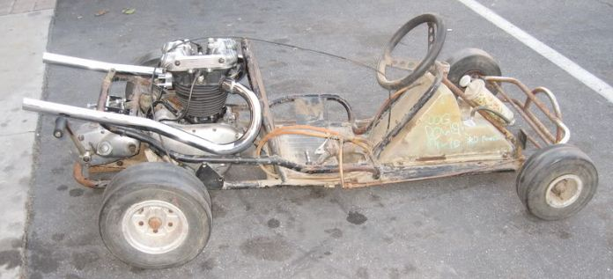
How is Your Craftsmanship Perceived by Others?
or

Slide 29
Agenda
Habits of Great Database Developers
Foundations
Design
Code
Test
DevOps
Maintenance

Slide 30
Design Practices
Follow basic relational data modeling principles:
Create and verify the conceptual model
Create and verify the logical model
Create and verify the physical model
Modeling tool should ensure changes in one flow into the others (if applicable)
Document and describe every entity, attribute and relationship
Enforce integrity (datatype, relationships, defaults and cardinality)
Eliminate duplication wherever found
Strive for consistent, simple, flexible models
Version, publish and discuss models with all concerned parties, including sponsors

Slide 31
Design Practices
First make the model correct, efficient, normalized…
THEN make it friendly
Abstract complex queries behind views and PL/SQL APIs that return ref cursors
RESTful JSON APIs use the views and PL/SQL APIs
Denormalizations like materialized views and rollup/tally tables for performance goals
Virtual columns, user-defined types, updateable views and other Oracle goodies to meet system requirements as needed

Slide 32
Design Practices
Always start design and change design from modeling tool, then forward engineer into the database.
Allows changes to the model to be versioned
Allows modeling mistakes to be easily seen with visual cues
Publish designs on the intranet and on paper
Distribute to team, management and sponsors
Bring them to meetings when discussing enhancements and issues

Slide 33
Agenda
Habits of Great Database Developers
Foundations
Design
Code
Test
DevOps
Maintenance

Slide 34
Coding Practices: Use the Version Control System
Ensure the version control system is used religiously.
Every database object that begins with the keyword “CREATE” gets its own source file stored and versioned in your directory structure
Never modify the database object directly
Development and maintenance activities always begin with the source file
Some PL/SQL IDEs default database object browsing to read-only mode. Use this feature to enforce the above.
Once compiled and tested, check in changed file with good comments
If development will take a long time, check it in periodically to preserve work

Slide 35
Coding Practices: Use Frameworks and Libraries
No need to re-invent the wheel.
Use pre-built, pre-tested PL/SQL frameworks and libraries to save months of coding effort.
Used to be a handful of full frameworks. Now we’re down to some of Feuerstein’s older stuff and mine.
I open-sourced my “PL/SQL Starter” framework in 2008 which includes a number of robust libraries, including packages for logging, debugging, emailing, auditing and performance view tagging.
One experiment done for a prior presentation on frameworks found that a complex reporting and emailing PL/SQL proc, coded side-by-side with and without a framework, took only 25% as much time and yielded 3X better code using libraries.
“Alexandria Project” is a list of PL/SQL libraries and utilities

Slide 36
Coding Practices: Routine Design and Structure
Use PL/SQL packages to group related functionality
Each routine should do one thing and one thing well
Keep each routine short, easily read and understood in a few minutes
Use packaged constants for immutable literals
Use table-driven parameters for mutable limits, ranges, thresholds and business-rule values
Break enormous, generic packages apart into separate packages that group related functionality.

Slide 37
Coding Practices: Documentation
Documentation is critical to high-quality work products
Each packaged routine, trigger, view and job should have a detailed comment
Encourage good descriptions through templates that have comment placeholders
Notes:
The only place where project/product documentation stands a slight chance of being read and maintained by future stewards of the code is if the comments are kept in the code. Keeping documentation separate from the code dooms it to almost immediate irrelevance and obsolescence.

Slide 38
Coding Practices: Documentation
Fully document each packaged routine in its comment block
Comment block in pkg spec if public routine, in body if private routine. NOT BOTH!
Focus on “tribal knowledge” that can’t be discovered by reading the code:
Who wrote it? When? Why? For whom or what system? What was the intended purpose? Were obvious alternatives rejected and why? Caveats, instructions and warnings.
Assumptions and expectations about input parameters
Return values, exceptions handled and errors raised
Usage example if not easy/obvious
Also document the body of each routine with pseudo-code
As the body is built, convert the pseudo-code into debug or log messages and add valuable context

Slide 39
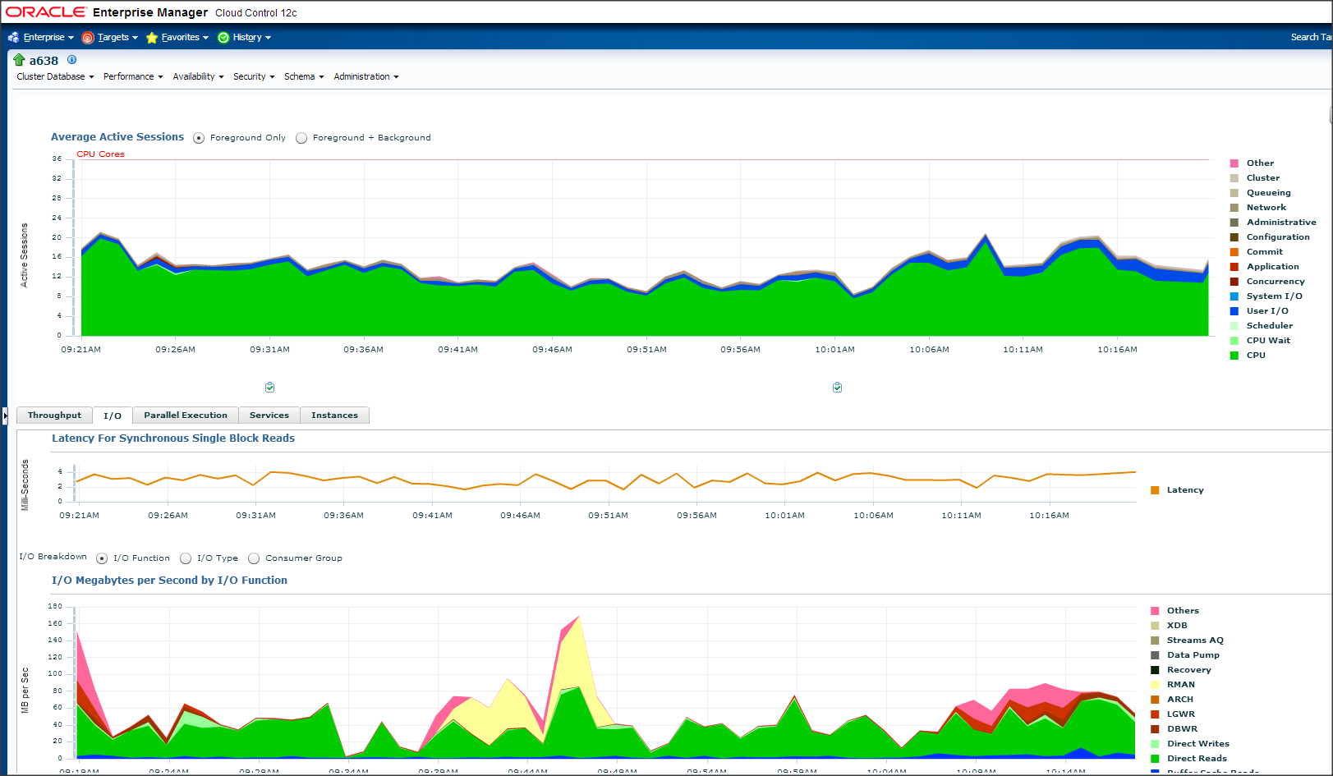
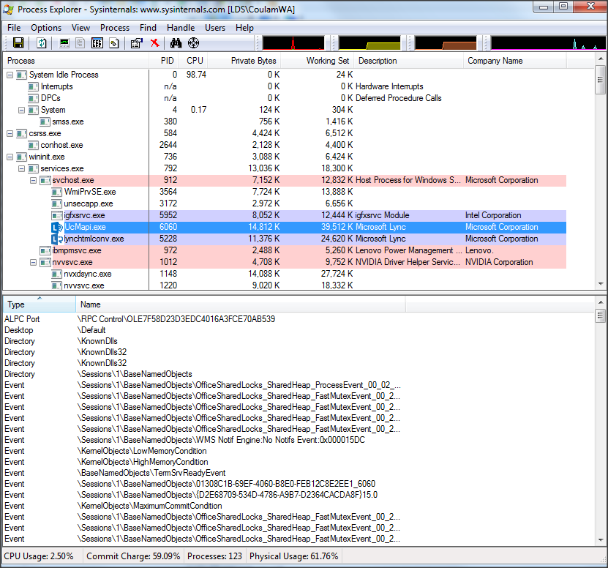
Coding Practices: Instrumentation
Think about some real-world complex software, like Oracle’s Enterprise Manager, a modern car, Windows Process Explorer, an aircraft, or a network operations center.
They all have interfaces that offer real-time, valuable insight into the inner workings, performance and historical behavior of their system.

Slide 40
Coding Practices: Instrumentation
And yet this is how much insight and metrics most database engineers build into their enterprise-grade code:
None! You get to fly blind.
Notes:
Adding DBMS_OUTPUT or attaching a debugger to production code is like crawling out on the hood of a moving race car, opening the hood and wiring in a tachometer all while the driver is trying to steer and win the race. Not acceptable.

Slide 41
Coding Practices: Instrumentation
Instrumentation is the act of adorning systems with code that directs runtime context to a destination where it can be useful.
Types of instrumentation:
Logging
Debugging
Notifying
Auditing
Notes:
Logging – Permanently enabled messages generated by the code at runtime, logging valuable information the business may require. This information is typically larger-grained than the detailed debug messages, such as when a critical process started and stopped and how long it took (metrics), or warnings and errors detected and the values being processed at the time of the error.
Debugging – Lots of highly detailed messages that, when enabled, can show a troubleshooter the exact path a call took and all the parameter and variable values experienced during execution. Due to sheer volume, debug messages are typically disabled in production code, but can be dynamically enabled by changing a table-based or application context-based key value.
Notifying – Usually used to deliver final results or proactively notify DBA of conditions outside the norm. Usually email or SMS message is sent to ensure visibility and rapid response.
Auditing – Data that exposes who changed what and when it was done. The audit data can be mixed in with the debug and log messages, but I’ve found it handy to keep audit data separate in a table set designed for tracking changes to rows and columns.

Slide 42
Coding Practices: Instrumentation
Useful runtime context includes:
Who: Name of called routine, metadata of caller, etc.
What: Parameters passed, variable values, iteration values, etc.
When: DATE or TIMESTAMP
What changed with old/new values (audit trail)
Metrics (timings, counters and sums)
Exceptions, warnings, errors
Landmarks and breadcrumbs (great for complex or long-running routines)

Slide 43
Coding Practices: Instrumentation
Useful destinations include:
Logging table
Email
SMS Text
Web service
Other destinations include:
DBMS_PIPE, DBMS_AQ, DBMS_ALERT, DBMS_SYSTEM, UTL_FILE, DBMS_OUTPUT, DBMS_APPLICATION_INFO, DBMS_SESSION, ftp

Slide 44
Coding Practices: Instrumentation
Should not have to build your own
There are many free and open-source instrumentation libraries
My “PL/SQL Starter” framework includes packages for logging, debugging, emailing, auditing and performance view tagging.
Tyler Muth’s forked “Logger” now found on github, is quite versatile
Local Oracle Advocate, Blaine Carter, has presentations and videos on using Logger
Adopt a good library that is simple to use and meets your needs
Can be added incrementally or all at once

Slide 45
Coding Practices: Performance & Resilience
If it can be done in a single SQL statement, do so
If not, use bulk PL/SQL features
BULK COLLECT, FORALL, etc.
If it must be done row-by-row, use record-based PL/SQL
Records or user-defined objects and input parameter type
Record-based inserts and updates
FORALL can be used on collections of type RECORD

Slide 46
Coding Practices: Exceptions
Ban the use of WHEN OTHERS
The only exception is when the error must be hidden
Write handlers only for anticipated exceptions.
Use a standard way of logging and re-raising handled exceptions
Allow PL/SQL’s default exception model to raise and rollback every unanticipated exception
Use pre-defined and user-defined exceptions.
Internally-defined exceptions should be abstracted with user-defined named exceptions

Slide 47
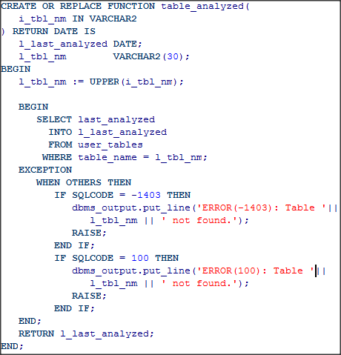
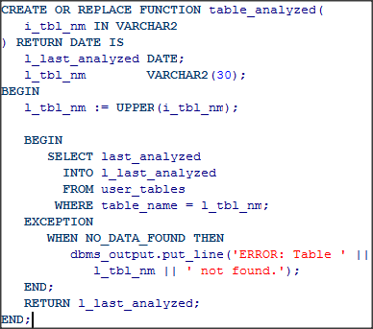
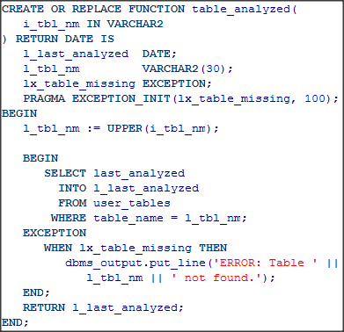
Coding Practices: Exceptions
Internally Defined
Predefined
User Defined
Bad
Better
Best
Bad but correct

Slide 48
Coding Practices: Transactions
The caller is in charge of transaction commit/rollback decisions
This is typically a java class, so most PL/SQL should never commit or rollback on its own
If the caller is a database job, the PL/SQL block driving the job makes the decision to commit or rollback

Slide 49
Agenda
Habits of Great Database Developers
Foundations
Design
Code
Test
DevOps
Maintenance

Slide 50
Testing Practices
Best testing occurs while documenting the interface
Write assertions in the body that test the validity of those assumptions (known as code-by-contract)
Test-Driven Development
Write tests of the interface before writing the implementation
Write body, re-testing all cases as you code to reach requirements
Left with nice suite of re-usable tests
Re-run the test suites whenever the code changes – able to quickly prove the change hasn’t adversely affected anything

Slide 51
Testing Practices
Use testing frameworks to help automate tests and the creation of test suites
utPLSQL is probably your best option as a framework
Various videos, webinars and tutorials available on how to use it
CodeTalk Series: Unit Testing PL SQL Code in the Real World
March 20th, 2018 ProHuddle webinar on utPLSQL by Jacek Gebal

Slide 52
Testing Practices: The Conundrum
Most enterprise PL/SQL routines use a lot of complex, interrelated data or do a lot of complex stuff.
Writing re-usable tests involves controlled data conditions that may not be present the next time the test is used. So one must write “setup” and “tear-down” scripts that create test data specifically for a given test.
Writing data setup and tear-down scripts can easily occupy 60 to 80% of the development effort.
So re-usable test suites are often skipped
Nirvana: Someday, using tools like Delphix, the entire database state will be saved in a repository for single or multiple test conditions and that state can be instantiated in seconds.

Slide 53
Agenda
Habits of Great Database Developers
Foundations
Design
Code
Test
DevOps
Maintenance

Slide 54
DevOps
What is DevOps? What does it include?
Build (compile or run SQL statements against target database)
SQL should be scripted. Can include DCL, DDL or DML
Deploy/Release (pre-scripts/tasks, build to Prod, post-scripts/tasks)
Manage Issues and Enhancements
We use Jira and Jama. There are many, many others.
Enterprise-grade DevOps use automation to handle these tasks
We use a custom build system using Maven and CruiseControl that is awesome
Liquibase and FlywayDB embody many of the same features and principles as our system.

Slide 55
DevOps: Lessons Learned
Folder per object-owning schema
Hook to notify everyone of new check-ins
Prefix all files with YYYYMMDD####-TICKET#-description prefix
The build stream is incremental. Each script is a new “version” of the DB.
Don’t change scripts once checked in. Instead fix them with another script that will run later.
Ensure each script is re-entrant
Aka re-runnable or [buzzword alert!] “idempotent”
Notes:
Idempotence, applied to modern software development, is typically seen as meaning that a client calling an idempotent service with the same inputs and expect the same results.

Slide 56
Agenda
Habits of Great Database Developers
Foundations
Design
Code
Test
DevOps
Maintenance

Slide 57
Maintenance
Traditional maintenance has mostly been folded into DevOps, where the same developers are responsible for the system front-to-back, from design to build to deployment to issue identification, documentation and resolution.
When things go wrong in Production, switch on debug statements for PL/SQL unit, authenticated user, Oracle session or schema
Should never have to recompile code in Production to get runtime context
Shouldn’t take more than a few minutes to identify root cause of issue
Agree upon and use tool to track and manage bugs, change requests and release bundles
We use Jama and Jira

Slide 58
Maintenance: Lessons Learned
Refresh production frequently, nightly if possible to continuous build DB box
Run proposed production data fixes on the refreshed copy first
Communicate well about future downtime for releases and PL/SQL compilation “hiccups”
Ensure each DB script intended for release or hotfix is tagged in some way to associate with the change management tool holding the problem description.
Write lots of proactive monitoring scripts and email/SMS DBAs when nasty errors are detected. DBAs should be aware of the problem before the customers are. Seek budget to improve the issues that waste the most time.
Notes:
The hiccup is when a package is recompiled and existing sessions that had a copy of the state of that package are given the ERROR that isn’t an error, that the state of the package has gone stale. All client has to do is make the call again and the ERROR that isn’t an error, goes away. Ideally architect your data services to trap this non-error and retry the calls for the users so they are never the wiser.

Slide 59
Day-in-the-Life Demos
<time permitting>

Slide 60
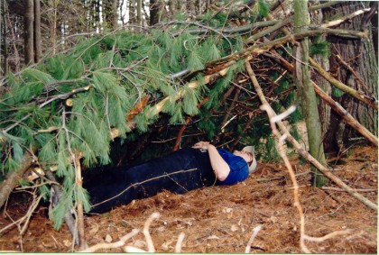
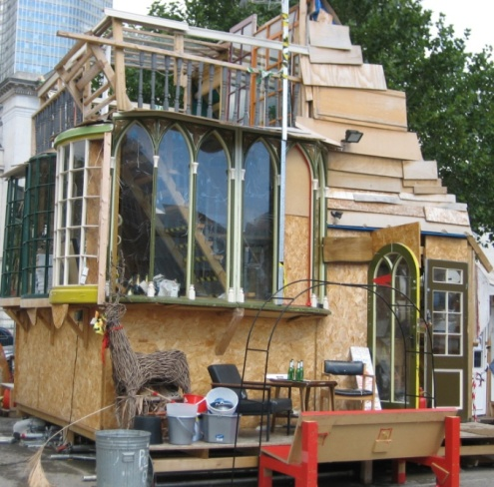
What Will Be Your Design & Build Legacy?
OR

Slide 61
Contact and Further Info
Contact: bcoulam@yahoo.com
Papers and Code:
http://www.dbartisans.com
http://www.dbsherpa.com
Framework:
http://sourceforge.net/projects/plsqlframestart
http://github.org/plsqlstarter

