Slide 1
UTOUG Training Days
2015
Data Layer Decisions
ORMs, SQL and PL/SQL
Notes:
http://typicalprogrammer.com/programmers-vs-rdbms/
http://www.tonymarston.net/php-mysql/object-relational-mappers-are-evil.html
* http://www.cforcoding.com/2009/05/orm-or-sql.html
http://www.reddit.com/r/programming/comments/rp9ha/bad_orm_is_infinitely_worse_than_bad_sql
* http://www.reddit.com/r/programming/search?q=stored+procedures&restrict_sr=on
* https://news.ycombinator.com/item?id=7310077
http://martinfowler.com/bliki/OrmHate.html
http://java.dzone.com/articles/martin-fowler-orm-hate (has lots of commentary)
* http://blogs.tedneward.com/2006/06/26/The+Vietnam+Of+Computer+Science.aspx
http://database-programmer.blogspot.com/2010/12/historical-perspective-of-orm-and.html
http://seldo.com/weblog/2011/08/11/orm_is_an_antipattern
http://programmers.stackexchange.com/questions/163185/torvalds-quote-about-good-programmer
http://terrazadearavaca.blogspot.com/2008/12/jpa-implementations-comparison.html
http://highscalability.com/blog/2008/2/2/the-case-against-orm-frameworks-in-high-scalability-architec.html
http://www.iheavy.com/2011/08/26/5-things-are-toxic-to-scalability/
http://www.bigdatalittlegeek.com/blog/2014/3/18/orm-the-killer-of-scalability
http://wozniak.ca/what-orms-have-taught-me-just-learn-sql
http://www.reddit.com/r/programming/comments/2cnw8x/what_orms_have_taught_me_just_learn_sql/
http://weblogs.asp.net/ricardoperes/differences-between-nhibernate-and-entity-framework
http://blog.jhades.org/solving-orm-complexity-keep-the-o-drop-the-r-no-need-for-the-m/
http://www.kenneth-truyers.net/2014/11/15/how-to-ditch-your-orm/

Slide 2
The Presenter
Bill Coulam (bcoulam@yahoo.com)
Programming C, C++, Java and PL/SQL since 1995
Custom Oracle design, development, [re]modeling and tuning since 1997
  Andersen Consulting (PacBell, US West, AT&T)
  New Global Telecom - Denver, CO
  The Structure Group - Houston, TX
  Church of Jesus Christ of Latter Day Saints - SLC, UT

Slide 3
Our Map
Application Data
A little history of application tiers
Options
The PL/SQL architectural option

Slide 4
Application Data
The only purpose of an application is to capture, validate, store, protect, retrieve, display, share and change data.
Sticks around forever.
Almost priceless.
Must be modeled right, recorded accurately, protected, and reported perfectly.
Application code falls out of favor and is rewritten and replaced frequently.
Data, however, is preserved and migrated from release to release.

Slide 5

Data Layer Evolution
1-tier (1960s to 1980s)
  Big iron operating on files
  Data is application-dependent
  Reporting required custom development
  Thin client dumb terminal

Slide 6
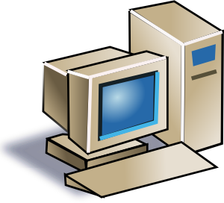
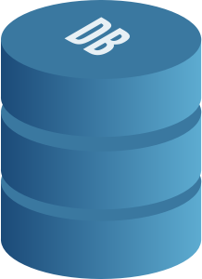
Data Layer Evolution
2-tier (80s to 1996-ish)
  Fat clients held presentation, business and data layers.
  Large data meant resource intensive clients

Slide 7

Data Layer Evolution
3-tier (1997 - ) / N-tier (2000 - )
  Processing farmed out to optimal hardware:
    Presentation layer in browser and app server.
    Business rules in app server. MVC.
    Data rules and queries kept (mostly) in the database

Slide 8
Data Layer Evolution
2-tier (2007-ish - now)
  Devs reject RDBMS, SQL, DBAs, Data Modeling and stored procs
    Big iron spread out across many boxes, operating on files
    Data is application dependent
    Reporting requires custom development
    Thin client smart browser
  CASE, 4GL, CORBA, OODB, ERP, XML, EJB, ORM, AOP, Web Services, NoSQL and SOA will save the world

Slide 9
Options for Data Layer
Custom POJOs and raw JDBC. Slow dev but screams.
EJB: Entity Beans Ick. Nope. Never again.
Big ORM: Hibernate, EclipseLink, TopLink, OpenJPA
Thin ORM: JOOQ, iBatis/MyBatis, SimpleORM, LinQ, Dapper, more…
SQLAlchemy, Apache Cayenne, MentaBean, Django, Propel, Entity Framework, .NET Web API, PetaPoco, more…
Spring JDBC/Template, Spring Data JPA, Spring Sync
Stored Procedures
Future: SOA - Service layer on top of queries, views, procs
Future: Store, retrieve and navigate the objects in the DB

Slide 10
ORMs
“ORMs are great for simple CRUD operations. As soon as you want to do anything mildly complex or desire efficiency, you need to write SQL.” This is known as a “leaky” abstraction.
Gavin King says
  “Just because you're using Hibernate, doesn't mean you have to use it for everything. A point I've been making for about ten years now.” - Dec 9, 2013 Gavin King Google+ feed
ORMs have been called the Vietnam of Computer Science
  Other articles call them anti-patterns, “the devil” and otherwise show no love
Devs so fed up with the difficulty of fusing object and data domains, they invent new data access frameworks almost daily
Can be done right, but usually requires an expert in that ORM
Notes:
Quote from user “meritt” at https://news.ycombinator.com/item?id=8133835
Vietnam of Computer Science: Ted Neward, cited by Jeff Atwood, one of the creators of stackoverflow: http://blog.codinghorror.com/object-relational-mapping-is-the-vietnam-of-computer-science/
From “http://www.javaperformancetuning.com/news/interview041.shtml” Gavin King says “I went into this knowing very little about ORM, and even very little about databases. One of my first tasks was to go out and buy a book to learn SQL properly”
And
“When I first started this, I thought that what was needed was a simple solution. (You often hear people say "J2EE is too complex", so this seems reasonable.) It turns out that ORM is a difficult problem, in subtle ways. It always looks simpler from the outside than it turns out to be once you start getting your hands dirty. This is why it has taken so incredibly long for decent persistence solutions to really appear. I pretty soon discovered that "simple" just wasn't going to cut it. So now we have a solution that is unashamedly complex. But hopefully no more complex than it needs to be.”
Google+ link is https://plus.google.com/+GavinKing/posts/LGJU1NorAvY
http://www.reddit.com/r/programming/comments/2cnw8x/what_orms_have_taught_me_just_learn_sql/

Slide 11
“Thin” ORM
A “new” flavor of mapping, but map to queries, views and procs. Some map to tables.
Queries often kept in XML. Easy to maintain and deploy.
SQL-friendly and DB-centric
Shallow learning curve
“Typesafe SQL”
Supports existing schema, views, procs, etc.
Notes:
SQL-centric means it is friendly to SQL, allows you to write real SQL statements that work directly on the database, store them in XML or the database (views and procs) and map to that.
DB-centric means you can map to existing schema, ensure latest java code is sync with DB schema, etc.
Typesafe SQL means syntax errors are detected before runtime.
iBatis 2001 Clinton Begin java, .Net and Ruby
maps objects to SQL result set and stored procs
does not map to tables
data model and object model independent
queries kept in XML files
MyBatis fork of iBatis 3.0 in 2007 - maintained by team that includes creators of iBatis, includes caching capability
Hibernate 2001 Gavin King java

Slide 12
Spring Options
Spring JDBC
  LDS Screening Project. On time, under budget, easy to understand and maintain. Fast. No issues.
  LDS IMOS Project. Certain screens refactored with Spring JDBC saw 100X and 50X speed and resource improvements
Spring Data JPA
  Our enterprises’ current recommendation
Spring Sync
  New. 1.0.0. Utilizes HTTP PATCH for partial updates

Slide 13
SOA
REST!
Angular!
Stateless!
Mobile web!
Service Bus!
New direction being aggressively pursued by many
Oracle REST Data Services (ORDS)

Slide 14
Ditch Relational
Store the object graph directly in the database
  MongoDB, Couchbase
  MarkLogic (native JSON as of v8)
  Neo4J and Spring Data Neo4J
  IBM DB2, PostgreSQL 9.2
  Azure DocumentDB, Amazon DynamoDB
  And…
  Oracle 12.1.0.2 !

Slide 15
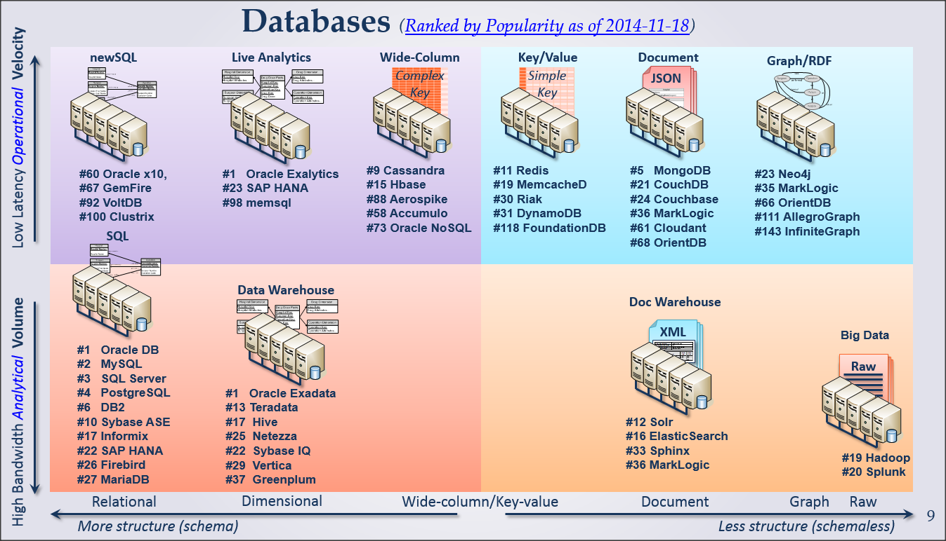
From “Are you ready for NoSQL” by Mike Bowers, Enterprise Database Architect for ICS,
Church of Jesus Christ of Latter Day Saints

Slide 16
Stored Procedures
Discuss

Slide 17
Args against PL/SQL
Inability to port apps to another DB
Can’t version the code
In-memory app server logic always faster
Increased cost, complexity and less maintainability
No business logic outside of the app server
DBA bottleneck
No skillset among the developers. Second lang for app.
Hard to debug. Rarely tested.
Not cached. Not pre-compiled. Not faster. Dynamic SQL as fast or faster than stored procs.

Slide 18
Args for PL/SQL
SQL where it belongs
Agility when changing app development language/framework
Continuous and easy deployment
Speed and efficiency
Set/Bulk transactions and processing
ETL
Security
Abstraction and de-coupling
Centralization of common logic and reusability
Automation of routine data-centric tasks
Built-in and bolt-on auditing and instrumentation
Notes:
Coleman: monthly sweep example where middle tier brought in all the data and then looped through; died after it reached 60k missionaries

Slide 19
Where should the SQL rest?
Religious debate, but I feel there is only truth:
  Simple SQL is fine in the middle tier
  Anything harder than a couple joins, store it in a view or packaged PL/SQL routine
Should be written by someone that understands relational, sets, SQL and the DB
Reviewed and tuned by DBAs
Can be easily instrumented for logging and debugging. Much easier to troubleshoot and monitor when kept inside the database, next to the data, where it belongs.

Slide 20
App Evolution
How often do apps change a framework they’re using? (POJO -> EJB -> Struts -> Ajax -> JSF -> Angular -> Angular2 -> ?)
How often do apps change the database?
Keeping the SQL and data logic in the database means much less work when re-tooling an app

Slide 21
Security
If business requires stiff protection of data structures, don’t grant them to any accounts.
Construct PL/SQL API for data access and manipulation
Can then design complex security privileges for the stored procs that have access to the tables and views.
Notes:
MDM uses a flavor of approach well through Virtual Private Database, PL/SQL policy applied to every query to ensure only DSA-approved data is pushed to consuming schemas.

Slide 22
Deployment
Being interpreted, PL/SQL is very simple to deploy.
Compile the versioned source file into the schema. Done.
  App data layer should be amended to capture the “existing state of packages has been discarded” error and re-try the previous call
  Voila. Continuous deployment to Prod achieved.

Slide 23
Data Proximity and Network Latency
Typical: Query DB, transport result set across the network, load objects, perform the operation(s) on the data in memory, unload objects, transport data back to DB, update and commit.
Stored Routines: Call routine, query DB, perform operation(s) on the data in memory, update and commit.
Eliminating the items in red saves significant runtime when dealing with large result sets.

Slide 24
Large Data Sets
Relational databases, in particular Oracle, are raging speed-demons for querying and manipulating large, normalized result sets.
RDBMS are set-oriented
Don’t treat DB like “dumb” persistence box
Take advantage of the set and performance-oriented features of your DB
  Doing as much as you can as one SQL statement
  If PL/SQL is the solution, use bulk features
Notes:
Point audience to Coleman’s presentation here.

Slide 25
Extraction
If requirements need to extract large amounts of data for consumption by app, reporting, data warehouse, external interfaces, etc.
  Especially if the filter or SELECT features are complex, use PL/SQL

Slide 26
Transformation & Loading
If requirements need to pump large amounts of data into the database, in particular if calculations or derivations need to read the destination database while processing incoming data, do it in the database using external tables and pipelined PL/SQL functions.

Slide 27
SQL Injection-Proofing
SQL written by devs and kept in the middle tier is much more likely to suffer from concatenation problems, hurting performance, shared pool and inviting SQL injectors
SQL behind a PL/SQL interface guarantees no SQL injection (unless dynamic SQL is being written with parameters)

Slide 28
Common Business Logic
Critical algorithms that must be available to and used by multiple systems and tiers should be kept in the least common denominator (the database) as a stored routine.
If direct access to the DB is not available, the stored routine can be published as a web service just like any java-based web service.

Slide 29
Reuse
Database processes, jobs, routines, triggers that need to use common business logic can’t take advantage of web services or middle tier methods, which demands duplication and fragility.
If kept in the database, designed and documented well, and published, encourages re-use, centralization and robustness.
Notes:
Example of exchange rate conversions

Slide 30
Auditing and Logging
SQL in the middle tier is notoriously done poorly (by devs or JPA engine).
When things go wrong, it is difficult to debug, monitor and log.
  Can be done right, but usually isn’t
SQL kept in stored packages trivial to instrument, monitor, debug, tune and re-deploy.
Notes:
Example of java stack trace (not dell well w/no insight into data layer) and instrumentation out of our pl/sql log

Slide 31
Automation
Most common use of PL/SQL
Used often by physical/system DBAs to schedule routine reports, extractions, loads, monitoring and cleanup tasks, etc.

Slide 32
Considerations
Time
SQL expertise
PL/SQL expertise
Size and complexity of data model
Portability
Scalability and Performance
Maintainability/Tuning/Troubleshooting
Persistence engine

Slide 33
Code Examples
Spring JDBC
Spring Data JPA
JOOQ
Stored Procs for all

Slide 34
bcoulam@yahoo.com
www.dbartisans.com

