Slide 1
Dynamic Debugging
Pain-free Troubleshooting of
Production PL/SQL

Slide 2
Agenda
Fluff (10 min)
Meat (20 min)
Q&A and Collaboration (15 min)

Slide 3
Production Problems
User calls or submits ticket
Getting error, nothing, or taking too long
Proactive monitoring
Determines errors occurring
Determines performance is not typical
No monitoring or history
aka “Taking your lumps”
User, customer, manager, CEO calls…
Backend process doesn’t complete, doesn’t run, spitting errors
Find and Fix. Then rebuild trust.

Slide 4
Debugging methods
DBMS_OUTPUT
Log to file
Log to table
GUI tool or DBMS_DEBUG API
Others?
Notes:
DBMS_OUTPUT.put/put_line:
Built-in. Easiest to remember and use. Fine for quick and dirty anonymous blocks. But…
Unpleasant to type over and over.
Goes to buffer, which in most tools is not fetched until the end of the block, after it’s too late to catch the bug in play, forcing at least one more debugging attempt.
If used in production troubleshooting, front end must fetch from the buffer to benefit. Most do not, and the output is lost to the Oracle aether.
If added to troubleshoot production, packages must be compiled, forcing invalidations, downtime, disgruntled users/customers.
Until 10g, severely limited to <= 255 characters. (32K limit now)
Logging to file:
Output is immediately visible. No need for anonymous transaction. But…
Must be designed for security and file system constraints.
If left in production, can quickly fill disk, so most opt to be very conservative, leaving little useful info when troubleshooting is required.
Logging to table:
Output immediately visible if within anonymous block.
If left in production, can quickly fill tablespace, so again logging is kept conservative.
GUI tool:
Most can only attach to new backend session, not an existing or client-side session.
Code must be compiled in prod with debug tokens.
I’ve seen these tools mess up the sessions, where it had to be killed externally and in the OS to clean it up. Risks running in Production.
DBMS_DEBUG is used under the covers of these tools. Too complex and low-level to use manually. Limitations with collections, which you should be using gratuitously.

Slide 5
Debug heaven
Dynamic: Can be turned on and off
Debug instrumentation can remain in Prod code
Turn on for a PL/SQL unit
Turn on for an existing session
Turn on for a named process
Turn on for an identifiable end user
Other? (IP address, Domain, Client program)
Visible immediately. No waiting.
Output choice: file, table, screen, other?
Painless for developers to learn and use
Auto-report time and origination

Slide 6
Which way to heaven?
Simple debug API
dbg(‘Calling X with ‘||i_parm);
Table-driven parameters with defaults
Debug toggle
Debug context of interest
Output destinations
Defaults overrideable
Robust file API for file-based
Anonymous transaction API for table-based
Method to identify end user

Slide 7
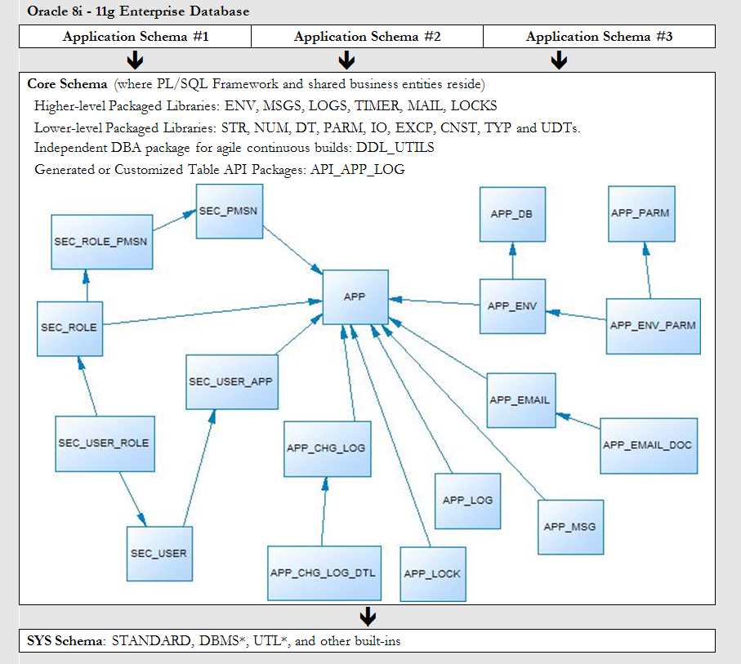
PL/SQL Starter Framework

Slide 8
Relevant pieces
Debug API: LOGS
logs.dbg()
Critical private routines: check_debug_toggle(), env.caller_meta()
Toggles: APP_ENV_PARM
Debug (on/off, session, unit, user)
Debug Toggle Check Interval (in minutes)
Default Log Targets (Screen=N,Table=Y,File=N)
File API: IO
Log Table API: APP_LOG_API
End-to-End User Identification
Modified Java connection classes
Application Context and DBMS_SESSION.set_identifier and DBMS_APPLICATION_INFO “tagging” (ENV pkg)

Slide 9
It’s Go time!
CIO just called. After last night’s release, she is not getting her daily email about the critical problem/solution repository.

Slide 10
Questions?
Ideas?
Contact: bcoulam@yahoo.com
Website: www.dbartisans.com
Framework: sourceforge.net/projects/plsqlframestart/

