Slide 1
Debugging & Instrumenting PL/SQL
Pain-free Auditing, Metrics and Troubleshooting

Slide 2
Agenda
Milk (15 min)
Meat (20 min)
Q&A and Collaboration (10 min)

Slide 3
If You Remember Just One Slide…
Like security, internationalization, performance and a good data model, instrumentation needs to be designed into the system from day one, and in place before the production problems occur.
Best way to accomplish this is to have a standard library, a standard to use the library, and peer reviews to enforce it.
Standard PL/SQL library can be built or adopted
In either case, meet developer and enterprise needs so it gets used.
Notes:
This is the worst possible time of day to give a presentation, let alone on a dry subject like making your code more maintainable. So I won’t blame any of you that slip into a digestion-induced post-lunch coma. But before you nod off, I’d like to give you the conclusion, so that your few minutes awake here aren’t wasted.

Slide 4
Production Problem Lifecycle
Become aware of a problem
Find the source of the problem
Fix the source of the problem
Or slow the bleed
Repair issues the problem caused
Often data to repair, customers to call, hotfixes to document, emails to send, reports to re-run.
Rebuild trust
Notes:
This slide it pretty much common sense. I placed it here as a reminder of what we go through whenever a problem is discovered in Production. We will be spending the remainder of our time on the first two points. While putting this to paper, it dawned on me that I’d seen these steps outlined somewhere before…in addiction recovery material. Felt compelled to review the AA 12 step program, and was struck by the similarities between the two processes of weaning ourselves from destructive behavior (bugs and alcoholism).

Slide 5
The 12 Steps to Recovery
Admitting that one cannot control one’s addition or compulsion
Recognizing a higher power that can give strength
Examining past error with the help of a sponsor
Making amends for these errors
Learning to live a new life with a new code of behavior
Helping others who suffer from the same addictions or compulsions
Notes:
The twelve step program includes…(go over each point, pointing out similarity to ridding system of bugs.

Slide 6
Problem Manifestation
The Silent Fester, aka “The Norm”
No monitoring, auditing, metrics or history.
No one calls. Users get used to slowness/badness.
User calls or submits ticket
Side Effects
Incremental buildup until something backs up, never returns, fails, etc.
Proactive monitoring
Determines errors occurring
Determines performance is atypical
Notes:
So how do we first become aware of our Production problems? (class discussion, repeat answers for mic)

Slide 7
Problem Diagnostics
Start peeking, prodding, poking, querying, hoping, guessing, trial and error, etc.
Ad-hoc, afterthought methods include:
DBMS_OUTPUT
Add some logging to file; recompile
Add some logging to table; recompile
GUI tool or DBMS_DEBUG API
What is wrong with these methods?
Even heroic efforts are too slow, error-prone, guess-prone, require downtime and leave customer impatient.
Notes:
And what do you use to find the root cause, or original source of the problem? (class discussion, repeat answers for mic)

Slide 8
Problem Diagnostics
With instrumentation in place…
Simply review what happened
If instrumentation was in place
Auditing: who changed what, and when?
Metrics: how long did it take?
Informational and Error Logging: what happened?
If option B does not find the root cause…
Replicate and monitor in real time
This requires dynamic debug logging pre-embedded in the code.
Notes:
The ideal method to find the problem source is to review detailed logs, filled by your highly-instrumented code. (Review Method B)
But for certain systems, it is not possible to keep such detail due to limited resources (disk space). In other cases, reviewing the past just doesn’t help. Sometimes a problem simply can’t be replicated in environments other than Prod. In both these cases, the error has to be replicated in Production, with detailed logging turned on. (Review Method C)
Wouldn’t it be nice to flip a switch, and see everything that is happening? What if that is too much info? Wouldn’t it be useful to narrow that logging to your user, session, PL/SQL unit, backend process or report?

Slide 9
Heavenly Instrumentation
Static Logging
Performance-critical metrics are always logged
Operations on sensitive or critical data are audited
Dynamic Logging
Off by default, and low overhead, so insightful debug lines can remain in Prod code
Can be turned on and off without Prod interruption
Toggles kept in XML file or tables
Turn on for a PL/SQL unit or list of units, session, end user or named process, IP address, domain
Notes:
With any time spent in maintenance, you quickly form a set of requirements, a vision for standard logging and debugging, that if met would make your life heavenly. What would instrumentation be like in heaven? Without much official doctrine or scripture on the nature of the afterlife, latter day saints are left to near death experiences, prayer and speculation. I speculate that this is what instrumentation is like in heaven, and it was my intention to get as close to that as possible when building the libraries I now use. If you are going to build your own library, ensure it meets most of these requirements, or it will quickly be ignored and fall into irrelevance.

Slide 10
Heavenly Instrumentation
Simple and Painless
dbg(‘Calling X with ‘||i_parm);
info(‘BEGIN: Nightly Reconcile’);
warn(‘X took ‘||l_diff||’ minutes too long’);
Choice of Output
file, table, screen, ftp, pipe, others?
Table-based output requires anonymous tx
Origin Metadata Transparently Derived
Time, unit, line, caller identifiers
End user identifiable from end-to-end

Slide 11
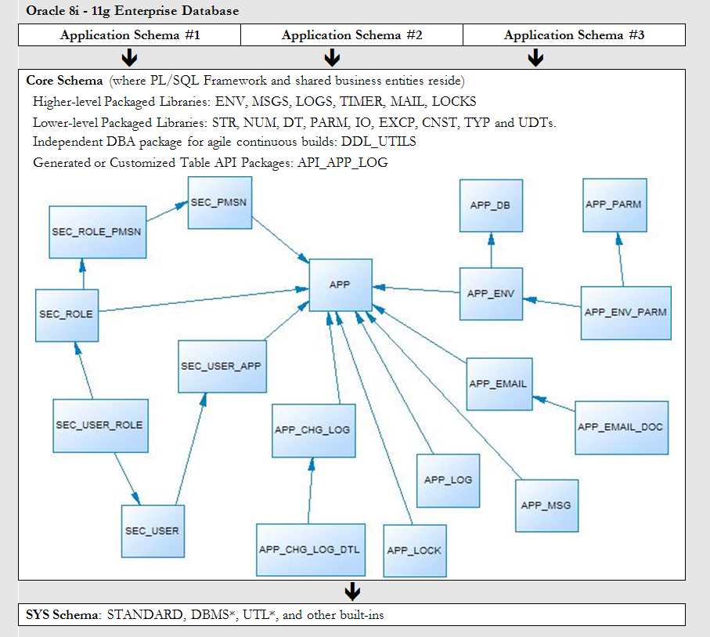
PL/SQL Starter Framework
Notes:
These requirements are met within an open source PL/SQL framework, available on SourceForge, that I wrote. This is an overview of the data entities within it, and the PL/SQL libraries available.
A trigger generator, and the app_chg_log/app_chg_log_dtl tables are used for auditing column-level changes, who did it, and when.
The LOGS package, and the app_log table are used for the static and dynamic debugging spoken of in this presentation.
The app, app_db, app_env, app_parm and app_env_parm tables compose the submodel that make environment-aware, dynamic parameters possible.

Slide 12
Starter: Auditing Components
The Starter Framework comes with a “gen_audit_triggers.sql” script which can generate a trigger for every table in your schema.
Run it. Remove triggers not needed. Remove auditing on columns not needed.
Done.
Audited changes are recorded to APP_CHG_LOG and APP_CHG_LOG_DTL
May need view or materialized view to simplify access to audit data.

Slide 13
Starter: Metrics Components
TIMER package
startme(timer name)
stopme(timer name)
elapsed(timer name)
Log elapsed times
Create separate automated processes to monitor metrics, learn from them over time, and notify when anomalies are detected.

Slide 14
Starter: Logging Components
LOGS package
info(msg)
warn(msg)
err(msg)
dbg(msg)
set_dbg (and more manual overrides)
Use info(), warn() and err() to record important data, expected and unexpected error conditions.
Use dbg() to both document code and leave hooks for dynamic, real-time logging.

Slide 15
Starter: Debug API
Debug API is found in the LOGS package
It is very simple:
logs.dbg(i_str)
Critical private routines:
check_debug_toggle()
env.caller_meta()

Slide 16
Starter: Debug Toggles
Toggles: APP_ENV_PARM
Debug (on/off, session, unit, user)
Debug Toggle Check Interval (in minutes)
Default Log Targets (Screen=N,Table=Y,File=N)
Toggles can be manually overridden, or read from the parameters table

Slide 17
Starter: Debug Destinations
Screen
Only useful for unit testing and debuggin backend processes.
File
Under the covers in LOGS, the IO package is used to write to the file system.
Log Table
Under the covers in LOGS, the APP_LOG_API package is used to write to APP_LOG
A default job keeps the table trimmed to a couple weeks of data.

Slide 18
Starter: Call Origin Metadata
ENV package governs metadata
Gets, sets and secures info about the host, database, session, calling application, calling client and application contexts.
End-to-End User Identification
Modified Java connection classes to set and clear the user’s login using env.init_client_ctx and reset_client_ctx
Uses custom application context, DBMS_SESSION procs and DBMS_APPLICATION_INFO procs (to tag)

Slide 19
Putting it Together
Solution Manager just called.
After last night’s release, she is not getting her daily email about the critical problem/solution repository.
Recent problem in Missionary Dept.
New procedure to be run at next release indicated it was successful, but there was no evidence it did anything.

Slide 20
The End
Questions?
Ideas?
Contact: William.Coulam@ldschurch.org
Framework: sourceforge.net/projects/plsqlframestart/

