Slide 1
Re-usable Models and Frameworks
For Database Applications

Slide 2
Agenda
Terminology
Development “from scratch”
Development with reusable models & database components
Rarity “in the wild”
Essential patterns and services
DIY best practices
Existing models and frameworks
Retail
Free
Tour of the “Starter” Framework

Slide 3
Define: Terminology
Framework: An application framework is a collection of software modules or components that implement common functionality used by developers to write software in a rapid, consistent manner.
Library: A collection of related components.
Component: A simple, robust object or routine that implements a feature of the library.
Model: A diagrammatic and textual representation of a system’s information, rules and relationships.

Slide 4
Define: Applied to DB Dev
A component is an DB object: table, view, trigger, type, context, sequence, packaged routine (func/proc), etc.
A library is typically a PL/SQL package of related routines, and the components that support that feature family.
A framework is the entire collection of templates, standards, and libraries (packages) that offer a set of features for reliable, rapid database development.
A data model is implemented in a physical schema.

Slide 5
Common Requirements of Every App
Login, security, authentication and authorization, permissions and roles.
Parameters, properties, addresses, constants and other magic numbers.
Messages, debugging and logging
From within app
From within DB
Email and notification
From within app
From within DB
Locking
Auditing
DBA Operations

Slide 6
Developing the Custom App
Initial costs of common services
Security: 1 – 3 weeks
Application parameters/properties: 1 – 5 days
Debugging and logging: 1 to 2 weeks
Text: 1 – 5 days, X 400-800% if i18n
Email, notifications and templates: 5-21 days
Locking: 3-5 days
Auditing: 5 – 10 days
Long term costs
Can one avoid the initial and long-term costs?

Slide 7
Maintaining the Custom App
“The only constant is change.”
“There is always another bug.”
Production bugs & enhancements
Security Rewrite
Embarrassing Typo
Production PL/SQL Bugs
Catch the Culprit
Singleton Process
New Application

Slide 8
The 80/20 rule (Pareto Principle)
Stellar programmers (the precious “20%”) know when to build and when to re-use.
Can skip much of initial architecture stage using pre-built frameworks.
Development of the front-end usually begins with the technical lead selecting the framework
Rails, Flex, JSF, Spring, Silverlight, etc.
It is a given that UI components will not be built from scratch.
Why is the same not true of database development?
Familiar with QCGU, PLVision, Starter, GED?

Slide 9
Reusable Data Models
And
Database Application Frameworks!

Slide 10
Life can be Sweet
Production solutions with reusable data models and frameworks
Security Rewrite
Embarrassing Typo
Production PL/SQL Bugs
Catch the Culprit
Singleton Process
New Application

Slide 11
Rarity
What do customers, managers and developers want out of the software they’re paying for or building?
Speed of delivery
Cost
Quality
Flexibility
Robustness
Scalability
Performance
Good application architecture (infrastructure, model and framework) is crucial to attain these attributes.

Slide 12
Rarity
This is no different from the criticality of location, site preparation, blueprints, foundation, and framing to a successful home building project.
What happens when a structure is built without sufficient thought and investment in the site, foundation or framing?

Slide 13
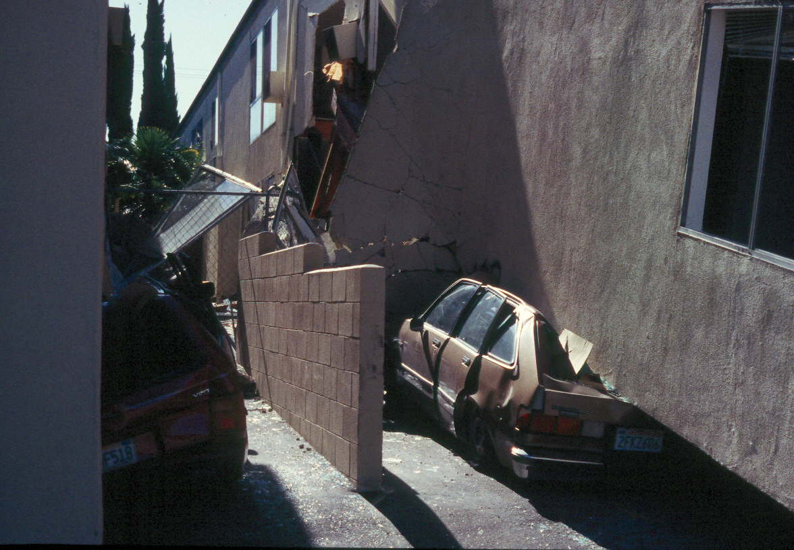
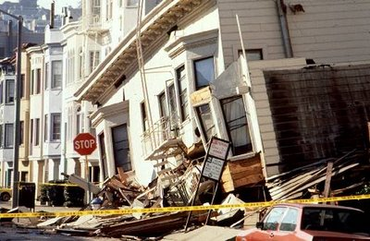
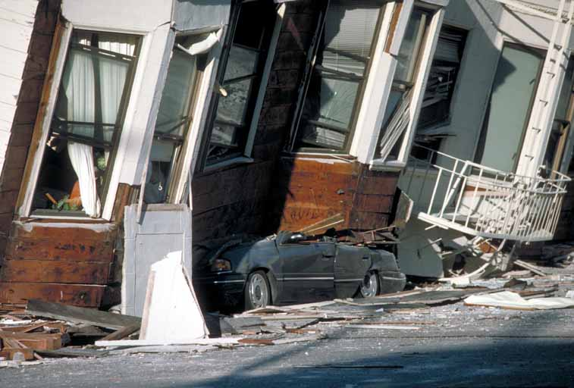
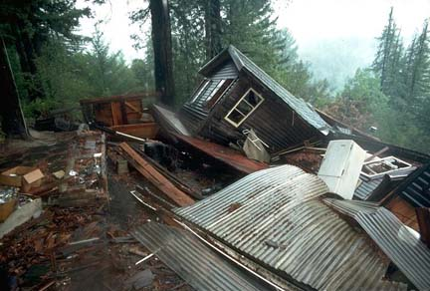
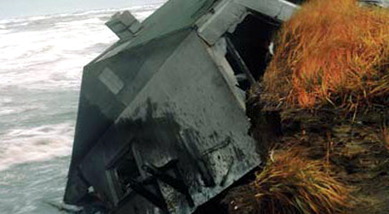
Rarity

Slide 14
Rarity
And yet, despite the values and risks, what are the first things to go when budgets and deadlines tighten?
Testing
Documentation
Security
Architecture, design and modeling
Not what the user sees. Not an immediate problem. So these are seen as “fluff” and dispensable.

Slide 15
Rarity
We are engineers, artisans and stewards.
Cannot allow application architecture to be cut or ignored.
Oracle and SQL Server are mature.
If we aren’t developing with the same rigor and best practices of frontend development, it is our fault database architecture is shrugged off as irrelevant.
What do frontend developers do?
Pair programming, regression tests, instrumentation, DRY, KISS, TDD, assertions and…
Re-use standard framework libraries.

Slide 16
Essential DB Framework Services
Needed by every database application:
Security
Parameters/Configuration
Auditing
Logging
DBA Ops

Slide 17
Common DB Framework Services
Needed by those with backend processes:
Application and Connection Metadata
Debugging, Timing and Instrumentation
Error Handling and Assertions
String manipulation
Number manipulation
Date handling
Messages and Email

Slide 18
Common Framework Services
Locking
IO
Constants, Types, Cached Reference Data
Shared SQL
Directory Integration
ETL
Unit Testing
Database code templates

Slide 19
Build or Buy?
Qualities of a good framework:
Solid exception handling scheme
Good documentation, sample app, comments
Clean, well maintained and tested
Short, but intuitive library and component names
Layer independence and non-circular
Simple

Slide 20
The Value of Simple
Programs must be written for people to read, and only incidentally for machines to execute. - Donald Knuth
Simplicity is prerequisite for reliability. - Edsger W. Dijkstra
Simplicity carried to the extreme becomes elegance. - Jon Franklin
Simplicity is the ultimate sophistication. - Leonardo da Vinci

Slide 21
Existing Market Survey
Retail Frameworks
GED Toolkit
Orbit
Turbo Enterprise
Free Frameworks
QCGU (was QNXO)
PLVision
Open Source Frameworks
PL/SQL Starter

Slide 22
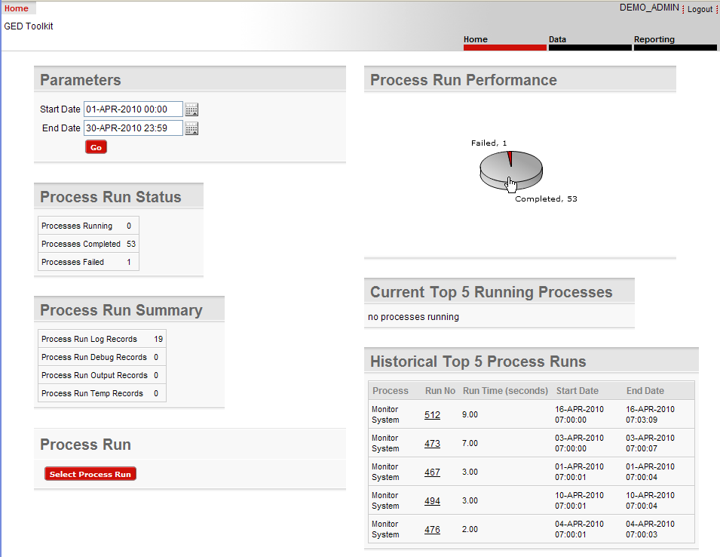
GED Toolkit
Re-usable libraries. Focus on insight into backend processing: inputs, outputs, state.

Slide 23
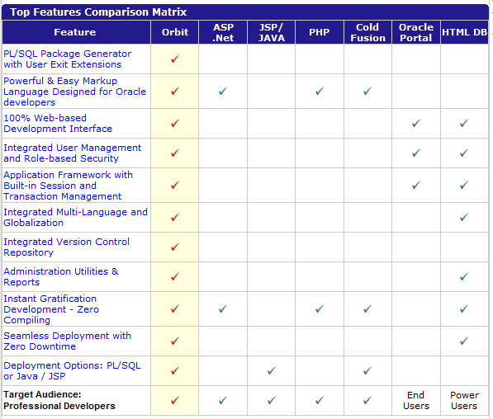
Orbit
Web-based, application development IDE and framework.

Slide 24
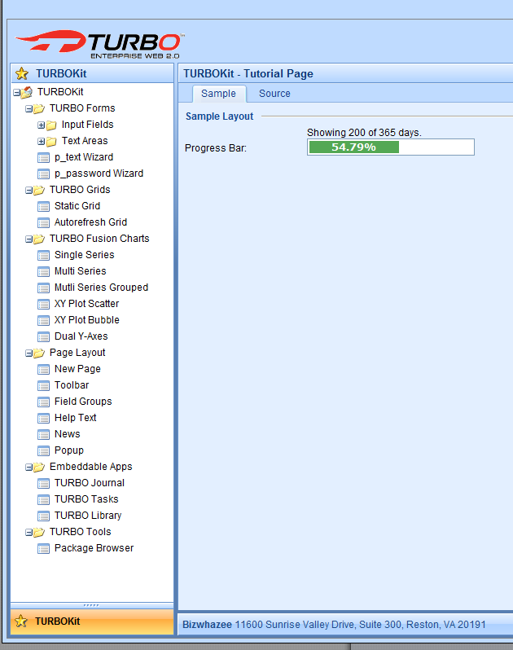
TURBO Enterprise
DB Application Factory and Framework

Slide 25
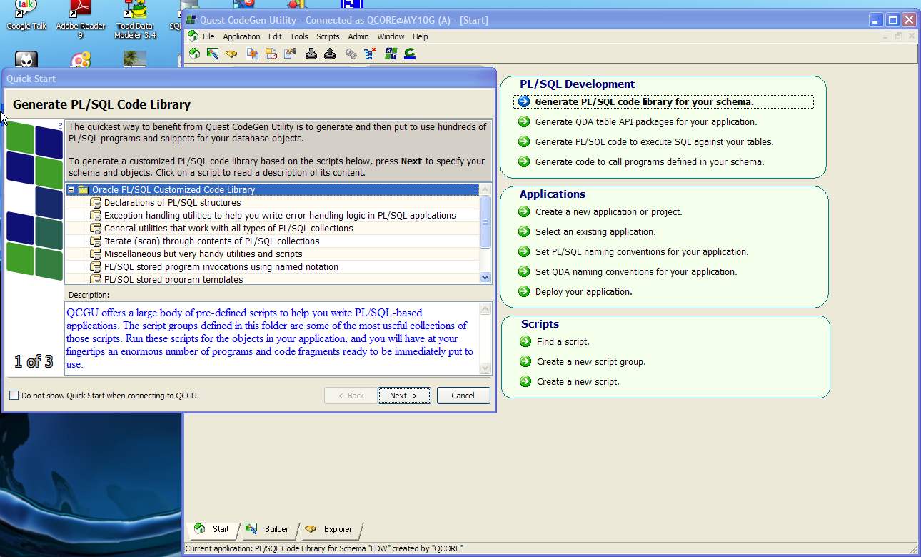
QCGU

Slide 26
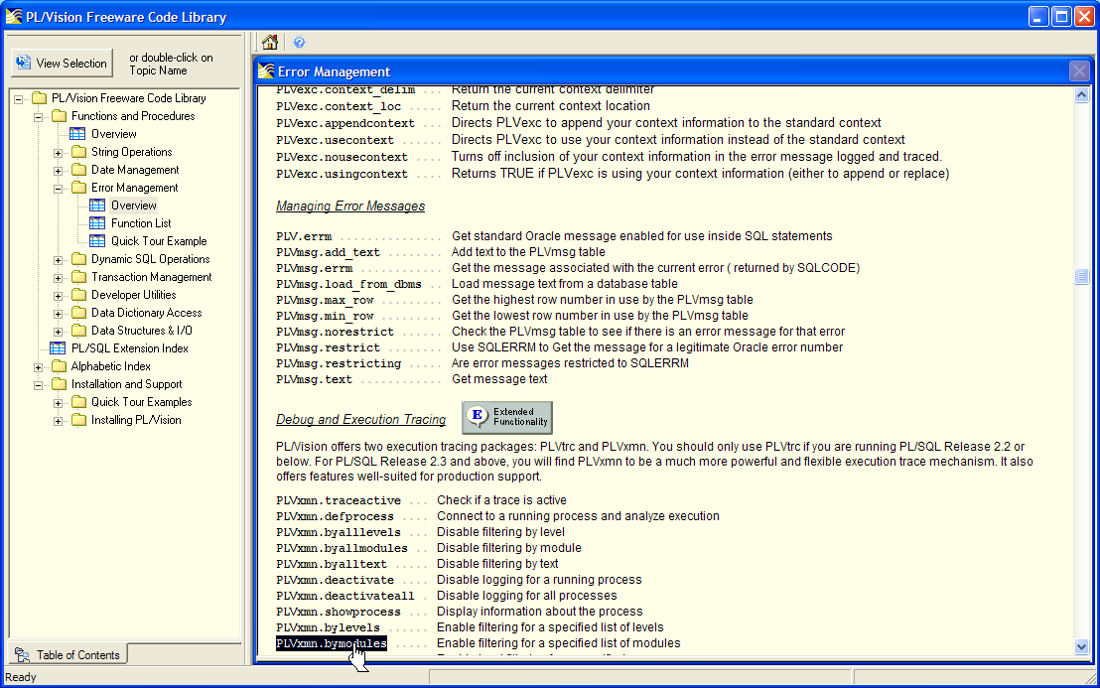
PL/Vision

Slide 27
Existing Market Survey
Retail Libraries
Quest Code Tester
PL/PDF
Open Source or Free Libraries
Quest Error Manager
utPLSQL, PLUTO, SQL Developer Testing
Log4PLSQL, OraLog, Orate
PL/FLOW
PLDoc
(more listed in the whitepaper)

Slide 28
The “Starter” Framework
Author’s free framework on SourceForge.
Existed in one form or another since 1997.
Version clock reset to v1.0 when released as open source. At 2.0 now (but 12 yrs old).
Used in telecom, not-for-profit and energy industry.
Only 2 bugs in the last 2 years. Simple and solid.
Install takes 2 minutes.
Can pick and choose some components.

Slide 29
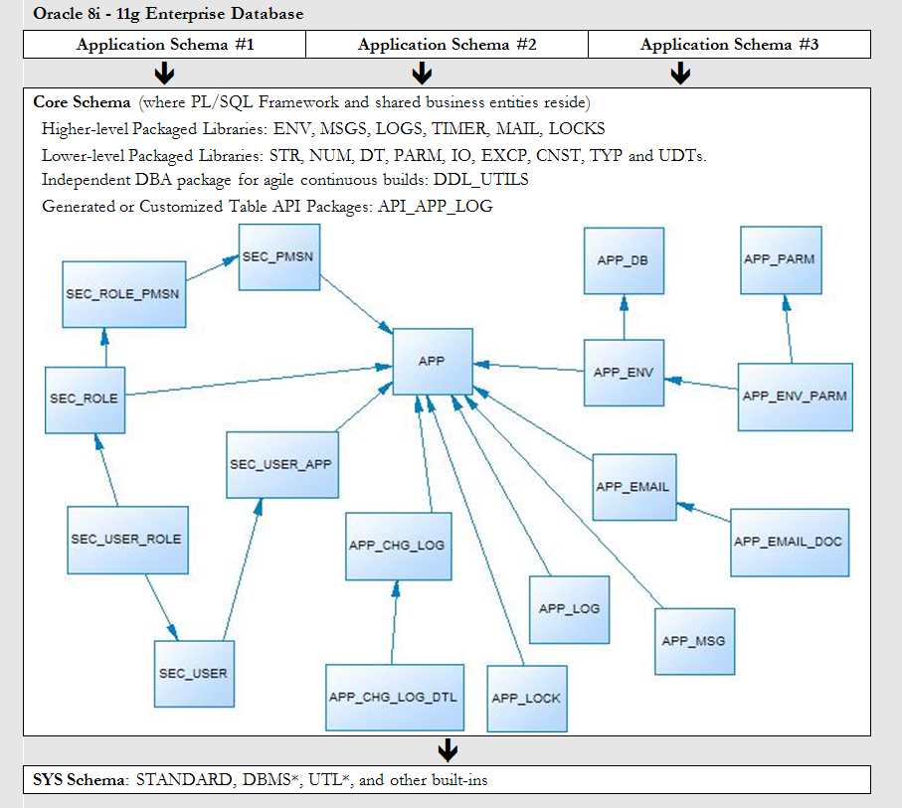
Starter Schema Model

Slide 30
Live Tour and Case Study
Install
Configure
Included sample application built on Starter:
Problem/Solution Repository
Side-by-Side Development Simulation
Problem/Solution Report with File and Email Capability

Slide 31
Simulation: Requirements
Director wants new backend report that reads the problem/solution repository, writes the results to a file, and emails the results.
File name & email subject contain today’s date.
Both should have a header with today’s date.
Report should show the problem metadata, then the solution below that.
Report should be robust, use exception handling for IO and SMTP problems, use standardized error messages, and include debugging and performance capture ability.
Email To static in Prod, dynamic in lower DBs.

Slide 32
Simulation: Actors
“Sam”
Decides to test out a framework for its promised development speed, robustness, and higher-quality deliverables.
“Arty”
Arty scoffs at the research and prototyping he perceives as wasted time. Arty prides himself on “getting the job done”. He will write the report using his typical one-off, design-on-the-fly approach.
Having studied this paper and the Starter framework, Sam challenges him, and asks the manager to compare results.
(See reports1.sql (Arty’s) and reports2.sql (Sam’s) in Starter’s SampleApps\ProblemSolution folder if you wish to compile the code which now follows...)

Slide 33
Simulation: Arty’s Solution
CREATE TABLE sol_log( log_ts TIMESTAMP NOT NULL ,log_msg VARCHAR2(4000) NOT NULL ,log_src VARCHAR2(128) NOT NULL ) / CREATE OR REPLACE PROCEDURE log_msg ( i_msg IN VARCHAR2, i_msg_src IN VARCHAR2 DEFAULT NULL ) AS PRAGMA AUTONOMOUS_TRANSACTION; BEGIN INSERT INTO sol_log (log_ts ,log_msg ,log_src) VALUES (SYSTIMESTAMP ,i_msg ,NVL(i_msg_src, 'Unknown')); COMMIT; END log_msg; / | Extra moving parts introduced here. The new logging table and logging proc are hasty one-off solutions that don’t take the enterprise’s best interests into account. New logging table missing index on timestamp and source. Default NULL. Would be better to know where every message came from. Ah, the ubiquitous “Unknown” default. That doesn’t help much.

Slide 34
Simulation: Arty’s Solution
CREATE OR REPLACE PROCEDURE print_send_ps_db ( i_email_addr IN VARCHAR2 DEFAULT NULL ) AS CURSOR cur_read_ps_db IS SELECT prob_src_nm ,prob_key ,prob_key_txt ,prob_notes ,sol_notes ,seq FROM (SELECT ps.prob_src_id ,ps.prob_src_nm ,p.prob_key ,p.prob_key_txt ,p.prob_notes ,ROW_NUMBER() OVER( PARTITION BY s.prob_id ORDER BY s.sol_id) AS seq ,s.sol_notes FROM ps_prob p JOIN ps_prob_src ps ON ps.prob_src_id = p.prob_src_id JOIN ps_sol s ON s.prob_id = p.prob_id) ORDER BY prob_src_id ,prob_key ,seq; | Arty used to writing quick and dirty procedures, instead of trying to organize, group or modularize anything. Isolated a potentially shareable query here. Could have placed behind package proc or in package spec as cursor for re-use.

Slide 35
Simulation: Arty’s Solution
file_rec utl_file.file_type; marker VARCHAR2(40); -- for debugging only idx INTEGER := 0; filename VARCHAR2(128) := 'ps_db_list_'|| TO_CHAR(SYSDATE,'YYYYMMDD')||'.txt'; file_err_msg VARCHAR2(256) := 'Unexpected error with UTL_FILE ops after marker @marker@ in print_send_ps_db.'; -- email variables email_body CLOB := EMPTY_CLOB(); db_name VARCHAR2(10); to_addr VARCHAR2(80); subj_hdr VARCHAR2(100); -- performance test variables begin_time NUMBER; end_time NUMBER; PROCEDURE handle_line(i_line IN VARCHAR2) IS BEGIN utl_file.put_line(file_rec, i_line); email_body := email_body || i_line || CHR(10); END handle_line; BEGIN SELECT UPPER(name) INTO db_name FROM v$database; | Declared a dozen variables to meet the proc’s requirements. OK, but immediately tells me the proc does too much. Poor man’s “marker” variable for dbms_output debugging. File_err_msg not really a standardized message as the requirements called for. Isolated here and not re-usable. This is good. Factored out the repetitive work and ensured that processing of the cursor only had to happen once. Hmm. Call to v$database belongs in its own routine. Remembering to wrap with UPPER good, but what if he forgets sometimes?

Slide 36
Simulation: Arty’s Solution
IF (i_email_addr IS NULL AND db_name <> 'MY10G') THEN log_msg('Error: NULL i_email_addr passed to print_send_ps_db. Destination address should be identified.'); RAISE_APPLICATION_ERROR(-20001,'Parameter i_email_addr is empty. Please pass the desired destination of the emailed report.'); END IF; -- Remove prior file run on same day -- BEGIN -- utl_file.fremove('CORE_DIR', filename); -- EXCEPTION -- WHEN utl_file.invalid_operation THEN -- log_msg('ERROR: Cannot remove file '||filename); -- END; begin_time := dbms_utility.get_time; marker := 'fopen'; file_rec := utl_file.fopen('CORE_DIR', filename, 'W', 32767); | Good. Checking condition. But presence of RAISE_APPLICATION_ERROR screams for exception-handling standard. Looks like Arty had some trouble with W and A file modes. Would be better if file ops were standardized in common package so he doesn’t have to think about this stuff and learn by trial and error. Directory hard-coded

Slide 37
Simulation: Arty’s Solution
-- Read entire Problem/Solution database FOR l_rec IN cur_read_ps_db LOOP idx := idx + 1; -- Write each problem and its possible solutions to a file -- check to ensure file is open and handle is valid BEGIN marker := 'is_open'; IF (utl_file.is_open(file_rec)) THEN -- write to file and email body at the same time marker := 'put_line'; IF (idx = 1) THEN -- report header handle_line('********************************************************************************'); handle_line(' Printout of the Problem/Solution Database'); handle_line(' '||TO_CHAR(SYSDATE, 'YYYY Month DD')); handle_line('********************************************************************************'||CHR(10)); END IF; handle_line('Type [' || l_rec.prob_src_nm || '] Key [' || l_rec.prob_key || '] Error [' || l_rec.prob_key_txt || ']'); handle_line('Comments:'); handle_line(CHR(9) || l_rec.prob_notes); handle_line('Solution #'||l_rec.seq||':'); handle_line(CHR(9) || l_rec.sol_notes || CHR(10)); handle_line('--------------------------------------------'); ELSE RAISE utl_file.invalid_filehandle; END IF; EXCEPTION WHEN OTHERS THEN RAISE_APPLICATION_ERROR(-20001, REPLACE(file_err_msg,'@marker@',marker)); log_msg(REPLACE(file_err_msg,'@marker@',marker), 'print_send_ps_db'); END; END LOOP; | Questionable whether this is necessary, especially on every iteration. Manually named markers are better than numeric, but still prone to copy-paste errors. Divider string should be standardized, placed in a Reports or Strings or Constants package spec for re-use. WHEN OTHERS is generally a bad idea. Although this captures all unexpected, it masks the real error and source of it. Better to have common approach in re-usable package to trap and handle all the known UTL_FILE exceptions. Proc name hard-coded, which can change and get out of sync.

Slide 38
Case: Arty’s Solution
BEGIN -- Now we are done writing lines, flush buffer (so line can be read immediately) and close file marker := 'fflush'; utl_file.fflush(file_rec); marker := 'fclose'; utl_file.fclose(file_rec); EXCEPTION WHEN OTHERS THEN RAISE_APPLICATION_ERROR(-20001, REPLACE(file_err_msg,'@marker@',marker)); log_msg(REPLACE(file_err_msg,'@marker@',marker), 'print_send_ps_db'); END; end_time := dbms_utility.get_time; log_msg('Reading table and writing to file took '|| ROUND((end_time - begin_time),2)||' seconds.'); | Comments are good, but if the comments or markers aren’t logged during processing in chronological order for debugging, has the requirement been met? Again with the WHEN OTHERS headache-waiting-to-happen. Bug. Arty’s unit test (if any) must have missed that times from dbms_utility must be divided by 100 to represent seconds.

Slide 39
Simulation: Arty’s Solution
begin_time := dbms_utility.get_time; -- Send the file to my phone if in Production, otherwise to my email address IF (db_name <> 'MY10G') THEN to_addr := i_email_addr; subj_hdr := 'Unit Test Report: '; ELSIF (db_name = 'MY10G') THEN to_addr := 'bcoulam@boguscompany.com'; subj_hdr := 'Production Report: '; END IF; -- This line requires that UTL_MAIL be installed (run $ORACLE_HOME/rdbms/admin/utlmail.sql and prvtmail.plb) -- and that your SMTP host be placed in the database init parameters, as in: -- ALTER SYSTEM SET smtp_out_server='smtp.yourdomain.com' SCOPE=SPFILE; -- Finally one must grant execute on UTL_MAIL to the schema housing this proc. UTL_MAIL.send(sender => 'oracle@'||db_name||'.net', recipients => to_addr, subject => subj_hdr||filename, message => email_body); end_time := dbms_utility.get_time; log_msg('Sending email took '|| ROUND((end_time - begin_time),2)||' seconds.'); END print_send_ps_db; / | Huh? Might have been Arty’s phone and email during dev, but not in production surely. Better to write re-usable, modular component that is self-documenting. Hard-coded DB names is a bug waiting to happen. Better to put the director’s address in an application property or use a distribution list in case the people behind the role change. Arty had to install UTL_MAIL to get this working. Interface is clean, but still better to encapsulate in a wrapper package, just in case the implementation of emailing from within the database ever had to change (as it has three times since 8i). Would be better if sender were stored in an application property in a table, or derived in a re-usable function, not one-off hard-coded as a literal here. Bug. See above. Must divide by 100.

Slide 40
Simulation: Arty’s Solution
Arty’s solution works, but because he had to re-familiarize himself with UTL_FILE, CLOB initialization, DBMS_UTILITY and install and learn UTL_MAIL, there were issues and it took over ten iterations before all the initial bugs were worked out.
Despite Arty’s demonstrated competence, this 185 line solution took Arty almost 4 hours to work through the kinks and deliver.
He had to introduce 2 new moving parts with no plan for re-use or maintenance, and due to poor debuggability and lack of standardized messages, it did not meet 100% of the requirements.
He’s been writing PL/SQL for a while. But Arty hasn’t taken the time to change his habits and start applying software best practices, like Don’t Hardcode, Don’t Repeat Yourself and Simple Routines. This opens up his work for all sorts of bugs, some of them obvious, some of them lurking. His solution is a bit fragile. It takes some time to digest and understand.

Slide 41
Simulation: Sam’s Solution
INSERT INTO app_msg VALUES ( app_msg_seq.nextval, env.get_app_id('PSOL'), 'Missing Parameter' ,'The call to @1@ was missing a value for parameter @2@. Please correct and re-try.' ,NULL, NULL ); COMMIT; CREATE OR REPLACE PACKAGE reports AS rpt_div_line CONSTANT VARCHAR2(80) := RPAD('*',80,'*'); -- Pass an email address if on non-Prod PROCEDURE print_and_send_ps(i_email_addr IN VARCHAR2 DEFAULT NULL); END reports; / CREATE OR REPLACE PACKAGE BODY reports AS PROCEDURE print_and_send_ps ( i_email_addr IN VARCHAR2 DEFAULT NULL ) IS | He adds a standardized message for the parameter-checking assertion. No need for a message about the file –handling errors; that is all encapsulated in the IO framework package. This message can now be re-used for all future routines in the Problem/Solution application that are missing expected parameters. Sam chose to use a package. Great idea. Among other benefits, now there is a public place to put re-usable things for reporting, like the 80-char * divider line.

Slide 42
Simulation: Sam’s Solution
PROCEDURE print_and_send_ps ( i_email_addr IN VARCHAR2 DEFAULT NULL ) IS l_lines typ.tas_maxvc2; l_email CLOB := EMPTY_CLOB(); l_filename VARCHAR2(128) := 'rpt_probsol_'||TO_CHAR(SYSDATE,'YYYYMMDD')||'.txt'; PROCEDURE handle_line(i_line IN VARCHAR2) IS BEGIN l_lines(l_lines.COUNT+1) := i_line; l_email := l_email || i_line || CHR(10); END handle_line; BEGIN excp.assert((env.get_env_nm <> 'ProbSol Prod' AND i_email_addr IS NOT NULL) OR env.get_env_nm = 'ProbSol Prod', msgs.fill_msg('Missing Parameter', env.who_am_i, 'i_email_addr'), TRUE); timer.startme('read_db_write_file'); | Most of the variables required for these complex IO and email operations are contained in the framework package. Sam only needs 3 new variables to complete the job. Sam also encapsulates the repetitive line-handling like Arty. Good. Assertion routine handles much for Sam so he doesn’t have to worry about it, like re-raising the exception after logging the message to desired output targets (default is table and screen). Uses standard error message too. Standardized timing mechanism. Can have multiple and nested timers within the same session.

Slide 43
Simulation: Sam’s Solution
PROCEDURE print_and_send_ps ( i_email_addr IN VARCHAR2 DEFAULT NULL ) IS l_lines typ.tas_maxvc2; l_email CLOB := EMPTY_CLOB(); l_filename VARCHAR2(128) := 'rpt_probsol_'||TO_CHAR(SYSDATE,'YYYYMMDD')||'.txt'; PROCEDURE handle_line(i_line IN VARCHAR2) IS BEGIN l_lines(l_lines.COUNT+1) := i_line; l_email := l_email || i_line || CHR(10); END handle_line; BEGIN excp.assert((env.get_env_nm <> 'ProbSol Prod' AND i_email_addr IS NOT NULL) OR env.get_env_nm = 'ProbSol Prod', msgs.fill_msg('Missing Parameter', env.who_am_i, 'i_email_addr'), TRUE); timer.startme('read_db_write_file'); logs.dbg('Checking for file '||l_filename); IF (io.file_exists(l_filename)) THEN logs.dbg('Deleting file '||l_filename); io.delete_file(l_filename); END IF; | Most of the variables required for these complex IO and email operations are contained in the framework package. Sam only needs 3 new variables to complete the job. Sam also encapsulates the repetitive line-handling like Arty. Good. Assertion routine handles much for Sam so he doesn’t have to worry about it, like re-raising the exception after logging the message to desired output targets (default is table and screen). Uses standard error message too. Standardized timing mechanism. Can have multiple and nested timers within the same session. logs.dbg annotates the code and offers debug trail. Automatically logs caller and line number, so no need to hard-code or pass parameter. Extra features offered in IO package inspired Sam to make his routine even more robust, ensuring older runs are cleaned up.

Slide 44
Simulation: Sam’s Solution
logs.dbg('Reading and storing all problem/solution rows'); FOR l_rec IN ps_dml.cur_read_ps_db LOOP IF (l_lines.COUNT = 0) THEN -- Add header handle_line(str.ctr(RPT_DIV_LINE)); handle_line(str.ctr('Printout of the Problem/Solution Database')); handle_line(str.ctr(TO_CHAR(SYSDATE, 'YYYY Month DD'))); handle_line(str.ctr(RPT_DIV_LINE) ||CHR(10)); END IF; handle_line('Type [' || l_rec.prob_src_nm || '] Key [' || l_rec.prob_key || '] Error [' || l_rec.prob_key_txt || ']'); handle_line('Comments:'); handle_line(CHR(9) || l_rec.prob_notes); handle_line('Solution #'||l_rec.seq||':'); handle_line(CHR(9) || l_rec.sol_notes || CHR(10)); handle_line('--------------------------------------------'); END LOOP; logs.dbg('Writing '||l_lines.COUNT||' to file '||l_filename); io.write_lines(i_msgs => l_lines, i_file_nm => l_filename); timer.stopme('read_db_write_file'); logs.info('Reading DB and writing file took '|| timer.elapsed('read_db_write_file')||' seconds.'); | Because Sam took his time to think, he put the report’s query in a public cursor in the PS_DML package. This shortened his code and centralized a useful piece of logic. Using constant instead of literal for divider. Nice. If it ever changes, only one line has to change, not every line that copied the literal over the years. This part is the same as Arty’s solution, but overall the loop is much shorter and less complex. One line to write the entire report. Sweet. Directory defaults to configurable application property in APP_ENV_PARM. File mode defaults. logs.info not dynamic like logs.dbg. This note goes into APP_LOG permanently.

Slide 45
Simulation: Sam’s Solution
timer.startme('write_email'); logs.dbg('Sending report to director if in Production, otherwise to given email address'); mail.send_mail(i_email_to => i_email_addr, i_email_subject => l_filename, i_email_body => l_email, i_env_list => 'ProbSol Dev, ProbSol Test'); mail.send_mail(i_email_to => 'bcoulam@boguscompany.com', i_email_subject => l_filename, i_email_body => l_email, i_env_list => 'ProbSol Prod'); timer.stopme('write_email'); logs.info('Writing email took '||timer.elapsed('write_email')||' seconds.'); END print_and_send_ps; END reports; / | Encapsulated and tested timing mechanism correctly handles the division by 100 that Arty missed. This ability to tie email targets to different destinations based on the framework’s ability to transparently detect the DB and environment it is running from is nice. Avoids hard-coding to names that can and do change over time. If implementation of the mail send is ever changed under the cover, no dependent code has to change. Ideally though, this routine would not do two things (file and email). It should break the email feature into a separate routine of the reports package, possibly modified to be more re-useable by other reports.

Slide 46
Simulation: Sam’s Solution
Even as a novice to the framework, once Sam had the proper metadata in the APP_ENV, APP_ENV_PARM and APP_MSG table, everything else was handled for him. He just had to plug pieces in and type in parameter values.
Sam only had one bug to iron out, and then it compiled and worked. His solution took 50% less code, met 100% of the requirements, is bug-free, and is at least 300% more clean, robust, maintainable and readable.
Best of all, it only took Sam a little over 1 hour to complete his version. Thus it took 25% of the time to obtain 3 to 4-fold better code.
The manager was hooked. Sam was given development lead position. Arty was sent to mandatory pragmatic programmer training and assigned a slew of work when he returned to refactor years of cobbled-together junk code.

Slide 47
Conclusion
Frameworks and reusable models are essential to application architecture.
“Starter” is a good model for features every custom Oracle application needs.
Frameworks and reusable models jumpstart new projects, saving weeks to months of risky wheel-reinventing.
Develop 3X better systems in at most half the time.
Take back your life and free time.

Slide 48
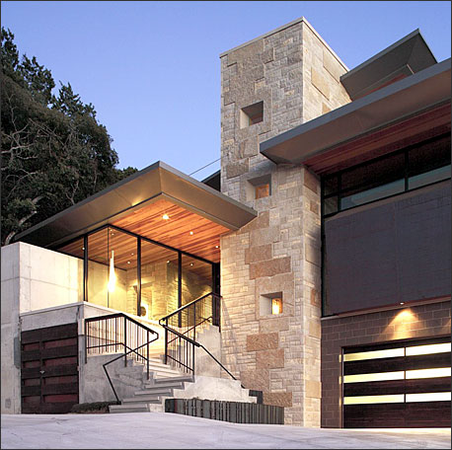
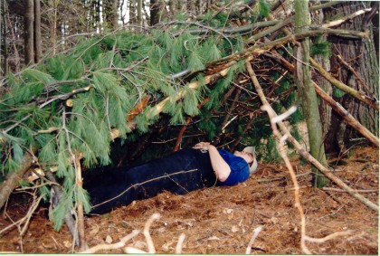
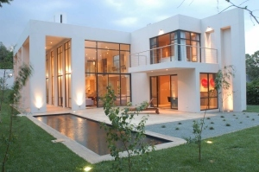
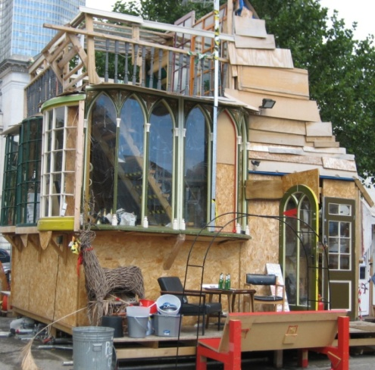
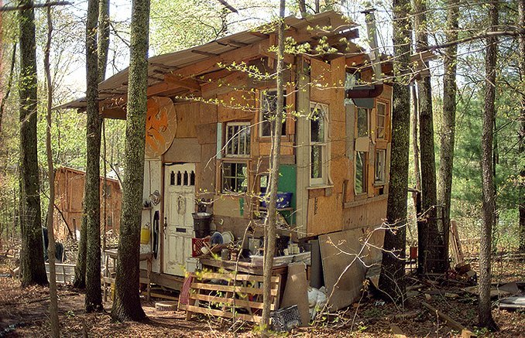
Your Design Legacy
OR

Slide 49
Contact Info:
Bill Coulam
2-8227
CoulamWA@ldschurch.org
If interested, download PL/SQL Starter from:
www.dbartisans.com
sourceforge.net/projects/plsqlframestart
sourceforge.net/projects/plsqlstarter (Soon)
Questions?

