Slide 1
PL/SQL
From Newbie to Knowledgeable
©DBArtisans 2015

Slide 2
The Author/Speaker
Contacts
Website: dbartisans.com
Twitter: @billcoulam
Email: bill.coulam@dbartisans.com
LinkedIn: billcoulam
Experience and Focus
C, C++, Java, JavaScript and PL/SQL since 1995
Oracle data/database design and tuning since 1997
Passionate about best programming/design practices
Andersen Consulting - San Francisco, Denver, Herndon VA
New Global Telecom - Denver, CO
The Structure Group - Houston, TX
Church of Jesus Christ of Latter Day Saints - SLC, UT
Speaker at RMOUG, IOUG, ODTUG and UTOUG since 2001
Notes:
Speaking at ODTUG this year

Slide 3
The Goal
Make you aware of most PL/SQL key terms, concepts and features.
Whet your appetite for more and provide code samples, links and resources to learn in-depth on your own.
Part 1: Familiarity with the fundamentals.
Part 2: Exposure to enterprise-grade PL/SQL and database development best practices.

Slide 4
Conventions Used
COURIER NEW: Bold = Required syntax text
Courier New: Italics = Replace this with own identifier/expression
{Courier New}: Curly Brace: Required code with options
[Courier New]: Square Brackets: Optional code
Word#: See slide notes for comment, caveat, or further info
Word: Current topic of focus
Word: Hyperlink to Oracle Docs or other resource
Word: Significant point for the slide
Word: Outside of presentation/slide scope.
Word: Golden advice. Hard-won wisdom. Best practice.

Slide 5
Conventions Used
The meaning behind some code being colored and boxed, and other examples with only a white background.
Code you can copy/paste and run. Run them in the order they are presented. They build on each other. | Code snippets and other non-running examples
Expected output

Slide 6
PL/SQL History
Introduced in Oracle 6
PL/SQL 2.0 in Oracle 7, 2.2 in 7.2, 2.3 in 7.3
PL/SQL versions now match Oracle DB release
Version 8.1 really bulked up on features
Version 9.2 brought it to completeness
Versions 10, 11 & 12 each added a handful of long-awaited improvements

Slide 7
PL/SQL in Other Databases
Times-Ten In-Memory (Oracle 11.2.1)
Native support in IBM’s DB2 9.7
Imitated in PostgreSQL* (pgplsql)
MySQL compatibility someday?
  MySQL already supports triggers and stored routines
Notes:
T-SQL in SQL Server is similar in purpose but has nowhere near the functionality.

Slide 8
PL/SQL
Based on ADA (and its ancestor Pascal)
Interpreted 3GL language
Has Object-Oriented features

Slide 9
PL/SQL Pluses
Very easy to use SQL and process SQL results
Keep SQL where it belongs (in the DB near the data)
ETL-friendly
Agility when changing app development language/frameworks
Continuous and easy deployment
Speed and efficiency
Set (bulk) transactions and processing
Row-by-row business logic processing when necessary
Many features dedicated to high-grade security
Aids in abstraction and de-coupling
Modularize and publish common, reusable business/data logic
Automation of routine data-centric tasks
Easy to audit, instrument, monitor and tune
Perfect choice for a RESTful data service layer
Very stable and works cross-platform (write-once, run anywhere [Oracle runs])

Slide 10
PL/SQL Minuses
Most detractors do not understand PL/SQL or have never seen it used well.
The only valid arguments I’ve seen:
Lack of PL/SQL talent pool
Inability to port PL/SQL logic from one database to another¹
Notes:
1: It does happen, but applications rarely switch databases.

Slide 11
Lesson Plan
Part 1
PL/SQL Resources
Dev Environment
Blocks & Execution
Data Types
Language Fundamentals
Control Statements
Static SQL
Dynamic SQL
Stored PL/SQL
Built-ins
Part 2
Composite Data Types
Bulk Processing
Exceptions
Data Abstraction
Code Org & DevOps
Compilation & Debug
Instrumentation
Security
Libraries
Templates & Tools

Slide 12
PL/SQL Resources
Give a man a fish, and you'll feed him for a day; give him a religion, and he'll starve to death while praying for a fish. (Unknown)
Give a man a fish, and he can eat for a day. But teach a man how to fish, and he'll be dead of mercury poisoning inside of three years. (Charles Haas)
There's a fine line between fishing and just standing on the shore like an idiot. (Steven Wright)
Give a man a fish and you feed him for a day. Teach him how to fish and you feed him for a lifetime. (Lao Tzu)
In 2 hours, this session can only unwrap the first layer of PL/SQL programming knowledge. But if you become familiar with the following resources, you’ll know where to get answers to the questions you have yet to ask.
Notes:
Wanted to share an old Chinese proverb about just giving you fish, vs. teaching you how to fish. Had a little trouble to begin with, but found that the wrong quotes were amusing enough to share.

Slide 13
PL/SQL Resources
Oracle 12c PL/SQL Language Reference
Oracle 12c SQL Language Reference
Oracle 11gR2 PL/SQL Language Reference
Oracle 10gR2 PL/SQL Language Reference
Feuerstein’s PL/SQL 101 Series
Oracle-Base
Ask-Tom
Oracle’s OTN PL/SQL Community
...and Google of course
Notes:
All of these links have been tested. These have been the most useful resources for me in recent years.

Slide 14
PL/SQL Resources
LiveSQL
  Learn and share SQL and PL/SQL
  Write and run code in browser
  Virtual Oracle Database, schema and session
Oracle Database Express Edition
  Write and run code on your own Oracle database
Best PL/SQL Books on Amazon
Practically Perfect PL/SQL on YouTube
Notes:
Bryn Llewellyn’s OOW 2015 talk on “Why use PL/SQL” is a fresh look at the benefits of application development with Oracle and PL/SQL
“Oracle PL/SQL Best Practices” by Steven Feuerstein is a concise, practical book. Recommended.

Slide 15
Lesson Plan
PL/SQL Resources
Dev Environment
Blocks & Execution
Data Types
Language Fundamentals
Control Statements
Static SQL
Dynamic SQL
Stored PL/SQL
Built-ins
Composite Data Types
Bulk Processing
Exceptions
Data Abstraction
Code Org & DevOps
Compilation & Debug
Instrumentation
Security
Libraries
Templates & Tools

Slide 16
Dev Environment
PL/SQL runs inside the database. At a minimum, you will need an application/editor/IDE¹ that lets you:
write, save and edit SQL and PL/SQL
submit SQL & PL/SQL to the database for compilation, storage and execution
read and format data returned by SQL & PL/SQL
debug PL/SQL programs
Notes:
1: Most PL/SQL IDEs come with many more features, many of them essential, like code highlighting and formatting, pl/sql profiler and trace and explain plan interfaces, database compare and find tools, source code control system interface, etc.

Slide 17
Dev Environment: Dev Client
SQL*Plus (free)
LiveSQL (free)
SQLcl (free)
SQL Developer¹ (free)
PL/SQL Developer (great value)
TOAD
Rapid SQL
AquaData Studio
SQL Detective
Notes:
1: Years ago there were many more IDE vendors, but Oracle’s free offering, SQL Developer, is good enough now that it has supplanted most of them. The fact that it runs on linux, Mac OS and Windows is icing on the cake. AquaData Studio is the only other desktop client I know of that is cross-platform. Toad has a Mac version, and can run on Linux through Wine.

Slide 18
Dev Environment: Oracle Client
Database developer tools require the ability to connect to and talk with Oracle.
Some require the “thick” or OCI driver
Others can optionally use the “thin” driver
Oracle Client downloads come with both drivers
Match 32bit/64bit client with your OS and dev tool

Slide 19
Dev Environment: Oracle Client
Download and install an Oracle Client before attempting to connect your dev tool to the Oracle database.
Oracle InstantClient - small and easy
  Unzip download file to C:\oracle\instantclient
  Add C:\oracle\instantclient to PATH env var
  Optionally create TNS_ADMIN env var. Point to location of sqlnet.ora file.
Oracle “fat” client - big installer
  Standalone client download: 32-bit or 64-bit
  Also comes with Oracle XE, SE, SE1, PE, or EE

Slide 20
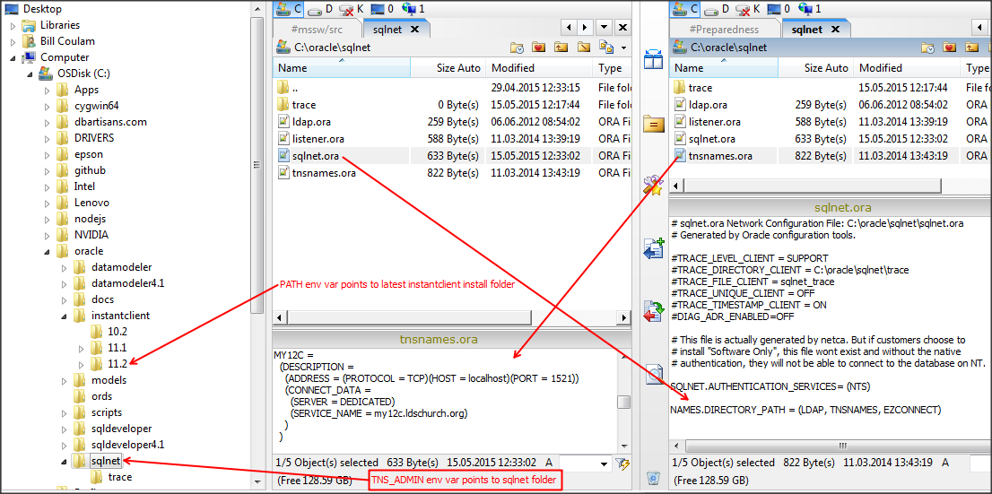
Dev Environment: InstantClient
This is what my directory looks like.
sqlnet.ora tells client which naming method to prefer.
tnsnames.ora points to a local Oracle DB named MY12C:
So… PATH=...;C:\oracle\instantclient\11.2;...
TNS_ADMIN=C:\oracle\sqlnet

Slide 21
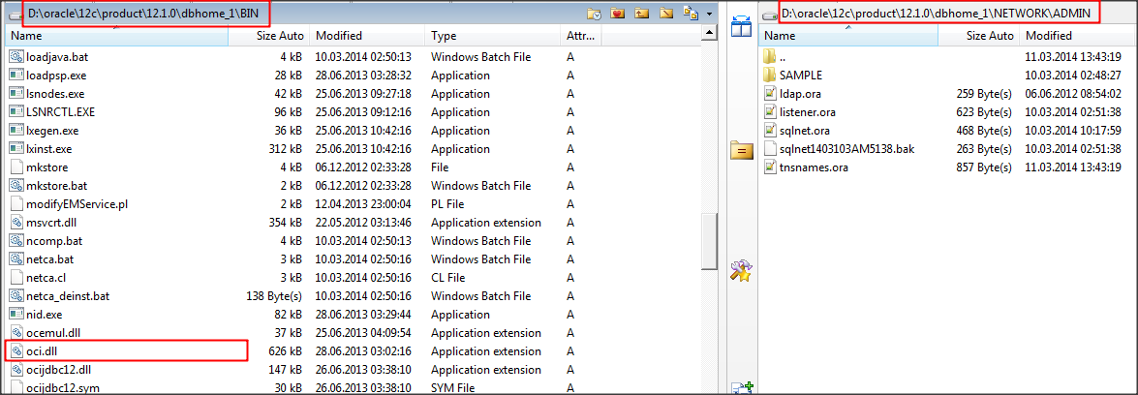
Dev Environment: “Fat” Client
I have 12c EE installed on my laptop on the D: drive.
So… PATH = …; D:\oracle\12c\product\12.1.0\dbhome_1\bin;...
TNS_ADMIN=D:\oracle\12c\product\12.1.0\dbhome_1\NETWORK\ADMIN

Slide 22
Dev Environment: Database
Lastly, a database and database account are needed to store and execute the PL/SQL routines.
Database
Easy (free): Use LiveSQL or employer’s DB
Easy (near free): Amazon AWS (7¢/hr)
Novice: Install Oracle Database Express Edition
Intermediate: Install Oracle 12c or 11gR2
Account
Oracle account = Oracle user = Oracle schema

Slide 23
Lesson Plan
PL/SQL Resources
Dev Environment
Blocks & Execution
Data Types
Language Fundamentals
Control Statements
Static SQL
Dynamic SQL
Stored PL/SQL
Built-ins
Collections
Bulk Processing
Exceptions
Data Abstraction
Code Org & DevOps
Compilation & Debug
Instrumentation
Security
Libraries
Templates & Tools

Slide 24
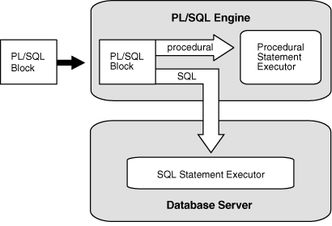
Execution
The database’s PL/SQL “engine” accepts and processes PL/SQL statements. SQL statements inside the PL/SQL are handed off to the SQL statement executor in the database.

Slide 25
Execution: Hello World
Let’s write and execute the “Hello World” program in PL/SQL and run it in SQL*Plus.
SET SERVEROUTPUT ON
BEGIN
dbms_output.put_line('Hello World!');
END;
/
Program
Connected to Oracle Database 12c Enterprise Edition Release 12.1.0.1.0
Connected as core@pdbcore
SQL>
Hello World!
Output

Slide 26
Blocks
Looking at our Hello World again...
Needed by SQL*Plus to display output from buffer
SET SERVEROUTPUT ON
BEGIN
dbms_output.put_line('Hello World!');
END;
/
Unless named and stored in the database, the block is known as an “anonymous” block.
Packaged routine
Built-in PL/SQL package
The SQL*Plus “run” character

Slide 27
Blocks: Structure
Blocks are the fundamental units of PL/SQL programs.
There is an optional declaration section
An executable section
And on optional exception section
DECLARE
-- optional declarations
BEGIN
-- at least one statement
EXCEPTION
-- optional handlers
END;

Slide 28
Blocks: Nesting
Blocks can be nested. Scope will be covered later.
Here is an example¹ of multiple levels of nesting.
Overall anonymous block
Declare a named inner block to print text sent in the “i_word” parameter.
Another inner block to end a line and send it to the output buffer.
SET SERVEROUTPUT ON
DECLARE
PROCEDURE print_word (
i_word IN VARCHAR2,
i_end IN BOOLEAN DEFAULT FALSE
) IS
PROCEDURE end_sentence IS
BEGIN
dbms_output.new_line;
END end_sentence;
BEGIN
dbms_output.put(i_word);
IF (i_end) THEN
end_sentence;
END IF;
END print_word;
BEGIN
print_word('Hello ');
print_word('World!', TRUE);
END;
/
SQL>
Hello World!
Notes:
1: It’s not great coding, just a demonstration.

Slide 29
Blocks: Nesting
Overall anonymous block
Inner anonymous block to prevent an exception being raised
Block nesting and an exception handler are needed when processing must continue instead of halting.
SET SERVEROUTPUT ON
DECLARE
l_account_holder fin_account.account_holder%TYPE;
BEGIN
BEGIN
SELECT account_holder
INTO l_account_holder
FROM fin_account
WHERE account_id = &i_acct;
EXCEPTION
WHEN NO_DATA_FOUND THEN
dbms_output.put_line('Account ID '||
TO_CHAR(i_acct)||' is not a valid account.');
END;
-- do more processing after obtaining holder
END;
/

Slide 30
dbms_output.put_line() replacement
That’s a long routine to call. To conserve visual real-estate in the examples in this presentation, compile the following procedure in your account.
CREATE OR REPLACE PROCEDURE pr(i_str IN VARCHAR2) IS
BEGIN
dbms_output.put_line(i_str);
END pr;
/
SQL>
Procedure created

Slide 31
Lesson Plan
PL/SQL Resources
Dev Environment
Blocks & Execution
Data Types
Language Fundamentals
Control Statements
Static SQL
Dynamic SQL
Stored PL/SQL
Built-ins
Composite Data Types
Bulk Processing
Exceptions
Data Abstraction
Code Org & DevOps
Compilation & Debug
Instrumentation
Security
Libraries
Templates & Tools

Slide 32
Data Types
The data type of a constant, parameter, variable or column determines:
Format of bytes (character, numeric, date, binary, etc.)
Length of bytes
Allowable operations (addition, concatenation, etc.)
Other attributes (precision, time zone, etc.)

Slide 33
Data Types
Using the correct data type is an activity of good data modeling and programming, implicitly defining an integrity constraint that helps ensure the right kind of data is used.

Slide 34
Data Types
We will cover
Scalar (Simple) Data Types (Part 1)
Composite Data Types (Part 2)

Slide 35
Data Types: Apologies
Will not have time/space to examine:
ROWID/UROWID
INTERVAL YEAR TO MONTH/DAY TO SECOND
Unicode types (NCHAR, NVARCHAR2, NCLOB)
Large Objects (CLOB, BLOB, BFILE, etc.)
RAW, LONG or LONG RAW
User-defined/Abstract/Object data types
AnyData, AnyType, AnyDataSet
Spatial, Media, Still Image or XML types
Notes:
Research these on your own.

Slide 36
Data Types: “Scalar”
SQL data types like:
  CHAR and VARCHAR2
  DATE and TIMESTAMP
  NUMBER
PL/SQL data types like:
  BINARY_INTEGER, PLS_INTEGER and SIMPLE_INTEGER
  BOOLEAN
  REF CURSOR
See this list for all datatypes defined by STANDARD

Slide 37
Data Types: Scalar SQL
SQL Datatypes...
Can be used to define table columns
Commonly used: CHAR, VARCHAR2, DATE, TIMESTAMP, NUMBER, BLOB, CLOB
Less Common: Nchar types, INTERVAL, FLOAT, BINARY_FLOAT, BINARY DOUBLE, BFILE, ROWID/UROWID, RAW, LONG, LONG RAW
ANSI Subtypes like INTEGER, REAL, DECIMAL, etc.
User-defined Types
Oracle-supplied: SYS.Any* types, XMLType, URIType, Spatial types, Media types

Slide 38
Data Types: Scalar PL/SQL
PL/SQL Datatypes...
PL/SQL-only: BOOLEAN, BINARY_INTEGER, PLS_INTEGER, SIMPLE_INTEGER, REF CURSOR, and User-defined Subtypes
Cannot be used to define table columns
Visit the PL/SQL Ref Appendix E for the full list
You may use all of the SQL data types within PL/SQL as well

Slide 39
Data Types: Scalar Differences
Because PL/SQL lets you work so seamlessly with SQL and database objects, it is important to realize that there are slight differences between SQL and PL/SQL character datatypes of the same name.
Data Type | PL/SQL | SQL
CHAR | Y, max 32K | Y, max 2000
VARCHAR2 | Y, max 32K | Y, max 4000 (32K in 12c¹)
NUMBER | Y | Y
DATE TIMESTAMP | Y | Y
BINARY_INTEGER PLS_INTEGER SIMPLE_INTEGER | Y | N
Boolean | Y | N
REF CURSOR | Y | N
Notes:
1: 32K VARCHAR2 in 12c is true if DB has been bounced with init parameter MAX_STRING_SIZE = EXTENDED

Slide 40
Data Types: CHAR
The CHAR data type specifies a fixed-length character string.
  Value is blank-padded until it matches the declared CHAR length.
CHAR(5) := 'CAT' is actually 'CAT '
This makes the fixed-width CHAR (and related subtypes) of little use except for old-style ETL processes.
Notes:
Oracle offers the synonymous CHARACTER [VARYING] subtype.

Slide 41
Data Types: CHAR
SET SERVEROUTPUT ON
DECLARE
l_mma_style CHAR(10) := 'Hapkido';
BEGIN
pr('l_mma_style: value ['||l_mma_style||']'||
' length ['||LENGTH(l_mma_style)||']');
END;
/
SQL>
l_mma_style: value [Hapkido ] length [10]

Slide 42
Data Types: VARCHAR2
The VARCHAR2 data type specifies a varying-length character string.
Character values are stored as-is without alteration.
The length of the item matches the length of the characters stored within¹, not the declared length.
VARCHAR2(50) := 'CAT' is 'CAT'
Notes:
Oracle offers the synonymous VARCHAR and STRING subtypes as well.
1: If you will be storing multi-byte characters in a char or varchar2, be sure to declare the length with character semantics, CHAR(10 CHAR). See the Globalization Guide for multi-lingual and international considerations.

Slide 43
Data Types: VARCHAR2
SET SERVEROUTPUT ON
DECLARE
l_mma_style VARCHAR2(10) := 'Hapkido';
BEGIN
pr('l_mma_style value: ['||l_mma_style||']'||
' length ['||LENGTH(l_mma_style)||']');
END;
/
SQL>
l_mma_style: value [Hapkido] length [7]

Slide 44
Data Types: Character Functions
Function | Used For | Example
ASCII | Get ASCII decimal code for char | ASCII('&') => 38
CHR | Get ASCII character for decimal code | CHR(38) => '&'
CONCAT or || | Join two strings together | CONCAT('A','BC') => 'ABC' 'A' || 'BC' => 'ABC'
LOWER | Lowercase the string | LOWER('KIWI') => 'kiwi'
UPPER | Uppercase the string | UPPER('Loquat') => 'LOQUAT'
INITCAP | Uppercase first char of each word | INITCAP('war and peace') => 'War And Peace'
LPAD | Add char(s) to left side | LPAD('peach',10,'*') => '*****peach'
RPAD | Add char(s) to right side | RPAD('pear',10,'_') => 'pear______'
LTRIM | Remove char(s) from left side | LTRIM('*****peach','*') => 'peach'
RTRIM | Remove chars from right side | RTRIM('pear______','_') => 'pear'
TRIM | Remove chars from one/both sides | TRIM('~' FROM '~~~CENTER~~~') => 'CENTER'
Notes:
CONCAT useful when code will be running on hosts with atypical character sets (where the pipe operator might be different for example)
Left out SOUNDEX as it is little used
Also COMPOSE, DECOMPOSE, ASCIISTR and UNISTR for dealing with unicode.
Also functions for dealing with character sets

Slide 45
Data Types: Character Functions
Function | Used For | Example
LENGTH | Get length of the string in bytes | LENGTH('1234567') => 7
REPLACE | Replace one char/set with another char/set | REPLACE(REPLACE('peteatbogusdotcom','at','@'),'dot','.') => pete@bogus.com
INSTR | Find the position of a char/set | INSTR('pete@bogus.com','@') => 5
SUBSTR | Extract portion of string | SUBSTR('pete@bogus.com',5+1) => 'bogus.com'
TRANSLATE | Replace chars per map | TRANSLATE('(801) 555-1212','x() -','x') => 8015551212
REGEXP_COUNT | Count the number of occurrences of a regex* | REGEXP_COUNT('/java/com/dbartisans','/') => 3
REGEXP_INSTR | Find position of a regex* | REGEXP_INSTR('/java/com/dbartisans','j.v.') => 2
REGEXP_REPLACE | Find and replace a regex* | REGEXP_REPLACE('/java/com/dbartisans','c.m','org') => /java/org/dbartisans
REGEXP_SUBSTR | Find and extract portion of string from matching regex* | REGEXP_SUBSTR('abc4abc0abc', '(abc)', 1, 3) => 'abc'
*Regex/Regexp means a regular expression pattern. See Oracle’s docs on POSIX regex support and its PERL extensions.
Notes:
CONCAT useful when code will be running on hosts with atypical character sets (where the pipe operator might be different for example)
Left out SOUNDEX and NLS functions as they are little used. However NLSSORT could be useful for searching and sorting with no sensitivity toward diacritical characters.

Slide 46
Data Types: DATE
Stores date and time
  Holds year, month, day, hour, minutes and seconds, each of which can be extracted.
Uses internal 7 byte binary format
Time component is always there.
  Use TRUNC when creating or comparing dates to “remove” the time¹
Valid dates range between
  Jan 1, 4712 BC to Dec 31, 9999 AD
Notes:
Literals can be Julian date values using the J format model.
1: Removing the time sets the date of the zero hour (midnight) of the date.

Slide 47
Data Types: DATE
Make a date using ANSI standard literal format
l_dt DATE := DATE '2015-12-05'; <-Dec 5 or May 12?
Make a date using default DB date format
  With NLS_DATE_FORMAT as DD-MON-RR...
l_dt DATE := '01-JAN-31'; <-Jan 1/31 1901/1931/2001/2031?
Best to always use explicit date format
  See Oracle Date format model elements
l_dt DATE := TO_DATE('2033Jan01','YYYYMonDD');
pr(TO_CHAR(l_dt,'YYYYMonDD'));
Notes:
SQL> show parameter nls_date_format

Slide 48
Data Types: DATE Functions
Function | Used For | Example
SYSDATE | Get current date and time | SELECT SYSDATE FROM dual; => 2016Jan09 12:36:17 SELECT TRUNC(SYSDATE) FROM dual; => 2016Jan09 00:00:00
ADD_MONTHS | Get same day [-]N months from date | ADD_MONTHS(TRUNC(DATE '2016-01-15'),1) => 2016Feb15 ADD_MONTHS(TRUNC(DATE '2016-01-31'),1) => 2016Feb29
MONTHS_BETWEEN | Months between two dates. Fractional value if not same day of each month. | MONTHS_BETWEEN(DATE '2016-11-01',DATE '2016-01-01') => 10
NEXT_DAY | Get date of named day following given | NEXT_DAY(DATE '2016-12-25','SAT') => 2016Dec31
LAST_DAY | Last day of the given date’s month | LAST_DAY(DATE '2016-07-04') => 2016Jul31
EXTRACT | Extract numeric year, month, day, hour, minutes, seconds from given date | EXTRACT(year FROM SYSDATE) => 2016
ROUND/TRUNC | Round or truncate a date to unit specified by the given format model. Default is day. | ROUND(SYSDATE) => 2016Jan10 00:00:00 TRUNC(SYSDATE) => 2016Jan09 00:00:00
TO_DATE | Convert a string to a DATE | TO_DATE('2033Jan01','YYYYMonDD')
TO_CHAR | Convert a DATE to a string | TO_CHAR(TO_DATE('1933Jan01','YYYYMonDD'),'YYYYMonDD')
Notes:
CURRENT_DATE and CURRENT_TIMESTAMP - session-based, not used as frequently
Fractional value from MONTHS_BETWEEN represents that portion of a 31-day month.
Note: Author’s IDE was configured to display DATE values as YYYYMonDD [HH24:MI:SS]
NEW_TIME converts a date from one time zone to another. I’ve never had to use it. EW_TIME(TO_DATE('2016Jan10 14','YYYYMonDD HH24'),'MST','HST') => 2016
Of course if date given to ROUND were before noon, it would have rounded to start of day instead of start of next day.

Slide 49
Data Types: DATE Math
See Oracle’s Datetime/Interval Arithmetic doc for the supported operations and intricacies involving timestamps, timezones and daylight savings.
Very common to do date math in business programming.
Mainly addition and subtraction of days (or portions of days).

Slide 50
Data Types: DATE Math
If less than a day, divide the operand by the units it takes to equal a day.
SET SERVEROUTPUT ON
DECLARE
l_old_dt DATE := SYSDATE;
l_new_dt DATE;
BEGIN
l_new_dt := l_old_dt + 1; -- add a day
l_new_dt := l_old_dt + (1/24); -- one hour
l_new_dt := l_old_dt + (5/1440); -- five minutes
l_new_dt := l_old_dt + (30/86400); -- 30 seconds
END;
/
SQL>

Slide 51
Data Types: DATE Math
These same math operations can be done using intervals.
SET SERVEROUTPUT ON
DECLARE
l_old_dt DATE := SYSDATE;
l_new_dt DATE;
BEGIN
l_new_dt := l_old_dt + INTERVAL '1' DAY;
l_new_dt := l_old_dt + INTERVAL '1' HOUR;
l_new_dt := l_old_dt + INTERVAL '5' MINUTE;
l_new_dt := l_old_dt + INTERVAL '30' SECOND;
END;
/
SQL>
Notes:
Cleaner and easier to read and maintain.

Slide 52
Data Types: TIMESTAMP
Stores same date and time components as DATE
  AND...fractional seconds out to 9 digits (defaults to 6).
Uses internal 11 to 13 byte binary format
Same valid date range as DATE
Works with most of the DATE functions
TIMESTAMP WITH TIME ZONE variant
TIMESTAMP WITH LOCAL TIME ZONE variant
NLS_TIMESTAMP_FORMAT parm for default fmt
New fmt modifiers: FF, TZH, TZM, TZD & TZR
Notes:
SQL> show parameter NLS_TIMESTAMP_FORMAT

Slide 53
Data Types: TIMESTAMP Functions
Additional functions available for timestamps:
DBTIMEZONE FROM_TZ LOCALTIMESTAMP ORA_DST_AFFECTED ORA_DST_CONVERT ORA_DST_ERROR | SESSIONTIMEZONE SYS_EXTRACT_UTC SYSTIMESTAMP TO_TIMESTAMP TO_TIMESTAMP_TZ TZ_OFFSET
Notes:
Some INTERVAL functions mixed in here too. Explore on your own.

Slide 54
Data Types: TIMESTAMP
SET SERVEROUTPUT ON
DECLARE
l_ts TIMESTAMP := TO_TIMESTAMP('2016Jan01 13:05:01.123456',
'YYYYMonDD HH24:MI:SSXFF6');
l_ts2 TIMESTAMP := TIMESTAMP '2006-04-06 08:20:00.1234'; -- literal
l_tstz TIMESTAMP(9) WITH TIME ZONE := SYSTIMESTAMP;
BEGIN
pr(TO_CHAR(l_ts));
pr(TO_CHAR(l_ts2));
pr(TO_CHAR(l_ts,'YYYYMonDD HH24:MI:SS.FF6 PM'));
pr(TO_CHAR(l_tstz,'YYYYMonDD HH24:MI:SS.FF9 TZH:TZM'));
END;
/
SQL>
01-JAN-16 01.05.01.123456 PM
06-APR-06 08.20.00.123400 AM
2016Jan01 13:05:01.123456 PM
2016Jan09 16:55:53.347612000 -07:00

Slide 55
Data Types: NUMBER
Oracle includes a good set of functions, types, subtypes, and features that enable just about any kind of mathematical operation.
NUMBER is the base type. It uses 1 to 22 bytes¹
Also types: BINARY_FLOAT & BINARY_DOUBLE
Also subtypes²: FLOAT, REAL, INT, SMALLINT, DECIMAL, DEC, NUMERIC, SIMPLE_FLOAT and SIMPLE_DOUBLE
For columns and variables in a typical business, NUMBER and subtype INTEGER are all you need.
Notes:
1: Oracle docs say a NUMBER requires from 1 to 22 bytes, but the smallest number yields a VSIZE of 2 bytes, and the biggest number I could conjure 99999999999999999999999999999999999999.99 yields a VSIZE value of 21 bytes.
2: Most of the subtypes are available in SQL and PL/SQL. SIMPLE_FLOAT and SIMPLE_DOUBLE are PL/SQL-only and are just NOT NULL constrained versions of the base types.

Slide 56
Data Types: NUMBER
NUMBER[(p[,s])]
  p = “precision”, 1 to 38 (total number of digits)
  s = “scale”, -84 to 127 (num digits to right of decimal pt)
INTEGER
  Subtype of NUMBER. Same as NUMBER(*,0)
  Does not allow digits to the right of the decimal. Whole numbers only.

Slide 57
Data Types: NUMBER
Soapbox:
  Most data modelers specify NUMBER as the datatype of their surrogate keys.
  Why? That allows numbers to the right of the decimal. Don’t dismiss. I’ve seen it happen.
  Does your sequence generator spit out non-whole numbers? Never?
  Use NUMBER(*,0) or INTEGER for your surrogate key column type to enforce¹ an additional constraint for free.
Notes:
1: Unfortunately, Oracle doesn’t error out if you try to insert a non-whole number into an INTEGER or NUMBER with no scale. Instead, it rounds!
NUMBER(38) is seen by Oracle as NUMBER(38,0), so it too rounds.
DROP TABLE nums PURGE;
CREATE TABLE nums(num1 NUMBER, num2 NUMBER(38), num_i1 NUMBER(*,0), num_i2 NUMBER(38,0), int1 INTEGER);
COL data_type FORMAT a10
SELECT column_name, data_type, data_length, data_precision, data_scale FROM user_tab_columns WHERE table_name = 'NUMS' ORDER BY column_id;
INSERT INTO nums VALUES(1,1,1,1,1);
INSERT INTO nums VALUES(2.1,2.1,2.1,2.1,2.1);
INSERT INTO nums VALUES(3.5,3.5,3.5,3.5,3.5);
INSERT INTO nums VALUES(9.14159,9.14159,9.14159,9.14159,9.14159);
COMMIT;
SELECT *
FROM nums;
SELECT TO_CHAR(num1, '99D99999') num1
,TO_CHAR(num2, '99D99999') num2
,TO_CHAR(num_i1, '99D99999') num_i1
,TO_CHAR(num_i2, '99D99999') num_i2
,TO_CHAR(int1, '99D99999') int1
FROM nums;

Slide 58
Data Types: NUMBER Literals
Literals¹:
  0-9 of course
  #E[+/-]n scientific notation, n=exponent digits, ex:3.14E11
  #F 32-bit binary floating point number, ex: 3.14159F
  #D 64-bit binary floating point number, ex. 3.14159D
Always initialize your numeric variables to 0
  A NULL number in an equation yields NULL
Like dates, numbers have a rich format model in order to display numbers just as you want them
Notes:
1: Exponent digits can range from -130 to 125
There are another 4 SQL and 12 PL/SQL constants to work with BINARY_FLOAT and BINARY_DOUBLE

Slide 59
Data Types: NUMBER Functions
Most are self-explanatory. See the Oracle docs for full syntax and explanations.
ABS | LN | TAN/TANH
ACOS | LOG | TO_BINARY_DOUBLE
ASIN | MOD | TO_BINARY_FLOAT
ATAN/ATAN2 | NANVL | TO_CHAR (number)
BIN_TO_NUM | POWER | TO_NUMBER
BITAND | REMAINDER | TRUNC (number)
CEIL | ROUND (number) | WIDTH_BUCKET
COS/COSH | SIGN
EXP | SIN/SINH
FLOOR | SQRT

Slide 60
Data Types: BINARY/PLS_INTEGER
BINARY_INTEGER = PLS_INTEGER
  Whole numbers between -2,147,483,648 and 2,147,483,647
  Uses hardware arithmetic, so they are faster than NUMBER operations (which use library arithmetic)
  Used to index PL/SQL array collections
Subtype SIMPLE_INTEGER
  Use SIMPLE_INTEGER if every nanosecond counts (variable can never be null or need overflow checking)
Subtype NATURAL must be non-negative
Subtype POSITIVE must be positive and non-zero
Notes:
NATURALN and POSITIVEN are same as base subtype, but must be NOT NULL
SIGNTYPE can be -1, 0, or 1

Slide 61
Data Types: BOOLEAN
Stores the logical values TRUE and FALSE¹
Occupies one byte
Limited to PL/SQL programs. No equivalent in SQL.
Cannot print a logical value, so a BOOLEAN must be evaluated and converted to a string or number for display
Good practice to initialize to FALSE
l_active BOOLEAN := FALSE;
Notes:
1: A BOOLEAN item can also store NULL, but then the value is known, neither TRUE nor FALSE.
Logic control statements can be directed by the value of expressions or booleans. Directing control by named boolean identifiers yields elegant, easy to read and maintain code.

Slide 62
Data Types: BOOLEAN
SET SERVEROUTPUT ON
DECLARE
-- Play with NULL/TRUE/FALSE
l_eval BOOLEAN := FALSE;
BEGIN
IF (l_eval = TRUE) THEN
pr('TRUE!');
ELSIF (l_eval = FALSE) THEN
pr('FALSE ;-(');
ELSIF (l_eval IS NULL) THEN
pr('Unknown');
END IF;
END;
/
SET SERVEROUTPUT ON
DECLARE
-- Play with NULL/TRUE/FALSE
l_is_true BOOLEAN := FALSE;
BEGIN
IF (l_is_true) THEN
pr('TRUE!');
ELSIF (NOT l_is_true) THEN
pr('FALSE ;-(');
ELSIF (l_is_true IS NULL) THEN
pr('Unknown');
END IF;
END;
/
SQL>
Unknown
Notes:
Substitute TRUE, FALSE and NULL in the assignment to l_eval and run the statement to see what happens

Slide 63
Data Types: REF CURSOR
Used to associate a variable or parameter to a SQL work area (an opened cursor, or in other words, an address or pointer to a result set)
TYPE typename IS REF CURSOR <= weak
TYPE typename IS REF CURSOR RETURN returntype <= strong
Oracle offers the built-in SYS_REFCURSOR, a flexible pre-defined REF CURSOR type
Will look at examples of this in Cursors section

Slide 64
Lesson Plan
PL/SQL Resources
Dev Environment
Blocks & Execution
Data Types
Language Fundamentals
Control Statements
Static SQL
Dynamic SQL
Stored PL/SQL
Built-ins
Lexical Units
Declarations
References
Assignments
Scope & Visibility
Expressions
Pragmas
Limitations

Slide 65
Fundamentals: Lexical Units
These are the words and characters that make up a PL/SQL program
  Delimiters (special characters)
  Identifiers
  Literals
  Comments

Slide 66
Fund: Lexical | Delimiters
These 1 and 2 character combinations all have special meaning within PL/SQL:
See Oracle’s page on Delimiters for full descriptions.
+ - * ** / := => = <> != ~= ^= < > <= >= | % ? ' " . || ( ) , << >> /* */ -- .. @ : ;

Slide 67
Fund: Lexical | Identifiers
Identifiers put a name on a PL/SQL program element that can be called, referenced or assigned a value.
Start with letter. Can include 0..9, #, $, _. <=30 chars
There are built-in Oracle identifiers like:
  SYS views, tables, packages, synonyms, other objects and many SQL and PL/SQL reserved words and keywords.
There are user-defined identifiers like:
  Constants, Cursors, Exceptions, Keywords, Labels, Packages, Subprograms, Subtypes, Types, and Variables
PL/SQL is case-insensitive: upyn = UpYn = UPYN

Slide 68
Fund: Lexical | Identifiers | Off-limits
Oracle comes with reserved words, keywords and predefined identifiers
  PL/SQL Reserved words are off-limits for user identifiers
    See V$RESERVED_WORDS for SQL reserved words
  PL/SQL Keywords can be used for user identifiers, but this is not recommended
  Predefined identifiers can be used too, but again it’s not recommended
    See STANDARD
    See ALL_TYPES WHERE PREDEFINED = 'YES'
Notes:
If forced to use reserved words as column names, at times you’ll need to wrap in double-quotes for oracle to take it.
You can usually tell a reserved or keyword because your PL/SQL IDE will uppercase it and bold it.

Slide 69
Fund: Lexical | Literals
Human-readable raw values that can be assigned to PL/SQL identifiers with a data type
We’ve seen many in the prior code examples.
PL/SQL literals include all SQL literals and BOOLEAN literals.
  A BOOLEAN literal is one of TRUE, FALSE, or NULL.

Slide 70
Fund: Lexical | Comments
Entire blocks of text can be commented out by starting the section with /* and ending with */
Or comment an entire line, or the rest of a line, using the inline style comment delimiter
-- everything to the right of “--” is commented out

Slide 71
Lesson Plan
PL/SQL Resources
Dev Environment
Blocks & Execution
Data Types
Language Fundamentals
Control Statements
Static SQL
Dynamic SQL
Stored PL/SQL
Lexical Units
Declarations
References
Assignments
Scope & Visibility
Expressions
Pragmas
Limitations

Slide 72
Fund: Declarations
Unlike loosely-typed languages, in PL/SQL objects must be declared before they can be used.
A declaration allocates space for an instance of a data type, and names it for later use & reference.
Declarations can appear in the declaration section of any block, routine, or package.
Notes:
We’ve seen many of these in the small code examples we’ve already encountered
Routine is a subprogram (aka function or procedure) either standalone or packaged

Slide 73
Fund: Declarations | Variables
The simplest declaration is a name and datatype
l_class_dt DATE;
  w/o initialization the variable defaults to NULL
Subtypes, variables, constants and parameters can be NOT NULL constrained, but must then have an assignment or default value.
l_class_dt DATE NOT NULL := DATE '2015-09-01';
l_class_dt DATE NOT NULL DEFAULT DATE '2015-09-01';

Slide 74
Fund: Declarations | Constants
A constant is an immutable “variable”; it is declared just like a variable but gets the CONSTANT keyword before the datatype and since it cannot change, it must be initialized upon declaration.
l_indep_day CONSTANT DATE := DATE '2015-07-04';

Slide 75
Lesson Plan
PL/SQL Resources
Dev Environment
Blocks & Execution
Data Types
Language Fundamentals
Control Statements
Static SQL
Dynamic SQL
Stored PL/SQL
Lexical Units
Declarations
References
Assignments
Scope & Visibility
Expressions
Pragmas
Limitations

Slide 76
Fund: References
Identifiers previously declared and visible can now be referenced.
  Local identifiers can use simple names to reference:
identifier
  External identifiers must use fully qualified names:
object.identifier
  Remote identifiers must use @ symbol to access : object@DBsvc or object.identifier@DBsvc
If remote routine has parameters, they follow DB name: object@DBsvc[(parameter_list)]
Notes:
Local: Locally declared in block, subprogram, or package spec/body.
External to current unit: Publicly declared subprogram in another package.
Remote: Object on another database

Slide 77
Fund: Assignments
Once declared and visible, a value can be placed in the identifier’s storage area, by using:
  The assignment statement
identifier := expression;
  DML:
SELECT...INTO identifier
OPEN...FETCH INTO identifier
EXECUTE IMMEDIATE...INTO identifier
  Passing value into receiving identifier through OUT or IN OUT parameters

Slide 78
Lesson Plan
PL/SQL Resources
Dev Environment
Blocks & Execution
Data Types
Language Fundamentals
Control Statements
Static SQL
Dynamic SQL
Stored PL/SQL
Lexical Units
Declarations
References
Assignments
Scope & Visibility
Expressions
Pragmas
Limitations

Slide 79
Fund: Scope & Visibility
Per the Oracle documentation:
The scope of an identifier is the region of a PL/SQL unit from which you can reference the identifier.
The visibility of an identifier is the region of a PL/SQL unit from which you can reference the identifier without qualifying it.
  An identifier is local to the PL/SQL unit that declares it. If that unit has subunits, the identifier is global to them.
That’s not confusing at all.

Slide 80
Fund: Scope & Visibility
SET SERVEROUTPUT ON
DECLARE
SEP CONSTANT CHAR(1) := '-';
SUBTYPE t_ssn IS VARCHAR2(13 CHAR);
l_ssn t_ssn;
PROCEDURE print_ssn(i_ssn IN t_ssn) IS
BEGIN
pr('SSN: '||i_ssn); -- preface output
END print_ssn;
BEGIN
l_ssn := '888'||SEP||'55'||SEP||'9999';
print_ssn(l_ssn);
END;
/
Scope of SEP, t_ssn, l_ssn and print_ssn() identifiers
Scope of i_ssn
SEP, t_ssn and l_ssn are global to and visible within print_ssn(). i_ssn and anything declared w/in print_ssn are local to that inner routine and not visible outside of it.

Slide 81
Fund: Scope & Visibility
I like to think of Scope as where an identifier “lives”, or its “territory” and Visibility as whether an identifier can be “seen.”
You can avoid most scope and visibility traps if you:
  Give variables and constants descriptive names
  Avoid subprogram nesting
  Avoid global variables. Use parameters instead.

Slide 82
Fundamentals: Tying it all Together
SET SERVEROUTPUT ON
DECLARE
SEP CONSTANT CHAR(1) := '-';
SUBTYPE t_ssn IS VARCHAR2(13 CHAR);
l_ssn t_ssn;
PROCEDURE print_ssn(i_ssn IN t_ssn) IS
BEGIN
pr('SSN: '||i_ssn); -- preface output
END print_ssn;
BEGIN
l_ssn := '888'||SEP||'55'||SEP||'9999';
print_ssn(l_ssn);
END;
/
Constant
Variables
Declarations
Assignments
Comments
Literals
References
SQL>
SSN: 888-55-9999

Slide 83
Lesson Plan
PL/SQL Resources
Dev Environment
Blocks & Execution
Data Types
Language Fundamentals
Control Statements
Static SQL
Dynamic SQL
Stored PL/SQL
Lexical Units
Declarations
References
Assignments
Scope & Visibility
Expressions
Pragmas
Limitations

Slide 84
Fund: Expressions
An expression returns a single value.
An expression can be a...
  Constant or variable
  Unary operator and operand
  Binary operator and two operands
To understand expressions better, we will look at
  Operators
  Collection methods and Cursor attributes
  Short-circuit evaluation
  Boolean expressions
  CASE expressions
  Certain SQL functions disallowed in PL/SQL expressions
Notes:
There are also character, date and number expressions, all of which involve calling upon literals, constants, variables, parameters and function calls.

Slide 85
Fund: Expressions | Operators
Arithmetic (+, -, *, /, ** and unary +/-)
Concatenation (||)
Comparison
  >,<,<=,>=,=,<> or != or ~= or ^=
  [NOT] IN, BETWEEN, [NOT] LIKE, IS [NOT] NULL
Logical (AND, OR, NOT)
SQL-centric Operators like [NOT] EXISTS and...
  Hierarchical (PRIOR, ROOT, etc)
  Set (UNION, UNION ALL, MINUS, INTERSECT)
  MULTISET and its variations
User-defined (can write your own)

Slide 86
Fund: Expressions | Ops | Not Equal
SET SERVEROUTPUT ON
DECLARE
l_eval INTEGER := 1;
BEGIN
IF (l_eval != 5) THEN pr('Not Equal to 5'); END IF;
IF (l_eval <> 5) THEN pr('Not Equal to 5'); END IF;
IF (l_eval ~= 5) THEN pr('Not Equal to 5'); END IF;
IF (l_eval ^= 5) THEN pr('Not Equal to 5'); END IF;
END;
/
Not Equal to 5
Not Equal to 5
Not Equal to 5
Not Equal to 5

Slide 87
Fund: Expressions | Ops | Compare
SET SERVEROUTPUT ON
DECLARE
l_int1 INTEGER := 1;
l_int2 INTEGER := 9;
l_title VARCHAR2(20) := 'Comparisons';
BEGIN
IF 1 IN (l_int1, l_int2) THEN pr('1 found in list'); END IF;
IF 2 NOT IN (l_int1, l_int2) THEN pr('2 not found in list'); END IF;
IF 3 BETWEEN l_int1 AND l_int2 THEN pr('3 sandwiched'); END IF;
IF l_title LIKE 'Compar%' THEN pr('Found good title'); END IF;
IF l_title IS NOT NULL THEN pr('Title is filled'); END IF;
END;
/
1 found in list
2 not found in list
3 sandwiched
Found good title
Title is filled

Slide 88
Fund: Expressions | Collect & Cursor
Collection methods are boolean and numeric expressions:
  EXISTS
  FIRST, LAST, COUNT, NEXT, PRIOR
Cursor attributes are boolean and numeric expressions:
  ISOPEN, [NOT]FOUND
  ROWCOUNT, BULK_ROWCOUNT

Slide 89
Fund: Expressions | Short-circuit
PL/SQL uses short-circuiting in logical expression evaluation
  As soon as the result can be determined, it stops evaluating subsequent parts of the expression
Very handy in SQL and PL/SQL to prevent errors when a variable or parameter might be empty, 0, etc.
  I use this heavily in PL/SQL routines which back frontend “dynamic reporting” forms where the fields filled in by the user are not known at compile time.

Slide 90
Fund: Expressions | Short-circuit
CREATE TABLE dept_sales( dept_num INTEGER ,sales_amt NUMBER ); INSERT INTO dept_sales VALUES (10, 100.50); INSERT INTO dept_sales VALUES (10, 200.00); INSERT INTO dept_sales VALUES (20, 200.00); INSERT INTO dept_sales VALUES (30, 300.00); INSERT INTO dept_sales VALUES (40, 400.00); COMMIT; | CREATE OR REPLACE FUNCTION get_sales( i_dept IN INTEGER DEFAULT NULL ) RETURN NUMBER IS l_total NUMBER; BEGIN SELECT SUM(sales_amt) INTO l_total FROM dept_sales WHERE (i_dept IS NULL OR dept_num = i_dept); RETURN l_total; END get_sales; /
SET SERVEROUTPUT ON BEGIN dbms_output.put_line('No Dept: [$'||get_sales()||']'); dbms_output.put_line('Dept 10: [$'||get_sales(10)||']'); END; /
No Dept: [$1200.5] Dept 10: [$300.5]

Slide 91
Fund: Expressions | Boolean Expr
Essential to PL/SQL programming. These are expressions that return TRUE, FALSE or NULL.
Used mostly to control program flow and in SQL predicates (WHERE clauses)
SET SERVEROUTPUT ON
DECLARE
l_dept INTEGER := 10;
l_count INTEGER;
BEGIN
IF (l_dept > 0) THEN -- boolean expr
SELECT COUNT(*)
INTO l_count
FROM orders
WHERE dept_num = l_dept; -- boolean expr
END IF;
END;
/

Slide 92
Fund: Expressions | CASE Expr
CASE expressions are just elegant IF-THEN-ELSIF control blocks
Simple CASE uses a “selector” (a variable or other expression) and evaluates the selector value
Searched CASE evaluates independent expressions
Both return the first result where the selector/expression is TRUE and evaluation stops
Both return the ELSE (if given) or NULL if none of the selectors/expressions evaluates to TRUE

Slide 93
Fund: Expressions | CASE Expr
Simple CASE Expression | Searched CASE Expression
CASE selector WHEN selector_value THEN result_value [ WHEN selector_value THEN result_value]... [ ELSE result_value] END | CASE WHEN boolean_expression THEN result_value [ WHEN boolean_expression THEN result_value]... [ ELSE result_value] END
Simple CASE Snippet | Searched CASE Snippet
l_state_nm := CASE l_state_cd WHEN 'AL' THEN 'Alabama' -- cut code here for brevity WHEN 'TX' THEN 'Texas' -- cut the rest as well ELSE 'Unknown Code' END; | l_verdict_nm := CASE WHEN (l_hung_jury) THEN 'Hung' WHEN (l_judge_hangry) THEN 'Guilty' WHEN (l_reasonable_doubt AND l_jury_fixed = 0) THEN 'Not Guilty' ELSE 'Recess' END;

Slide 94
Fund: Expressions | CASE Expr
SET SERVEROUTPUT ON
DECLARE
l_num_knights INTEGER := 3;
l_num_questions INTEGER := 3;
l_curr_question VARCHAR2(55);
BEGIN
FOR k IN 1..l_num_knights LOOP
FOR q IN 1..l_num_questions LOOP
l_curr_question :=
CASE q -- In simple CASE, selector and return type must match datatype
WHEN 1 THEN 'What is your name?'
WHEN 2 THEN 'What is your quest?'
WHEN 3 THEN
CASE -- No selector, so this is a searched CASE expression
WHEN k = 1 THEN 'What is favorite color?'
WHEN k = 2 THEN 'What is the capital of Assyria?'
WHEN k = 3 THEN 'What is the air-speed velocity of an unladen swallow?'
END
END;
dbms_output.put_line(l_curr_question);
END LOOP; -- questions
END LOOP; -- knights
END;
/
SQL>
What is your name?
What is your quest?
What is favorite color?
What is your name?
What is your quest?
What is the capital of Assyria?
What is your name?
What is your quest?
What is the air-speed velocity of an unladen swallow?

Slide 95
Lesson Plan
PL/SQL Resources
Dev Environment
Blocks & Execution
Data Types
Language Fundamentals
Control Statements
Static SQL
Dynamic SQL
Stored PL/SQL
Lexical Units
Declarations
References
Assignments
Scope & Visibility
Expressions
Pragmas
Limitations

Slide 96
Fundamentals: Pragmas
Keywords that give the PL/SQL compiler special instructions:
Pragma | Used For
AUTONOMOUS_TRANSACTION | PL/SQL unit will execute w/in its own independent transaction
EXCEPTION_INIT | Associate a named exception with a numeric excp
INLINE | The subprogram call will be replaced with a copy
RESTRICT_REFERENCES | Deprecated. Use DETERMINISTIC instead.
SERIALLY_REUSABLE | Re-use storage area of a package. Used for large temp work areas used once in a long-running session
UDF | PL/SQL unit is a user-defined function meant for use in SQL statements.
Notes:
INLINE: With PLSQL_OPTIMIZE_LEVEL set to 2 or 3, eligible subprograms will be inlined. At 2 you have to be explicit with the pragma. At 3 the compiler looks for them and does it automatically.

Slide 97
Lesson Plan
PL/SQL Resources
Dev Environment
Blocks & Execution
Data Types
Language Fundamentals
Control Statements
Static SQL
Dynamic SQL
Stored PL/SQL
Lexical Units
Declarations
References
Assignments
Scope & Visibility
Expressions
Pragmas
Limitations

Slide 98
Fundamentals: PL/SQL Limitations
See the Oracle PL/SQL Program Limits page for the list of limits.
If you actually hit one of these limits, you are either doing something very wrong, or something heavy-duty.
  The one exception to this rule is the maximum length of an Oracle identifier (30 characters¹). You will encounter and resent this limitation a lot. Abbreviations will become your lifeline².
Notes:
1: Assuming the announcement about possible 12.2 features holds true, the object name length limit may be extended to 128 characters.
2: Highly recommend they create an abbreviation guide for their common business terms that are longer than 8 characters long.

Slide 99
Lesson Plan
PL/SQL Resources
Dev Environment
Blocks & Execution
Data Types
Language Fundamentals
Control Statements
Static SQL
Dynamic SQL
Stored PL/SQL
Built-ins
Collections
Bulk Processing
Exceptions
Data Abstraction
Code Org & DevOps
Compilation & Debug
Instrumentation
Security
Libraries
Templates & Tools

Slide 100
Control Statements
Conditional Control
  IF-THEN
  CASE Statement
Loop Control
  LOOP
  FOR LOOP
  WHILE LOOP
  Cursor FOR LOOP
Sequential Control
  Involves labels (rare), GOTO (don’t use) and NULL;
Notes:
Conditionals and loops can be nested deeply, but more than two levels tends to make the code difficult to read, understand and maintain.
I’ve only ever seen GOTO used to regain some modicum of control in a deeply nested, overly complex routine.
NULL statement good for placeholders, test-driven development (prove the interface before the body), and to document that you considered and coded for every possibility.

Slide 101
Control: IF-THEN
Conditional Control
IF condition_1 THEN
statements;
[ELSIF condition_2 THEN
statements;]
[ELSE
statements;]
END IF;
Notes:
We’ve already seen several examples of IF-THEN statements in the prior code snippets.

Slide 102
Control: CASE Statements
Much like CASE expressions, except:
  When a match is found, statements are executed.
  Ends with
END CASE;
SET SERVEROUTPUT ON
DECLARE
l_river VARCHAR2(30) := 'Amazon';
l_len INTEGER := 0;
l_mod VARCHAR2(10);
BEGIN
CASE l_river
WHEN 'Danube' THEN l_len := 1777;
WHEN 'Yangtze' THEN l_len := 3915;
WHEN 'Amazon' THEN l_len := 4000;
END CASE;
CASE
WHEN l_len < 2000 THEN l_mod := 'short';
WHEN l_len BETWEEN 2000 AND 3999
THEN l_mod := 'moderately long';
WHEN l_len >= 4000 THEN l_mod := 'long';
END CASE;
pr(l_river||' river is '||l_len||' '||l_mod||' miles.');
END;
/
Simple
Searched
SQL>
Amazon river is 4000 long miles
Notes:
When ELSE is missing, does nothing.

Slide 103
Control: Looping
[ label ] LOOP statements; END LOOP [ label ];
[ label ] FOR index_var IN [ REVERSE ] lower_bound..upper_bound LOOP statements; END LOOP [ label ];
[ label ] WHILE boolean_expression LOOP statements; END LOOP [ label ];
[ label ] FOR implicit_ref_cur_var IN {explicit cursor | (select statement)} LOOP statements that process the cursor row-by-row; END LOOP [ label ];
All loops can be terminated with: EXIT [label] [WHEN boolean_expr];
Statements can be skipped, but continue at next iteration of current or labeled loop with:
CONTINUE [label] [WHEN boolean_expr];

Slide 104
Control: Looping
SET SERVEROUTPUT ON DECLARE l_count INTEGER := 0; l_num INTEGER := 0; BEGIN LOOP l_count := l_count + 1; l_num := ROUND( dbms_random.value(1,100)); pr('Guess #'||l_count|| ' -> '|| TO_CHAR(l_num)); EXIT WHEN l_count = 5; END LOOP; END; / | SET SERVEROUTPUT ON DECLARE l_num INTEGER := 0; BEGIN FOR i IN 1..5 LOOP l_num := ROUND( dbms_random.value(1,100)); pr('Guess #'||i|| ' -> '|| TO_CHAR(l_num)); END LOOP; END; / | SET SERVEROUTPUT ON DECLARE l_count INTEGER := 1; l_num INTEGER := 0; BEGIN WHILE l_count <= 5 LOOP l_num := ROUND( dbms_random.value(1,100)); pr('Guess #'||l_count|| ' -> '|| TO_CHAR(l_num)); l_count := l_count + 1; END LOOP; END; /
SQL> Guess #1 -> 70 Guess #2 -> 68 Guess #3 -> 93 Guess #4 -> 69 Guess #5 -> 68 | SQL> Guess #1 -> 62 Guess #2 -> 24 Guess #3 -> 34 Guess #4 -> 61 Guess #5 -> 98 | SQL> Guess #1 -> 38 Guess #2 -> 42 Guess #3 -> 67 Guess #4 -> 39 Guess #5 -> 13

Slide 105
Control: Cursor FOR Loop
In the Static SQL section we will look at Cursor FOR loops as a related form of program control.

Slide 106
Lesson Plan
PL/SQL Resources
Dev Environment
Blocks & Execution
Data Types
Language Fundamentals
Control Statements
Static SQL
Dynamic SQL
Stored PL/SQL
Built-ins
Composite Data Types
Bulk Processing
Exceptions
Data Abstraction
Code Org & DevOps
Compilation & Debug
Instrumentation
Security
Libraries
Templates & Tools

Slide 107
Static SQL
SQL and PL/SQL are tightly integrated.
The ability to run raw SQL statements directly in PL/SQL is one of the language’s big advantages.
The performance benefits of keeping data computations next to the data is one of the reasons Big Data solutions like Hadoop are so hot.
It can be argued PL/SQL does that as well, reading and processing the data on the database host¹.
So...master SQL within PL/SQL²
Notes:
1: Doing large, data-centric operations in PL/SQL, instead of the middle tier, completely avoids bottleneck of transferring it somewhere else for processing and then putting it back.
2: Really good 2008 whitepaper by Bryn Llewellyn “Doing SQL from PL/SQL: Best and Worst Practices”

Slide 108
Static SQL: DML
With few exceptions, the same DML you issue against the database at the command line also runs in PL/SQL.
DML in PL/SQL Differences:
  SELECT¹: Data goes INTO variable(s) or ref_cursor
  INSERT: VALUES plsql_record
  UPDATE: SET ROW = plsql_record
  MERGE: none
  UPDATE and DELETE: WHERE CURRENT OF forupdate_cursor
Notes:
1: There are some additional top-N/pagination related features of SELECT introduced in 12.1.0.2: FETCH FIRST/LAST n ROWS | n PERCENT ROWS and OFFSET n ROWS

Slide 109
Static SQL: DML
DROP TABLE gender PURGE; CREATE TABLE gender( id INT NOT NULL PRIMARY KEY ,cd CHAR(1) NOT NULL UNIQUE ,nm VARCHAR2(20) NOT NULL); BEGIN INSERT INTO gender SELECT 1, 'F', 'Female' FROM dual UNION ALL SELECT 2, 'M', 'Male' FROM dual UNION ALL SELECT 3, 'U', 'Unknown' FROM dual; COMMIT; END; / SELECT * FROM gender; | SET SERVEROUTPUT ON DECLARE l_gnd_nm gender.nm%TYPE; BEGIN SELECT nm INTO l_gnd_nm FROM gender WHERE cd = 'U'; pr('U: '||l_gnd_nm); END; / | SET SERVEROUTPUT ON BEGIN UPDATE gender SET nm = 'FEMALE' WHERE cd = 'F'; IF (SQL%ROWCOUNT > 0) THEN pr('Update succeeded.'); END IF; COMMIT; END; / SELECT * FROM gender; | SET SERVEROUTPUT ON BEGIN DELETE FROM gender WHERE cd = 'U'; pr('Deleted '|| SQL%ROWCOUNT|| ' row(s)'); COMMIT; END; / SELECT * FROM gender;
SQL> ID CD NM -- ---- ------- 1 F Female 2 M Male 3 U Unknown | SQL> U: Unknown | SQL> Update succeeded. | SQL> Deleted 1 row(s) ID CD NM -- ---- ------ 1 F FEMALE 2 M Male
Notes:
Most of the following code examples depend on the presence of the gender table in the example above. Go ahead and do these examples so your data is in the correct state for the next code examples.

Slide 110
Static SQL: DDL, DCL and TCL
DDL (data definition) and DCL (data control) statements can be issued from PL/SQL using dynamic SQL (covered in next section).
TCL (transaction control) statements can be issued directly in PL/SQL.
  COMMIT - leave to the caller/client
  ROLLBACK - usually auto-handled during exception
  SET TRANSACTION - rarely used
  SAVEPOINT - rarely used
Notes:
DDL: CREATE, ALTER, DROP, TRUNCATE, COMMENT, RENAME, ANALYZE, AUDIT, FLASHBACK, PURGE
DCL: GRANT, REVOKE
TCL: Could also see LOCK TABLE, SELECT FOR UPDATE as TCL
Perhaps add a slide or two here on autonomous transactions, or stick in second half of the training.

Slide 111
Static SQL: Autonomous Transaction
Using stored procedures, Oracle allows independent transactions to be broken off from the main transaction, which commit or roll back on their own.
This is useful for logging error messages or incrementing retry counters, even when the outer program fails and rolls everything else back.
A good example of this will be seen in the Part 2 Abstraction section.

Slide 112
Static SQL: Cursors
Cursors are fundamental to database programming.
One uses an implicit or explicit cursor to get data out and process it in PL/SQL.
A cursor is a handle (pointer) to an area of memory private to the session that holds information about a DML statement and its results.
A cursor variable is used to pass a cursor. It is an address to a SQL work area.

Slide 113
Static SQL: Cursors
When session ends, its cursors¹ cease to exist.
Implicit Cursor: created and handled automatically by PL/SQL engine.
Cursor attributes available for implicit cursors²: SQL%ISOPEN (never used because it’s always false), SQL%FOUND, SQL%NOTFOUND, SQL%ROWCOUNT, SQL%BULK_ROWCOUNT, SQL%BULK_EXCEPTIONS
Explicit Cursor: created and handled by coder.
  Same cursor attributes are available, but prefixed with cursor name:
mycur%FOUND, mycur%ROWCOUNT, my%ISOPEN, etc.
Notes:
1: PL/SQL opens an implicit cursor every time you run a SELECT or DML statement. V$OPEN_CURSOR shows the session cursors not yet closed. An implicit cursor closes after its associated statement runs; however, its attribute values remain available until another SELECT or DML statement runs.
2: The same attributes are available, and more useful, for explicit cursors, except that the cursor name is used and not the SQL keyword.

Slide 114
Static SQL: Cursors | Explicit
Declare and define a named cursor query | CURSOR cursor_name [ parameter_list ] [ RETURN return_type ] IS select_statement;
Open the cursor | OPEN cursor_name [parameter_list];
Fetch the row into variable(s) | FETCH cursor_name INTO {variable(s)/record}
Ensure a row was found | IF cursor_name%FOUND...
Close the cursor | CLOSE cursor_name;
Notes:
Opening allocates resources to handle the query, runs the query and positions the cursor (pointer) before the first row of the result set.

Slide 115
Static SQL: Cursors | Implicit
Implicit Cursors come in two flavors:
SELECT … [BULK COLLECT] INTO
Cursor FOR Loop

Slide 116
Static SQL: Cursor FOR Loop
Elegant, simple way of getting data out and working with it. Far easier than an explicit cursor.
Implicitly allocates a local record variable
  Record type signature matches the columns in the cursor
  Record scope is just the loop
Handles most cursor operations implicitly:
  Cursor is opened
  Next row is fetched on each iteration
  When no more rows, cursor closed and loop exits
Not for single-row fetches or bulk processing.
Notes:
Very handy. But can be abused as it forces row-by-row processing. Do as much as you can in bulk before row-by-row. If the cursor will only ever bring back one row, don’t use a loop, use an explicit SELECT INTO.

Slide 117
Static SQL: Cursor FOR Loop
SET SERVEROUTPUT ON
DECLARE
l_count INTEGER := 0;
BEGIN
FOR l_obj IN (SELECT object_name, object_type
FROM user_objects
ORDER BY object_type, object_name) LOOP
l_count := l_count + 1;
CONTINUE WHEN l_count = 4;
pr(l_count || ': ' || l_obj.object_name ||
' ('||l_obj.object_type||')');
EXIT WHEN l_count = 10;
END LOOP;
END;
/
Implicit Cursor FOR Loop
Implicit Cursor
Skip on 4th
Leave on 10th

Slide 118
Static SQL: Explicit vs. Implicit Loop
Explicit Cursor and Loop
Cursor FOR Loop
DECLARE
CURSOR cur_objs IS -- explicit cursor
SELECT object_name, object_type
FROM user_objects
ORDER BY object_type, object_name;
l_obj cur_objs%ROWTYPE; -- local record
l_count INTEGER := 0;
BEGIN
OPEN cur_objs; -- explicit open
LOOP -- open-ended loop
FETCH cur_objs INTO l_obj; -- explicit fetch
EXIT WHEN cur_objs%NOTFOUND; -- explicit exit
l_count := l_count + 1;
CONTINUE WHEN l_count = 4;
pr(l_count || ': ' || l_obj.object_name ||
' ('||l_obj.object_type||')');
EXIT WHEN l_count = 10;
END LOOP;
CLOSE cur_objs; -- explicit cursor close
END;
/
DECLARE
l_count INTEGER := 0;
BEGIN
FOR l_obj IN (SELECT object_name,object_type
FROM user_objects
ORDER BY object_type,object_name) LOOP
l_count := l_count + 1;
CONTINUE WHEN l_count = 4;
pr(l_count || ': ' || l_obj.object_name ||
' (' || l_obj.object_type || ')');
EXIT WHEN l_count = 10;
END LOOP;
END;
/
All the commented items in the explicit cursor example become unnecessary using the Cursor FOR Loop.
Notes:
The elegance becomes more apparent when you juxtapose the two flavors of cursor.

Slide 119
Static SQL: Cursor Variables
An address to a SQL work area. Must be opened, or pointed at an already open cursor, to be useful¹.
Can be pointed at different queries.
Declare cursor variable to be:
  the weak SYS_REFCURSOR built-in data type
l_cur_var SYS_REFCURSOR;
  a strong, user-defined REF CURSOR type which returns a table, cursor or PL/SQL record-anchored rowtype.
TYPE type_name IS REF CURSOR [ RETURN return_type ];
l_cur_var type_name;
Notes:
1: (see limitations below)
Before you can reference a cursor variable, you must make it point to a SQL work area, either by opening it or by assigning it the value of an open PL/SQL cursor variable or open host cursor variable.
Cursor variables and explicit cursors are not interchangeable. Cannot use cursor variable in cursor FOR loop.
Cannot declare cursor variables in package specs.
Cursor variables cannot be compared.

Slide 120
Static SQL: Cursor Variables
SET SERVEROUTPUT ON
DECLARE
TYPE t_gender_row IS REF CURSOR RETURN gender%ROWTYPE;
l_cv_strong t_gender_row;
l_cv_weak SYS_REFCURSOR;
TYPE t_gender_tab IS TABLE OF gender%ROWTYPE;
l_gender_tab1 t_gender_tab;
l_gender_tab2 t_gender_tab;
BEGIN
OPEN l_cv_strong FOR SELECT * FROM gender;
FETCH l_cv_strong BULK COLLECT INTO l_gender_tab1;
CLOSE l_cv_strong;
OPEN l_cv_weak FOR SELECT * FROM gender;
FETCH l_cv_weak BULK COLLECT INTO l_gender_tab2;
CLOSE l_cv_weak;
IF (l_gender_tab1.COUNT = l_gender_tab2.COUNT) THEN
pr('Both ref cursors fetched same number of rows.');
END IF;
FOR i IN l_gender_tab1.FIRST .. l_gender_tab1.LAST LOOP
pr(l_gender_tab1(i).id||': '||l_gender_tab1(i).cd);
END LOOP;
END;
/
SQL>
Both ref cursors fetched same number of rows.
1: F
2: M
3: U

Slide 121
Static SQL: Cursor Expressions
One of the columns in a SELECT statement can be a nested cursor, essentially a result set per row within another result set.
You can spot a cursor expression if a subquery is wrapped like this:
SELECT … CURSOR(subquery)...FROM
Cursor expressions are perfect for services that marshall JSON data.

Slide 122
Lesson Plan
PL/SQL Resources
Dev Environment
Blocks & Execution
Data Types
Language Fundamentals
Control Statements
Static SQL
Dynamic SQL
Stored PL/SQL
Built-ins
Composite Data Types
Bulk Processing
Exceptions
Data Abstraction
Code Org & DevOps
Compilation & Debug
Instrumentation
Security
Libraries
Templates & Tools

Slide 123
Dynamic SQL
Static SQL is a SQL statement that the Oracle Cost Based Optimizer can evaluate at compile time.
Dynamic SQL is evaluated at runtime.
  Columns, predicates and even tables can be flexibly added or eliminated from the query at runtime
  Used to generate SQL scripts
  Used to run DDL and DCL statements
  Used to support flexible reporting screens
Native Dynamic SQL: EXECUTE IMMEDIATE 'sql_stmt'
DBMS_SQL: When NDS doesn’t suffice
Notes:
With static SQL, everything except for bind variables are known at compile time.
With dynamic SQL, even the tables might not be known at compile time. Might also dynamically adjust the columns being returned, the columns being evaluated in the predicate, or the values being used in the predicate (the bind variables).
Use DBMS_SQL when the inputs or outputs and their datatypes are not known at compile time. Very powerful.

Slide 124
Dynamic SQL: Generate more SQL
SET SERVEROUTPUT ON SIZE 1000000
DECLARE
ln_count INTEGER := 0;
CURSOR cur_tables IS
SELECT ut.table_name, ut.num_rows, ut.last_analyzed
FROM user_tables ut
LEFT JOIN user_views uv ON uv.view_name = ut.table_name
LEFT JOIN user_mviews um ON um.mview_name = ut.table_name
LEFT JOIN user_queue_tables uq
ON uq.queue_table = ut.table_name
LEFT JOIN user_external_tables ex
ON ex.table_name = ut.table_name
WHERE uv.view_name IS NULL
AND um.mview_name IS NULL
AND uq.queue_table IS NULL
AND ex.table_name IS NULL
AND ut.table_name NOT LIKE 'AQ$%'
AND ut.table_name NOT LIKE 'DR$%'
AND ut.table_name NOT LIKE 'ERR%'
AND TEMPORARY = 'N'
ORDER BY 1;
-- <body continued in next column>
BEGIN
FOR lr IN cur_tables LOOP
ln_count := 0;
EXECUTE IMMEDIATE
'SELECT COUNT(*) FROM ' || lr.table_name
INTO ln_count;
IF (ln_count = 0) THEN
pr(lr.table_name || ' is empty.');
END IF;
END LOOP;
END;
/
FACIL_CONTACTS is empty.
FACIL_EMAILS is empty.
FACIL_LEADER_EMAILS is empty.
FACIL_LEADER_PHONES is empty.
FACIL_PHONES is empty.
Notes:
An example of using native dynamic SQL (NDS) to create and run a useful script.

Slide 125
Dynamic SQL: DDL and DCL
CREATE OR REPLACE PROCEDURE create_seq
(
i_seq_nm IN VARCHAR2,
i_cache IN INTEGER DEFAULT NULL,
i_start IN INTEGER DEFAULT NULL
) IS
BEGIN
EXECUTE IMMEDIATE
'CREATE SEQUENCE '||i_seq_nm || CHR(10) ||
CASE
WHEN i_cache > 0 THEN
'CACHE ' || i_cache
ELSE
'NOCACHE'
END || CHR(10) || CASE
WHEN i_start > 0 THEN
'START WITH ' || i_start
END;
EXECUTE IMMEDIATE 'GRANT SELECT ON '||i_seq_nm||' TO DBA';
END create_seq;
/
Dynamic DDL
Dynamic DCL

Slide 126
Dynamic SQL: Flexible Reporting
CREATE OR REPLACE PROCEDURE find_gender
(
i_col_list IN VARCHAR2 DEFAULT NULL,
i_gender_id IN INTEGER DEFAULT NULL,
i_gender_cd IN VARCHAR2 DEFAULT NULL,
o_gender_rc OUT SYS_REFCURSOR
) IS
l_stmt VARCHAR2(4000);
BEGIN
l_stmt := 'SELECT '|| NVL(i_col_list, '*');
l_stmt := l_stmt || CHR(10) || ' FROM gender';
l_stmt := l_stmt || CHR(10) || ' WHERE 1 = 1';
IF (i_gender_id IS NOT NULL) THEN
l_stmt := l_stmt || CHR(10) || ' AND id = :gender_id';
ELSE -- ensure there is a bind variable for the static USING clause
l_stmt := l_stmt || CHR(10) || ' AND (1=1 OR :gender_id IS NULL)';
END IF;
IF (i_gender_cd IS NOT NULL) THEN
l_stmt := l_stmt || CHR(10) || ' AND cd = :gender_cd';
ELSE -- ensure there is a bind variable for the static USING clause
l_stmt := l_stmt || CHR(10) || ' AND (1=1 OR :gender_cd IS NULL)';
END IF;
pr(l_stmt);
OPEN o_gender_rc FOR l_stmt USING i_gender_id, i_gender_cd;
END find_gender;
/

Slide 127
Lesson Plan
PL/SQL Resources
Dev Environment
Blocks & Execution
Data Types
Language Fundamentals
Control Statements
Static SQL
Dynamic SQL
Stored PL/SQL
Built-ins
Composite Data Types
Bulk Processing
Exceptions
Data Abstraction
Code Org & DevOps
Compilation & Debug
Instrumentation
Security
Libraries
Templates & Tools

Slide 128
Stored PL/SQL
Anonymous blocks are fine for “throw-away” code, scripts and programs that run once¹.
For code that might be used more than once, it should be named and stored in the database.
Oracle offers the following to store PL/SQL
  Subprograms
    Functions
    Procedures
  Packages
  Triggers
  Objects
Notes:
1: Single-use programs: learning PL/SQL, ad-hoc tests and queries, DML (data fixes), DDL object creation

Slide 129
Stored PL/SQL
Other reasons to store reusable PL/SQL:
Abstraction
  Encapsulatation, information hiding and data APIs
Modularity and Simplicity
  Simplify. Reduce coupling. Do one thing well.
Robustness and Maintainability
  Pre-tested. Pre-compiled. Instrumented. Find and trace.
Testability
Performance

Slide 130
Stored PL/SQL: Subprograms
Functions and procedures are known as subprograms
  Functions return a value
  Procedures do processing of some sort
Subprograms can be called directly
Subprograms might receive or return parameters
Most in the database profession refer to these as “stored procedures.”
I like to refer to subprograms as “routines” and frequently use that term in these slides.

Slide 131
Stored PL/SQL: Subprograms
If the named routine is declared and defined in an anonymous block or within another named routine, it is known as “nested.”
  Rarely used. Use packaged private routines instead.
If the named routine is created directly in the schema, it is known as “standalone.”
  Never* necessary. Use packaged public routines instead.
If the routine is declared and defined within a PL/SQL package, it is known as “packaged.”
Notes:
In 20 years of PL/SQL development, I have found only one reason to use a standalone routine, and I no longer remember what it was (edge case). I think it had to do with a requirement for granular security because a package’s grants and accessible by clause apply to the whole package; it is currently impossible to achieve the same level of detailed security with packaged routines.

Slide 132
Stored PL/SQL: Subprograms
Function Declaration Syntax:
[CREATE OR REPLACE¹] FUNCTION fn_name[(parameter_list)] RETURN return_type [function options²];
Function Definition Syntax:
fn_declaration IS
[declaration_section]
BEGIN
body statements;
RETURN expression;
[exception_section]
END fn_name;
Notes:
1: CREATE OR REPLACE only needed if creating a standalone function. If creating standalone, function can be EDITIONABLE or NONEDITIONABLE if using edition-based redefinition.
2: Function options are: DETERMINISTIC, PIPELINED, PARALLEL_ENABLE, RESULT_CACHE, AGGREGATE USING
If standalone, function options also include: AUTHID CURRENT_USER (aka Invoker Rights) and ACCESSIBLE BY (allowed accessor unit list)

Slide 133
Stored PL/SQL: Subprograms
Procedure Declaration Syntax:
[CREATE OR REPLACE¹] PROCEDURE proc_name[(parameter_list)] [procedure options²];
Procedure Definition Syntax:
proc_declaration IS
[declaration_section]
BEGIN
body statements;
[exception_section]
END proc_name;
Notes:
1: CREATE OR REPLACE only needed if creating a standalone procedure. If creating standalone, procedure can be EDITIONABLE or NONEDITIONABLE if using edition-based redefinition.
2: If standalone, procedure options are: AUTHID CURRENT_USER (aka Invoker Rights) and ACCESSIBLE BY (allowed accessor unit list)

Slide 134
Stored PL/SQL: Subprograms
Parameter List Syntax:
(param_name param_mode datatype [DEFAULT expression]
[,param_name...etc.]
)
Where param_mode is one of:
IN - Can’t change. Passed in by client.
OUT - Determined and passed out by routine
IN OUT [NOCOPY] - Can be read and changed by routine

Slide 135
Stored PL/SQL: Subprograms
Note: “CREATE OR REPLACE” only used when storing a standalone routine.
Putting it all together:
CREATE OR REPLACE FUNCTION get_gender_cd(
i_gender_id IN INTEGER
) IS
l_cd gender.cd%TYPE;
BEGIN
SELECT cd
INTO l_cd
FROM gender
WHERE id = i_gender_id;
RETURN l_cd;
END get_gender_cd;
/
Parameter List
Function Declaration
Function Definition
Return value to client

Slide 136
Stored PL/SQL: Subprograms
We’ve seen various examples earlier, but here we label its parts.
Putting it all together:
CREATE OR REPLACE PROCEDURE add_gender
(
i_cd IN VARCHAR2,
i_nm IN VARCHAR2
) IS
BEGIN
INSERT INTO gender
(id ,cd, nm)
VALUES
((SELECT MAX(id) + 1 FROM gender)
,i_cd
,i_nm);
END add_gender;
/
Parameter List
Procedure Declaration
Procedure Definition

Slide 137
Stored PL/SQL: Calling Procedures
Calling a procedure requires a PL/SQL statement.
The parameters can be named, positional or mixed.
If the parameter has a default value, it may be omitted, unless you want to override the default.
BEGIN
add_gender('O','Other'); -- positional
add_gender(i_cd => 'N', i_nm => 'None'); -- named
-- add_gender('T', i_nm => 'Trans'); -- mixed
END;
/
SQL> SELECT * FROM gender;
ID CD NM
--- -- --------------------
1 F Female
2 M Male
3 U Unknown
4 O Other
5 N None

Slide 138
Stored PL/SQL: Calling Functions
Similar rules to calling a procedure.
One may call a function wherever an expression is allowed: Variable assignment, Default value, SQL statement, Control statements, etc.
CREATE OR REPLACE FUNCTION get_tbl_stats_dt( i_tbl_nm IN VARCHAR2 ) RETURN DATE IS l_last_analyzed DATE; BEGIN BEGIN SELECT last_analyzed INTO l_last_analyzed FROM user_tables WHERE table_name = UPPER(i_tbl_nm); EXCEPTION WHEN NO_DATA_FOUND THEN pr('Table '||i_tbl_nm||' not found.'); END; RETURN l_last_analyzed; END get_tbl_stats_dt; / | SET SERVEROUTPUT ON DECLARE l_stats_dt DATE; BEGIN dbms_stats.gather_table_stats(USER,'GENDER'); l_stats_dt := get_tbl_stats_dt('GENDER'); SELECT get_tbl_stats_dt('GENDER') INTO l_stats_dt FROM dual; pr('Table last analyzed on ['|| get_tbl_stats_dt('GENDER')||']'); IF (get_tbl_stats_dt('GENDER') IS NULL) THEN pr('Table has not been analyzed.'); END IF; END; /

Slide 139
Stored PL/SQL: Packages
Packages are like folders in a directory. They provide a way to organize sets of related things.
  and routines.
A package is a named, schema-level object that acts primarily as a container.
  Can also have its own cursors, constants, types, variables, exceptions¹
  Can have its own initialization section
Notes:
1: Defined in the spec they are public and parts of its interface, accessible to those with EXECUTE privilege on the package.
Define in the body, they are private to the package body, but global to the package body as well.

Slide 140
Stored PL/SQL: Packages
A package is made of two parts¹:
  A package specification
  A package body
CREATE OR REPLACE PACKAGE pkg_name [package options²] AS [public declarations: cursors, constants, variables, exceptions, types/subtypes, routines] END pkg_name; | CREATE OR REPLACE PACKAGE BODY pkg_name AS [private declarations: cursors, constants, variables, exceptions, types/subtypes, routines] [definitions and assignments: cursors, variables, routines] [BEGIN -- rare init section statements that init variable state; [EXCEPTION ... -- handle init errors]] END pkg_name;
Notes:
1: Rarely one might find a package specification that has no routines, just a number of declarations, like a package of date-format constants, for example.
2: The package can be EDITIONABLE or NONEDITIONABLE if using edition-based redefinition.
Package options include: SERIALLY_REUSABLE, AUTHID CURRENT_USER (aka Invoker Rights) and ACCESSIBLE BY (allowed accessor unit list)

Slide 141
Stored PL/SQL: Package Spec
Items declared in the “spec” are available to:
  the package owner
  accounts with EXECUTE privilege (grantees) on the package.
Items declared in the spec are part of its interface, its public API.
  Expose only those items that should have public scope.

Slide 142
Stored PL/SQL: Package Body
Items declared only in the body are private to the package and cannot be accessed directly by the owner or grantees.
  Items private to the package can be accessed indirectly using “getter” and “setter” routines.
Body can be compiled independently of the spec, protecting clients from the effects of changing the implementation (not true for standalone routines)

Slide 143
Stored PL/SQL: Packages
The same reasons given earlier for using stored PL/SQL apply to packages as well, only more so:
Abstraction
Modularity and Simplicity
Robustness and Maintainability
Testability
Performance
Polymorphism¹
Bundling and Organization
Notes:
1: Oracle Docs on Overloading
You can use the same name for several different subprograms if their formal parameters differ in name, number, order, or data type family

Slide 144
Stored PL/SQL: Packages
Best Practice:
  When writing a new piece of stored PL/SQL, give it a home, either an existing package where it belongs, or create a new package for it.
  This does not guarantee, but makes it more likely your new routine will sport the benefits touted in the previous slide.
  Organize, protect, publicize and group the related functionality of your routines in packages.
Packages are awesome! Use them!

Slide 145
Stored PL/SQL: Packages
One way to get a feel for good packaged PL/SQL is to examine the collection of an expert, like this author’s open-source PL/SQL Starter Framework on github or Sourceforge.
Not enough vertical room here in the slides to include package examples. Author may give a tour of packages during the live presentation, time permitting.

Slide 146
Stored PL/SQL: Triggers
Triggers are named and stored subprograms
Unlike functions, procedures and packages, triggers cannot be called directly.
  They “fire” or run upon an event taking place
Triggers are used to ensure that certain business and data rules are always adhered to.
Cannot bypass¹ their execution because they reside at the lowest common denominator level: the table.
Notes:
1: Unfortunately they can be disabled and accidentally left that way, which is one of their weaknesses.

Slide 147
Stored PL/SQL: Triggers
Types of Triggers:
DML triggers
  Table triggers (simple and compound)
  Instead-of triggers
System triggers
  Schema event triggers
  Database event triggers
Crossedition triggers

Slide 148
Stored PL/SQL: Triggers
What are Triggers For?
Often overused, usually to patch a broken data model or broken process.
Most common valid uses are:
  Record audit trail of events
  Record changes at a column-level
  Copy changes elsewhere
  Table proxies and backwards compatibility (using instead-of triggers)

Slide 149
Stored PL/SQL: Triggers
Trigger Timing:
Before or after the entire DML statement
Before or after DML on every row
Trigger Conditions:
Can use a condition to ensure it only operates on rows that meet certain data conditions.
Fire only after UPDATE of columns in optional column list.

Slide 150
Stored PL/SQL: Triggers
Trigger Syntax:
Simple DML Trigger | Instead-of DML Trigger
CREATE OR REPLACE TRIGGER trg_name {BEFORE | AFTER} {DELETE | INSERT | UPDATE [OF column [, column ]... ]} ON {table_name | view_name} [FOR EACH ROW] ← Omit for stmt-level [[FOLLOWS | PRECEDES] other_trg_name] [WHEN (condition)] DECLARE BEGIN trigger_body_statements; [EXCEPTION] END trg_name; | CREATE OR REPLACE TRIGGER trg_name INSTEAD OF {DELETE | INSERT | UPDATE} ON view_name [FOR EACH ROW] [[FOLLOWS | PRECEDES] other_trg_name] DECLARE BEGIN trigger_body_statements; [EXCEPTION] END trg_name;
Notes:
The trigger can be EDITIONABLE or NONEDITIONABLE if using edition-based redefinition.
Reader to refer to Oracle docs for further info on the referencing clause, trigger editioning clause, compound triggers, and system triggers.

Slide 151
Stored PL/SQL: Triggers
“Conditional Predicates”
Boolean operators the trigger body can use to determine whether trigger was fired for insert, update or delete.
INSERTING
DELETING
UPDATING
UPDATING (‘column’)

Slide 152
Stored PL/SQL: Triggers
Correlation Records
In row-level triggers, access the current row using the built-in handles “:old” and “:new”
They are like a PL/SQL record¹ and have a field for every column in the table.
If triggered table is named OLD or NEW, :old and :new can be renamed using the REFERENCING clause
There is a :parent as well. Only used in instead-of triggers on nested table columns.
Notes:
1: Unfortunately, still cannot pass entire correlated record to subroutine.

Slide 153
Stored PL/SQL: Triggers
Correlation Records
:old holds the row’s pre-update/delete column values
  empty during an INSERT trigger
:new holds the row’s post-insert/update column values
  empty during a DELETE trigger
Trigger cannot change values in :old
An AFTER trigger cannot change values in :new

Slide 154
Stored PL/SQL: Triggers
Trigger Body
Use the full power of PL/SQL in the body.
Trigger body code is difficult to debug, edit and maintain w/o a PL/SQL IDE.
Best to code the body in a packaged routine, passing the old and new values from the trigger.

Slide 155
Stored PL/SQL: Trigger Errors
Debugging Errors in Triggers
USER_SOURCE contains all PL/SQL source code
  TEXT column contains all the code (over mult. rows)
When you get an Oracle error message like
ORA-06512: at "CORE.GENDER_PKG", line 11
  It means line 11 from from the top of the source seen in the user_source.text column.

Slide 156
Stored PL/SQL: Trigger Errors
However, ORA-06512: at "CORE.GENDER_BIUD", line 11
from a trigger means line 11 starting at the top of the stored trigger body.
USER_TRIGGERS contains parsed triggers
  TRIGGER_BODY limited to section between DECLARE/BEGIN to the END
  It is from the top of this trigger_body text that Oracle begins counting the line numbers, not from the CREATE TRIGGER line.

Slide 157
Stored PL/SQL: Triggers
Sometimes you’ll need to correct some bad data, updating all rows in the database, but you don’t want to fire the triggers.
Disable them, but BE SURE to re-enable them.
ALTER TRIGGER trigger_name { ENABLE | DISABLE };
ALTER TABLE table_name { ENABLE | DISABLE } ALL TRIGGERS;

Slide 158
Stored PL/SQL: Triggers
CREATE OR REPLACE TRIGGER gender_biud
BEFORE INSERT OR UPDATE OF cd, nm OR DELETE
ON gender
FOR EACH ROW
BEGIN
IF INSERTING THEN
pr('Added gender '||:new.nm);
ELSIF UPDATING('cd') THEN
pr('Updated ['||:old.cd||' -> '||:new.cd||']');
ELSIF UPDATING('nm') THEN
pr('Updated ['||:old.nm||' -> '||:new.nm||']');
ELSIF DELETING THEN
pr('Deleted row '||:old.id||' ('||:old.nm||')');
END IF;
END;
/
SET SERVEROUTPUT ON
UPDATE gender SET nm = 'Ummm?' WHERE cd = 'U';
DELETE FROM gender WHERE nm = 'None';
INSERT INTO gender VALUES(5,'N','None');
ROLLBACK;
SQL>
Updated [Unknown -> Ummm?]
1 row updated
Deleted row 5 (None)
1 row deleted
Added gender None
1 row inserted
Rollback complete

Slide 159
Stored PL/SQL: Triggers
Triggers are important and can be just the right solution for certain problems.
But used poorly, or too often, they can terrorize performance and spew side-effects.
Understand them well.
See the Oracle Documentation on PL/SQL Triggers and the CREATE TRIGGER statement for a much deeper treatment.

Slide 160
Lesson Plan
PL/SQL Resources
Dev Environment
Blocks & Execution
Data Types
Language Fundamentals
Control Statements
Static SQL
Dynamic SQL
Stored PL/SQL
Built-ins
Composite Data Types
Bulk Processing
Exceptions
Data Abstraction
Code Org & DevOps
Compilation & Debug
Instrumentation
Security
Libraries
Templates & Tools

Slide 161
Built-in Functions
In addition to the string, date and number functions we’ve already looked at, there are others¹:
Conversion Functions | Miscellaneous Functions
CAST CHARTOROWID HEXTORAW RAWTOHEX ROWIDTOCHAR TO_BLOB TO_CLOB TO_LOB TREAT | BFILENAME DECODE -- SQL-only DUMP -- SQL-only EMPTY_BLOB EMPTY_CLOB GREATEST LEAST NVL ORA_HASH SYS_CONTEXT SYS_GUID UID USER USERENV VSIZE -- SQL-only
Notes:
1: The collection functions will be covered in the section on collections.

Slide 162
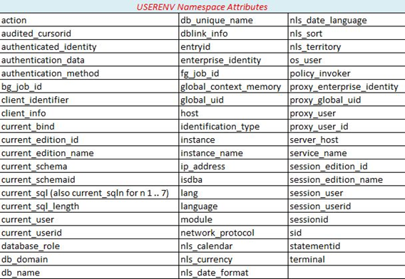
Built-in Functions
USERENV or SYS_CONTEXT(‘USERENV’,’attr’)
This list is from 11gR2

Slide 163
Built-in Packages
Oracle comes with a vast array¹ of built-in packages meant to ease the use of certain features. The most useful of these are:
STANDARD²
DBMS_CRYPTO
DBMS_LDAP
DBMS_LOCK
DBMS_LOB
DBMS_MONITOR
DBMS_OUTPUT
DBMS_RANDOM
DBMS_SQL
DBMS_SCHEDULER
DBMS_SESSION
DBMS_UTILITY
DBMS_XPLAN
UTL_FILE
UTL_HTTP
UTL_SMTP
UTL_TCP
Notes:
1: 11gR2 has 625 packages. 12gR1 has 706. See [ SELECT * FROM dba_objects WHERE owner = 'SYS' AND object_type = 'PACKAGE' ORDER BY object_name; ]
2: STANDARD is the entire basis of the PL/SQL language. No need to qualify any reference to items within it with the name of the package.

Slide 164
End Part 1
(Continue to Part 2)

Slide 165
The Goal
Make you aware of most PL/SQL key terms, concepts and features.
Whet your appetite for more and provide code samples, links and resources to learn in-depth on your own.
Part 1: Gain a cursory understanding of the fundamentals.
Part 2: Exposure to enterprise-grade PL/SQL and database development best practices.

Slide 166
Lesson Plan
PL/SQL Resources
Dev Environment
Blocks & Execution
Data Types
Language Fundamentals
Control Statements
Static SQL
Dynamic SQL
Stored PL/SQL
Built-ins
Composite Data Types
Bulk Processing
Exceptions
Data Abstraction
Code Org & DevOps
Compilation & Debug
Instrumentation
Security
Libraries
Templates & Tools

Slide 167
Composites
Scalar data types are simple: one piece of data.
Composite data types are made of more than one piece of data, scalar or composite or both.
There are three different types of composites:
  Record
  Object¹
  Collection
Notes:
1: Oracle documentation does not include the user-defined OBJECT data type in the list of composites

Slide 168
Composites: Records
In a record, each piece of data could be a different datatype and is called a “field.”
Records are declared explicitly like this:
TYPE type_name IS RECORD (field[,field]...);
Where field is defined as:
field_name field_type [[NOT NULL] {:= | DEFAULT} expr]

Slide 169
Composites: Records
Or they are declared implicitly by basing the record type on the “signature” of a table, view, or cursor.
CURSOR c_mytab IS SELECT col1, col2, … FROM mytab WHERE …; --explicit cursor
lr_mytab c_mytab%ROWTYPE; --based on explicit cursor's ROWTYPE attribute
TYPE trc_mytab IS REF CURSOR RETURN mytab%ROWTYPE; --define ref cursor
lrc_mytab trc_mytab; --declare ref cursor variable
lr_mytab lrc_mytab%ROWTYPE; --based on ref cursor's ROWTYPE attribute
lr_myview myview%ROWTYPE; --based on view's ROWTYPE attribute
lr_mytab mytab%ROWTYPE; --based on table's ROWTYPE attribute
lr_theirtab theirtab%ROWTYPE; --based on ROWTYPE attribute of private synonym's table
lr_cust_account acc_types.tr_account; --based on packaged, explicit record

Slide 170
Composites: Records
Simple Example
TYPE tr_person IS RECORD ( person_id INTEGER ,natl_id VARCHAR2(60 CHAR) ,last_nm VARCHAR2(200 CHAR) ,first_nm VARCHAR2(200 CHAR) ,gender_cd gender.cd%TYPE ,deceased_yn VARCHAR2(1) NOT NULL DEFAULT 'N');
Hairy Example
TYPE tr_account IS RECORD ( account_id acc_types.t_account_id NOT NULL -- packaged subtype, constrained , account_owner acc_types.tr_account_owner -- packaged record type , related_accounts acc_types.tas_acct_id -- packaged array type of account IDs , created_ts TIMESTAMP DEFAULT SYSTIMESTAMP -- precise time w/default , active_flg accounts.active_flg%TYPE -- anchored to table column type , fraud_check risk_types.to_fraud_check -- packaged object type );

Slide 171
Composites: Objects
Objects, w/o methods, look much like records and they can be used in many ways just like records.
Unlike PL/SQL records, objects can be defined at the schema-level and be used as a column type.
Simple Example
CREATE OR REPLACE TYPE to_person AS OBJECT ( person_id INTEGER ,natl_id VARCHAR2(60 CHAR) ,last_nm VARCHAR2(200 CHAR) ,first_nm VARCHAR2(200 CHAR) ,gender_cd VARCHAR2(1) ) /

Slide 172
Composites: Objects
You should be aware of objects.
Objects and collections of objects can be just the right structures to solve certain problems.
But the topic of OO development using Oracle and PL/SQL is a large area of exploration not covered here.

Slide 173
Composites: Records
Records automatically adjust¹ if the associated type/structure/query changes.
If PL/SQL API is record-based, no changes needed.
Saves time and cost for dependents.
Saves happiness and serenity of DBA.
This is a critical abstraction feature of PL/SQL that few take advantage of.
Use records when reading data for processing, as formal parameters, and when inserting/updating rows in a table.
Notes:
1: Virtual columns and invisible column are not included and break the abstraction provided by %ROWTYPE. In this case, use a cursor instead, selecting all the columns except the virtual columns, and tie the record to the “partial row” cursor with %ROWTYPE.

Slide 174
Composites: Records
One gets data into a record either by assignment, or by SQL/cursor-based statements.
SQL/cursor statements:
  SELECT INTO record_var...
  FETCH cursor INTO record_var;
  FOR loop_record_var IN cursor LOOP...
  RETURNING column_list INTO record_var;
(part of DML RETURNING clause)

Slide 175
Composites: Records
Assignment statements:
Record variable fields are accessed with dot notation:
lr_account.account_id := acct_seq.NEXTVAL;
If the field is itself a record, then use double-dot notation:
IF (SUBSTR(lr_account.cust.last_name,1,1) = 'A') THEN
We’ll see examples of records in action in the next section on Collections.

Slide 176
Composites: Records
To easily empty or re-initialize a record variable, assign NULL to it. Every field, including fields of nested records, will be set to NULL as well.
lr_account := NULL;
Records cannot be tested for being NULL, or compared to other records.
  Must implement own comparison routines

Slide 177
Composites: Records
9iR2 added record-based DML, almost completing¹ PL/SQL’s data abstraction capabilities. Call, insert, update and return using a record.
Code is now self-maintaining.
CREATE OR REPLACE PACKAGE gender_pkg AS PROCEDURE add_gender(ir_gender IN gender%ROWTYPE); PROCEDURE upd_gender(ir_gender IN gender%ROWTYPE); PROCEDURE del_gender(i_gender_id IN gender.id%TYPE); END gender_pkg; / CREATE OR REPLACE PACKAGE BODY gender_pkg AS PROCEDURE add_gender(ir_gender IN gender%ROWTYPE) IS BEGIN INSERT INTO gender VALUES ir_gender; END add_gender; | PROCEDURE upd_gender(ir_gender IN gender%ROWTYPE) IS BEGIN UPDATE gender SET ROW = ir_gender WHERE ID = ir_gender.id; END upd_gender; PROCEDURE del_gender(i_gender_id IN gender.id%TYPE) IS BEGIN DELETE FROM gender WHERE ID = i_gender_id; END del_gender; END gender_pkg; /
Notes:
1: Still cannot pass the :old and :new correlation names, essentially records, from triggers to stored procs. Still need to break :old/:new into individual columns to pass the values anywhere for processing.

Slide 178
Composites: Collections
In a collection, each piece of data shares the same data type and is called an “element.”
Elements are accessed using a unique numeric or named index.
Collections can be multi-dimensional
There are three different types of collections:
  Associative Array (aka PL/SQL Table or Index-by Table)
  Varrying Array¹
  Nested Table
Notes:
1: I have yet to find a situation where a VARRAY was the better choice over a nested table. Its name suggests that it shares something in common with the varrying length character datatype VARCHAR2. It can grow in size, but not past the declared maximum. Its name also suggest is shares something with associative arrays, but it is closer to a nested table than it is an array. It should be named FTAB or FIXEDTAB to indicate its true nature. The only feature I can discern that might be of use is that varrays aren’t allowed to become sparse like arrays and nested tables. You can empty the whole thing with DELETE, but if you attempt to call DELETE on one of the elements, you get PLS-00306: wrong number or types of arguments in call to 'DELETE'

Slide 179
Composites: Arrays
An associative array¹ is a key-value pair.
Arrays are PL/SQL-only and cannot be declared at the schema level or used as a column type.
Arrays can be indexed with any whole number, including 0 and negative numbers.
Arrays can be indexed with characters and strings
  Called “hash tables” in other languages
Arrays can be sparse, where elements at certain indexes don’t exist, so you need to code defensively.
Notes:
1: Hereafter referred to as “arrays”. It can be argued that nested tables are arrays as well, but we’ll refer to those as nested tables.

Slide 180
Composites: Arrays
Declaring an associative array type and variable:
TYPE t_name_arr IS TABLE OF datatype
INDEX BY {PLS_INTEGER | VARCHAR2(#)};
array_var_name t_name_arr;
Where datatype is any PL/SQL data type¹
Note: I like to name my collection types starting with a “t” and ending with a collection type suffix, “arr” for associative arrays and “tab” for nested tables. See Naming Standard (pg. 8) in PL/SQL Programming Standard.
Notes:
1: Except for REF CURSOR

Slide 181
Composites: Arrays
Fill arrays directly or with SQL methods. Access by index.
Array Indexed by Number | Array Indexed by String
SET SERVEROUTPUT ON DECLARE TYPE t_num_arr IS TABLE OF NUMBER INDEX BY SIMPLE_INTEGER; l_nums t_num_arr; BEGIN l_nums(-1) := 111; l_nums(0) := 222; l_nums(1) := 333; l_nums(3) := 555; -- missing element 2 FOR i IN l_nums.FIRST..l_nums.LAST LOOP IF (l_nums.EXISTS(i)) THEN pr('Element '||i||': '||l_nums(i)); END IF; END LOOP; END; / | CREATE OR REPLACE PACKAGE postal_pkg AS SUBTYPE t_iso_cd IS VARCHAR2(5); -- some islands are 5 chars TYPE t_states_arr IS TABLE OF VARCHAR2(30) INDEX BY t_iso_cd; l_states t_states_arr; FUNCTION get_state(i_iso_cd IN t_iso_cd) RETURN VARCHAR2; END postal_pkg; / CREATE OR REPLACE PACKAGE BODY postal_pkg AS FUNCTION get_state(i_iso_cd IN t_iso_cd) RETURN VARCHAR2 IS BEGIN RETURN l_states(i_iso_cd); -- "random" access. No loop/seek time. END get_state; BEGIN -- package init section. Only once for life of pooled session. l_states('AL') := 'Alabama'; -- Could fill by SELECT from lookup table l_states('AK') := 'Alaska'; l_states('AR') := 'Arkansas'; l_states('AZ') := 'Arizona'; -- ...snip many more END; / SET SERVEROUTPUT ON EXEC pr(postal_pkg.get_state('AL'));

Slide 182
Composites: Nested Tables
Called “nested” because they can be used as a column type (table within a table).
Can be created at the schema level.
Automatically indexed by positive integers.
Can be made sparse.
After declaration are “atomically null”.
Must be initialized before use.
After initialization are empty but no longer null.
Unlike VARRAY, memory used is dynamic.
Can perform DML on nested tables.

Slide 183
Composites: Nested Tables
Declaring a nested table type and variable:
TYPE t_name_tab IS TABLE OF datatype;
or
[CREATE OR REPLACE ]TYPE nt_type_name IS TABLE OF datatype
/
ntab_var_name t_name_tab;
ntab_var_name t_name_tab := t_name_tab(); -- init w/constructor
ntab_var_name t_name_tab := t_name_tab(value1,value2…);
Where datatype is any PL/SQL data type¹, including objects, records, and other collections.
Notes:
1: Except REF CURSOR. However, if created at the schema level as a standalone type, datatype cannot be PL/SQL-only types like BOOLEAN, associative array, etc.

Slide 184
Composites: Nested Tables
Fill tables directly or with SQL methods. Access by index.
Table Filled Directly | Table Filled by SQL
SET SERVEROUTPUT ON DECLARE TYPE t_gender_tab IS TABLE OF gender.cd%TYPE; l_gender_tab t_gender_tab := t_gender_tab('M','F','O'); -- constructor w/values BEGIN FOR i IN l_gender_tab.FIRST..l_gender_tab.LAST LOOP pr('Element '||i||' value is '||l_gender_tab(i)); END LOOP; END; / | SET SERVEROUTPUT ON DECLARE TYPE t_gender_tab IS TABLE OF gender%ROWTYPE; l_gender_tab t_gender_tab; BEGIN SELECT id, cd, nm BULK COLLECT -- covered in bulk ops section INTO l_gender_tab FROM gender; FOR i IN l_gender_tab.first .. l_gender_tab.last LOOP pr(l_gender_tab(i).id||':'|| l_gender_tab(i).cd||':'|| l_gender_tab(i).nm); END LOOP; END; /
Element 1 value is M Element 2 value is F Element 3 value is O | 1:F:Female 2:M:Male 3:U:Unknown 4:O:Other 5:N:None

Slide 185
Composites: Collection Methods
Function or Procedure | Description
EXISTS(n) | Returns TRUE if there is an element at n, otherwise returns FALSE (even if collection was not yet initialized).
COUNT | Returns number of elements in the collection¹. Returns 0 if the collection is initialized but not populated. After elements have been deleted, COUNT no longer equals LAST… so base loops on FIRST/LAST, not n..collection.COUNT
FIRST LAST | Returns the smallest/largest index number in the collection². Returns NULL if collection is is initialized but not populated.
PRIOR(n) NEXT(n) | Returns the index preceding/following the element at n. Returns NULL if n is the first or last element, respectively. Essential for iterating through a string-indexed array.
DELETE DELETE(n) DELETE(a,z) | DELETE removes all elements from a collection. DELETE(n) removes the nth element from the collection. n can be a string key. May not use with varrays. DELETE(a,z) removes all elements between the range from a to z. a and z can be string keys. May not use with varrays.
EXTEND EXTEND(n) | EXTEND adds one empty element to the collection. EXTEND(n) appends n empty elements to the collection.
TRIM TRIM(n) | TRIM removes one element from the end of the collection³. TRIM(n) removes n elements from the end.
Notes:
1: Return ORA-06531 if the collection has not been initialized.
2: For string-indexed arrays, uses the binary values of the strings to determine order.
3: TRIM includes deleted elements in its successfully trimmed count, so be careful. Treat nested tables as an array and use only DELETE, or treat them as a stack and use only TRIM and EXTEND.
4: LIMIT function is limited to the VARRAY. Returns NULL for arrays and nested tables.

Slide 186
Composites: Nested Tables
You may need to compare or merge collections, looking for distinct values, shared values, & missing values.
The SQL functions MULTISET and SET can be used in PL/SQL on collections to compare and merge.
nt3 := nt1 MULTISET UNION nt2;-- merge two collections
nt3 := nt1 MULTISET UNION DISTINCT nt2;-- merge distinct values
nt3 := nt2 MULTISET INTERSECT nt2;-- return matches even if duplicated
nt3 := nt2 MULTISET INTERSECT DISTINCT nt2;-- return distinct matches
nt3 := SET(nt1);-- return distinct set of values from nt1
nt3 := nt1 MULTISET EXCEPT nt2;-- values in nt1 but not in nt2
nt3 := nt1 MULTISET EXCEPT DISTINCT nt2;-- distinct values in nt1 not in nt2

Slide 187
Composites: Nested Tables
Surprise: A collection type defined in a package specification is incompatible with an identically defined local or standalone collection type.
Tip: When working with nested tables populated elsewhere, always ensure it has been initialized and has values.
IF (collection IS NOT NULL AND collection.COUNT > 0) THEN...

Slide 188
Composites: Nested Tables
Filling Nested Tables by Assignment and by Constructor
CREATE OR REPLACE TYPE t_ssn_tab IS TABLE OF VARCHAR2(11) / CREATE OR REPLACE PROCEDURE print_ssn_list (i_ssn_list IN t_ssn_tab) IS BEGIN -- First IF prevent ORA-06531 and ORA-06533 IF (i_ssn_list IS NOT NULL AND i_ssn_list.COUNT > 0) THEN FOR i IN i_ssn_list.FIRST..i_ssn_list.LAST LOOP -- prevents ORA-01403 if an element was deleted IF (i_ssn_list.EXISTS(i)) THEN pr('SSN('||i||'): '||i_ssn_list(i)); END IF; END LOOP; END IF; END print_ssn_list; / | SET SERVEROUTPUT ON DECLARE -- block1, delete an element l_ssn_list t_ssn_tab := t_ssn_tab(); BEGIN l_ssn_list.EXTEND; l_ssn_list(1) := '555-22-8888'; l_ssn_list.EXTEND; l_ssn_list(2) := '444-33-6666'; l_ssn_list.EXTEND; l_ssn_list(3) := '999-77-1111'; l_ssn_list.DELETE(2); print_ssn_list(l_ssn_list); END; / SET SERVEROUTPUT ON DECLARE -- block2, fill during constructor call l_ssn_list t_ssn_tab := t_ssn_tab('555-22-8888',NULL,'999-77-1111'); BEGIN print_ssn_list(l_ssn_list); END; /
SSN(1): 555-22-8888 SSN(3): 999-77-1111 | SSN(1): 555-22-8888 SSN(2): SSN(3): 999-77-1111
block1 output
block2 output

Slide 189
Composites: Collections & Records
Visit dbartisans.com/papers for a list of prior slides and whitepapers I’ve written. Among them is one on Collections and Records that goes into much more detail, including everything about collections of object, columns of nested table, multidimensional collections, SQL*Plus tricks, SQL on nested tables and more.
It was written for 9i, but very little has changed. A few limitations have been removed since 9i.

Slide 190
Lesson Plan
PL/SQL Resources
Dev Environment
Blocks & Execution
Data Types
Language Fundamentals
Control Statements
Static SQL
Dynamic SQL
Stored PL/SQL
Built-ins
Composite Data Types
Bulk Processing
Exceptions
Data Abstraction
Code Org & DevOps
Compilation & Debug
Instrumentation
Security
Libraries
Templates & Tools

Slide 191
Bulk Processing
In a number of presentations, books and forum posts, Tom Kyte has repeatedly taught that to make something fast:
First ask yourself: Do I need to do this at all?
If it is needed, do it in a single SQL statement (think in sets; very powerful when you know SQL well).
If SQL can’t do it, do it in bulk PL/SQL operations.
If bulk PL/SQL can’t do it, then consider row-by-row PL/SQL (as a last resort).

Slide 192
Bulk Processing
Best way to operate on large data sets is to use the powerful features of Oracle¹ and SQL.
But this training is about PL/SQL. So we’ll focus on point #3 in the previous slide.
Notes:
1: RAC, parallel query and parallel server, analytic functions, model clause, SQL*Loader, DBMS_PARALLEL_EXECUTE, etc.

Slide 193
Bulk Processing
If you inherit older PL/SQL, it is likely you’ll find suboptimal routines that could be improved.
If one set of data feeds into another query which is processed and fed into another query which...
  Use dependent SQL CTEs¹ in a single SQL statement
  Use pipelined table functions
Look for row-by-row loops, especially those that do DML within the loop.
  Convert to a single SQL statement
  Use bulk PL/SQL ops FORALL and BULK COLLECT
Notes:
1: Common Table Expressions, aka “WITH” subqueries

Slide 194
Bulk Processing: BULK COLLECT
Use BULK COLLECT INTO collection to fetch SELECT results in large batches with just one context switch between PL/SQL and SQL.
{SELECT list |
FETCH cursor |
EXECUTE IMMEDIATE stmt |
DML stmt RETURNING column(s)}
BULK COLLECT INTO collection;
Where collection is a packaged array or nested table, or a schema level nested table.
Notes:
1: RAC, parallel query and parallel server, analytic functions, model clause, SQL*Loader, etc.

Slide 195
Bulk Processing: FORALL
Use FORALL to send just one DML statement to the SQL engine bound to a large collection of values.
FORALL index IN [
[INDICES OF | VALUES OF ] collection | collection.FIRST..collection.LAST
[SAVE EXCEPTIONS¹]
{INSERT INTO table VALUES (collection(index)...)|
UPDATE table SET column = collection(index)... |
DELETE FROM table WHERE column = collection(index)};
Where collection is a packaged array or nested table, or a schema level nested table.
Notes:
1: See Oracle docs to learn about saving the exception metadata to the SQL%BULK_EXCEPTIONS cursor attribute handle.

Slide 196
Bulk Processing
SET SERVEROUTPUT ON DECLARE TYPE t_nm_tab IS TABLE OF gender.nm%TYPE; TYPE t_cd_tab IS TABLE OF gender.cd%TYPE; l_nm_tab t_nm_tab; l_cd_tab t_cd_tab := t_cd_tab('O','N'); BEGIN FORALL c IN l_cd_tab.FIRST..l_cd_tab.LAST DELETE FROM gender WHERE cd = l_cd_tab(c); COMMIT; SELECT nm BULK COLLECT INTO l_nm_tab FROM gender ORDER BY id; FOR i IN l_nm_tab.first .. l_nm_tab.last LOOP pr(i||':'||l_nm_tab(i)); END LOOP; END; /
Deleted row 4 (Other) Deleted row 5 (None) | 1:Female 2:Male 3:Unknown
Notes:
1: RAC, parallel query and parallel server, analytic functions, model clause, SQL*Loader, etc.

Slide 197
Lesson Plan
PL/SQL Resources
Dev Environment
Blocks & Execution
Data Types
Language Fundamentals
Control Statements
Static SQL
Dynamic SQL
Stored PL/SQL
Built-ins
Composite Data Types
Bulk Processing
Exceptions
Data Abstraction
Code Org & DevOps
Compilation & Debug
Instrumentation
Security
Libraries
Templates & Tools

Slide 198
Exceptions
Your code may encounter expected and unexpected errors. When this happens, Oracle will raise a runtime exception.
You can let them happen, rolling back the transaction and bubbling an error stack to the client (this is the best choice, usually).
You can trap it and do something or nothing. This is called “handling” an exception.

Slide 199
Exception
Syntax:
DECLARE
BEGIN
statements;
EXCEPTION
WHEN exception1 THEN
statements1;
[WHEN exception2 OR exception3 THEN
statements2;]
[WHEN OTHERS THEN
statements3;]
END;
Must have at least one exception
Can handle more than one at once
Optional and ill-reputed OTHERS must be last.

Slide 200
Exceptions: Basic Rules
Each PL/SQL block can have an exception section.
An exception section has 1..N exception handlers which start with WHEN expr.
A raised exception halts and transfers control to nearest exception section
If no handler, the exception “bubbles” up to the caller
After handler runs, control moves to next statement in the enclosing block (if any), unless re-raised.
If exception from block declaration section, will bubble up w/o being handled in the block.
WHEN OTHERS handler must be last
PROCEDURE remove_acct(i_acct IN NUMBER) IS
l_acct_valid := check_acct(i_acct);
BEGIN
-- do some initial stuff
BEGIN
DELETE FROM ...
IF (SQL%ROWCOUNT = 0) THEN
RAISE biz_pkg.gx_acct_missing;
END IF;
-- more actions to follow acct removal
EXCEPTION
WHEN biz_pkg.gx_acct_missing THEN
logs.warn('Account '||i_acct||
'has already been removed.');
END;
-- do additional stuff when named
-- account is confirmed as removed
EXCEPTION
WHEN OTHERS THEN logs.err;
WHEN no_data_found THEN
logs.err('Account start date not found');
END;
Bad
Bad

Slide 201
Exceptions: Exception Types
Internally Defined - has error code, but no name
  PLS-00049 to PLS-01918
  ORA-00000 to ORA-64621
Predefined - has error code and a given name
  Oracle named 22 of their internally defined errors
  Most commonly used: NO_DATA_FOUND, DUP_VAL_ON_INDEX, and TOO_MANY_ROWS
User-defined - users defines code and name
  Must be raised explicitly, unless tied to internally defined error
  Tied with user-defined code or internally defined code with:
PRAGMA EXCEPTION_INIT(exception_name, error_code)
  Keep user-defined exception names in a package specification

Slide 202
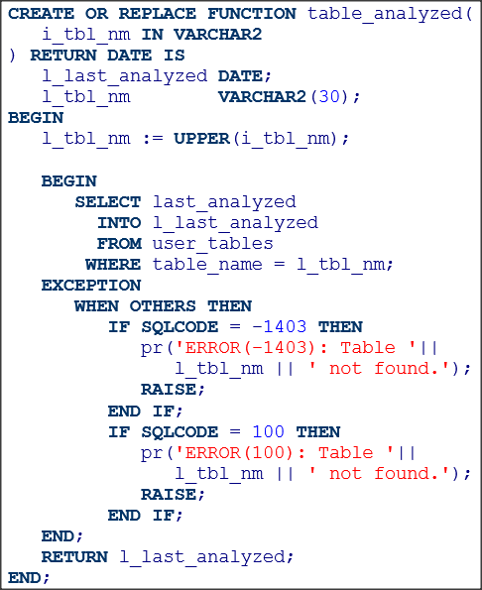
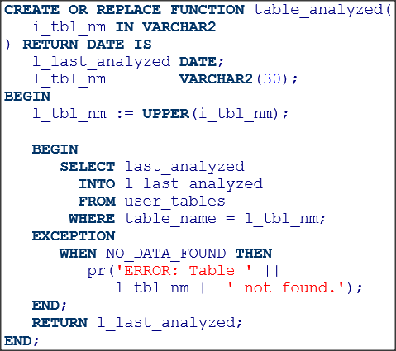
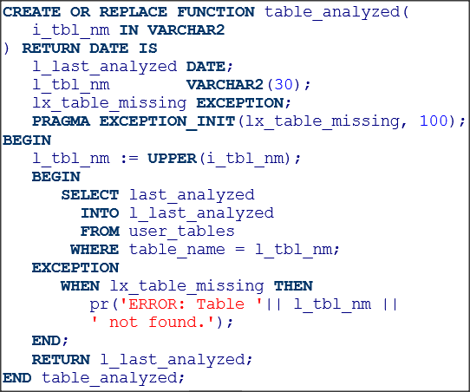
Exceptions: System-Raised
Interally Defined Exception Codes
Predefined Exception
User-defined Exception
Best
Bad
Better
Bad but correct

Slide 203
Exceptions: User-Raised
RAISE
  Inside an exception handler, use just “RAISE;” to re-raise the trapped exception once it has been handled.
  Outside an exception handler, use RAISE exception_name to spawn the exception.

Slide 204
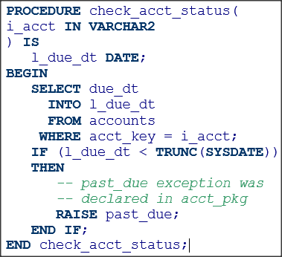
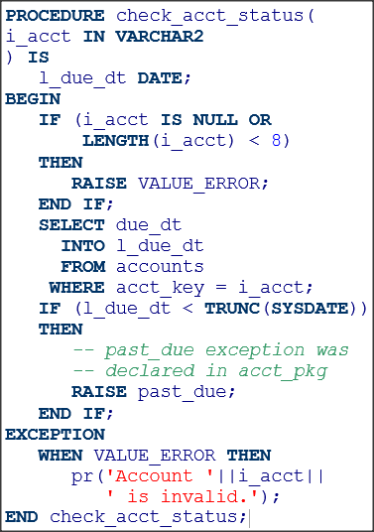
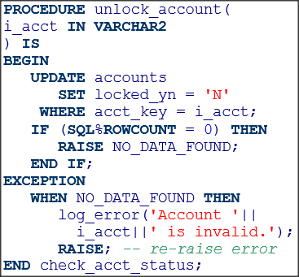
Exceptions: User-Raised
Raise User-Defined Exception
Raise Predefine Exception
Re-Raise User-raised Exception

Slide 205
Exceptions: Raising User-defined
RAISE_APPLICATION_ERROR
Used to raise user-defined messages tied to error codes
Error code must be in the range -20000 to -20999
Message limited to 2048 bytes
Only common exception library should use it, not developers.
Raising User-Defined Exception w/Msg | Handling User-Defined Exception
CREATE PROCEDURE check_acct_status( i_due_dt IN accounts.due_dt%TYPE ,i_today IN DATE) IS BEGIN IF (i_due_dt < i_today) THEN RAISE_APPLICATION_ERROR( -20000, 'Account past due'); END IF; END check_acct_status; | DECLARE lx_past_due EXCEPTION; PRAGMA EXCEPTION_INIT(lx_past_due, -20000); BEGIN check_acct_status('01-JAN-2016', '4-FEB-2016'); EXCEPTION WHEN lx_past_due THEN pr(SQLERRM); END;

Slide 206
Exceptions
When the exception bubbles high enough to reach a caller with no handler, the transaction rolls back¹ and the error stack can be processed.
When the exception is handled and re-raised, the reported point of error is changed from the original error point to the handler’s re-raise line.
  This is a big problem for any logging you attempt
Thankfully since 10g Oracle provides the “error backtrace” to determine the actual point of error.
Notes:
1: If your application has need to continue re-trying the transaction until it succeeds, look at this section in the Oracle documentation. I’ve never used this feature mainly because whatever caused the first error is very likely to still be there in the next millisecond upon the next iteration of the re-try loop, and so, ad nauseum. So when my transactions fail, I log it, perhaps email it, and allow the rollback and failure to bubble up, halting processing.

Slide 207
Exceptions: The Stacks
Package Specifications | Package Bodies | Unhandled and Handled Error Stacks
CREATE OR REPLACE PACKAGE top AS PROCEDURE proc(i_str IN VARCHAR2); END top; / CREATE OR REPLACE PACKAGE middle AS PROCEDURE proc(i_str IN VARCHAR2); END middle; / CREATE OR REPLACE PACKAGE bottom AS PROCEDURE proc(i_str IN VARCHAR2); END bottom; / | CREATE OR REPLACE PACKAGE BODY top AS PROCEDURE proc(i_str IN VARCHAR2) IS BEGIN middle.proc(i_str); END proc; END top; / CREATE OR REPLACE PACKAGE BODY middle AS PROCEDURE proc(i_str IN VARCHAR2) IS BEGIN bottom.proc(i_str); END proc; END middle; / CREATE OR REPLACE PACKAGE BODY bottom AS PROCEDURE proc(i_str IN VARCHAR2) IS BEGIN IF (i_str = 'unhandled') THEN RAISE NO_DATA_FOUND; ELSIF (i_str = 'handled') THEN RAISE VALUE_ERROR; END IF; EXCEPTION WHEN VALUE_ERROR THEN RAISE; END proc; END bottom; / | SET SERVEROUTPUT ON EXEC top.proc('unhandled');
 |  | ORA-01403: no data found ORA-06512: at "CORE.BOTTOM", line 5 ORA-06512: at "CORE.MIDDLE", line 4 ORA-06512: at "CORE.TOP", line 3 ORA-06512: at line 1
 |  | SET SERVEROUTPUT ON EXEC top.proc('handled');
 |  | ORA-06502: PL/SQL: numeric or value error ORA-06512: at "CORE.BOTTOM", line 10 ORA-06512: at "CORE.MIDDLE", line 4 ORA-06512: at "CORE.TOP", line 3 ORA-06512: at line 1
line 5
line 7
line 10
Should have stack entry for line 7
Should say error came from BOTTOM.PROC

Slide 208
Exceptions: The Error Backtrace
To handle an error (typically logging it with context) and still see the original point of error, in 10g to 11g, use dbms_utility.format_error_backtrace()
  Returns string. Parse if logging routine, line and error metadata
CREATE OR REPLACE PACKAGE BODY bottom AS PROCEDURE proc(i_str IN VARCHAR2) IS BEGIN IF (i_str = 'unhandled') THEN RAISE NO_DATA_FOUND; ELSIF (i_str = 'handled') THEN RAISE VALUE_ERROR; END IF; EXCEPTION WHEN VALUE_ERROR THEN pr(dbms_utility.format_error_backtrace); RAISE; END proc; END bottom; / | SET SERVEROUTPUT ON EXEC top.proc('handled');
 | ORA-06512: at "CORE.BOTTOM", line 7 ORA-06502: PL/SQL: numeric or value error ORA-06512: at "CORE.BOTTOM", line 12 ORA-06512: at "CORE.MIDDLE", line 4 ORA-06512: at "CORE.TOP", line 3 ORA-06512: at line 1
There is the original error line culprit
Still doesn’t tell us BOTTOM.PROC, which is critical for logging

Slide 209
Exceptions: The Error Backtrace
12c introduces the UTL_CALL_STACK package, 13 functions that provide array-based access into the call, error and error backtrace¹ stacks.
CREATE OR REPLACE PACKAGE BODY bottom AS PROCEDURE proc(i_str IN VARCHAR2) IS BEGIN IF (i_str = 'unhandled') THEN RAISE NO_DATA_FOUND; ELSIF (i_str = 'handled') THEN RAISE VALUE_ERROR; END IF; EXCEPTION WHEN VALUE_ERROR THEN pr(RPAD('Error#',7)||RPAD('Line#',6)||RPAD('Unit',12)||'Msg'); FOR i IN REVERSE 1..utl_call_stack.backtrace_depth() LOOP pr(RPAD(TO_CHAR(utl_call_stack.error_number(i)),7)|| RPAD(TO_CHAR(utl_call_stack.backtrace_line(i)),6)|| RPAD(SUBSTR(utl_call_stack.backtrace_unit(i),1,12),12)|| utl_call_stack.error_msg(i)); END LOOP; RAISE; END proc; END bottom; / | SET SERVEROUTPUT ON EXEC top.proc('handled');
 | Error# Line# Unit Msg 6502 7 CORE.BOTTOM PL/SQL: numeric or value error ORA-06502: PL/SQL: numeric or value error ORA-06512: at "CORE.BOTTOM", line 18 ORA-06512: at "CORE.MIDDLE", line 4 ORA-06512: at "CORE.TOP", line 3 ORA-06512: at line 1
There is the original error line culprit
STILL doesn’t tell us BOTTOM.PROC, which is critical for logging
Easier than parsing to get at stack components. But complex enough, this all belongs in a reusable logging pkg.
Notes:
1: I’ve been waiting since 1994 to be able to call SELF.NAME to get the fully qualified subprogram name. This can finally be done for items on the call stack, but not the backtrace. It baffles me they left out this feature when developing UTL_CALL_STACK.

Slide 210
Exceptions: UTL_CALL_STACK
Error Stack¹ Functions | ERROR_DEPTH Returns the number of errors on the error stack ERROR_MSG Returns the error message of the error at the specified error depth ERROR_NUMBER Returns the error number of the error at the specified error depth
Backtrace¹ Functions | BACKTRACE_DEPTH Returns the number of backtrace items in the backtrace BACKTRACE_LINE Returns the line number of the unit at the specified backtrace depth BACKTRACE_UNIT Returns the name of the unit at the specified backtrace depth
Call Stack² Functions | DYNAMIC_DEPTH Returns the number of subprograms on the call stack LEXICAL_DEPTH Returns the lexical nesting level of the subprogram at the specified dynamic depth SUBPROGRAM Returns the unit-qualified name of the subprogram at the specified dynamic depth CONCATENATE_SUBPROGRAM Returns a concatenated form of a unit-qualified name OWNER Returns the owner name of the unit of the subprogram at the specified dynamic depth UNIT_LINE Returns the line number of the unit of the subprogram at the specified dynamic depth
Miscellaneous | CURRENT_EDITION Returns the current edition name of the unit of the subprogram at the specified dynamic depth
Notes:
1: Error stack and backtrace are only available on error. Will be empty and have no depth if not on error.
2: Call stack always available.

Slide 211
Exceptions: Best Practices
Keep routines small and simple¹
Use assertions² to test assumptions
  This prevents most unexpected exceptions
Only handle anticipated errors with an exception
  Use a standard method of logging and re-raising
  Do not use parameters to communicate execution status
  Do not use WHEN OTHERS. If you must, ensure it is the last handler and that you re-raise the exception.
  Allow PL/SQL’s default exception and rollback model to handle everything else.
Notes:
1: An aside about how simple routines make error handling more manageable:
Simple routines do one thing well
Simple routines usually don’t need any exception handlers
If they do, it is usually just one, focused exception
2: An assertion is a statement of truth. If the boolean expression is not true, then an exception is raised with context about the business/data rule violated. Use a standalone or packaged proc to standardize your assertions (PL/SQL Starter Framework has an assertion checker in the EXCP package).

Slide 212
Lesson Plan
PL/SQL Resources
Dev Environment
Blocks & Execution
Data Types
Language Fundamentals
Control Statements
Static SQL
Dynamic SQL
Stored PL/SQL
Built-ins
Composite Data Types
Bulk Processing
Exceptions
Data Abstraction
Code Org & DevOps
Compilation & Debug
Instrumentation
Security
Libraries
Templates & Tools

Slide 213
Abstraction
One of the most important principles of software engineering (and hardware engineering for that matter) is abstraction and encapsulation. The two terms are highly related and often conflated or confused.
Abstraction is essentially how objects and data are presented externally for consumption by others. Through abstraction complex things are rendered simple to use.
Encapsulation is what makes abstraction (simple interfaces) possible. It is the technique used to bundle data and operations upon it, exposing essential attributes and hiding data and implementation details.

Slide 214
Abstraction
One of the key benefits of providing a simple interface and hiding the details is meeting the data architect’s goal of system extensibility¹.
Brittle, fragile, ghastly-to-alter systems are those that ignore extensibility.
When apps are allowed to code directly to data structures, they are now tightly coupled and exposed to any changes that structure will undergo in the future
Requests to alter a database object should not be costly or painful.
Notes:
1: Paul Nielsen: "Data architecture evaluates various database designs and implementations by several criteria: e.g. usability, scalability, integrity, extensibility, security, and availability."

Slide 215
Abstraction
Rather than allowing the crippling costs and maintenance nightmares of tight coupling, provide shielding layers of abstraction:
  Constants and Subtypes
  %TYPE, %ROWTYPE
  Collections, Records and Object Types¹
  Synonyms and Views
  Data APIs (packaged routines)
Notes:
1: Sometimes known as User Defined Types, or Abstract Data Types
Me; In most organizations the relentless push to meet deadlines and time to market at the cost of technical debt means abstraction is ignored and then wind up with a fragile database tightly coupled to scores of system, hundreds of reports, and thousands of concurrent end users. Requests to change a table can take months to research, approve and implement. Is it any wonder that developers the world over see the database as the bottleneck and are enamored with "NoSQL" solutions that seem to lure them with the siren's call of Schema-less Design and no DBA?
Paul Nielsen: "The cost of a brittle database is enormous to an organization. On the corporate roadmap, the database is the primary roadblock. The organization can’t implement critical changes because the database can’t support those changes. The organization (both internal clients and IT) will try to work around the brittle database with additional databases in an attempt to find features. IT will try to wrap the brittle database with additional layers in an attempt to find loose coupling. But complexity breeds complexity and eventually the organization with multiple completing database solutions will try to apply a master database so there’s a single source for answers. All this takes years and millions of dollars and… never… really… works."

Slide 216
Abstraction
Constants
For truly generic literals, create a package-spec of system/business-wide constants.
Keep other, narrower constants defined in a package to which the constant is functionally related
Defined once and used everywhere, if the literal/code/value ever needs to change, it only needs change in one place¹.
Notes:
1: One downside is that a package upon which every other package relies, means a change to that package will invalidate ALL the dependents.

Slide 217
Abstraction
Constants (excerpt from PL/SQL Starter pkg CNST)
-- Lengths
PAGEWIDTH CONSTANT INTEGER := 80;
MAX_COL_LEN CONSTANT INTEGER := 4000;
MAX_VC2_LEN CONSTANT INTEGER := 32767;
-- Basic return codes, following Unix convention of non-zero indicating failure
SUCCESS CONSTANT PLS_INTEGER := 0;
FAILURE CONSTANT PLS_INTEGER := 1;
-- Basic numeric represenation of boolean values, following the conventions found
-- in C and other languages, where true=1 and false=0.
TRUE CONSTANT PLS_INTEGER := 1;
FALSE CONSTANT PLS_INTEGER := 0;

Slide 218
Abstraction
Subtypes
For common or critical business attributes (like SSN, Phone Number, Member ID, etc.) define re-usable subtypes in a package spec and publish/market them.
Defined once and used everywhere, if the subtype attributes ever change, it only needs to change in one place.

Slide 219
Abstraction
Subtypes (excerpt from PL/SQL Starter pkg TYP)
-- Subtypes
SUBTYPE t_maxobjnm IS VARCHAR2(30); -- maxlength for normal Oracle object name
SUBTYPE t_maxfqnm IS VARCHAR2(61); -- fqnm = fully qualified name
SUBTYPE t_maxcol IS VARCHAR2(4000);
SUBTYPE t_maxvc2 IS VARCHAR2(32767);
SUBTYPE t_msg IS t_maxcol;
SUBTYPE t_rc IS PLS_INTEGER;
SUBTYPE t_mime_type IS VARCHAR2(100); -- used by MAIL and UTILS
-- used by ENV to avoid dependence on v$ performance views that might not be
-- available to all framework champions.
SUBTYPE t_module IS VARCHAR2(48);
SUBTYPE t_action IS VARCHAR2(32);
SUBTYPE t_client_id IS VARCHAR2(64);
SUBTYPE t_instance_nm IS VARCHAR2(16);
SUBTYPE t_host_nm IS VARCHAR2(64);

Slide 220
Abstraction
“Anchoring” with %TYPE and %ROWTYPE
When declaring variables and parameters, if the row or column is already defined in a table, view or cursor, tie the identifier to the pre-defined datatype use the %TYPE and %ROWTYPE attributes.
If the underlying row or column type ever changes, dependent code will not need to be altered¹.
Notes:
1: Unless the fundamental type changes, like from NUMBER to DATE, or DATE to STRING, in which case even with anchoring, every piece of dependent code will have to be revisited for impact, wrapped in conversion functions, etc.

Slide 221
Abstraction
Anchoring
-- From PL/SQL Starter pkg ENV
FUNCTION get_app_id (i_app_cd IN app.app_cd%TYPE DEFAULT NULL) RETURN NUMBER;
-- From PL/SQL Starter pkg LOCKS
FUNCTION get_lock
(
i_lock_nm IN app_lock.lock_nm%TYPE,
i_obj_rid IN app_lock.locked_obj_rid%TYPE,
i_locker_id IN app_lock.locker_id%TYPE DEFAULT NULL
) RETURN INTEGER
IS
lr_lock app_lock%ROWTYPE;
l_rc typ.t_rc; -- example of using subtype abstraction
BEGIN

Slide 222
Abstraction
Collections, Records and Object Types
This is where the biggest gains can be realized in extensibility.
Rather than shredding table data into individual fields, keep them in column (collection) and row (record/object) and result set (collection of record/object) form.
These will greatly simplify your job, reducing the amount of work when data structures change.
Whenever appropriate^{1&2}, use records/objects and collections of record/object as the parameters for your data access layer.
Notes:
1: A routine that takes in a primary key value and returns a single value does not require the entire record to be passed in, for example. If it returned an entire row of a table or view, then the RETURN datatype, or the OUT parameter datatype should be a composite datatype to abstract away the details of the composite structure asked for.
2: Up until 12.1.0.2 though, clients could not “speak” to PL/SQL record-based APIs. An additional layer mapping JDBC datatypes to PL/SQL datatypes was necessary.

Slide 223
Abstraction
Collections, Records and Object Types
(excerpt from PL/SQL Starter pkg APP_LOG_API)
PROCEDURE ins(ir_app_log IN app_log%ROWTYPE) IS
PRAGMA AUTONOMOUS_TRANSACTION;
BEGIN
INSERT INTO app_log
VALUES ir_app_log;
COMMIT; -- must be here for autonomous to work
END ins;
The app_log table has changed four times since I wrote the first draft and this routine has never had to change.

Slide 224
Abstraction
Synonyms and Views
Simple synonyms can also serve as a cost-saving abstraction when used to hide the true location of things.
Use private synonyms to mask the schema where the granted objects reside.
Do not allow client developers to hard-code schema names if they are doing embedded SQL or PL/SQL calls.

Slide 225
Abstraction
Synonyms and Views
Use synonyms to hide objects that are being accessed over DB links, or through other esoteric methods the client shouldn’t know or care about.
-- Hide DB links behind views and synonyms
CREATE OR REPLACE SYNONYM sales FOR sales@remote_dw_db;
CREATE OR REPLACE FORCE VIEW sales AS
SELECT * FROM sales@remote_dw_db;

Slide 226
Abstraction
Views
If you allow direct access to tables, at least hide them behind views.
Consider a policy of granting access only to views. The view becomes the interface, or "contract".
Now free to change the source, add columns, derive columns in new ways, change details w/o affecting the client (still test of course)

Slide 227
Abstraction
Views
A few examples of how details can be abstracted away.
CREATE OR REPLACE VIEW customer AS SELECT * FROM customer_tbl;
CREATE OR REPLACE VIEW employee AS SELECT * FROM hr.employee@hr;
CREATE OR REPLACE VIEW contact AS SELECT *
FROM TABLE(core_dir.get_contacts() t WHERE t.active_yn = 'Y');
CREATE OR REPLACE VIEW accounts AS SELECT * FROM accounts_tbl;
CREATE OR REPLACE VIEW account_type AS
SELECT * FROM account_type_tbl
WHERE valid_dt >= TO_DATE('2001Sep12','YYYYMonDD');

Slide 228
Abstraction
PL/SQL-based Data Access Layer
Impossible to display entire sample data layer here. Would be composed of getters, setters, find operations, business ops, create/delete and select routines.

Slide 229
Abstraction
Bryn Llewellyn recently wrote a paper, “Why Use PL/SQL”, which calls for the “thick database” approach to application development which beautifully embodies the principles of abstraction and security spoken of here. I HIGHLY encourage you to read it several times.
This model has been spoken of in other books, like those by Knox, Kite and Feuerstein, but this paper brings it all together and argues convincingly for the proper location of database queries and operations.

Slide 230
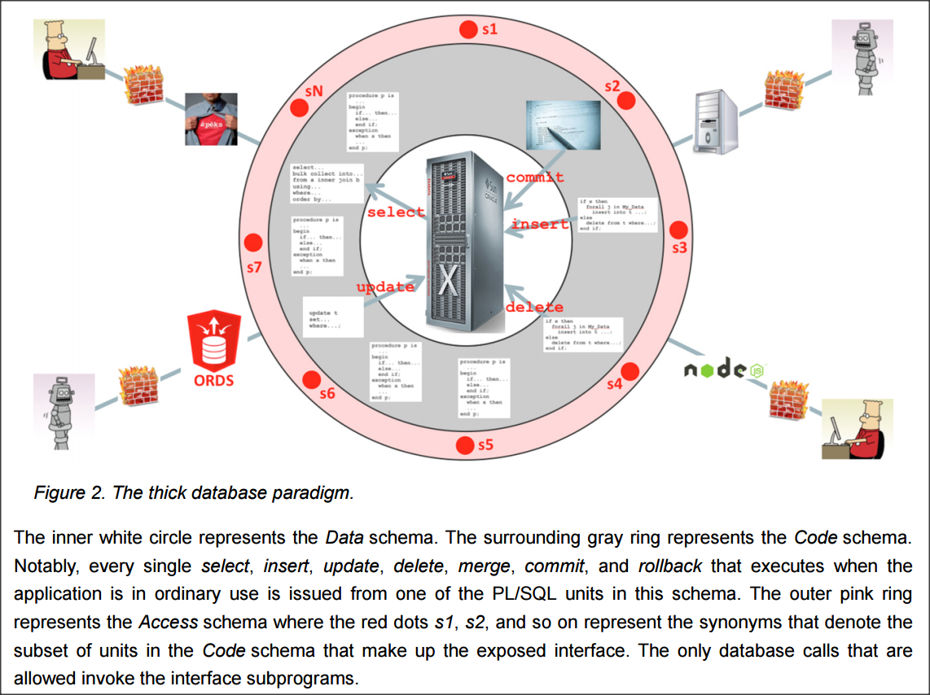
Abstraction
Llewellyn’s “Thick Database” model

Slide 231
Abstraction
Simple Data Abstraction API:
CREATE OR REPLACE PACKAGE acct_mgr AS
/* Note: all template text and routine comments left out for brevity */
FUNCTION get_new_acct_id RETURN NUMBER;
FUNCTION is_acct_active(i_acct_id IN INTEGER) RETURN BOOLEAN;
FUNCTION get_acct_open_dt(i_acct_id IN INTEGER) RETURN DATE;
FUNCTION get_acct_cust_nm(i_acct_id IN INTEGER) RETURN VARCHAR2;
FUNCTION get_acct_balance(i_acct_id IN INTEGER) RETURN NUMBER;
PROCEDURE acct_withdraw(i_acct_id IN INTEGER, debit_amt IN NUMBER);
PROCEDURE acct_deposit(i_acct_id IN INTEGER, credit_amt IN NUMBER);
PROCEDURE open_acct(i_acct_id IN INTEGER);
PROCEDURE close_acct(i_acct_id IN INTEGER);

Slide 232
Abstraction
Simple Data Abstraction API Continued
PROCEDURE find_acct
(
i_cust_nm IN VARCHAR2 DEFAULT NULL,
i_phone_num IN VARCHAR2 DEFAULT NULL,
i_acct_type IN INTEGER DEFAULT NULL,
i_cust_blg_addr IN VARCHAR2 DEFAULT NULL,
o_acct_list OUT SYS_REFCURSOR
);
PROCEDURE combine_acct(i_src_acct IN INTEGER, i_tgt_acct IN INTEGER);
-- reporting
PROCEDURE opened_accounts(i_start_dt IN DATE, i_end_dt IN DATE, o_rc OUT SYS_REFCURSOR);
PROCEDURE closed_accounts(i_start_dt IN DATE, i_end_dt IN DATE, o_rc OUT SYS_REFCURSOR);
PROCEDURE upsell_accounts
(
i_acct_type IN INTEGER,
balance_threshold IN NUMBER DEFAULT parm.get_val('upsell_threshold'),
o_rc OUT SYS_REFCURSOR
);
PROCEDURE accounts_at_risk(o_rc OUT SYS_REFCURSOR);
END acct_mgr;

Slide 233
Abstraction
Steven Feuerstein, Bill Pribyl, Connor McDonald and others have written books and articles on this subject.
I’ve got an older paper as well on Collections, Records and Objects that gets into the lowest level details of using these composite data types.

Slide 234
Lesson Plan
PL/SQL Resources
Dev Environment
Blocks & Execution
Data Types
Language Fundamentals
Control Statements
Static SQL
Dynamic SQL
Stored PL/SQL
Built-ins
Composite Data Types
Bulk Processing
Exceptions
Data Abstraction
Code Org & DevOps
Compilation & Debug
Instrumentation
Security
Libraries
Templates & Tools

Slide 235
Code Org & DevOps
Store source code for database objects in files.
  Create one PL/SQL object per source file¹.
  Use lowercase for file names².
  File names in the source folder should match the name of the object³ being created by the file’s source code.
  Store type/pkg spec separate from type/pkg body⁴.
  File extension can be “.sql” for everything, or a unique code⁵ for each object type, if your IDE supports that.
Notes:
1: It is just fine to create multiple related items when the source file is a DDL script, like the table, sequence, constraints, comments and indexes that are all created at the same time.
2: It just looks cleaner.
3: See the Oracle Object Naming Standards docs for how to name Oracle objects.
4: This is an important part of abstraction that helps ensure dependents are not invalidated or inconvenienced when the details of the type/pkg body need to change and be recompiled in Production.
5: For example: function=.fnc, procedure=.prc, package spec=.pks, packe body=.pkb, type spec=.tps, type body=.tpb, materialized view=.mv, view=.vw, trigger=.trg, queue=.aq. I write all schedule objects in .sql files and keep them in the “sched” folder in “src”.

Slide 236
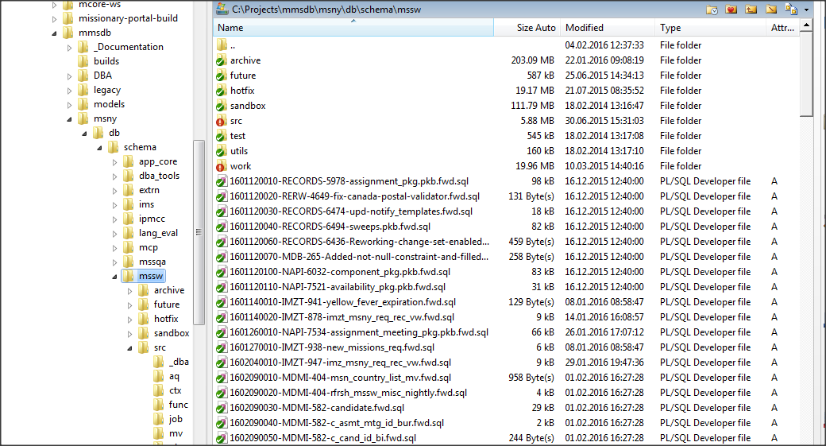
Code Org & DevOps
Files checked into the database “build” folder should be re-runnable¹
Files being migrated in a database “build” should begin with prefix timestamp+seq-CMSkey-description.sql
timestamp: YYYYMMDD
seq: #### (start 0010, incr by 10)
CMSkey (Change Mgmt Sys): key/ticket/ID of change request
description: action + object being operated upon
Notes:
1: Drop the new object before creating it. If dropping something, you’ll need to check for its existence before dropping it, avoiding the drop if it’s already been removed. If renaming something, again check to see if the object already sports the new name before the rename attempt. See PL/SQL Starter Framework’s DDL_UTILS package for a library of routines used to build scripts that have routines to help you do all the above.

Slide 237
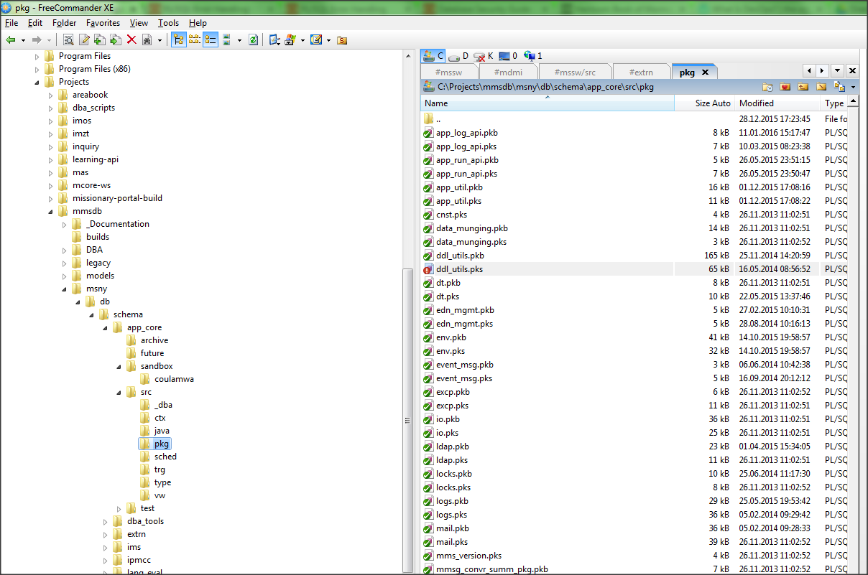
Code Org & DevOps: Directory Design
Create directory that mimics your org’s depts & projects
Projects: Folder per Subversion/git repo
msny: main folder for schemas in our multi-app database.
db/schema: structure forced by our build tool
archive: old incremental build scripts
future: work on hold
sandbox: folder per DBA
src: folder per object type
test: folder per pkg, lots of unit test scripts

Slide 238
Code Org & DevOps: SCC Tool
Version all source code files¹ in a source code control (SCC) system like Subversion or git.
  Use hook to email commit notifications to other DBAs
  Use SCC commit logs to time-travel, compare versions and see who changed what, why and when.
  For Subversion use TortoiseSVN to overlay file names in the Windows Explorer shell.
  Always update before committing. Ensure file prefix has not been taken by concurrent developer commits.
Notes:
1: And all your other work files as well.

Slide 239
Code Org & DevOps: DB Builds
Adopt an “agile” database versioning/migration tool like Flyway DB if releases include more than a few scripts.
  Manually compile, debug, unit test, repeat in dev lane only.
  Use database build tool to migrate release scripts to test, staging and production.
Separate dev from test from staging from production.
  Staging should mirror production in every way.
Consider additional environments: continuous DB build, maint, user acceptance, automation test, training, etc.
Adopt thin-DB cloning technology like NetApp¹ or Delphix
  Unless small DBs & $$: then use expdp/impdp, etc.
Notes:
1: NetApp’s feature is called FlexClone. There’s also Snap Clone and SnapMirror.

Slide 240
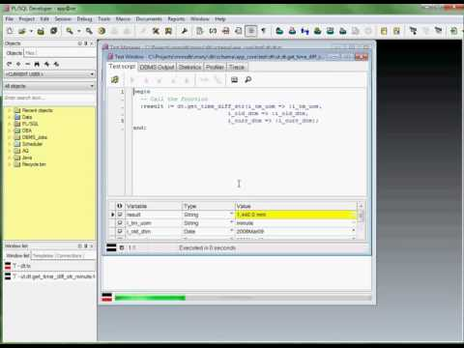
Code Org & DevOps: Testing
Build or adopt Test Driven Development or Test First practices and tools.
Ensure each routine has been unit tested.
Ideally each unit-test has a data setup and teardown script.
Assemble the unit tests in a suite per package so the entire schema of PL/SQL can be regression tested with the push of a button.
Share scripts, SQL and tips in CM tool so QA understands DB change and can re-test.

Slide 241
Code Org & DevOps: Modeling
Perform conceptual (subject area), logical and physical modeling. Reverse engineer inherited schemas of data models.
Break large ERDs into smaller functional submodels.
Publish the models on the team/dept intranet/wiki
Print key models and deliver to/train devs
Recommendations: Embarcadero’s ER/Studio Data Architect and Oracle’s SQL Data Modeler

Slide 242
Lesson Plan
PL/SQL Resources
Dev Environment
Blocks & Execution
Data Types
Language Fundamentals
Control Statements
Static SQL
Dynamic SQL
Stored PL/SQL
Built-ins
Composite Data Types
Bulk Processing
Exceptions
Data Abstraction
Code Org & DevOps
Compilation & Debug
Instrumentation
Security
Libraries
Templates & Tools

Slide 243
Compilation & Debug
Compile source code into Oracle database schema to turn it into a stored object.
  Manually compile using a tool like SQL*Plus¹, SQLcl or a PL/SQL IDE (usually only in the dev database)
  Use automation tools to compile in non-dev environments
If there are compile-time or runtime errors, debug the object until it compiles and runs.
Notes:
1: All our examples end in “/” which tells SQL*Plus to send its buffer to the database for execution/compilation.

Slide 244
Compilation: Settings
Query USER_PLSQL_OBJECT_SETTINGS to see compilation settings used on existing units:
  Optimize level
  Native vs. interpreted
  Compiled for debug¹ or not
  Warnings setting
  CC Flags
  PL/SQL Scope setting
Each of these are worth the time to learn.
But only optimization, warnings and debug covered here.

Slide 245
Compilation: Settings
The 10g+ compilation parameter PLSQL_OPTIMIZE_LEVEL defaults to 2¹.
May want to set it to 1 (debuggable and basic optimizations) to prevent inlining and code rearrangement or long compile times.
May want to experiment with 3 for a wider range of optimizations, if your unit is a performance hotspot².
ALTER SESSION SET PLSQL_OPTIMIZE_LEVEL=1
Notes:
1: Oracle Database Reference says it defaults to 0, which is wrong.
2: If the package is computational intensive, look into using the PLSQL_CODE_TYPE=NATIVE setting, to compile the package in low-level machine-native code that does not need to be interpreted at runtime as compiled PL/SQL “P-code” does.

Slide 246
Compiling: Warnings
Compile-time warnings (PLW-#####) are either severe, performance or informational.
Default setting DISABLE:ALL not typically sufficient for development. Better to start with ENABLE:ALL
ALTER SYSTEM SET PLSQL_WARNINGS='ENABLE:ALL';
Leave default DISABLE:ALL for higher environments.
Notes:
1: PLSQL_DEBUG compilation parameter is deprecated in 12.1. Use the PLSQL_OPTIMIZE_LEVEL=1 to compile for debug.

Slide 247
Compilation: Warnings
Altering PLSQL_WARNINGS can be done for entire system, session or individual PL/SQL unit.
PLSQL_WARNINGS = 'value_clause' [, 'value_clause']...
Where value_clause = qualifier:modifier
Where qualifier = {ENABLE | DISABLE | ERROR}
and modifier = { ALL|SEVERE|INFORMATIONAL|PERFORMANCE|
{ errcode | (errcode [, errcode ] ...) }
}
The ERROR qualifier and errcode¹ modifier treat the code as an error instead of a warning.
Notes:
1: For example ORA-06502 means the errcode value would be 6502

Slide 248
Compilation: Warnings
Examples:
ALTER SYSTEM SET PLSQL_WARNINGS='DISABLE:ALL';
ALTER SESSION SET PLSQL_WARNINGS='ENABLE:ALL';
EXEC DBMS_WARNING¹.set_warning_setting_string('ENABLE:ALL', 'SESSION');
ALTER PACKAGE mail COMPILE PLSQL_WARNINGS='ENABLE:ALL'
ALTER PACKAGE env COMPILE PLSQL_WARNINGS='ENABLE:SEVERE', 'ENABLE:PERFORMANCE', 'DISABLE:INFORMATIONAL’, 'ERROR:06002';
Note: Altering a package alters the package body setting as well.
Notes:
1: DBMS_WARNING is the PL/SQL API provided for programmatic access to the compiler warning settings.

Slide 249
Compilation: Warnings
ALTER SESSION SET PLSQL_WARNINGS='ENABLE:ALL'; CREATE OR REPLACE PROCEDURE test_warn AS l_count INTEGER := 0; BEGIN SELECT COUNT(*) INTO l_count FROM user_objects; EXCEPTION WHEN OTHERS THEN NULL; END test_warn; /
SP2-0804: Procedure created with compilation warnings SQL> show error Errors for PROCEDURE TEST_WARN: LINE/COL ERROR -------- ----------------------------------------------------------------- 1/1 PLW-05018: unit TEST_WARN omitted optional AUTHID clause; default value DEFINER used 8/9 PLW-06009: procedure "TEST_WARN" OTHERS handler does not end in RAISE or RAISE_APPLICATION_ERROR

Slide 250
Compilation: Conditional Directives
Conditional compilation¹ directives work the same as those in C, compiling different source code based on directive values (introspected at compile time).
This is useful for PL/SQL source code that runs on different versions of Oracle, exposing or hiding the use of features that may or may not be available.
Can also be used to expose runtime behavior, like debug logging, only in certain environments.
Notes:
1: Available since 10gR1

Slide 251
Compilation: Conditional Directives
Pre-processor Control Tokens
  $identifier - tells compiler to evaluate before compilation
Inquiry Directives
  Pre-defined:
    $$PLSQL_UNIT_OWNER, $$PLSQL_UNIT_TYPE, $$PLSQL_UNIT, $$PLSQL_LINE,
    $$plsql_compilation_parameter¹
  Use-defined: Through setting PLSQL_CCFLAGS name:value pairs. Value must bee boolean literal or PLS_INTEGER literal
    ALTER SESSION SET PLSQL_CCFLAGS = 'name1:value1, name2:value2, ... nameN:valueN'
Notes:
1: I haven’t found it very useful to have the source code be aware of the current values for $$PLSCOPE_SETTINGS, $$PLSQL_CCFLAGS, $$PLSQL_CODE_TYPE, $$PLSQL_OPTIMIZE_LEVEL, or $$PLSQL_WARNINGS

Slide 252
Compilation: Conditional Directives
Selection Directives
  $IF boolean_static_expr $THEN…$ELSIF…$ELSE…$END
Static Expressions
  Cannot be a character-based comparison, variable or function
  Must be a literal or static constant available at compile time
  BOOLEAN static expression
  PLS_INTEGER static expression
  VARCHAR2 static expression
  Static constants from the DBMS_DB_VERSION package spec
Error Directives
  $ERROR varchar2_static_expression $END

Slide 253
Compilation: Conditional Directives
This chunk of code was once used in the PL/SQL Starter Framework’s LOGS package to ensure that downloaders who installed on 9i or older didn’t attempt to compile with the 10g backtrace feature:
$IF dbms_db_version.version >= 10 $THEN
IF (i_reraise) THEN
l_msg := SUBSTR(l_msg,1,1980)||CHR(10)||
'-- BACKTRACE --'||CHR(10)||
dbms_utility.format_error_backtrace; -- 10g+
END IF;
$END

Slide 254
Debug
When there are compile-time errors, debug the source code manually.
But when the errors happen at runtime, context around the point of error must be understood to find the root cause.

Slide 255
Debug: Manually
If the code does not compile cleanly, it is because of a syntax error, a compile-time warning, or something so weird & heinous, it gives the compiler an aneurysm and you’ll actually get an internal Oracle error, usually an ORA-600 or ORA-7445.
If compiling in SQL*Plus, use SHOW ERR[ORS] to see the location, code, msg and context of the error
PL/SQL IDEs will show the location and error message in a separate pane. Click=jump to error
Go to the line and fix the problem. Recompile.

Slide 256
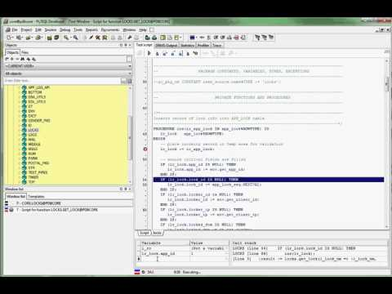
Debug: Manually
Another way to manually debug a routine is to compile the unit for debug¹ and then attach a PL/SQL IDE debugger to it.
As with other 3GL IDEs, this allows you to set breakpoints, conditional breakpoints, watches, run to exception, alter variable values while debugging, etc.
A real time-saver. Highly worth your time to learn.
Notes:
1: ALTER PACKAGE package_name COMPILE DEBUG [compiler parameters];

Slide 257
Debug: Runtime
Gathering runtime context to determine why a routine is erroring at a certain spot is the subject of our next section on Instrumentation.
You can do it the hard way, using DBMS_OUTPUT.put_line() everywhere, but that’s fraught with problems.
Flipping a “switch” to turn logging and debugging messages on is the only way to go, as we’ll see.

Slide 258
Lesson Plan
PL/SQL Resources
Dev Environment
Blocks & Execution
Data Types
Language Fundamentals
Control Statements
Static SQL
Dynamic SQL
Stored PL/SQL
Built-ins
Composite Data Types
Bulk Processing
Exceptions
Data Abstraction
Code Org & DevOps
Compilation & Debug
Instrumentation
Security
Libraries
Templates & Tools

Slide 259

Instrumentation

Slide 260

Instrumentation

Slide 261
Instrumentation
The difference between maintenance paradise and maintenance meltdown is instrumentation.

Slide 262

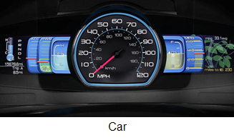

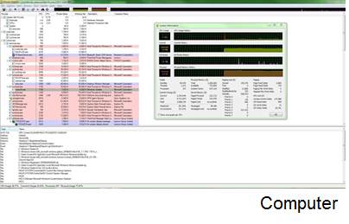
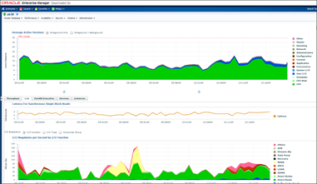
Instrumentation
Big word. Not terribly fun to say. But it is far more familiar than it seems:
These all provide real-time, valuable insight into the inner workings of complex systems.
OEM

Slide 263
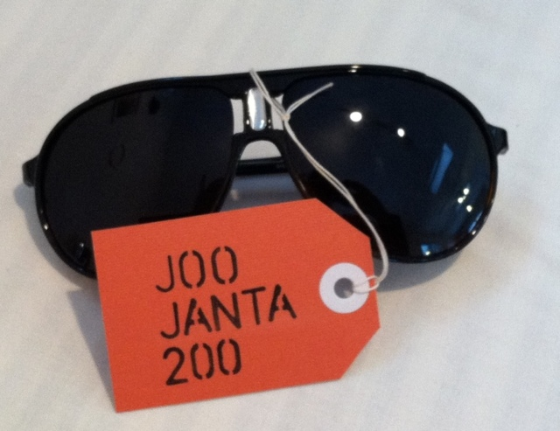
Instrumentation
Too many DBA’s rely on little to no instrumentation in their code, unaware how pleasant their jobs could be with it in place.
This approach resembles Douglas Adams’ Joo Janta 200 Super-Chromatic Peril Sensitive Sunglasses which are
“specially designed to help people develop a relaxed attitude to danger. At the first hint of trouble, they turn totally black and thus prevent you from seeing anything that might alarm you.”

Slide 264
Instrumentation: The Vision
Instead…
We want to be proactively notified by our systems when errors and things out of the ordinary are detected.
When a problem arises, we want to simply review the logs to trace what happened and exactly what was passed, who did it, when, what data was being processed, and what was changed.
If that isn’t possible, we want to flip a switch, have the user re-try the operation and immediately see rich context data from the PL/SQL routines in the logs.

Slide 265
Instrumentation
Typical Lifecycle of a Production Problem:
Become aware of a problem
Find the source of the problem
Fix the source of the problem
Repair issues the problem caused
Rebuild trust (costliest, longest step)
Improve so problem doesn’t happen again
Instrumentation greatly aids with the first two steps.

Slide 266
Instrumentation
Instrumentation is the process of fitting applications with code that directs runtime context to a destination where it can be useful.
Runtime context: Who, when, what was passed in, what changed, time taken, errors and warnings encountered, etc.
Context destination: stdout (screen), V$ views, logging table, log file, queue, pipe, alert, other web service or TCP-based callouts.

Slide 267
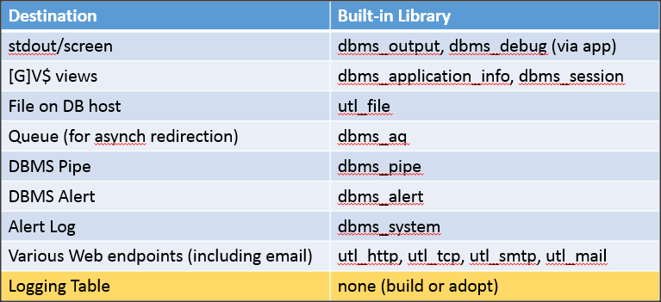
Instrumentation
Oracle provides a number of built-in features to grab context and deliver it somewhere, but most are insufficient on their own. See this prezi for a detailed demo of each.

Slide 268
Instrumentation
Requirements of a good log/debug/audit/metrics/error library:
Destination Choice
Must have [to table and screen] Optional [to file] Nice to have [ftp, pipe, AQ, http, etc]
Output must be transaction-independent
Output Type
Log errors, warnings, and information-only messages
Identifiers, metrics and runtime context (parameter values, variable values, # iterations, etc.)
Dynamic debug messages (“off” by default, data switch in a table or GAC¹ turns it on)
    Even better if it can targeted to certain user, session, application, or PL/SQL unit
Auditing
Aids to generate audit tables and triggers
Simplicity
Must be simple to understand, use and remember
Client and session metadata should be gathered for you
Notes:
1: Global Application Context

Slide 269
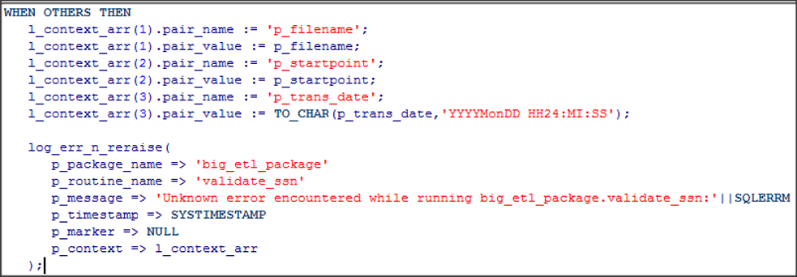
Instrumentation
A logging and exception-handling framework like this is well-intentioned, but it is hard and ignored.

Slide 270
Instrumentation
It should be this easy
dbg('Calling X with '||i_parm);
info('BEGIN: Nightly Reconcile');
warn('X took '||l_diff||' s too long');
err();
tag();
startT(); /* do stuff */ stopT(); elapsed();
Origin metadata (time, unit, line, caller, end user) should all be transparently obtained

Slide 271
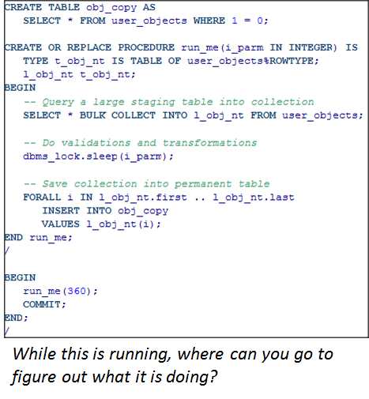
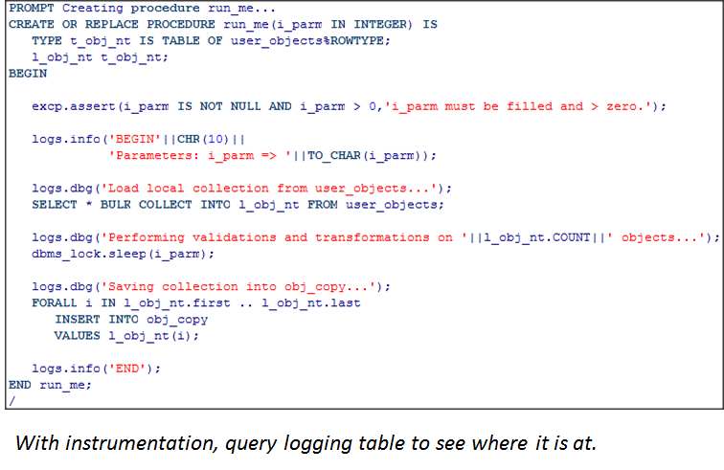
Instrumentation
An example of instrumenting an opaque routine so it has dials and gauges to tell us what it’s doing. (API is from the PL/SQL Starter Framework)

Slide 272
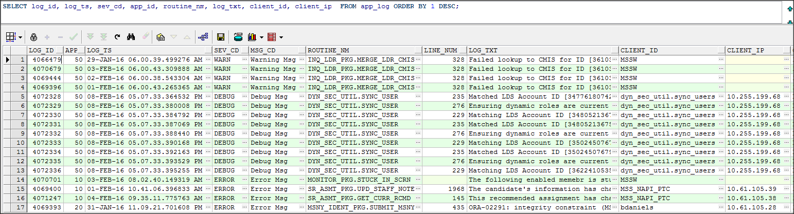
Instrumentation
Sample of our APP_LOG table

Slide 273
Instrumentation: Column Auditing
Oracle includes a number of auditing options.
Until recently to get column-level auditing (tracking old/new values over time) you had to write your own triggers and audit tables¹.
Well, there was Flashback Data Archive (FDA/FBA), but it was too expensive for most shops.
With 12.1.0.2, backported to 11.2.0.4, FDA (w/o compression) is now free. Retain changes over time for years if needed. 12c adds extended audit metadata.
Use VERSIONS BETWEEN to query.
See this Tim Hall article for a tutorial.
Notes:
The PL/SQL Starter Framework comes with a generic audit table set in the CORE schema, and an audit trigger generating helper script. These may no longer be necessary with FDA (aka FBA).

Slide 274
Instrumentation
Instrumentation should be in place before production problems occur.
But it can be added easily after as well.
Adopt or build a standard instrumentation library.
It must be simple and easy to use.
Encourage or enforce its use.
Do it today! It’s easy and rewarding.
To spend more time learning about instrumentation in-depth, visit dbartisans.com/papers. Especially this whitepaper.

Slide 275
Lesson Plan
PL/SQL Resources
Dev Environment
Blocks & Execution
Data Types
Language Fundamentals
Control Statements
Static SQL
Dynamic SQL
Stored PL/SQL
Built-ins
Composite Data Types
Bulk Processing
Exceptions
Data Abstraction
Code Org & DevOps
Compilation & Debug
Instrumentation
Security
Libraries
Templates & Tools

Slide 276
Security
Oracle is packed with security features
How and when to use them can and does fill volumes
I recommend these resources:
  Oracle Database 12c Security
  Oracle 11g Anti-Hacker’s Cookbook
  Oracle Security Guide and Advanced Security Guides
Notes:
You can also wrap PL/SQL, but I’ve never encountered a reasonable need to actually do that. You would have to have some really proprietary, valuable algorithm to need to hide it at that level.

Slide 277
Security
We will focus on security that can be applied while designing and building PL/SQL applications, rather than all the security options available to DBAs in the database.
  Basic Security Principles
  End-to-End Identification
  Data Hiding
  Grants
  White lists
  Invoker’s Rights
  SQL Injection

Slide 278
Security: The Basics Principles
Design it In
  Design for security from day one. Costly to tack on later.
Multi-faceted Barriers
  Effective security requires multiple layers of protection.
Least Privileges
  Grant only the minimum needed privileges to users in order to perform their work.
Balance
  Security, performance, and usability are sometimes at odds. There are trade-offs. Find the right balance.
Concepts from “Effective Oracle Database 10g Security by Design” by David Knox

Slide 279
Security: End-to-End Identification
Coordination between client and database to ensure the application user’s login ID or name is passed to the backend for use by security policies, column level auditing, FGA, FGAC, OLS, VPD, ODR, ODV and more.
Use a library¹ which includes routines to set and get the client identifier, set and get application contexts, and reset application context² and clear client identifier.
Client calls set_client_id() proc on every trip to DB. Calls reset_state() proc when control returns from DB.
At one point this could be done transparently with features offered by Oracle’s JDBC driver. YMMV³.
Notes:
1: The PL/SQL Starter Framework includes these routines in the ENV package. Clients connection classes are altered to call env.init_client_ctx on every trip to the DB, passing in the user’d ID. When call to DB ends, the class calls env.reset_client_ctx. The client_identifier value is then used all over the place, from the default value for audited crt_by/mod_by columns (env.get_client_id), to column old/new audit triggers, to v$ views when troubleshooting, to the dynamic debug logging.
2: Clearing contexts and client ID are very important with connection pools where sessions are re-used and old package context/state might be hanging around
3: Last time I checked in 11gR2 docs, the end-to-end identification features offered by the Oracle JDBC driver were deprecated with no announced replacement.

Slide 280
Security: Data Hiding
Data Hiding is the practice of protecting sensitive¹ or volatile implementation details.
In Oracle, the “details” include data structures and PL/SQL source code that operate upon them.
Protect the details with grants, secure roles, views, a public PL/SQL data access API, after-logon triggers, and a schema design that separates access from ownership².
Only expose the packaged routines that must be publicly available.
Notes:
1: One thing that can be done to hide sensitive code from prying eyes is to “wrap” the PL/SQL source code so the *_SOURCE performance views don’t give away the family jewels
2: See Bryn Llewellyn’s whitepaper “Why Use PL/SQL?” on the “thick database” model, where this design is detailed.

Slide 281
Security: Grants
Design roles that represent levels of authority, authorization or job function within your organization.
Consider adding roles for generic read-only access
Grant DML privs on data structures to the roles.
Or make packaged API of routines that apps must use to get at the data. Grant just the API package to the access accounts/roles.
Know that PL/SQL routines ignore roles.

Slide 282
Security: White Lists
As of 12c you can now use the ACCESSIBLE BY clause of object creation to ensure that -- even in the account that owns the object -- only certain units are allowed to call the unit needing protection.

Slide 283
Security: Invoker Rights
Stored PL/SQL units have an optional AUTHID property.
  It defaults to DEFINER (unit owner), but can be altered to CURRENT_USER (unit invoker).
  AUTHID setting only observed at runtime
Used when names and privs should be based on the invoker’s privileges, not the package owner’s privs.
Think of a utility package with some DBA helper procs to use dynamic SQL to drop objects.
  Dangerous w/o invoker rights
Notes:
12c adds some nuances surrounding the INHERIT PRIVILEGES grant and granting roles to PL/SQL units

Slide 284
Security: SQL Injection
Ensure dynamic SQL issued from any tier of the application is using bind variables, not concatenation.
  Bind variables beneficial to performance & security
  Concatenation is wide-open door for SQL injection attack
Native Dynamic SQL built in PL/SQL where the number of predicates is not known until runtime makes USING bind variables difficult unless a short-circuiting technique is used (first seen suggested by Bryn Llewelyn)

Slide 285
Security: Llewellyn Trick for NDS
In a proc with many optional parameters called by an ad-hoc reporting screen, we would see a bunch of predicate-build statements like this:
IF (i_pct_filled IS NOT NULL) THEN
l_stmt := l_stmt ||CHR(10)||' AND '||'n.pct_filled <= :i_pct_filled';
ELSE
l_stmt := l_stmt ||CHR(10)||' AND (1=1 OR :i_pct_filled IS NULL)';
END IF;
This ensures we end up with the same amount of host variable placeholders whether or not the client passed them. Thus the USING clause of the NDS SQL can have a set number of bind variables.

Slide 286
Security: SQL Injection
Most PL/SQL NDS code do not use this trick and rely on concatenation instead of binding. Even if your client is validating user inputs, backend PL/SQL should sanitize inputs before allowing any concatenation.
Since 10gR2 DBMS_ASSERT¹ provides the following routines to sanitize input:
ENQUOTE_LITERAL
ENQUOTE_NAME
NOOP*
QUALIFIED_SQL_NAME
SCHEMA_NAME
SIMPLE_SQL_NAME
SQL_OBJECT_NAME
Notes:
1: See Tim Hall’s tutorial at https://oracle-base.com/articles/10g/dbms_assert_10gR2

Slide 287
Lesson Plan
PL/SQL Resources
Dev Environment
Blocks & Execution
Data Types
Language Fundamentals
Control Statements
Static SQL
Dynamic SQL
Stored PL/SQL
Built-ins
Composite Data Types
Bulk Processing
Exceptions
Data Abstraction
Code Org & DevOps
Compilation & Debug
Instrumentation
Security
Libraries
Templates & Tools

Slide 288
Libraries
Oracle actually has a LIBRARY object, which can be associated with an operating-system shared library on the database host, usually a C program.
That’s not the kind of library I’m referring to.
Wikipedia defines a software library as
"a collection of non-volatile resources used by computer programs to develop software. These may include configuration data, documentation, help data, message templates, pre-written code and subroutines, classes, values or type specifications."

Slide 289
Libraries
I like to think of a library as best represented in Oracle by a package of related routines, and the objects that it uses.
A large collection of libraries (pre-built, pre-tested packages offering various areas of functionality) is called a framework.
Frameworks are used to write software in a rapid, reliable, consistent manner.
  Think of a standardized car body and frame, upon which you can design your own dream car, rather than sourcing, designing, cutting and welding the frame yourself.
  Or a prefabricated house foundation, plumbing and frame, upon which you can build a suitable home.

Slide 290
Libraries
A pre-built, fully tested PL/SQL library or entire framework can save weeks to months of coding.
  PL/SQL Starter (sourceforge / github)
  PL/SQL Commons (google code)
  Feuerstein’s PL/Vision, QCGU, etc¹.
“Alexandria Utilities” - list of libraries
There are a dozen+ PL/SQL logging utilities
And a number of single-feature libraries (like FTP, PDF-generation, Excel integration, etc.)
Notes:
1: Need to check with Steven. Since he left Dell, I can’t find links to these tools anymore.

Slide 291
Libraries
Live tours (time permitting):
PL/SQL Starter
PL/SQL Commons
Alexandria PL/SQL Utility Library
I can’t stress enough the value of studying the code written by experts who have come before. It is worth your time to examine the composition, style and inner workings of these libraries.

Slide 292
Libraries
To spend more time learning about frameworks in-depth, visit dbartisans.com/papers for a few whitepapers and presentations:
“PL/SQL Application Frameworks for Custom Systems” paper and slides
“Lazy Application Architecture” paper and slides
And this list of known frameworks and libraries

Slide 293
Lesson Plan
PL/SQL Resources
Dev Environment
Blocks & Execution
Data Types
Language Fundamentals
Control Statements
Static SQL
Dynamic SQL
Stored PL/SQL
Built-ins
Composite Data Types
Bulk Processing
Exceptions
Data Abstraction
Code Org & DevOps
Compilation & Debug
Instrumentation
Security
Libraries
Templates & Tools

Slide 294
Templates & Tools
A basic programming best practice that applies to all aspects of software engineering is known as
DRY (Don’t Repeat Yourself)
Duplication is, generally, evil.
For some reason most DBAs I meet don’t mind starting from scratch and re-inventing the wheel.
Why? Build on existing solid foundations.

Slide 295
Templates & Tools
Whenever you find yourself doing something more than once, find a way to do it only once or automate it.
Some items we’ll cover to make automation easier:
PL/SQL Programming Standards
PL/SQL IDEs
Formatting Tools
Text Search Tools
File Comparison Tools
Templates

Slide 296
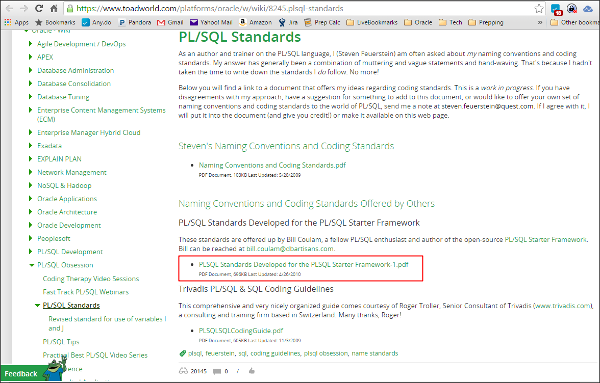
Templates & Tools: Standards
Google “PL/SQL Standards” Search
ToadWorld has Steven Feuerstein’s list
Read with team
Adopt one
Customize it
Ease and enforce with templates, formatters and peer review.

Slide 297
Templates & Tools: IDEs
IDEs provide scores of handy features to ease development, reduce duplication and improve productivity.
See Developer Client slide at the front of Part 1
Notes:
AquaData fee to Open Source Software contributors/authors

Slide 298
Templates & Tools: Formatters
Instant SQL Formatter website
SQL Developer’s SQL/Oracle Formatter
TOAD’s Formatter - Great, flexible formatter
PL/SQL Developer’s Beautifier - 98% there
SQL Detective’s Code Analyzer - formatter + more
DDL Wizard - for messy DDL

Slide 299
Templates & Tools: Text Search
In 2012 I compared ~40 text search tools
Had a small set of requirements
Many passed, but most were far too slow for deep search, especially with regex.
Best for little to no cost were:
  Cygwin grep and find with custom wrappers that also searched the entire database
  TextCrawler 3.0.3 Free Edition

Slide 300
Templates & Tools: File Comparison
In 2011 I compared ~30 text/file comparison tools
Had a small set of requirements
Most did not pass, even commercial tools
Best for little to no cost were:
  CompareIt! by Grigsoft
  WinMerge open source SourceForge project

Slide 301
Templates & Tools: Templates
Most PL/SQL IDEs come with a default set of templates and frequent code/code completion features
Best if the IDE can be pointed to a single, networked template, formatting rules, and password collection
  Approved changes are immediately shared by all
I love the rich template language in Allround Automations’ PL/SQL Developer IDE
  See the templates in Appendix A of the PL/SQL Programming Standards pdf mentioned 5 slides ago

Slide 302
Templates & Tools: Other Tools
If you’re on Apple, I’m no help
Other free* productivity helpers I use and love:
Cygwin - linux terminal power on Windows
Ditto - deep clipboard
DuckLink - rich screen capture tool
FileZilla - ftp client
FreeCommander XE - powerful file explorer
KeePass - password safe
MobaXterm/PuTTY - *nix terminal manager
Notepad++ - text editor
OneNote/EverNote - do-everything notekeeper
Notes:
Soapbox: If you fall in love with it as well and use it every day, donate a measly $5 to $20 to keep the free software movement alive. Time is money. Say thanks for saving you tons of time.

Slide 303
Oracle Application Development
There are other aspects and tools of database development that have not been covered here, each of which could occupy 4 to 8 hours just becoming familiar with all the features. You are encouraged to investigate these areas on your own:
Edition-based Redefinition
Continuous Query Notification
Data replication, asynchronous transactions and queues
Publish/subscribe
PL/Scope and the Hierarchical Profiler
Oracle Text
Object-relational features of Oracle
JSON and web services support
Application Express (APEX)
Spatial and Multimedia
XML, .NET, Java and JDBC
Globalization/i18n features and more

Slide 304
Some Parting Hard-won Lessons
Model data correctly first. Then make it friendly¹.
Get another pair of eyes on it.
Involve users early and often.
Reduce and Reuse. Don’t Repeat.
Test with plenty of dirty data.
Document it well.
Simplify.
Notes:
1: Use views to minimize joins and materialized views for performance

Slide 305
End Part 2

