Slide 1
Dynamic Debugging
and Instrumentation of Production PL/SQL
Pain-free Auditing, Metrics and Troubleshooting

Slide 2
Bill Who?
RMOUG, IOUG and UTOUG. 10 yrs
PL/SQL enthusiast. 16 yrs
Andersen Consulting – SF, Denver
New Global Telecom – Golden
Structure Consulting Group – Houston
Church of Jesus Christ of Latter Day Saints
DBArtisans.com (place to keep my stuff)
Hiking, biking, snowshoeing, martial arts
Notes:
After hearing this presentation, I know it will be hard to believe, but I am not a professional speaker.
I’m just a fellow Oracle and PL/SQL enthusiast that enjoys learning, applying what I’ve learned, and sharing lessons from the trenches. I’ve been writing in C, C++, a little Java and PL/SQL for 16 years now, and speaking about it for 10.
I’ve worked as a consultant, architect, modeler, DBA and tuner for Andersen Consulting (telecom: PacBell, US WEST, AT&T), NGT, (2nd tier long distance and VOIP), SCG (energy utility software), and now for my church in Utah.
When I’m not working with Oracle, I enjoy spending time with my kids, my scouts and getting in some time in the Rockies, camping, hiking, biking and snowshoeing. Also took up tactical martial arts 2 years ago, which I’m really enjoying.
I’d like to encourage everyone here to submit to RMOUG as well. You never learn more than when you have to teach.

Slide 3
Survey
Strictly DBA? Strictly developers? Hybrids?
Written PL/SQL that was release to Prod?
Significant personal or enterprise investment in production PL/SQL?
Who has never had anything go wrong in that production PL/SQL?
When things do go wrong, how long does it take to find out what it is doing, what it did, why it did what it did?
How did the users/mgmt appreciate your handling of the issue?
Notes:
To set the stage and get the gears turning a little, I’d like to ask a few questions:

Slide 4
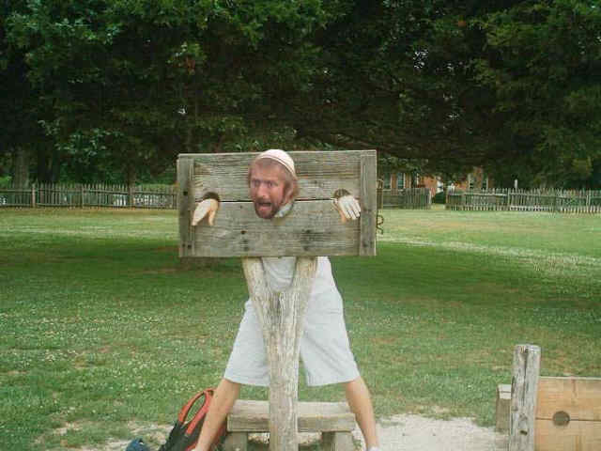
Notes:
Did they appreciate your efforts and the outcome kind of like this? (kitten pic)
Or is Brian here in the stockades a better likeness of how things went for you?
Today I’d like to show you a few easy to learn and apply techniques and tools that should make production problem resolution feel more like the first pic (kitten)

Slide 5
If You Remember Just One Slide…
Instrumentation should be designed into the system from day one, and in place before the production problems occur.
But in can be added easily after as well.
Adopt or build a standard library, a standard to use the library, and peer reviews to enforce it.
It must meet both developer and enterprise needs so it gets used.
Do it! It’s easy and rewarding.
Notes:
I always like to start with the end in mind. So here is the conclusion to this presentation…and then we’ll see how we’re going to get there.

Slide 6
Agenda
Typical Production Problem Lifecycle
Define instrumentation
Oracle built-ins for instrumentation
Develop requirements of good instrumentation
Existing instrumentation libraries
Demos using one of them
Notes:
So we’re going to talk about the lifecycle of a typical production PL/SQL problem, in particular finding the problem.
We’ll define instrumentation and see how it can apply it to the same production problem diagnostics
Then we’ll look at some built-in tools provided by Oracle to do diagnostics on production PL/SQL. They come up short.
So we’ll briefly survey the existing instrumentation tool landscape and show just one example where we install it and begin using it right away.

Slide 7
Production Problem Lifecycle
Become aware of a problem
Find the source of the problem
Fix the source of the problem
Or slow the bleed
Repair issues the problem caused
Often data to repair, customers to call, hotfixes to document, emails to send, reports to re-run.
Rebuild trust (costliest, longest step)
Do things better so problem doesn’t happen again
Notes:
What steps does a production problem usually pass through on its way to being found, resolved and everything returning to normal?
This slide it pretty much common sense. We will be spending the remainder of our time on the first two points. But while putting this to paper, it dawned on me that I’d seen these steps outlined somewhere before…in addiction recovery material I’d seen somewhere before. Felt compelled to review the AA 12 step program, and was struck by the similarities between the two processes of weaning ourselves from destructive behavior (bugs and alcoholism).

Slide 8
The 12 Steps to Recovery
Admitting that one cannot control one’s addition or compulsion (become aware)
Examining past error with the help of a sponsor (find source)
Learning to live a new life with a new code of behavior (fix source)
Making amends for these errors (repair effects and rebuild trust)
Recognizing a higher power that can give strength (instrumenting)
Helping others who suffer from the same addictions or compulsions (share & evangelize)
Notes:
The twelve step program includes…(go over each point, pointing out similarity to ridding system of bugs.

Slide 9
Becoming Aware
The Silent Fester, aka “The Norm”
No monitoring, auditing, metrics or history.
No one calls. Users get used to slowness/badness.
User calls or submits ticket
Side Effects
Incremental buildup until something backs up, never returns, fails, etc.
Proactive monitoring
Determines errors occurring
Determines performance is atypical
Notes:
So how do we first become aware of our Production problems? (class discussion, repeat answers for mic)
There’s the Silent Fester, which unfortunately is the norm in too many Oracle shops, where there’s no proactive monitoring, auditing, metrics or logged history.
Sometimes the users get fed up or notice a new issue, and they’ll call or email.
We might become aware due to side effects of the root problem
Or, in an ideal world, there IS proactive monitoring of sessions, SQL, resources, logs, metrics, audit data, etc, analytics performed on them, and our systems notify us when something is amiss.

Slide 10
Finding the Problem Source
Start peeking, prodding, poking, querying, hoping, guessing, trial and error, etc.
Ad-hoc, afterthought methods include:
DBMS_OUTPUT
Add some logging to file; recompile
Add some logging to table; recompile
GUI tool or DBMS_DEBUG API
What is wrong with these methods?
Even heroic efforts are too slow, error-prone, guess-prone, require downtime and leave customer impatient.
Notes:
Now that we’re aware of the problem, what do we use to find the root cause? (class discussion, repeat answers for mic)

Slide 11
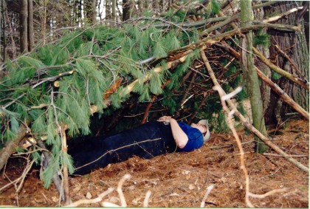
Typical Production PL/SQL
The “lean-to”, or “just enough to make it run”
Notes:
Why is it so hard? Because most PL/SQL developers and DBAs I’ve met don’t think, design or code like frontend programmers.
Steven Feuerstein’s experience. My experience. Re-usable code, libraries, frameworks fall on deaf ears. DB-types generally like to code everything from scratch, and then just enough so that it will run, and call it good. I like to call this kind of production code “the Lean-To”

Slide 12
Typical Production PL/SQL
The “shanty” or “house of bolt-ons”
Notes:
But this is what I saw more of when consulting and joining companies with prior PL/SQL investment. You know the code I’m talking about don’t you? Sadly this is sometimes the work of just one guy, but more often than not, it’s the result of 8 of so DB folks touching the code over the year, without even a nod to cleanliness, re-use, simplification, modularity, instrumentation, etc.
I’ve inherited environments with hundreds of nasty little PL/SQL standalone huts like this. The fire-fighting alone was enough to cost the company millions each years as the Rube-Goldberg contraptions that was our production code gasped for air.
Why is there never enough time to do it right, but there’s always enough time to do it over?

Slide 13
This is not fun
“Code as if the next guy to maintain your code is a homicidal maniac who knows where you live.” – Kathy Sierra and Bert Bates
Notes:
This is no way to live. This is not fun! An architect at my current employer has this quote above his desk:

Slide 14
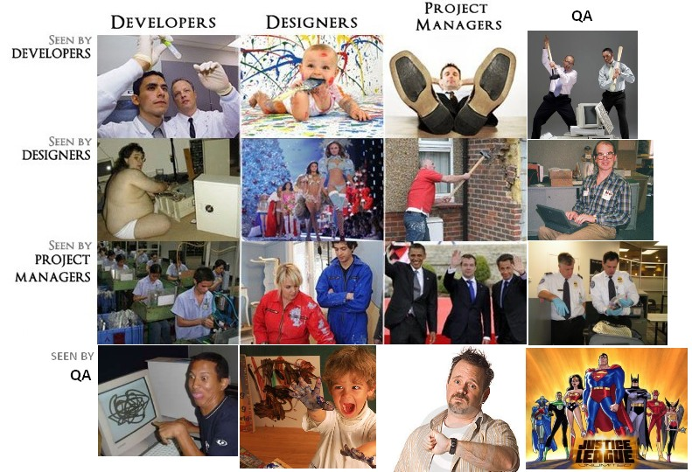
How other techies see developers
Notes:
We don’t want our deliverables and production results to lend any weight to how other techies already see us.

Slide 15
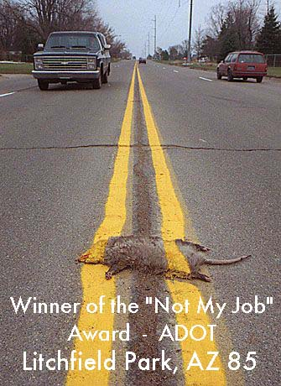
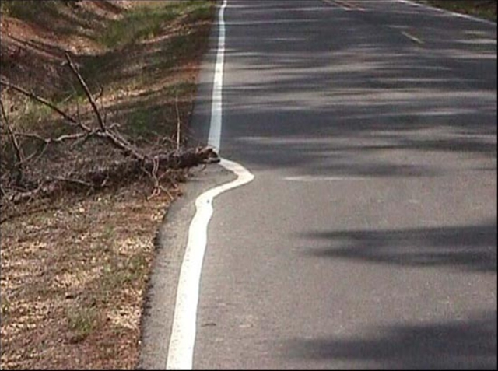
Is it my job?
Somebody needs to care enough to do it right, or somebody else will have to do it over!

Slide 16
Agenda
Typical Production Problem Lifecycle
Define instrumentation
Oracle built-ins for instrumentation
Develop requirements of good instrumentation
Existing instrumentation libraries
Demos using one of them
Notes:
Programming, at the least the sort that gets me up in the morning, is supposed to be fun!
There are many best programming practices to get you there. I’m going to focus on instrumentation and dynamic debugging.
I’ll show you an easy way to supplement your passion for awesome, performant, maintainable code that you can be proud of.
I’m hoping you’ll get so excited, you’ll download an instrumentation library during this talk, install it and start using it when you get home.

Slide 17
There is Another Way
Write and document public interface.
Write tests that all fail.
Write body in pseudo-code.
Fill in the algorithm, making sure routine does one thing and one thing well. Ensure it uses assertions to check assumptions. Clean. To standard. Formatted.
Then I go back and wrap pseudo-code with log and debug calls, adding a little runtime context. Voila! 3-birds with one stone.
Then I run the tests until they all work, using the instrumentation and metrics if there is trouble.
Simple
Elegance
Notes:
So rather than coding like typical database developers, how should it be done?
Write and document public interface.
Write tests that all fail.
Write body in pseudo-code.
The fill in the algorithm, making sure routine does only one thing and one thing well. Make sure it uses assertions to check assumptions. Clean. To standard. Formatted.
Then I go back and wrap pseudo-code with log and debug calls, adding a little runtime context. Voila! 3-birds with one stone.
Then I run the tests until they all work, using the instrumentation and metrics if there is trouble.
Code written like this resembles, to me, Frank Lloyd Wright’s masterpiece: Falling Water

Slide 18
There is Another Way
Instrumentation
“Instrumentation is the process of fitting production applications with code that directs runtime context to some destination where it can be useful.”
Notes:
Here’s how I like to define instrumentation.
Instrumentation can be seen as time-consuming and a chore, but the payback is enormous when things go wrong, as they sometimes do. Instrumented code is easy to measure, tune and troubleshoot. When called upon, it can provide all the information needed to easily diagnose performance, security or functional problems.

Slide 19
There is Another Way
Runtime Context
“The runtime context can be who, when, what was passed in, what changed, time taken, errors and warnings encountered, etc.”
Three categories:
Debugging – disabled by default
Logging – enabled by default
Error, warning, informational, metric
Column-level Audit Data
Notes:
Runtime context is…
I see runtime context fitting into threat neat buckets: debug messages, log messages and fine-grained audit data

Slide 20
There is Another Way
Destination
“The destination of the runtime context can be stdout, V$ performance views, a logging table, a log file on the database host, a queue for asynchronous publication and monitoring, a DBMS pipe or alert, and other slower, more complex alternatives like HTTP, FTP and UDP callouts.”
IMHO: Best option is logging table written within an anonymous transaction
Notes:
The destination of the runtime context is really up to you, but my favorite is a logging table behind an anonymous transaction.

Slide 21
Finding the Problem Source
With instrumentation in place…
Simply review what happened
If instrumentation was in place
Auditing: who changed what, and when?
Metrics: how long did it take?
Informational and Error Logging: what happened?
Notes:
Going back to finding the problem source, rather than peeking, prodding, poking and hoping, the ideal method to find the problem is to simply review what happened. We open the detailed logs, filled by our highly-instrumented code and reap the benefits of our wisdom and foresight. (Review Method B)

Slide 22
Finding the Problem Source
If option B does not find the root cause…
Replicate and monitor in real time
This requires dynamic debug logging pre-embedded in the code.
Notes:
But for certain systems and situations, reviewing what happened after-the-fact is not sufficient. Sometimes a problem simply can’t be replicated in environments other than Prod. In both cases, the error has to be replicated in Production, with detailed logging/debugging turned on, so we can see in real-time what is happening. (Review Method C)
When situations like that crop up, wouldn’t it be nice to flip a switch, and see everything that is happening? What if that is too much info? Wouldn’t it be useful to narrow that logging to your user, session, PL/SQL unit, backend process or report?

Slide 23
Agenda
Typical Production Problem Lifecycle
Define instrumentation
Oracle built-ins for instrumentation
Develop requirements of good instrumentation
Existing instrumentation libraries
Demos using one of them
Notes:
Let’s look at what comes with Oracle. Perhaps it has something that would meet our needs for fine-grained auditing, logging, debugging, and metrics.

Slide 24
What is Available From Oracle?
Column-level Auditing
11g Flashback Data Archive (Total Recall)
Most build custom triggers to capture change, and tables to hold the history.
Metrics
DBMS_UTILITY.get_time {DEMO}
DBMS_PROFILER {DEMO}
Notes:
Oracle’s basic and fine-grained auditing features seem promising, but it turns out that neither provide column-level auditing that can track who changed a column value, what changed, and when. Oracle really had nothing for column-level auditing until 11g’s FDA
Can’t manage what you don’t measure. Method-R. The ability to time a process has always been there, at least as long as I can remember, found in DBMS_UTILITY.get_time. returns elapsed time in terms of hundredths of seconds Who here has not used this function before? DBMS_PROFILER helps you quickly identify performance bottlenecks and when integrated with a GUI tool, can do so in an intuitive and visual way. However, like the debug feature, it is less useful for the sessions and routines being accessed by end users. It is better used while tuning in development where you have full control of the start of the session and what is called.

Slide 25
What is Available From Oracle?
Logging/Debugging
DBMS_OUTPUT
Notes:
When most Oracle developers think of debugging PL/SQL, their thoughts turn to DBMS_OUTPUT. This is like bringing the rusty, flatted BMX bike you had as a kid to a street race, instead of the Yamaha YZF-R1 superbike sitting unused in your garage. DBMS_OUTPUT, like Java’s System.out.println, is known as a “poor man’s” debugger. Although it can be useful, and has been a staple of PL/SQL coders for 15 years, it should only be used in quick-and-dirty development and discovery. Worst part is transaction dependence.
A more appropriate use of DBMS_OUTPUT is as a quick-and-dirty logging tool for transient anonymous blocks, often written during data exploration, unit testing and development. We use DBMS_OUTPUT within our automated database build system to read what happened in scripts that had anonymous PL/SQL blocks, piping the output to the build logs, which are further examined by the tool for build success or failure. If building, buying or adopting an instrumentation library, ensure that it includes the ability to output messages to stdout/screen, and that it is transaction-independent.
It has many limitations and far superior alternatives, like DBMS_PIPE and DBMS_DEBUG, which we’ll cover…now

Slide 26
What is Available From Oracle?
Logging/Debugging
DBMS_DEBUG & DBMS_DEBUG_JDWP {DEMO}
Notes:
Traditional debugging is usually done within a programmer’s IDE and allows the troubleshooter to step in/out of modules, run to breakpoint or condition or exception, add watches, change variables at runtime, peer into memory structures, view code execution in real-time, etc. PL/SQL has this capability too.
Since Oracle 7, there has been a debugging API that PL/SQL IDEs have used to provide the veritable debugging superbike.
To debug, need DEBUG CONNECT SESSION system privilege.
With DBMS_DEBUG_JDWP it is possible to begin a session with some other application, and have the IDE “wake up” when it detects a connection entering that object. Unfortunately, it does no good if the client application was not coded for remote debugging.
Leaving objects compiled for debug in Production is not recommended. Performance can be impacted due to the overhead it imposes. But in my experience, the scariest thing was stability.

Slide 27
What is Available From Oracle?
Logging/Debugging
ORADEBUG
Notes:
This “undocumented” but well-known utility does allow real-time peeking into other sessions, one of the things instrumentation should be able to do. Unfortunately, it is oriented more towards really low-level memory and process debugging and tracing. It is the stuff of Oracle wizards that peep and mutter. Oracle Support prefers that you not use it unless instructed to. That it requires SYSDBA privilege is another factor against using it for production instrumentation. There are many informative papers on this utility if still curious, but there are definitely far less obtuse ways of peering into the execution of active sessions.

Slide 28
What is Available From Oracle?
Logging/Debugging
DBMS_ERRLOG? Nope.
Notes:
This package sure sounds like what we need for logging, but the name is somewhat misleading. It is only used to create a special DML error logging table. It is useful in its own right, but useless for the kind of logging we need.

Slide 29
What is Available From Oracle?
Logging/Debugging
DBMS_ALERT {DEMO}
Notes:
Despite the docs indicating DBMS_ALERT is useful for asynchronous notification of database events, its use is transactional; that is the waiting client can’t see the desired event message until after the alerting session commits. This is an Achilles heel for instrumentation which needs to deliver its messages, even if the transaction fails and rolls back.
According to various sources, using alerts is also resource intensive. The client has to wait (blocks) and the server piece requires a pipe and a lock.
I found that it takes about a second to get registered and return to waiting, as the signals that followed right after a prior signal were simply lost. Oracle docs warn about this possibility. The messages are limited to 1800 chars as well. Finally, session-specific metadata, like client_id isn’t communicated across to another session. Taken together, DBMS_ALERT is unsuitable for instrumentation.

Slide 30
What is Available From Oracle?
Logging/Debugging
DBMS_PIPE {DEMO}
Notes:
DBMS_PIPE is actually promising. Sending messages is independent of the sending session’s transaction. There is a level of security offered with private pipes that could be perfect for debug, timing and error logging within the application object-owning account. Packing the messages is a little cumbersome, and it does not guarantee message delivery like AQ does. Furthermore, once the message is consumed it is automatically removed from the buffer and cannot be read again. One can send the message to a table or file where it can be read again, but that begs the question why the message wasn’t sent directly to the table in the first place, bypassing the pipe entirely? DBMS_PIPE is a viable piece of infrastructure for getting instrumentation messages out of an application.

Slide 31
What is Available From Oracle?
Logging/Debugging
DBMS_APPLICATION_INFO {DEMO}
set_module(), set_action(), set_client_info() and set_session_longops()
Use DBMS_SESSION.set_identifier to set client_identifier seen in V$SESSION, AUDIT, trace and elsewhere.
Notes:
There are a few pieces of client metadata that, when set, are available in V$SESSION and a few other performance views. Since many performance views can join to V$SESSION by means of the sid+serial# or sqlid, availability in V$SESSION is typically sufficient. This metadata is labeled as module, action, client_info and client_identifier. Despite what the package specification says in 11g, Oracle still truncates their length to 48, 32, 64 and 64 bytes respectively. They are somewhat weak individually, but in combination they are powerful. Originally intended for 2-tier and client-server applications to identify themselves to the database, they can be put to great use inside PL/SQL programs to provide DBAs with low-overhead, highly useful, real-time, transaction-independent keyhole views into what the program is currently doing. This is particularly handy when debugging programs taking longer than expected or hanging. I like to call this “tagging” a session.
DBMS_APPLICATION_INFO’s main routines are set_module(), set_client_info() and set_session_longops().
Ensure your frontend applications are passing the user’s login ID to the database to be stored in the client_identifier.

Slide 32
What is Available from Oracle?
Logging/Debugging
DBMS_APPLICATION_INFO
set_session_longops()
Notes:
On certain resource intensive operations (like DML on more than 10,000 blocks) and certain parallel operations, Oracle automatically records how much work it has to do and how far along it is in the V$SESSION_LONGOPS view. With this info one can construct a query and even a frontend progress bar to inform how long database operations will take. Oracle allows us to write to that view to track our own scripts, DDL operations or DML statements through set_session_longops().
This is known as end-to-end identification. Oracle docs call it end-to-end metrics. I’ve given an entire presentation on this subject, so won’t go into detail here.
Note that the time_remaining value in the v$session_longops view should not be construed as 100% accurate. There are a number of variable that affect the accuracy of metrics in this view. One of them is recursive SQL statements (like index updates and such) which don’t figure into the time remaining.
Drawbacks to calling DBMS_APPLICATION_INFO routines pertain to the durability of the tags. Sometimes they stay around too long (if the developer forgets to clear them out). This is especially risky with the client_identifier, which could accuse the wrong user as the changer of sensitive data. Sometimes they are cleared or overwritten prematurely. This is particularly tricky if one instrumented routine with tags calls another instrumented routine with tags. This wipes out the session tag from the calling routine, leaving the incorrect tags in place once control returns from the subroutine. So although DBMS_APPLICATION_INFO should be an integral part of an instrumentation library, it is no fun to type repeatedly and it should be wrapped in a library to nested tagging. If modifying your application’s connection classes to pass the client_id, also modify them to clear package state, application contexts, and session tags before returning the database connection to the pool.

Slide 33
What is Available From Oracle?
Logging/Debugging
DBMS_SYSTEM {DEMO}
<msg time='2012-02-03T18:30:40.283-07:00' org_id='oracle' comp_id='rdbms'
client_id='bcoulam' type='UNKNOWN' level='16'
host_id='R9AXR65' host_addr='fe80::cd94:25d3:ee1a:9777%11' module='PL/SQL Developer'
pid='15156'>
<txt>WARNING! Here is my real-time msg logged to alert.log
</txt>
</msg>
Notes:
SYS.DBMS_SYSTEM includes the ksdwrt() routine, which lets you write messages directly to the alert log, independent of the containing transaction. It is the closest thing Oracle includes that almost matches our needs for logging. If the client identifier has been set, it will be used in the alert log entry, helping pinpoint who generated a particular message. A timestamp will be written, along with other session metadata like client module (program), client machine name and address, module, and host process ID The first parameter to ksdwrt must be 2 if writing to the alert log.
DBMS_SYSTEM is not typically granted to non-SYSDBA accounts (for good reason). Writing to the alert log is not a great idea either. Oddly, each new line in your message is interpreted by ksdwrt as a separate message, and normal characters are escaped with their HTML equivalents, making some messages to read outside of a browser. Plus you can’t control the format of the log messages. Think very carefully before opening its use up to other accounts or roles.

Slide 34
What is Available From Oracle?
Logging/Debugging
UTL_FILE, UTL_HTTP, UTL_TCP
Notes:
The UTL_FILE package provides the low-level framework required of any logging solution that wishes to write to database host files. As long as a file has been successfully opened in write or append mode, calling UTL_FILE.put_line will send a message to the file, formatted as desired (up to 32K characters per line), independent of the encompassing transaction. However, using all of UTL_FILE’s constants, exceptions and routines is rather involved and prone to human error. It is best to wrap this in a custom file-logging API that hides much of the complexity for your developers.

Slide 35
What is Available From Oracle?
Logging/Debugging
USERENV namespace and V$SESSION, V$SESSION_LONGOPS
Notes:
There are a number of scattered helper routines and built-in functions that can return metatadata about the connected client, database host, database, instance, version, etc. These are things like DBMS_UTILITY.current_instance, DBMS_DB_VERSION.version and release, and SYS_CONTEXT(‘USERENV’,’<attribute>’) which offers a host of values describing the current session. These should be included in your instrumentation library so that they get used and used consistently when logging messages

Slide 36
Agenda
Typical Production Problem Lifecycle
Define instrumentation
Oracle built-ins for instrumentation
Develop requirements of good instrumentation
Existing instrumentation libraries
Demos using one of them
Notes:
Given everything we now know about what Oracle offers, and their drawbacks, we can form a decent list of requirements as we design or shop for a library of re-usable instrumentation routines.

Slide 37
Heavenly Instrumentation
Simple API to clock and record metrics
Should handle nested timers
Simple API to tag sessions and long operations
Should handle nested tagging
Simple API to write files
Simple API for static & dynamic log messages
Must be independent of the calling transaction
Standard method of handling exceptions
Routines to gather client & session metadata so the APIs can remain simple
Tables and helps to create column-level auditing structures and triggers
Notes:
With any time spent in maintenance, you quickly form a set of requirements, a vision for standard logging and debugging, that if met would make your life as an engineer fun and rewarding, instead of constant fire-fighting. If you are going to build your own library, ensure it meets most of these requirements, or it will quickly be ignored and fall into irrelevance.

Slide 38
Heavenly Instrumentation
Dynamic Logging
Off by default, and low overhead, so insightful debug lines can remain in Prod code
Can be turned on and off without Prod interruption
Toggles kept in a table or application context
Turn on for a PL/SQL unit or list of units, session, end user or named process, IP address, domain
Notes:
Where it comes to dynamic debug logging, there are additional details our library should handle.

Slide 39
Heavenly Instrumentation
Simple
dbg(‘Calling X with ‘||i_parm);
info(‘BEGIN: Nightly Reconcile’);
warn(‘X took ‘||l_diff||’ s too long’);
err();
tag();
startT(); <stuff> stopT(); elapsed();
Origin Metadata Transparently Derived
Time, unit, line, caller identifiers
End user identifiable from end-to-end
Notes:
By simple, I mean simple. Easy to remember. Easy to type. Not easy to screw up.

Slide 40
Heavenly Instrumentation
Choice of Output
Minimally: to table and screen
Optionally: to file
Nice to have: ftp, pipe, AQ, http, etc.
Output must be transaction-independent
Notes:
Our instrumenation library should at least allow logging of messages to screen and table, optionally to file. There are other possibilities, not as useful or necessary in my opinion, that you’d have to evaluate to see if they better meet your needs.

Slide 41
Agenda
Typical Production Problem Lifecycle
Define instrumentation
Oracle built-ins for instrumentation
Develop requirements of good instrumentation
Existing instrumentation libraries
Demos using one of them
Notes:
Let’s take a look at the commercial, open source and freeware market.

Slide 42
Frameworks & Libraries
Resource Name | License | Purpose | Location & Notes
Google Code | Free | Library of libraries | http://code.google.com/hosting/search?q=label:plsql
Feuerstein PL/SQL Obsession | Free | Repository of all things SF and PL/SQL | http://www.toadworld.com/sf
QCGU (Quest CodeGen Utility) | Free | Full framework, Standards, Scripts, Template Factory, Code Generation, + more | http://codegen.inside.quest.com/index.jspa Latest incarnation of Feuerstein's vast reservoir of experience. (successor of QXNO, PL/Vision, and PL/Generator.)
PL/SQL Starter | Free | Author's full framework. | http://sourceforge.net/projects/plsqlframestart
Simple Starter | Free | Logging, Timing, Auditing, Debugging, Error Handling, + more | Simplified PL/SQL Starter to just logging, timing and auditing components (and the low-level packages they depend on). Designed to be used in one schema. Install and begin using in under a minute.
GED Toolkit | $120-$1200 | Almost full framework | http://gedtoolkit.com Includes APEX UI to administer jobs and tables. Monitor processing.
PL/Vision | Free | Framework, API Generator, + more | http://toadworld.com/Downloads/PLVisionFreeware/tabid/687/Default.aspx Replaced by QXNO and then QCGU. Not supported.
Log4ora | Free | Logging | http://code.google.com/p/log4ora/ Fresh, full-featured logging library. Alerts. AQ. Easy to use. Good stuff.
ILO | Free | Timing and Tuning | http://sourceforge.net/projects/ilo From the sharp minds at Hotsos
Quest Error Manager | Free | Error Handling | http://www.toadworld.com/LinkClick.aspx?link=685&tabid=153 Included in QCGU. But offered separately as well. Not supported.
Plsql-commons | Free | Collection of utilities, including logging | http://code.google.com/p/plsql-commons
Log4oracle-plsql | Free | Logging | http://code.google.com/p/log4oracle-plsql Seems like an active project, but could not find code to download…
Log4PLSQL | Free | Logging | http://sourceforge.net/projects/log4plsql Popular, but aging and complex log4j analog in PL/SQL
Logger | Free | Logging | http://sn.im/logger1.4 Recently orphaned when Oracle decommissioned its samplecode site. Simple. Easy to use.
Orate | Free | Logging | http://sourceforge.net/projects/orate Never used it, but has been around a while. Still active.

Slide 43
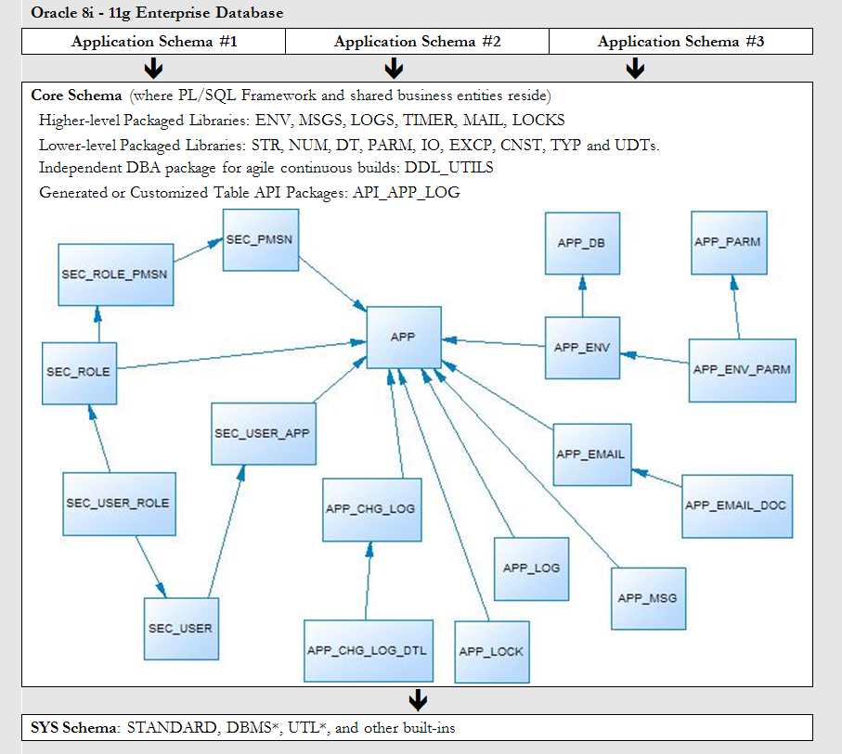
PL/SQL Starter Framework
Notes:
These requirements are met within an open source PL/SQL framework, available on SourceForge, that I wrote. This is an overview of the data entities within it, and the PL/SQL libraries available.
A trigger generator, and the app_chg_log/app_chg_log_dtl tables are used for auditing column-level changes, who did it, and when.
The LOGS package, and the app_log table are used for the static and dynamic debugging spoken of in this presentation.
The app, app_db, app_env, app_parm and app_env_parm tables compose the submodel that make environment-aware, dynamic parameters possible.

Slide 44
Starter => Simplified
Thousands of downloads, but not much feedback or developer contributions.
Too many moving parts.
Too complex for shops with one app per schema or one app per DB.
60 page doc and days to week learning curve
Security often done in directory server now
Common messages almost never used
Email-from-DB tables rarely used
Locking always needs customization

Slide 45
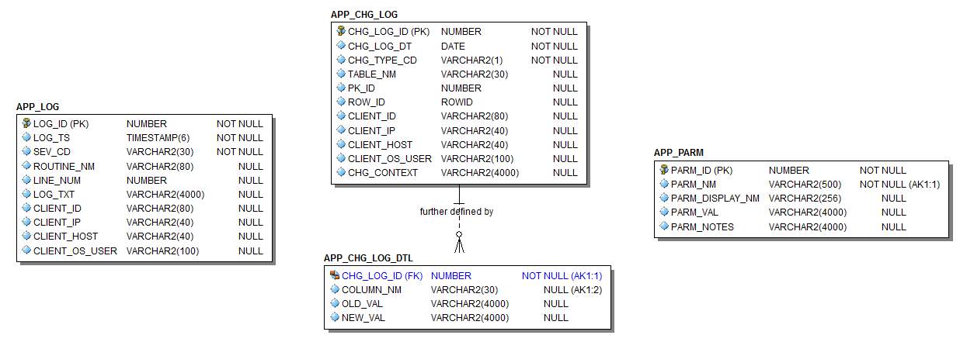
Simple Starter
LOGS, TIMER, ENV, gen_audit_triggers.sql

Slide 46
Simple Starter
Library | Main Routines | Supporting Components and Notes
Auditing: gen_audit_triggers.sql |  | APP_CHG_LOG, APP_CHG_LOG_DTL (tables)
Metrics: TIMER (package) | startme() stopme() elapsed() | Uses DBMS_UTILITY
Debugging, Logging and Error Handling: LOGS (package) EXCP (package meant to be used only by LOGS) APP_LOG_API (pkg meant to be used only by LOGS) | err() warn() info() dbg() | APP_LOG (table) TRIM_APP_LOG (scheduled job)
Connection Metadata: ENV (package) | init/reset_client_ctx() tag/untag() tag_longop() | Uses DBMS_DB_VERSION, DBMS_APPLICATION_INFO, DBMS_SYSTEM, v$session and v$mystat.
File Operations: IO (meant to be used primarily by LOGS) | write_line() write_lines(0 p() | Uses UTL_FILE, DBMS_LOB
Dynamic (Table-Driven) Parameters/Properties: PARM (package) | get_val() | APP_PARM (table)
Extras (required for the seven libraries above to function): CNST, TYP, DDL_UTILS, DT, STR, NUM (packages) | These are libraries of application-wide constants and subtypes, build utility functions; date, string and number manipulation routines.

Slide 47
Starter: Auditing Components
The Starter Framework comes with a “gen_audit_triggers.sql” script which can generate a trigger for every table in your schema.
Run it. Remove triggers not needed. Remove auditing on columns not needed.
Done.
Audited changes are recorded to APP_CHG_LOG and APP_CHG_LOG_DTL
May need view or materialized view to simplify access to audit data.

Slide 48
Starter: Metrics Components
TIMER package
startme(timer name)
stopme(timer name)
elapsed(timer name)
Log elapsed times
Create separate automated processes to monitor metrics, learn from them over time, and notify when anomalies are detected.

Slide 49
Starter: Log & Debug Components
LOGS package
info(msg)
warn(msg)
err(msg)
dbg(msg)
set_dbg (boolean and directed)
Use info(), warn() and err() to record important data, expected and unexpected error conditions.
Use dbg() to document code and leave hooks for dynamic, real-time logging.

Slide 50
Starter: Debug Toggles
Toggles in APP_PARM
Debug (on/off, session, unit, user)
Debug Toggle Check Interval (in minutes)
Default Log Targets (Screen=N,Table=Y,File=N)
Toggles can be altered in the table
Toggle can be temporarily overridden through logs.set* routines

Slide 51
Starter: Log Destinations
Screen
Quick-and-dirty testing and debugging.
10K messages in 1 sec
Log Table
10K messages in 4 sec
A default job keeps the table trimmed to a couple weeks of data.
File
10K messages in 15 sec
Note: 10K messages to DB pipe in 8 sec + another 4 sec to log them
Notes:
More should be said about the log targets mentioned in the previous slide

Slide 52
Starter: Call Origin Metadata
ENV package governs metadata
Gets, sets and secures info about the host, database, session, calling application, calling client and application contexts.
End-to-End User Identification
Modified Java connection classes to set and clear the user’s login using env.init_client_ctx and reset_client_ctx
Uses custom application context, DBMS_SESSION procs and internal memory structure to discourage spoofing

Slide 53
Monitoring and Tracing
ENV offers:
tag/untag to modify module, action and client_info
tag_longop to track long operations
init/reset_client_ctx to set/unset client_identifier and other client metadata if desired

Slide 54
Agenda
Typical Production Problem Lifecycle
Define instrumentation
Oracle built-ins for instrumentation
Develop requirements of good instrumentation
Existing instrumentation libraries
Demos using the “Simple” PL/SQL Framework
Notes:
So we’re going to talk about the lifecycle of a typical production PL/SQL problem, in particular finding the problem.

Slide 55
Putting it Together
Solution Manager just called.
After last night’s release, she is not getting her daily file about the critical problem/solution repository.
{LIVE DEMO real-time debugging, monitoring, and adding instrumentation to two pages of code}

Slide 56
The End
Questions?
Ideas?
Contact: bcoulam@yahoo.com
Framework: sourceforge.net/projects/plsqlframestart/

