Slide 1
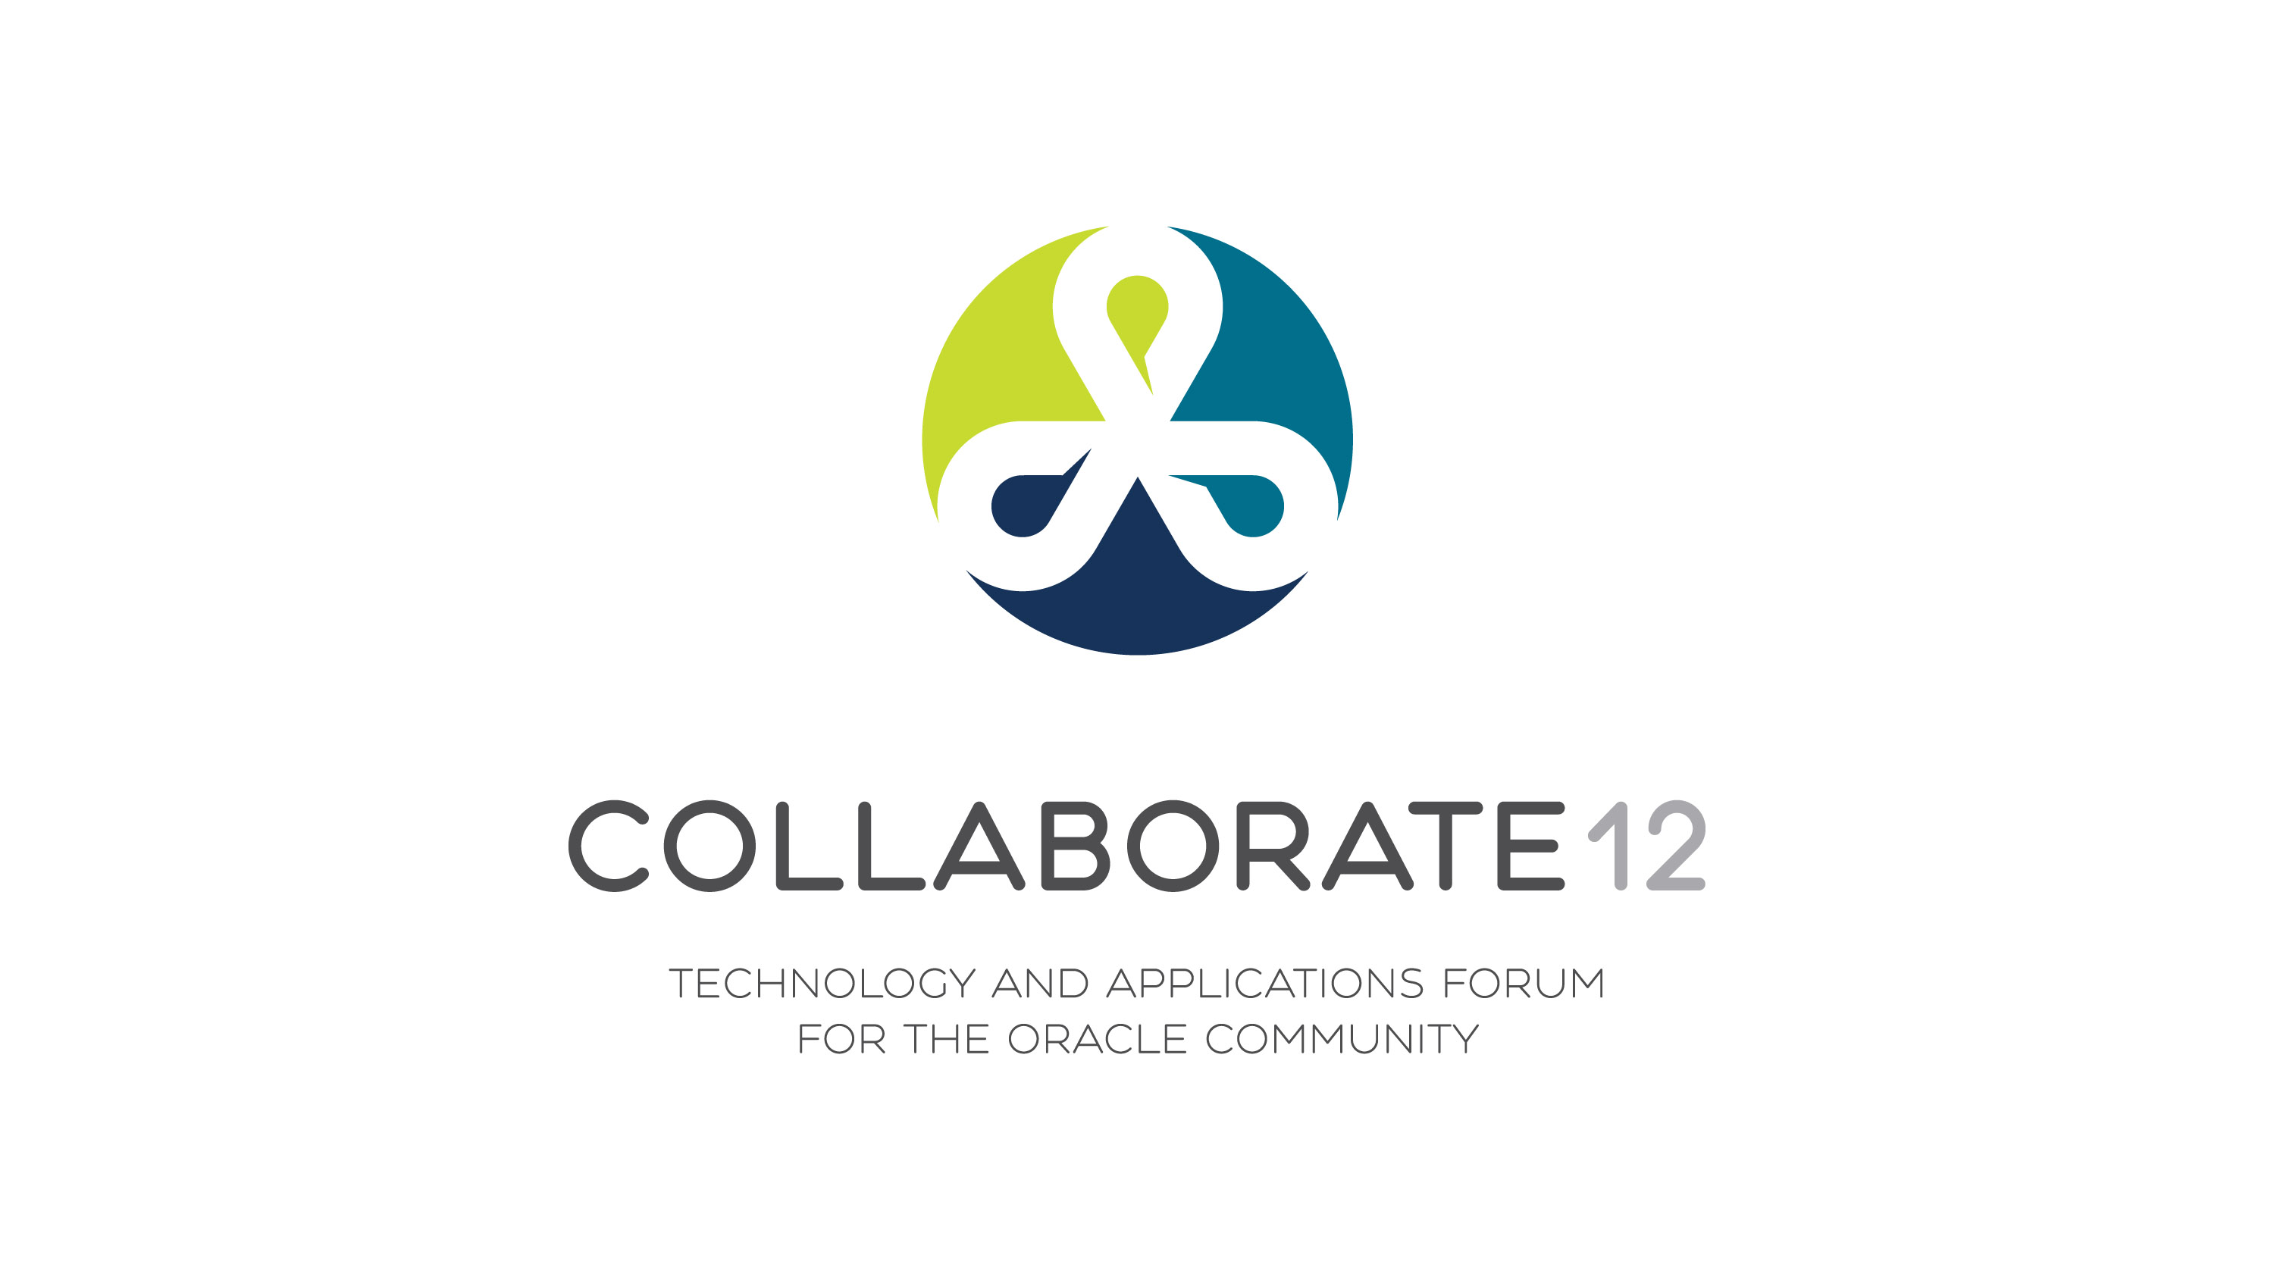

Slide 2
Dynamic Debugging and
Instrumentation
of Production PL/SQL
Notes:
Welcome

Slide 3
Bill Who?
RMOUG, IOUG and UTOUG. 10 yrs
PL/SQL enthusiast. 16 yrs
  Andersen Consulting – SF, Denver
  New Global Telecom – Golden
  Structure Consulting Group – Houston
  Church of Jesus Christ of Latter Day Saints
  DBArtisans.com (place to keep my stuff)
Notes:
After hearing this presentation, I know it will be hard to believe, but I am not a professional speaker.
I’m just a fellow Oracle and PL/SQL enthusiast that enjoys learning, applying what I’ve learned, and sharing lessons from the trenches. I’ve been writing in C, C++, a little Java and PL/SQL for 16 years now, and speaking about it for 10.
I’ve worked as a consultant, architect, modeler, DBA and tuner for Andersen Consulting (telecom: PacBell, US WEST, AT&T), NGT, (2nd tier long distance and VOIP), SCG (energy utility software), and now for my church in Utah.
I’d like to encourage everyone here to submit to IOUG as well. You never learn more than when you have to teach.
Before we get started, I’m trying something new this year to see if it is of any value to you. I’d like to share a few maxims and truths I’ve learned about database development over the span of my career. It’s not an exhaustive list of everything I’ve learned, but some of the more poignant lessons that keep reaffirming themselves upon me.

Slide 4
Some Lessons Learned
There’s always another bug.
Involve users early and often.
Is it redundant? Simplify.
Test with dirty data and plenty of it.
Get another pair of eyes.
Document the code well.
If it isn’t simple, back up, reduce, reuse.
Have compassion on your successor.
Notes:
#1 The first lesson is therapy for the perfectionist in me. At some point, it is good enough to ship. Just know that there will always be another bug or design flaw and don’t be too upset when it surfaces. You are only human after all.
#2 Andersen Consulting (now Accenture) used to mandate all new employees attend 2 weeks training in St. Charles, IL. The main point of the training was to involve stakeholders and end users early and often. This is still true almost 20 years later and has become a key part of agile methodologies. With constant feedback comes immediate and valuable improvement.
#3 This is a basic programming best practice. DRY (don’t repeat yourself). Don’t hardcode. Each routine should do one thing and one thing well. Use polymorphism when applicable. Etc. Simplify.
#4 Always make sure to test with representative data from production. Happy-day, hello world-like test cases won’t exercise your system well enough.
#5 Pair programming. Collaboration. Two heads are better than one. Staring at a problem for longer than 30 minutes, you’re too close to the forest to see the trees, etc.
#6 Documenting the public interface, spelling out how it is expected to be used, assumptions about the caller, etc. usually finds 85% of my bugs. The public interface is the only documentation that stands a snowball’s chance of ever being updated too.
#7 Back to #3. If it’s unwieldy, mind-boggling, hard to navigate, days to understand and use, etc., it’s wrong. Something happened. Back up and try again. Nuke and re-write if you have to.
#8 This lesson is relevant to this session. Your code should be easy to read, use, follow, debug and maintain. If not for your own sake, at least as a silent witness of your legacy and as a kindness to your successor.

Slide 5
Survey Says!
Strictly DBA? Strictly developers? Hybrids?
Written PL/SQL that was release to Prod?
Who has never had anything go wrong in that production PL/SQL?
When things do go wrong, how long does it take to find out what it is doing, what it did, why it did what it did?
How did the users/mgmt appreciate your handling of the issue?
Notes:
To set the stage and get the gears turning a little, I’d like to ask a few questions:

Slide 6
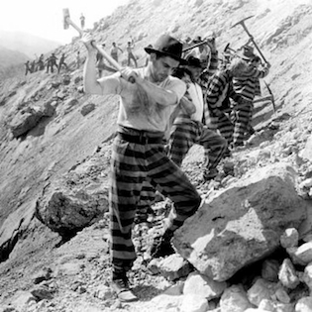

OR
Notes:
How did management reward your heroic efforts?
Programming, at the least the sort that gets me up in the morning, is supposed to be fun!
There are many best programming practices to get you there.
I’m going to focus on instrumentation and dynamic debugging, which are easy to learn and apply, yielding code that is easy to monitor, maintain, manage and troubleshoot.
I’m hoping you’ll get so excited, you’ll download an instrumentation library during this talk, install it and start using it when you get home.

Slide 7
Agenda
Typical Production Problem Lifecycle
Define instrumentation
Oracle built-ins for instrumentation
Develop requirements of good instrumentation
Existing instrumentation libraries
Demos: Debugging & adding Instruments
Notes:
So we’re going to talk about the lifecycle of a typical production PL/SQL problem, in particular finding the problem.
We’ll define instrumentation and see how it applies to becoming aware of and finding the problem.
Then we’ll look at some built-in features provided by Oracle that can be used to instrument. They come up short.
This drives us to survey the existing instrumentation market. We’ll take one of these and demo its installation and how you can be using it within minutes.

Slide 8
Lifecycle of Production Problem
Become aware of a problem
Find the source of the problem
Fix the source of the problem
Repair issues the problem caused
Rebuild trust (costliest, longest step)
Improve so problem doesn’t happen again
Notes:
What steps does a production problem usually pass through on its way to being found, resolved and everything returning to normal? {read through quickly}
This presentation focuses on the first two steps, which we want to be as quick and painless as possible.

Slide 9
Awareness of Problem
Non-instrumented:
  Silent Fester
  Side Effect
  New Guy
  Phone Call
  Email
  Pink slip
Instrumented: Proactive monitoring
Notes:
How do you typically become aware that there is a problem in Production?
The “Silent Fester” method. The “Side Effect” method. The “New Guy” method. Phone call. Error on end-users’ screen. Email. Operations monitoring alert logs, etc. The damage is already done by the time we become aware of problems through these methods.
In an ideal world, we would become aware of the problem before the users do. With instrumentation in place, we can proactively monitor sessions, SQL, resources, logs, metrics, audit data, etc… and perform analytics on them, letting our systems automatically notify us when something is amiss.
If something unexpected happens, which our proactive monitoring does not cover, we want to be able to find the problem as fast as possible.

Slide 10
Finding the Problem Source
Options without instrumentation:
  Hunt, poke, prod, peek, query, hope, trace, explain, waits, OEM, TOAD, AskTom, …
Options with instrumentation:
  Review what happened
  Replicate and monitor in real-time
  Add to proactive monitor
Notes:
Without instrumentation, it can be difficult to impossible in Production. With instrumentation, it can be a cake-walk.
But even with instrumentation, for certain systems and situations, reviewing what happened after-the-fact is not sufficient. Sometimes a problem simply can’t be replicated in environments other than Prod. In both cases, the error has to be replicated in Production, with detailed logging/debugging turned on, so we can see in real-time what is happening. Once found and fixed, a rule or module can be added to proactively look for and notify if the same condition arises again.

Slide 11
Agenda
Typical Production Problem Lifecycle
Define instrumentation
Oracle built-ins for instrumentation
Develop requirements of good instrumentation
Existing instrumentation libraries
Demos: Debugging & adding instruments
Notes:
Most of us knows what it is to debug code. But what is “instrumenting” code?

Slide 12
Instrumentation
Big word, but more familiar than it seems
  Dashboard of car and airplane
  Task Manager/Process Explorer
  Network Operations Center
  What do they have in common?
Instrumentation: the process of fitting applications with code that directs runtime context to some destination where it can be useful.
Pics
Notes:
It’s a mouthful. Big word. Not fun to say or type repeatedly. But I can’t think of a better word except for windows, which is probably trademarked.
Instrumentation is actually a concept that is very familiar to us all. {Show pics.}
Imagine driving a car, flying an airplane, running a telephone network or large enterprise WAN with absolutely no windows, graphs, dials, reports or data of any kind to tell you what the system is currently doing. And yet this is how we like to write our software because we perceive the instrumentation is busywork. Complex systems require instruments, windows into the guts of the system.
Here’s how I like to define instrumentation in the context of software engineering.

Slide 13
Runtime Context
Who, when, what was passed in, what changed, time taken, errors and warnings encountered, etc.
Four categories of runtime insight:
  Debugging – disabled by default
  Logging – enabled by default
    Error, warning, informational, metric
  Column-level audit data
  Monitor and Trace
Notes:
Runtime context is…
I see runtime context fitting into four buckets…

Slide 14
Destination
Direct runtime context to stdout (screen), V$ views, a logging table, a log file on the database host, a queue for asynchronous re-direction, a DBMS pipe or alert, and other slower, more complex alternatives like HTTP, FTP and UDP callouts.
IMHO: Best option is writing to heap table within an anonymous transaction
Notes:
The destination of the runtime context is really up to you, but my favorite is a logging table behind an anonymous transaction.
Kept in the database you automatically inherit everything Oracle and SQL offer (query, filter, mine, backup, etc.)

Slide 15
Agenda
Typical Production Problem Lifecycle
Define instrumentation
Oracle built-ins for instrumentation
Develop requirements of good instrumentation
Existing instrumentation libraries
Demos: Debugging & adding instruments
Notes:
Let’s look at what comes with Oracle.

Slide 16
Oracle Instrumentation APIs?
Column-level Auditing
  11g Flashback Data Archive (Total Recall)
  Most build custom triggers to capture change, and tables to hold the history.
Metrics
  DBMS_UTILITY.get_time {DEMO}
  DBMS_PROFILER {DEMO}
Notes:
Oracle’s basic and fine-grained auditing features seem promising, but it turns out that neither provide column-level auditing that can track who changed a column value, what changed, and when. Oracle really had nothing for column-level auditing until 11g’s FDA
Can’t manage what you don’t measure. Method-R an entire methodology about performance tuning based on response time.
The ability to time a process has always been there, at least as long as I can remember, found in DBMS_UTILITY.get_time. returns elapsed time in terms of hundredths of seconds Who here has not used this function before? DBMS_PROFILER helps you quickly identify performance bottlenecks and when integrated with a GUI tool, can do so in an intuitive and visual way. However, like the debug feature, it is less useful for the sessions and routines being accessed by end users. It is better used while tuning in development where you have full control of the start of the session and what is called.

Slide 17
Oracle Instrumentation APIs?
Logging/Debugging
  DBMS_OUTPUT (Dev only)
  DBMS_DEBUG & DBMS_DEBUG_JDWP (Yes)
  ORADEBUG (Rarely)
  DBMS_ERRLOG (No)
  DBMS_ALERT (No)
  DBMS_PIPE (Possibly) {DEMOS}
Notes:
DBMS_OUTPUT:
When most Oracle developers think of debugging PL/SQL, their thoughts turn to DBMS_OUTPUT. This is like bringing the rusty, flatted BMX bike you had as a kid to a street race, instead of the Yamaha YZF-R1 superbike sitting unused in your garage. DBMS_OUTPUT, like Java’s System.out.println, is known as a “poor man’s” debugger. Although it can be useful, and has been a staple of PL/SQL coders for 15 years, it should only be used in quick-and-dirty development and discovery. Worst part is transaction dependence.
A more appropriate use of DBMS_OUTPUT is as a quick-and-dirty logging tool for transient anonymous blocks, often written during data exploration, unit testing and development. We use DBMS_OUTPUT within our automated database build system to read what happened in scripts that had anonymous PL/SQL blocks, piping the output to the build logs, which are further examined by the tool for build success or failure. If building, buying or adopting an instrumentation library, ensure that it includes the ability to output messages to stdout/screen.
It has many limitations and far superior alternatives, like DBMS_PIPE and DBMS_DEBUG, which we’ll cover…now
DBMS_DEBUG:
Traditional debugging is usually done within a programmer’s IDE and allows the troubleshooter to step in/out of modules, run to breakpoint or condition or exception, add watches, change variables at runtime, peer into memory structures, view code execution in real-time, etc. PL/SQL has this capability too.
Since Oracle 7, there has been a debugging API that PL/SQL IDEs have used to provide the veritable debugging superbike.
To debug, need DEBUG CONNECT SESSION system privilege.
With DBMS_DEBUG_JDWP it is possible to begin a session with some other application, and have the IDE “wake up” when it detects a connection entering that object. Unfortunately, it does no good if the client application was not coded for remote debugging.
Leaving objects compiled for debug in Production is not recommended. Performance can be impacted due to the overhead it imposes. But in my experience, the scariest thing was stability.
ORADEBUG:
This “undocumented” but well-known utility does allow real-time peeking into other sessions, one of the things instrumentation should be able to do. Unfortunately, it is oriented more towards really low-level memory and process debugging and tracing. It is the stuff of Oracle wizards that peep and mutter. Oracle Support prefers that you not use it unless instructed to. That it requires SYSDBA privilege is another factor against using it for production instrumentation. There are many informative papers on this utility if still curious, but there are definitely far less obtuse ways of peering into the execution of active sessions.
DBMS_ERRLOG:
This package sure sounds like what we need for logging, but the name is somewhat misleading. It is only used to create a special DML error logging table. It is useful in its own right, but useless for the kind of logging we need.
DBMS_ALERT:
Despite the docs indicating it is useful for asynchronous notification of database events, its use is transactional; that is the waiting client can’t see the desired event message until after the alerting session commits. This is an Achilles heel for instrumentation which needs to deliver its messages, even if the transaction fails and rolls back.
According to various sources, using alerts is also resource intensive. The client has to wait (blocks) and the server piece requires a pipe and a lock.
I found that it takes about a second to get registered and return to waiting, as the signals that followed right after a prior signal were simply lost. Oracle docs warn about this possibility. The messages are limited to 1800 chars as well. Finally, session-specific metadata, like client_id isn’t communicated across to another session. Taken together, DBMS_ALERT is unsuitable for instrumentation.
DBMS_PIPE:
is actually promising. Sending messages is independent of the sending session’s transaction. There is a level of security offered with private pipes that could be perfect for debug, timing and error logging within the application object-owning account. Packing the messages is a little cumbersome, and it does not guarantee message delivery like AQ does. Furthermore, once the message is consumed it is automatically removed from the buffer and cannot be read again. One can send the message to a table or file where it can be read again, but that begs the question why the message wasn’t sent directly to the table in the first place, bypassing the pipe entirely? DBMS_PIPE is a viable piece of infrastructure for getting instrumentation messages out of an application.

Slide 18
Oracle Instrumentation APIs?
Logging/Debugging
  DBMS_SYSTEM {DEMO}
<msg time='2012-02-03T18:30:40.283-07:00' org_id='oracle' comp_id='rdbms'
client_id='bcoulam' type='UNKNOWN' level='16'
host_id='R9AXR65' host_addr='fe80::cd94:25d3:ee1a:9777%11' module='PL/SQL Developer'
pid='15156'>
<txt>WARNING! Here is my real-time msg logged to alert.log
</txt>
</msg>
Notes:
SYS.DBMS_SYSTEM includes the ksdwrt() routine, which lets you write messages directly to the alert log, independent of the containing transaction. It is the closest thing Oracle includes that almost matches our needs for logging. If the client identifier has been set, it will be used in the alert log entry, helping pinpoint who generated a particular message. A timestamp will be written, along with other session metadata like client module (program), client machine name and address, module, and host process ID The first parameter to ksdwrt must be 2 if writing to the alert log.
DBMS_SYSTEM is not typically granted to non-SYSDBA accounts (for good reason). Writing to the alert log is not a great idea either. Oddly, each new line in your message is interpreted by ksdwrt as a separate message, and normal characters are escaped with their HTML equivalents, making some messages to read outside of a browser. Plus you can’t control the format of the log messages. Think very carefully before opening its use up to other accounts or roles.

Slide 19
Oracle Instrumentation APIs?
Logging/Debugging
  UTL_FILE
  UTL_HTTP
  UTL_TCP
Notes:
The UTL_FILE package provides the low-level framework required of any logging solution that wishes to write to database host files. As long as a file has been successfully opened in write or append mode, calling UTL_FILE.put_line will send a message to the file, formatted as desired (up to 32K characters per line), independent of the encompassing transaction. However, using all of UTL_FILE’s constants, exceptions and routines is rather involved and prone to human error. It is best to wrap this in a custom file-logging API that hides much of the complexity for your developers.
There are other packages provided to interface with certain network protocols, like HTTP and TCP/IP which can be used to send instrumentation to specialized destinations.

Slide 20
Oracle Instrumentation APIs?
Monitor and Trace Metadata
  DBMS_SESSION.set_identifier
    Sets client_identifier seen in V$SESSION, AUDIT, trace and elsewhere.
  DBMS_APPLICATION_INFO
    set_module(), set_action(), set_client_info()
    set_session_longops()
  USERENV namespace and V$SESSION
  {DEMO}
Notes:
There are a few pieces of client metadata that, when set, are available in V$SESSION and a few other performance views. Since many performance views can join to V$SESSION by means of the sid+serial# or sqlid, availability in V$SESSION is typically sufficient. This metadata is labeled as module, action, client_info and client_identifier. Despite what the package specification says in 11g, Oracle still truncates their length to 48, 32, 64 and 64 bytes respectively. They are somewhat weak individually, but in combination they are powerful. Originally intended for 2-tier and client-server applications to identify themselves to the database, they can be put to great use inside PL/SQL programs to provide DBAs with low-overhead, highly useful, real-time, transaction-independent keyhole views into what the program is currently doing. This is particularly handy when debugging programs taking longer than expected or hanging. I like to call this “tagging” a session.
DBMS_APPLICATION_INFO’s main routines are set_module(), set_client_info() and set_session_longops().
Ensure your frontend applications are passing the user’s login ID to the database to be stored in the client_identifier.
On certain resource intensive operations (like DML on more than 10,000 blocks) and certain parallel operations, Oracle automatically records how much work it has to do and how far along it is in the V$SESSION_LONGOPS view. With this info one can construct a query and even a frontend progress bar to inform how long database operations will take. Oracle allows us to write to that view to track our own scripts, DDL operations or DML statements through set_session_longops().
This is known as end-to-end identification. Oracle docs call it end-to-end metrics. I’ve given an entire presentation on this subject, so won’t go into detail here.
Note that the time_remaining value in the v$session_longops view should not be construed as 100% accurate. There are a number of variable that affect the accuracy of metrics in this view. One of them is recursive SQL statements (like index updates and such) which don’t figure into the time remaining.
Drawbacks to calling DBMS_APPLICATION_INFO routines pertain to the durability of the tags. Sometimes they stay around too long (if the developer forgets to clear them out). This is especially risky with the client_identifier, which could accuse the wrong user as the changer of sensitive data. Sometimes they are cleared or overwritten prematurely. This is particularly tricky if one instrumented routine with tags calls another instrumented routine with tags. This wipes out the session tag from the calling routine, leaving the incorrect tags in place once control returns from the subroutine. So although DBMS_APPLICATION_INFO should be an integral part of an instrumentation library, it is no fun to type repeatedly and it should be wrapped in a library to nested tagging. If modifying your application’s connection classes to pass the client_id, also modify them to clear package state, application contexts, and session tags before returning the database connection to the pool.
There are a number of scattered helper routines and built-in functions that can return metatadata about the connected client, database host, database, instance, version, etc. These are things like DBMS_UTILITY.current_instance, DBMS_DB_VERSION.version and release, and SYS_CONTEXT(‘USERENV’,’<attribute>’) which offers a host of values describing the current session. These should be included in your instrumentation library so that they get used and used consistently when logging messages

Slide 21
Agenda
Typical Production Problem Lifecycle
Define instrumentation
Oracle built-ins for instrumentation
Develop requirements of good instrumentation
Existing instrumentation libraries
Demos: Debugging & adding instruments
Notes:
Given everything we now know about what Oracle offers, and their drawbacks, we can form a decent list of requirements as we design or shop for a library of re-usable instrumentation routines.

Slide 22
Sweet Instrumentation
Simple API to clock and record metrics
  Should handle nested timers
Simple API to tag sessions and long operations
  Should handle nested tagging
Simple API to write files
Simple API for static & dynamic log messages
  Must be independent of the calling transaction
Standard method of handling exceptions
Routines to gather client & session metadata so the APIs can remain simple
Column-level auditing structures and triggers
Notes:
If you are going to build your own library, ensure it meets most of these requirements, or it will quickly be ignored and fall into irrelevance.

Slide 23
Sweet Instrumentation
Dynamic Logging
  Off by default, and low overhead, so insightful debug lines can remain in Prod code
  Can be turned on and off without Prod interruption
  Toggles kept in a table or application context
  Turn on for a PL/SQL unit or list of units, session, end user or named process, IP address, domain
Notes:
Where it comes to dynamic debug logging, there are additional details our library should handle.

Slide 24
Sweet Instrumentation
Simple
  dbg(‘Calling X with ‘||i_parm);
  info(‘BEGIN: Nightly Reconcile’);
  warn(‘X took ‘||l_diff||’ s too long’);
  err();
  tag();
  startT(); <stuff> stopT(); elapsed();
Origin Metadata Transparently Derived
  Time, unit, line, caller identifiers
  End user identifiable from end-to-end
Notes:
By simple, I mean dead simple. Easy to remember. Easy to type. Not easy to screw up.

Slide 25
Sweet Instrumentation
Choice of Output
  Minimally: to table and screen
  Optionally: to file
  Nice to have: ftp, pipe, AQ, http, etc.
  Output must be transaction-independent
Notes:
Our instrumentation library should at least allow logging of messages to screen and table, optionally to file. There are other possibilities, not as useful or necessary in my opinion, that you’d have to evaluate to see if they better meet your needs.

Slide 26
Agenda
Typical Production Problem Lifecycle
Define instrumentation
Oracle built-ins for instrumentation
Develop requirements of good instrumentation
Existing instrumentation libraries
Demos: Debugging & adding instruments
Notes:
Let’s take a look at the commercial, open source and freeware market.

Slide 27
Resource Name | License | Purpose | Location & Notes
Google Code | Free | Library of libraries | http://code.google.com/hosting/search?q=label:plsql
Feuerstein's PL/SQL Obsession | Free | Repository of all things SF and PL/SQL | http://www.toadworld.com/sf
QCGU (Quest CodeGen Utility) | Free | Full framework Standards, Scripts, Template Factory, Code Generation, + more | http://codegen.inside.quest.com/index.jspa
 |  |  | Latest incarnation of Feuerstein's vast reservoir of experience. (successor of QXNO, PL/Vision, and PL/Generator.)
PL/SQL Starter | Free | Author's full framework. | http://sourceforge.net/projects/plsqlframestart
Simple Starter | Free | Logging, Timing, Auditing, Debugging, Error Handling, + more | Simplified PL/SQL Starter to just logging, timing and auditing components (and the low-level packages they depend on). Designed to be used in one schema. Install and begin using in under a minute.
GED Toolkit | $120-$1200 | Almost full framework | http://gedtoolkit.com
 |  |  | Includes APEX UI to administer jobs and tables. Monitor processing.
PL/Vision | Free | Framework, API Generator, + more | http://toadworld.com/Downloads/PLVisionFreeware/tabid/687/Default.aspx
 |  |  | Replaced by QXNO and then QCGU. Not supported.
Log4ora | Free | Logging | http://code.google.com/p/log4ora/
 |  |  | Fresh, full-featured logging library. Alerts. AQ. Easy to use. Good stuff.
ILO | Free | Timing and Tuning | http://sourceforge.net/projects/ilo
 |  |  | From the sharp minds at Hotsos
Quest Error Manager | Free | Error Handling | http://www.toadworld.com/LinkClick.aspx?link=685&tabid=153
 |  |  | Included in QCGU. But offered separately as well. Not supported.
Plsql-commons | Free | Collection of utilities, including logging | http://code.google.com/p/plsql-commons
Log4oracle-plsql | Free | Logging | http://code.google.com/p/log4oracle-plsql
 |  |  | Seems like an active project, but could not find code to download…
Log4PLSQL | Free | Logging | http://sourceforge.net/projects/log4plsql
 |  |  | Popular, but aging and complex log4j analog in PL/SQL
Logger | Free | Logging | http://sn.im/logger1.4
 |  |  | Recently orphaned when Oracle decommissioned its samplecode site. Simple. Easy to use.
Orate | Free | Logging | http://sourceforge.net/projects/orate
 |  |  | Never used it, but has been around a while. Still active.
Notes:
Many of the above are quite good. Some are limited to just logging. Some are more complex to use than others.
In my decidedly biased opinion, the easiest offering to begin using, which satisfies the requirements on the previous page, is the “Simple” version of the open-sourced PL/SQL Starter Framework.

Slide 28
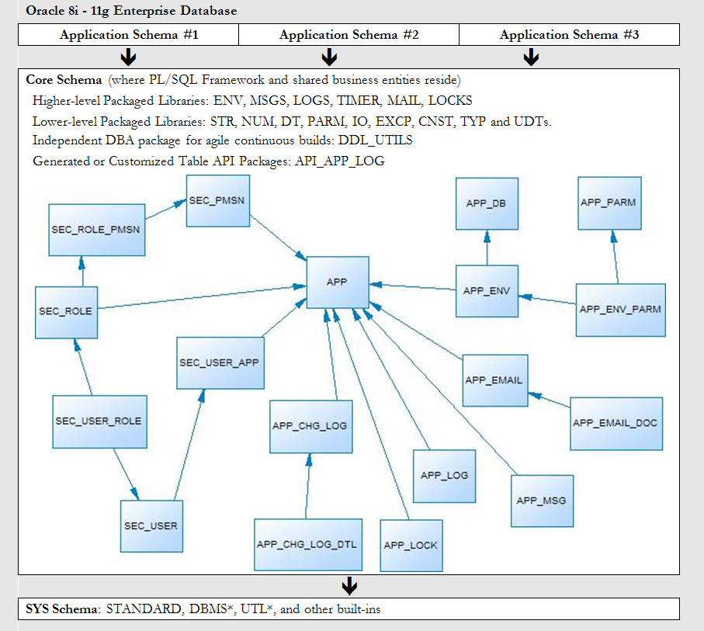
PL/SQL Starter Framework
Notes:
This is a graphic depicting how Starter is meant to be shared as a common foundational layer under multiple application schemas in a single database.
It also depicts a high-level logical data model of the tables that support the framework, and the two handfuls of packages that expose the services of the framework, as well as the layering and interdependencies between them.

Slide 29
“Starter” too much?
Thousands of downloads, but not much feedback or developer contributions.
21 services and 55 objects
Some shops only have one major app schema per DB
60 page doc and days to week learning curve
Security often done in directory server now
Common messages almost never used
Email-from-DB tables rarely used
Locking always needs customization
Notes:
The reason I never fully adopted Steven Feuerstein’s framework is because it was too complete. Too much to digest. Learning curve too high. So I didn’t bother.
Starter was created and, over the ensuing years, simplified in order to address that complexity and make it more approachable.
But for many shops, even the Starter framework is too much.
So to shorten and focus this presentation, and for those shops which only need instrumentation for a single schema, I simplified the Starter framework even further.
In the time that remains to us, we will walk through the Simple Starter framework, how to install and use it. Although this paper will demonstrate only one framework, it is hoped the reader will evaluate the other libraries for their merits and catch the vision of how easy it is to use any of them to add maturity and maintainability to applications.

Slide 30
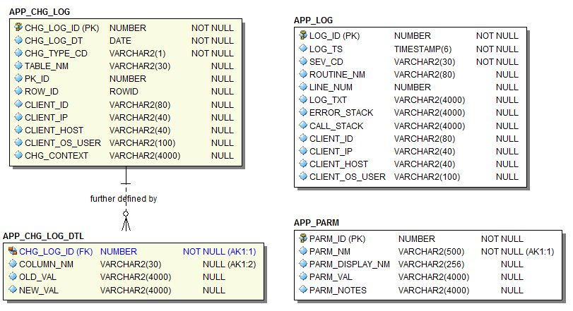
Simple Starter
LOGS, TIMER, ENV, gen_audit_triggers.sql
Notes:
There are only 4 tables now, and four major services.

Slide 31
Library | Main Routines | Supporting Components and Notes
Auditing: gen_audit_triggers.sql |  | APP_CHG_LOG, APP_CHG_LOG_DTL (tables)
Metrics: TIMER (package) | startme() stopme() elapsed() | Uses DBMS_UTILITY
Debugging, Logging and Error Handling: LOGS (package) EXCP (package meant to be used only by LOGS) APP_LOG_API (pkg meant to be used only by LOGS) | err() warn() info() dbg() | APP_LOG (table) TRIM_APP_LOG (scheduled job)
Connection Metadata: ENV (package) | init/reset_client_ctx() tag/untag() tag_longop() | Uses DBMS_DB_VERSION, DBMS_APPLICATION_INFO, DBMS_SYSTEM, v$session and v$mystat.
File Operations: IO (meant to be used primarily by LOGS) | write_line() write_lines(0 p() | Uses UTL_FILE, DBMS_LOB
Dynamic (Table-Driven) Parameters/Properties: PARM (package) | get_val() | APP_PARM (table)
Extras (required for the seven libraries above to function): CNST, TYP, DDL_UTILS, DT, STR, NUM (packages) | These are libraries of application-wide constants and subtypes, build utility functions; date, string and number manipulation routines.
Notes:
It comes with a few other libraries which it requires to function, but really one only need worry about the items in red to be instrumenting code in short order.

Slide 32
Simple: Auditing
Run gen_audit_triggers.sql. Generates trigger for every table in your schema.
Remove triggers not needed. Remove auditing on columns not needed. Done.
Audited changes are recorded to APP_CHG_LOG and APP_CHG_LOG_DTL
May need view or materialized view to simplify access to audit data.
Notes:
A few quick notes about the four major libraries.

Slide 33
Simple: Metrics
TIMER package
  startme(timer name)
  stopme(timer name)
  elapsed(timer name)
Log elapsed times
Create separate automated processes to monitor metrics, learn from them over time, and notify when anomalies are detected.

Slide 34
Simple: Log & Debug
LOGS package
  info(msg), warn(msg), err(msg)
    record important data, expected and unexpected error conditions
  dbg(msg)
    to document code and leave hooks for dynamic, real-time logging
  set_dbg (boolean and directed)

Slide 35
Simple: Log Destination
Screen (10K msgs = 1 sec)
  Quick-and-dirty testing and debugging.
Log Table (10K msgs = 4 sec)
  A default job keeps the table trimmed to a couple weeks of data.
File (10K msgs = 15 sec)
Pipe (10K msgs = 8 sec + 4 sec to log them)
Notes:
A quick note about the performance of 10, 000 messages sent to various destinations.

Slide 36
Simple: Debug Parameters
Parameters in APP_PARM
  Debug (on/off, session, unit, user)
  Debug Toggle Check Interval (in minutes)
  Default Log Targets (Screen=N,Table=Y,File=N)
Parameter values table-driven
Parameters can be temporarily overridden through logs.set* routines
Notes:
Now back to the other half of this presentation, this is where dynamic debugging comes in.

Slide 37
Simple: Monitor and Trace
ENV offers:
  tag/untag to modify module, action and client_info
  tag_longop to track long operations
  init_client_ctx(), reset_client_ctx()
    Front end client should pass the user’s ID to the DB through init_client_ctx, and reset_client_ctx upon returning the connection to the pool.

Slide 38
Simple Framework: Install
Go to Sourceforge.net
Search for PL/SQL framework. First option.
Select Browse All Files.
  Drill to plsqlfmwksimple/2.1.
  Download and unzip Simple.zip
Start SQL*Plus as SYS
  If installing to existing schema, remove DROP and CREATE USER statements.
  Run __InstallSimpleFmwk.sql
Done.

Slide 39
Agenda
Typical Production Problem Lifecycle
Define instrumentation
Oracle built-ins for instrumentation
Develop requirements of good instrumentation
Existing instrumentation libraries
Demos: Debugging & adding instruments

Slide 40
Putting it all Together
Solution Manager just called.
  After last night’s release, she is not getting her daily file about the critical problem/solution repository.
  {LIVE DEMO real-time debugging, monitoring, and adding instrumentation to two pages of code}

Slide 41
Putting it all Together
Write and document public interface.
Write tests that all fail.
Write body in pseudo-code.
Fill in the algorithm, making sure routine does one thing and one thing well. Ensure it uses assertions to check assumptions. Clean. To standard. Formatted.
Wrap pseudo-code with log and debug calls, adding a little runtime context. Voila! 3-birds with one stone.
Then I run the tests until they all work, using the instrumentation and metrics if there is trouble.

Slide 42
Conclusion
Instrumentation should be in place before production problems occur.
But it can be added easily after as well.
Adopt or build a standard library.
  It must be simple and easy to use.
Encourage or enforce its use.
Do it today! It’s easy and rewarding.
Notes:
Instrumentation can be seen as time-consuming and a chore, but the payback is enormous when things go wrong, as they sometimes do. Instrumented code is easy to measure, tune and troubleshoot. When called upon, it can provide all the information needed to easily diagnose performance, security or functional problems.

Slide 43
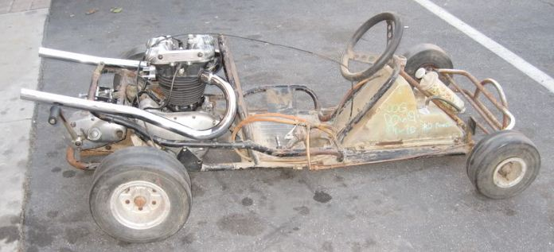

vs.

Slide 44
Q&A
Questions?
Contact: bcoulam@yahoo.com
Framework: sourceforge.net/projects/plsqlframestart/

Slide 45
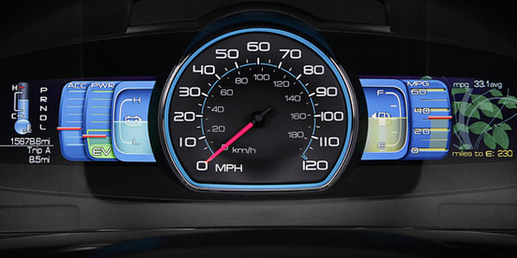
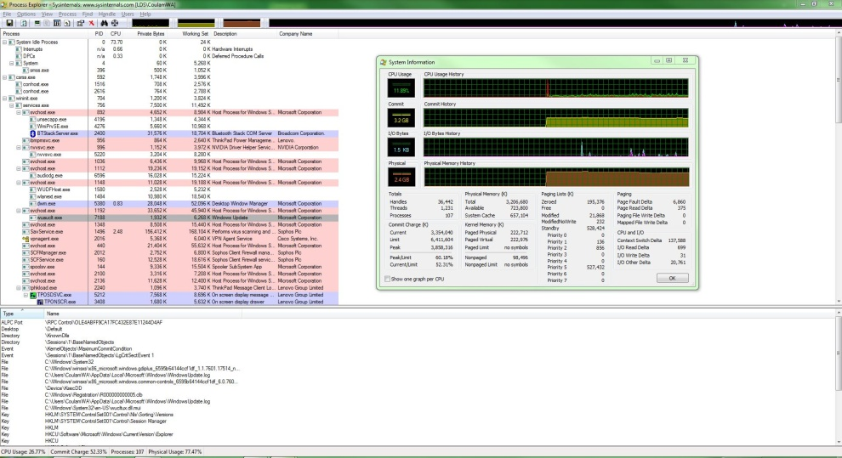

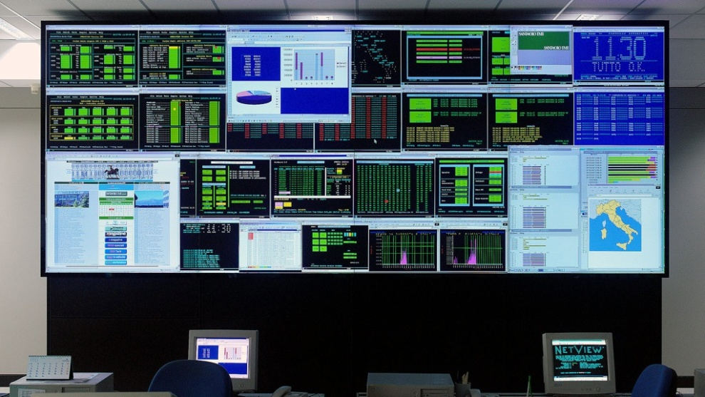
Instrumentation: Dials, Graphs, Guages
Car
Computer
Return
Network Operations Center
Passenger Jet
Return

