Slide 1
System Statistics
Giving the CBO what it craves: Input!

Slide 2
Before 9i
The magic sauce for tuning queries and aberrant CBO behavior was:
OPTIMIZER_INDEX_COST_ADJ, OPTIMIZER_INDEX_CACHING
Defaults were 0 for caching and 100 for index cost, indicating a 0% hit ratio on the buffer cache and that indexed access is 100% (exactly the same) as costly as full table scans.
Awful defaults for OLTP systems
DB_FILE_MULTIBLOCK_READ_COUNT also handy to help the CBO out.

Slide 3
9i
Old OPTIMIZER parameters obsolete. Do not use.
9i and up: CBO uses the CPU Costing Model
Lewis, Gorman, Kyte, Foote, Brietling, Geist and many, many more have all written about it.
Cost = (#srds * sreadtm + #mrds * mreadtm + #cpucycles / cpuspeed) / sreadtm
Let Oracle determine how costly IO operations are: memory, single vs. multiblock, etc.
9i
Manual
Had to ensure mreadtim was larger than sreadtim
Can manually set them if gathering botches it

Slide 4
10g
10g
Uses default NOWORKLOAD statistics upon DB startup if there are none (only gathers cpuspeednw):
cpuspeednw: millions of operations per second
ioseektim: disk seek time in milliseconds, default 10
iotfrspeed: disk transfer time in bytes per millisecond, default 4096 (most are faster than this)
If workload stats aren’t gathered, Oracle does its best and calculates sreadtim, mreadtim and MBRC from NW stats:
MBRC = db_file_multiblock_read_count | _db_file_optimizer_read_count [8]
sreadtim = ioseektim + db_block_size/iotrfrspeed [12ms]
mreadtim = ioseektim + db_file_multiblock_read_count * db_block_size/iotfrspeed [26ms]
Can explicitly gather NOWORKLOAD stats to get real ioseektim and iotfrspeed measurements.

Slide 5
Which costing model in use?
Can be seen at the end of tkprof output.
10g – CPU Costing by default
9i - CPU Costing if system statistics present
Toggle off:
optimizer_features_enable to low version
_optimizer_cost_model
NOCPU_COSTING hint

Slide 6
Maintain System Statistics
Some OS bugs resulted in wacky values, in particular AIX had problems.
So good idea to always check them after a gather.
If wacky, manually set, ensuring mreadtim is some factor (2 to 4 times) larger than sreadtim to be semi-realistic.
Good to regather after new hardware, disk, OS upgrade, Oracle upgrade, etc.

Slide 7
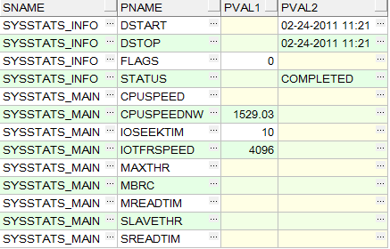
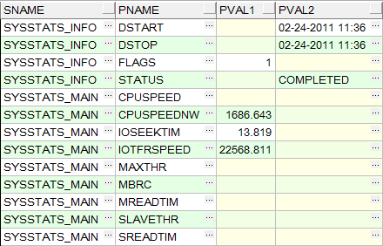
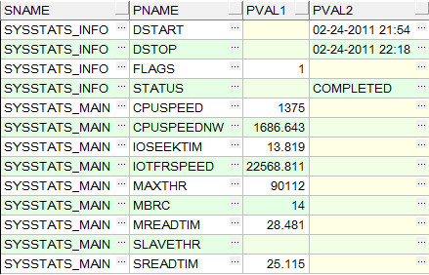
What do we have?
Dev2 Before Fiddling
Dev2 After Gather & Delete
Dev2 After Regather of NOWORKLOAD
Dev2 After Gather of WORKLOAD

Slide 8
What do we have?
Statistics Retention
SQL> EXEC dbms_output.put_line(dbms_stats.get_stats_history_retention);
31
PL/SQL procedure successfully completed
MBRC
SQL> show parameter multiblock
NAME VALUE
------------------------------------ ------
db_file_multiblock_read_count 16

Slide 9
Jonathan Lewis
If you haven't done anything to set the system statistics and have reset the db_file_multiblock_read_count, then Oracle uses a hidden parameter called _db_file_optimizer_read_count as the basis for calculating the cost of tablescans and index fast full scans. If you set the db_file_mulitblock_read_count, then the _db_file_optimizer_read_count copies the value. If you don't set the db_file_multiblock_read_count then the default for the _db_file_optimizer_read_count is eight.

Slide 10
Gathering
NOWORKLOAD
EXEC dbms_stats.gather_system_stats();
OR
EXEC dbms_stats.gather_system_stats('NOWORKLOAD');
INTERVAL
EXEC dbms_stats.gather_system_stats('INTERVAL',360);--6hrs
START/STOP
EXEC dbms_stats.gather_system_stats('START');
-- time passes, can close session if you wish, later...
EXEC dbms_stats.gather_system_stats('STOP');

Slide 11
Migration SQL for RCMD_ANSWER
SELECT sr.enamem_id
,sr.scrphr_id AS phrase_id
,sr.scritmtyp_id AS item_type_id
,1 AS lang_id -- English for numerics and dates
,NULL AS answer_txt
,sr.scrres_answer_date AS answer_dt
,sr.scrres_answer_num AS answer_num
FROM script_responses sr
JOIN enabled_member_mstr em ON em.enamem_id = sr.enamem_id
WHERE em.procstat_id < 14
AND em.enamem_home_unit_id > 0
AND (sr.scrphr_id <> 969 OR (sr.scrphr_id = 969 AND sr.scrres_answer_num IS NOT NULL))
AND (em.enamem_id <> 173563 OR (em.enamem_id = 173563 AND sr.scrphr_id <> 969))
AND (sr.scrres_answer_date IS NOT NULL OR sr.scrres_answer_num is NOT NULL)
UNION
SELECT srt.enamem_id
,srt.scrphr_id AS phrase_id
,srt.scritmtyp_id AS item_type_id
,srt.lang_id
,srt.restrans_answer_text AS answer_txt
,NULL AS answer_dt
,NULL AS answer_num
FROM script_response_translations srt
JOIN enabled_member_mstr em ON em.enamem_id = srt.enamem_id
WHERE em.procstat_id < 14
AND em.enamem_home_unit_id > 0
AND (srt.scrphr_id <> 969 OR (srt.scrphr_id = 969 AND srt.restrans_answer_text IS NOT NULL))
AND srt.restrans_answer_text IS NOT NULL;

Slide 12
Fixed SQL for RCMD_ANSWER
SELECT /*+ FIRST_ROWS */ sr.enamem_id
,sr.scrphr_id AS phrase_id
,sr.scritmtyp_id AS item_type_id
,1 AS lang_id -- English for numerics and dates
,NULL AS answer_txt
,sr.scrres_answer_date AS answer_dt
,sr.scrres_answer_num AS answer_num
FROM script_responses sr
JOIN enabled_member_mstr em ON em.enamem_id = sr.enamem_id
WHERE em.procstat_id < 14
AND em.enamem_home_unit_id > 0
AND (sr.scrphr_id <> 969 OR (sr.scrphr_id = 969 AND sr.scrres_answer_num IS NOT NULL))
AND (em.enamem_id <> 173563 OR (em.enamem_id = 173563 AND sr.scrphr_id <> 969))
AND (sr.scrres_answer_date IS NOT NULL OR sr.scrres_answer_num is NOT NULL)
UNION ALL
SELECT /*+ FIRST_ROWS */ srt.enamem_id
,srt.scrphr_id AS phrase_id
,srt.scritmtyp_id AS item_type_id
,srt.lang_id
,srt.restrans_answer_text AS answer_txt
,NULL AS answer_dt
,NULL AS answer_num
FROM script_response_translations srt
JOIN enabled_member_mstr em ON em.enamem_id = srt.enamem_id
WHERE em.procstat_id < 14
AND em.enamem_home_unit_id > 0
AND (srt.scrphr_id <> 969 OR (srt.scrphr_id = 969 AND srt.restrans_answer_text IS NOT NULL))
AND srt.restrans_answer_text IS NOT NULL;

Slide 13
Cost Comparison before System Stats
UNION
UNION ALL + FIRST_ROWS

