Slide 1
Lazy Application Architecture
Save Months with a
PL/SQL Framework!

Slide 2
The Goal
Encouragement to care enough about our craft, our reputations and our free-time, to design and produce top-notch backend code, quickly and reliably, using frameworks.

Slide 3
Agenda
Laziness or Wisdom? The 80/20 Rule.
Define application frameworks
Database application frameworks
  Rarity “in the wild”
  Essential and common services
  DIY best practices
  Existing market
    Intro to retail frameworks
    Tour of the open source offerings
  Sample App and Case Study (4X faster development, 300% better results)

Slide 4
“If you want something done quickly, give it to a lazy person.” - Joe

Slide 5
The 80/20 rule (Pareto Principle)
Stellar programmers (the precious “20%”) know when to build and when to re-use.
Development of the front-end usually begins with the technical lead selecting the framework: JSF, Spring, Silverlight, etc.
  It is a given that UI components will not be built from scratch.
Why is the same not true of database development?
  Familiar with QCGU, PLVision, Starter, GED?

Slide 6
Define: Terminology
Framework: An application framework is a collection of software modules or components that implement common functionality used by developers to write software in a rapid, consistent manner.
Library: A collection of related components.
Component: A simple, robust object or routine that implements a feature of the library.

Slide 7
Define: Applied to DB Dev
A component is an Oracle object: table, view, trigger, type, context, sequence, packaged routine (func/proc), etc.
A library is typically a PL/SQL package of related routines, and the components that support that feature family.
A framework is the entire collection of templates, standards, and libraries (packages) that offer a set of features for reliable, rapid database development.

Slide 8
Rarity
Good application architecture is crucial to the aspects of deliverables that users, managers and developers care about:
  Speed of delivery
  Cost
  Quality
  Flexibility
  Robustness
  Scalability
  Performance

Slide 9
Rarity
This is no different from the criticality of location, site preparation, blueprints, foundation, and framing to a successful home building project.
What happens when a structure is built without sufficient thought and investment in the site, foundation or framing?

Slide 10
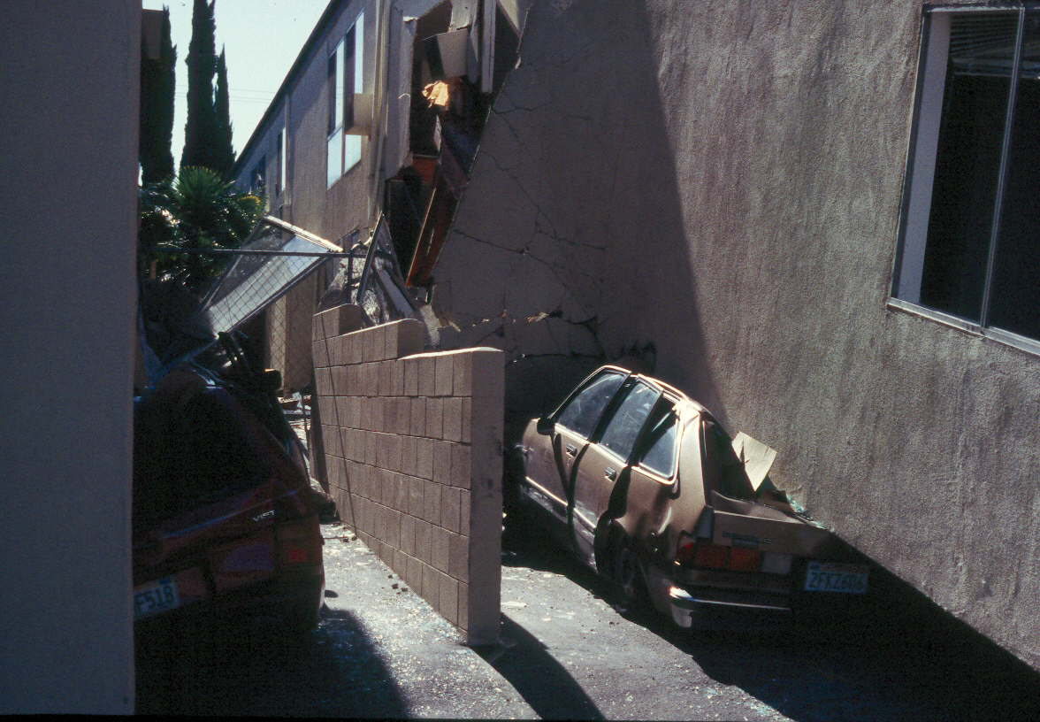
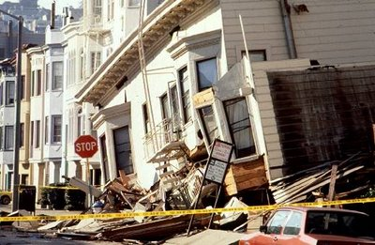
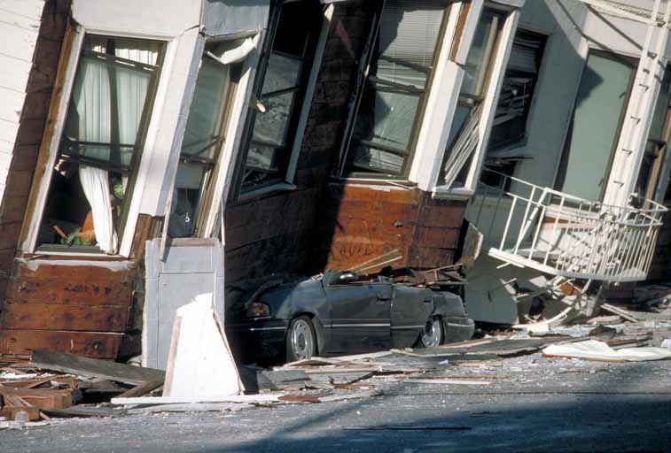
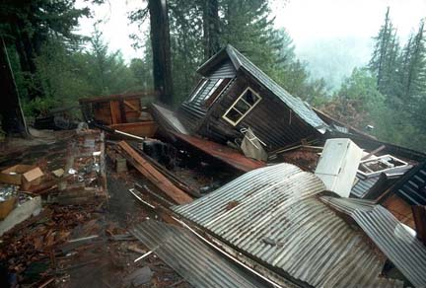

Rarity

Slide 11
Rarity
And yet, despite the values and risks, what are the first things to go when budgets and deadlines tighten?
  Testing
  Documentation
  Security
  Architecture, design and modeling
Not what the user sees. Not an immediate problem. So these are seen as “fluff” and dispensable.

Slide 12
Rarity
We are engineers, artisans and stewards.
  Cannot allow application architecture to be cut.
PL/SQL is mature. Let’s act like it.
  If we aren’t developing with the same rigor and best practices of frontend development, it is our fault database architecture is shrugged off.
What do frontend developers do?
  Pair programming, regression tests, instrumentation, DRY, KISS, TDD, assertions and…
  Re-use standard framework libraries.

Slide 13
Essential DB Framework Services
Needed by every database application:
Security
Parameters/Configuration
Auditing
Logging
DBA Ops

Slide 14
Common DB Framework Services
Needed by those with backend processes:
Application and Connection Metadata
Debugging, Timing and Instrumentation
Error Handling and Assertions
String manipulation
Number manipulation
Date handling
Messages and Email

Slide 15
Common Framework Services
Locking
IO
Constants, Types, Cached Reference Data
Shared SQL
Directory Integration
ETL
Unit Testing
Database code templates

Slide 16
Build or Buy?
Qualities of a good framework:
  Solid exception handling scheme
  Good documentation, sample app, comments
  Clean, well maintained and tested
  Short, but intuitive library and component names
  Layer independence and non-circular
  Simple

Slide 17
The Value of Simple
Programs must be written for people to read, and only incidentally for machines to execute. - Donald Knuth
Simplicity is prerequisite for reliability. - Edsger W. Dijkstra
Simplicity carried to the extreme becomes elegance. - Jon Franklin
Simplicity is the ultimate sophistication. - Leonardo da Vinci

Slide 18
Existing Market Survey
Retail Frameworks
  GED Toolkit
Free Frameworks
  QCGU (was QNXO)
  PLVision
Open Source
  PL/SQL Starter

Slide 19
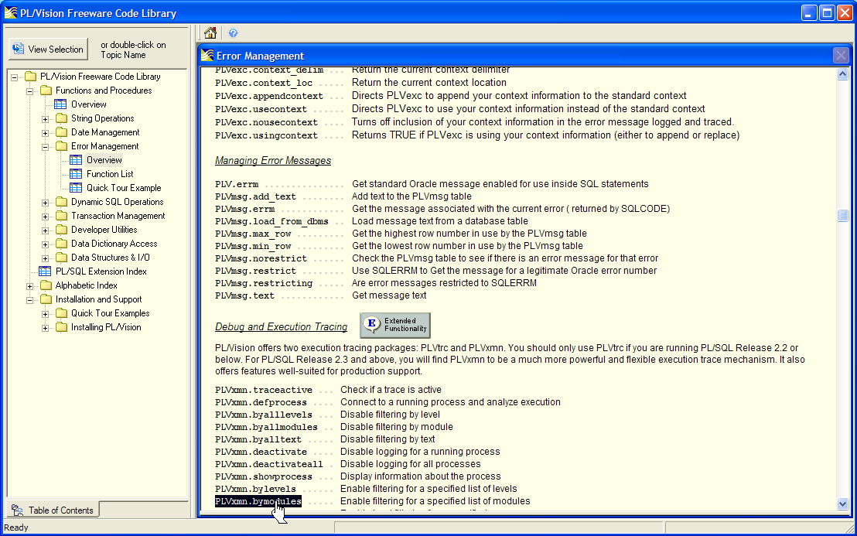
PL/Vision

Slide 20
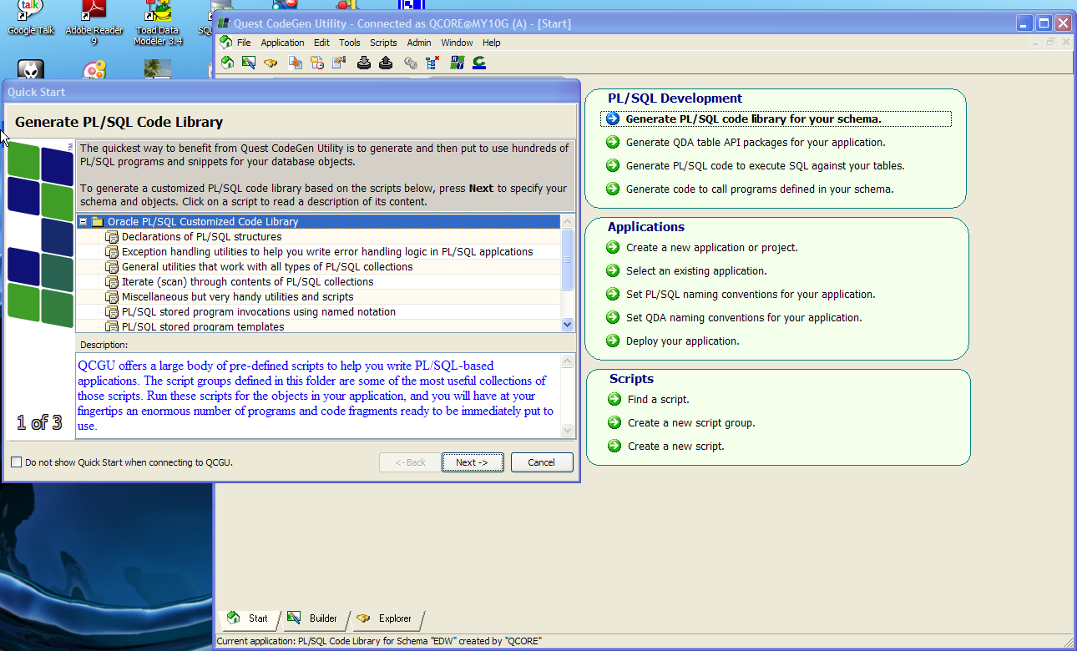
QCGU

Slide 21
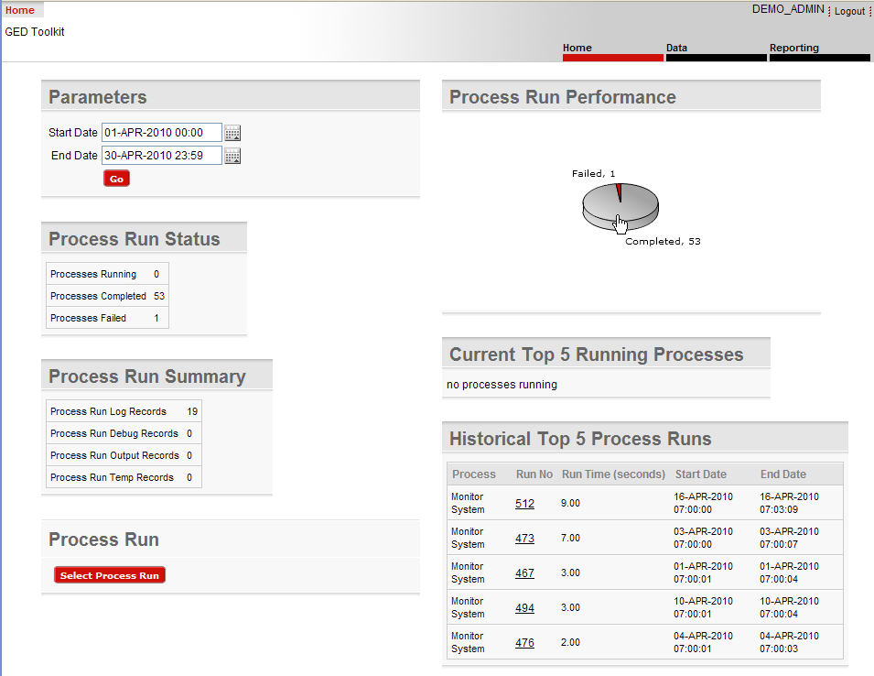
GED Toolkit
Re-usable libraries. Focus on insight into backend processing: inputs, outputs, state.

Slide 22
Existing Market Survey
Retail Libraries
  Quest Code Tester
  PL/PDF
Open Source or Free Libraries
  Quest Error Manager
  utPLSQL, PLUTO, SQL Developer Testing
  Log4PLSQL, OraLog, Orate
  PL/FLOW
  PLDoc

Slide 23
PL/SQL “Starter”
Author’s free framework on SourceForge.
Existed in one form or another since 1997.
Version clock reset to v1.0 when released as open source. At 2.0 now (but 12 yrs old).
Used in telecom, not-for-profit and energy industry.
2 years, 2 bugs. Simple and solid.
Install takes 2 minutes.
Can pick and choose some components.

Slide 24

StarterSchema Model

Slide 25
Live Tour and Case Study
Install
Configure
Included sample application built on Starter:
  Problem/Solution Repository
Side-by-Side Case Study
  Problem/Solution Report with File and Email Capability

Slide 26
Report Requirements
Director wants new backend report that reads the problem/solution repository, writes the results to a file, and emails the results.
File name & email subject contain today’s date.
Both should have a header with today’s date.
Report should show the problem metadata, then the solution below that.
Report should be robust, use exception handling for IO and SMTP problems, use standardized error messages, and include debugging and performance capture ability.
Email To static in Prod, dynamic in lower DBs.

Slide 27
Results
See reports1.sql (without framework) and reports2.sql (with framework) in Starter’s SampleApps\ProblemSolution folder.
See the whitepaper for the list of problems with the viable solution in reports1.sql
  Developing with framework met 100% of the requirements, yielding 300% better code and it took 25% of the time!

Slide 28
Conclusion
Frameworks essential to application architecture and can yield systems you can be proud of.
Frameworks jumpstart new projects, saving weeks to months of risky wheel-reinventing.
  Is that laziness? Or wisdom?
“Starter” a decent model for features every custom Oracle application needs, but is certainly not the only framework.

Slide 29
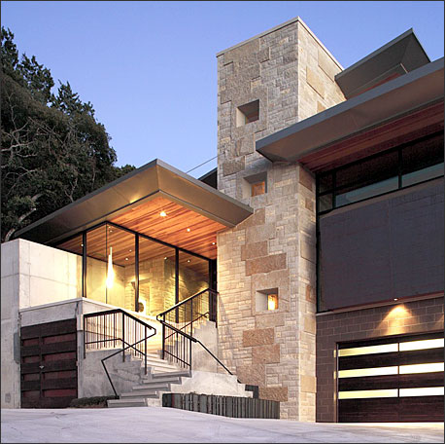
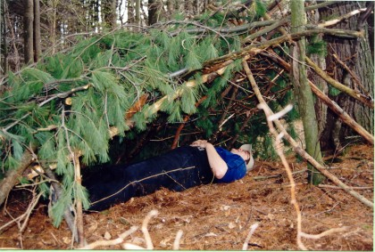
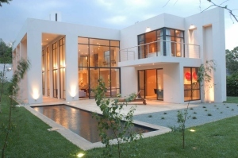
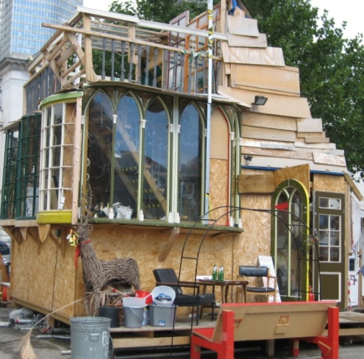
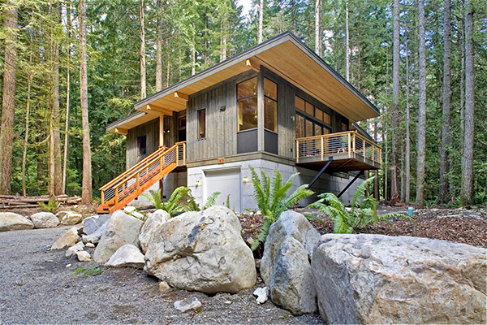
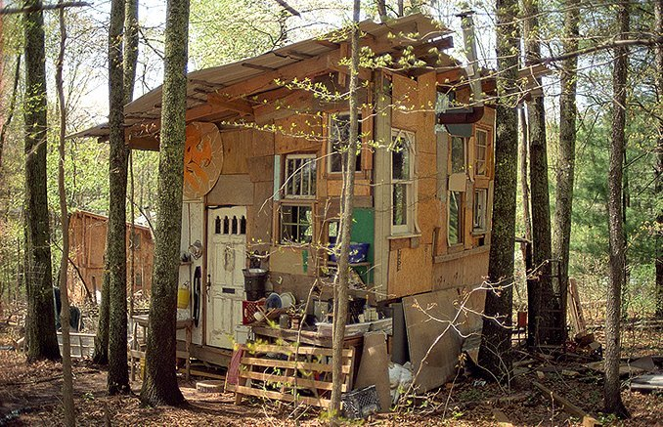
Your Design Legacy
OR
Template 4_beige29

Slide 30
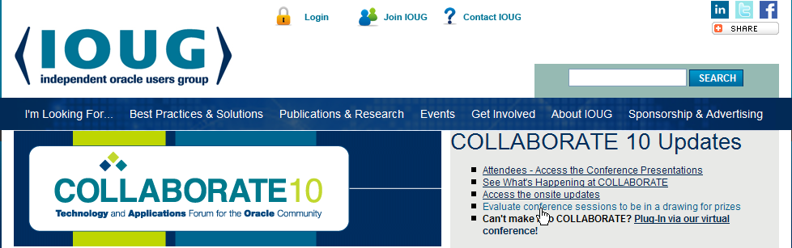
Online Evaluations
No paper this year. Hurray! ☺
But you need internet access: ioug.org
Session 309

Slide 31
Contact Info: Bill Coulam (bcoulam@yahoo.com)
If interested, download PL/SQL Starter from:
  www.dbartisans.com
  sourceforge.net/projects/plsqlframestart
  sourceforge.net/projects/plsqlstarter (May 2010)
Questions?

