Slide 1
PL/SQL Application Frameworks
For Custom Systems
Presenter: Bill Coulam (bcoulam@yahoo.com)
Notes:
Template 04

Slide 2
How to get the most of this?
Sit back and enjoy the first 20-30 minutes.
  Presentation and whitepaper can be had from IOUG website.
Make notes about existing frameworks you want to check out.
Engage as we walk through the starter framework:
  http://sourceforge.net/projects/plsqlframestart
  http://www.dbartisans.com/index.htm

Slide 3
Software Architecture and Construction
Programming is a combination of art, science and engineering…
…and for those inheriting legacy systems, methods and policies, it also includes skills in archaeology, psychopathology, waste management and forensics.
If your development environment and deliverables were seen as dwellings meant to be used by others, what would they resemble?
Notes:
CLICK
Many have compared the role of an IT professional to an engineer. One of the industry’s gurus, Steve McConnell, is making it his life’s calling to see that IT becomes just like the engineering profession. I’ll be doing the same, although there are areas of our work where the analogy breaks down. We are engineers. But we are also artisans and scientists as well. Many have said Programming is a combination of art, science and engineering. I agree. But for those inheriting legacy systems, methodologies and policies, it also involves, archaeology, psychopathology, waste management and forensics.
CLICK
With that in mind, I’d like to ask you to visualize the systems you manage and build as livable, useable structures, like a cozy home.

Slide 4
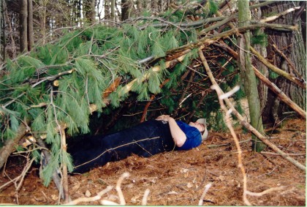
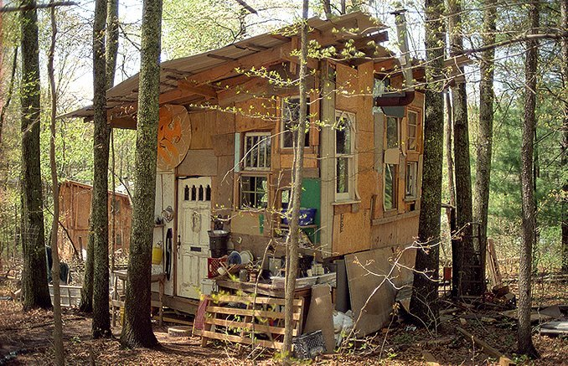
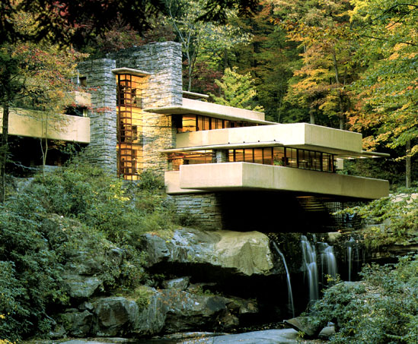
Software as Useful Structures
OR
Notes:
CLICK – for smaller shops and those with little to no development methodology, perhaps your systems resemble this neat little lean-to. Built in a day. Fulfills an immediate need. A bit drafty though. Not terribly user-friendly. Definitely won’t stand the test of time, changing requirements, addition of other dwellers, etc.
CLICK – perhaps your systems are more like this shack. These would be systems built in an architectural vacuum, with lots of cooks in the kitchen, everyone contributing a little here and little there, doing their own thing in their own way.
Maybe you’re lucky enough to have progressive, wise architects and IT leadership, clean and flexible standards and processes, good methodology, rock-solid infrastructure; great designers, frameworks, tools, and so on. For these shops, your software is gorgeous, nearly bug-free, easy to maintain and enhance, enjoyed by your users, and performs like a champ.
CLICK – systems like these could be represented by Falling Water here, one of Frank Lloyd Wright’s masterpieces.
10:45

Slide 5
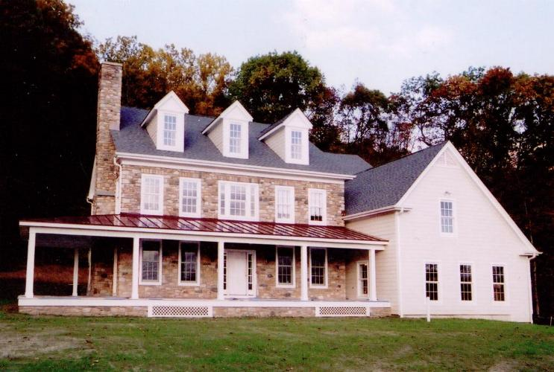
Software as Useful Structures
It’s been said that if you don’t know where you’re going, any road will get you there.
So I like to use metaphors to visualize the goal.
This is how I like to envision the systems I design and build: clean, robust, functional, comfortable…
Notes:
CLICK
I like to envision the software I’m responsible for like this home…
CLICK
Elegant, rock-solid, classic design (follows architectural best practices), but ultimately functional and a joy to the end-users.
CLICK
So what kind of systems do you want to build? Lean-To’s, Shacks or functional masterpieces? When you move on and others inherit your legacy, do you want them respecting your work or cursing your name?
PAUSE

Slide 6
The Target
My hope is to validate or renew the fire within you to produce clean, elegant, robust PL/SQL-based systems more rapidly and reliably than you could before…
…so that you can enjoy your work more, or spend less time getting it done.
Application infrastructure is crucial to aspects everyone cares about: speed, cost, quality, flexibility, scalability, etc.

Slide 7
Agenda
Define: Frameworks, libraries, components.
Are frameworks needed?
Examining your environment
Framework contents
Framework design, build and rollout
Existing frameworks and libraries
Case study: PL/SQL Starter Framework
Notes:
The stone farmhouse we just saw has a foundation, a frame, some solid and appealing exterior treatments, and a few nice user-friendly amenities. We’re going to be focusing today on the software frame or framework, specifically for shops that have, or will have, a weighty investment in PL/SQL.
CLICK – so we’ll first visit some definitions of a framework and its components
CLICK – we’ll discuss why software infrastructure, like foundations and frameworks, are so important.
CLICK – we’ll touch on the things you’ll need to evaluate when choosing to build a new framework, or extend and improve an existing one
CLICK – whether you build or buy, or already have one, we’ll cover what your framework should include
CLICK – we’ll briefly mention aspects of building momentum behind a framework, and seeing it embraced and used well
CLICK – we’ll survey the existing landscape of PL/SQL frameworks
CLICK – in the remaining time, we’ll look at a freeware, starter framework I’ve built and used in one form or another for 12 years.

Slide 8
Definitions
Framework
  Organized collection of libraries that implement common functionality used by developers to write software in a rapid, consistent manner.
Library
  Organized collection of related components.
Component
  Individual routine that does a single thing well.
Caveats
  Oracle libraries
  Class libraries

Slide 9
Are frameworks needed?
A few analogs:
Automobile design and construction
Web site design & construction
Home design and construction
Notes:
Let’s move on to why I’m fussing over frameworks. Why should I, the Oracle developer, care about them? You might be thinking -- to misquote Gold Hat in Legend of the Sierra Madre (1948 film with Humphrey Bogart): Frameworks? I don’t need no stinkin’ frameworks! Let’s talk about the use of frames and standardized processes in the auto and home construction industry briefly, as a metaphor for better understanding the need for proper software infrastructure and framing.
CLICK - When the auto industry was in its infancy, each vehicle was a custom, one-off, hand-crafted work of art and engineering (for its time). They were costly and production quite slow. It was the introduction of the first standardized car (134 Benz Velo made in 1895) and the assembly line by Ransom Olds in 1902, and later refinement by Henry Ford in 1914 that turned the world on its ear, and happened to coincide with the rise of the American economic juggernaut. Ford’s production increased 8 fold as a result of his practices (from 12 hours to 1.5 hours per car). It became so successful at producing clean, reliable cars quickly and cheaply, that any competitor who didn’t adopt the same practices could not compete. Of the 250 or so car companies before 1920, only 40 remained by 1930, 17 by 1945. Standardized platforms and part-sharing became commonplace between automakers by 1950, further reducing costs and making new model introduction easier.
CLICK – Then there’s home construction, a better metaphor in my opinion.

Slide 10
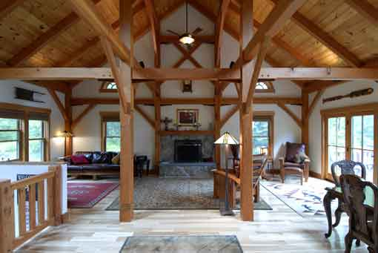
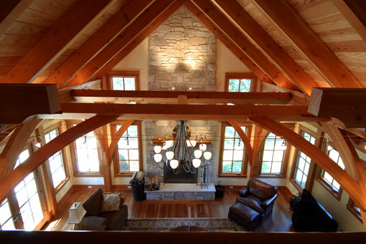
Timber Framed
Robust. Warm. Spacious. Inviting.
Each one a work of art. Skilled carpenters.
But slow-going and costly.
Notes:
I could really enjoy living in a piece of software built like this. How about you?
CLICK. CLICK. CLICK.
This is how most homes used to be constructed, even when you think about the lowly cabin. Then came conventional “stick-built” homes. They were an improvement, with trusses and specialized workers who did nothing but framing. But blueprints still had to be followed for each one, relegating even spec homes to the “custom” category in my mind. And the practice was quite wasteful of materials.

Slide 11
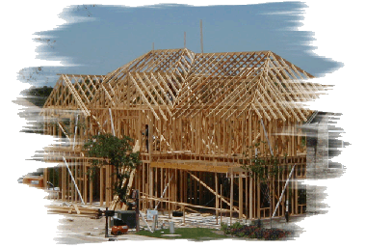

Conventional or Stick-Built
The norm. Slower build exposes project to risk. Wasteful.
Requires lots of specialists.
Quality not always the best.

Slide 12
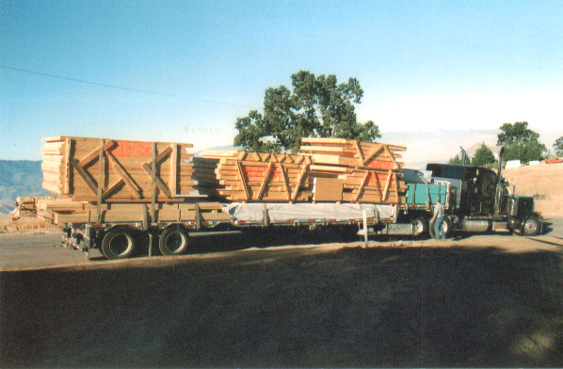
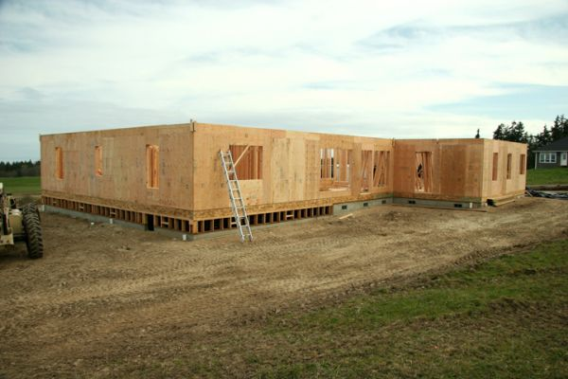
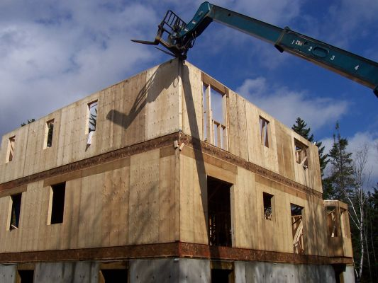
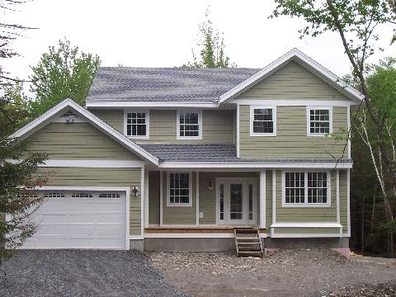
Panel-built Homes
The frame’s components are pre-built in a factory by specialized carpenters.
Far less waste. Higher quality and exacting deliverables.
Pieces are delivered in a bundle, and the home’s frame can be erected in a day.
Notes:
Then panelized homes were introduced, which is a very close match to what pre-built frameworks can do for your development.
Blueprints are still followed, but it is done in factory or warehouse, CLICK designed specifically for churning out chunks of insulated home walls, with high quality, at a rapid pace by skilled craftsmen who do nothing but. The standardized, controlled practices produces far less waste, and produces perfectly square, to-spec components. CLICK
When complete, the panels are delivered CLICK, CLICK usually on a single flatbed trailer. Using a few helpers and a special heavy lifter, the walls are usually up in a day,CLICK the roof shortly thereafter. CLICK
New home in much less time for less money.
The history of web site design followed a similar evolution from custom works of art to off-the-shelf and templatized.
The same efficiencies and benefits can be realized when adopting frameworks and standardized practices into your software development. Those who attempt to continue the one-off, un-managed, custom-everything, or cowboy approaches will go the way of the dinosaur.

Slide 13
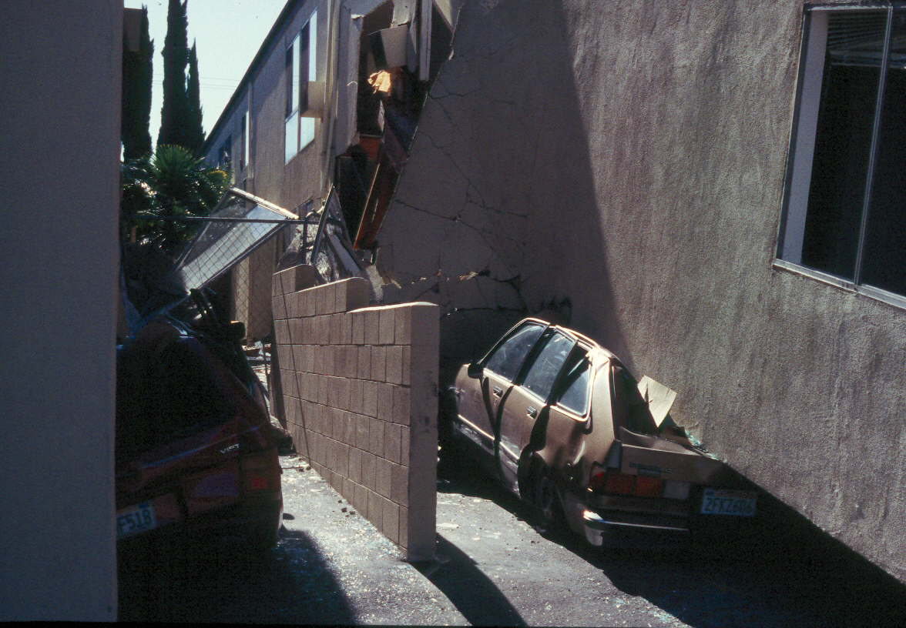
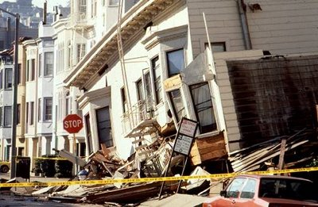
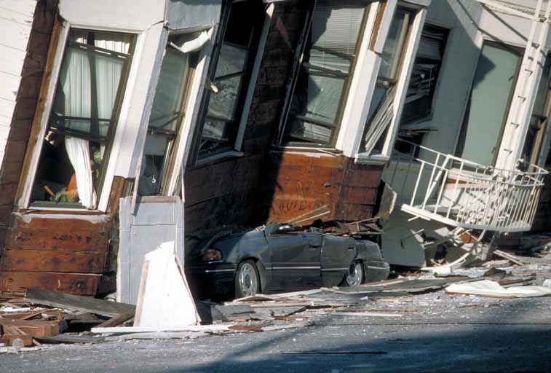
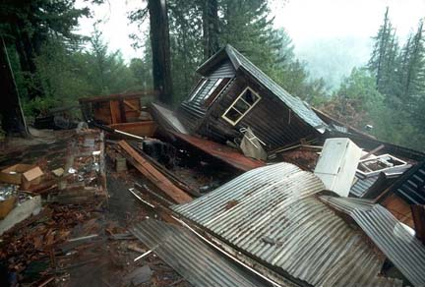
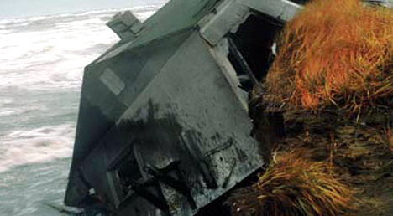
Are frameworks needed?
What happens when a structure is built ad-hoc, without sufficient thought and effort invested in the foundation and frame?
Notes:
By examining history then, we’ve established that good construction goes through growing pains until it gets to the point of using standardized, high-quality components as its frame in order to meet the needs of businesses and consumers for that construction to be fast, flexible and cheaper.
Yet that does not seem to be the case in many IT shops where they have an investment in custom PL/SQL. I’m hoping that as you are looking at these pictures, you’re thinking about the systems you maintain and build. Do you have sufficient thought and investment in the foundation and framing underlying your PL/SQL applications? If so, great! You may just need a little refinement and to fill a few holes in the services your framework offers. If not, it is time to start introducing one.

Slide 14
Are frameworks needed?
Yes!
…well, it depends.
Notes:
For most, lots of legacy code has already been written; things are difficult to maintain, let alone enhance; and something has to be done soon before things implode. It is time to survey the current state of affairs at the company, acknowledging future direction, and then make a plan.
Your need for a PL/SQL application framework depends on a number of factors, only a few of which we'll have the time to cover here. 10:00

Slide 15
Assessing the Need
Timing
Existing code base
Existing frameworks
Architectural direction
Security and other policies
Maintenance & enhancement demands
Quality and performance

Slide 16
Framework Contents
Early stage services
  String, number, date and collection handling
  Logging, debugging, messaging & email, exception handling, timing, assertions
  Codes, configuration, environment
  Locking, auditing, security
  Testing
  Standards, templates, code analyzers/advisers
Late stage services
  ETL-related, 3rd party integration, reporting, job management, DBA-centric utilities
Industry/Project-specific services
Notes:
Once you decide to design or find a suitable framework, or extend or improve the one you’ve got, it helps to know what it ought to contain and what it should look like when you’re done.
Start with the low-level features that every system needs, no matter what type of application you are building. CLICK
After those are in place, tested and documented you might then proceed to functionality specific to your application or industry. CLICK CLICK
But in many cases, unless your systems are already mature and your problem domain is well understood, you might want to let your systems ripen a while, before you tackle the unique-to-you or your industry services that your framework needs to encapsulate and standardize.
Perhaps your application has special needs surrounding image-handling, web pagination, reporting, SOA-fluency, geospatial mapping, inventory tracking, financial modeling, zip code distance calculation, ad-infinitum. Whatever your system does, you just need to find the hotspots, the things done more than once and/or inconsistently. Factor them out into a standardized, packaged API, and then introduce them into the code, testing vigorously as you go. 20:00

Slide 17
Framework Design & Build
Programs must be written for people to read, and only incidentally for machines to execute. - Donald Knuth
Simplicity is prerequisite for reliability. - Edsger W. Dijkstra
Simplicity carried to the extreme becomes elegance. - Jon Franklin
Simplicity is the ultimate sophistication. - Leonardo da Vinci
Notes:
I you don’t get another thing out of this section, I’m hoping to impress one point upon you: keep it simple. Ensure your components are small, clean, robust, well-tested, easily remembered, and organized.
The human brain can handle just so much complexity before the synapses start misfiring and mistakes are made, lots of them. Expend the effort to make your frameworks elegant: Leonardo will be proud.

Slide 18
Framework Design & Build
Use packages to bundle related components.
Decentralize constants and literals.
Overloading (pseudo-polymorphism)
Precede code with high-quality comments, testing and pseudo-code.
Model use of your assertions, exceptions, messaging, debugging and logging library.
Set up and model use of your templates, versioning, formatting, and testing tools.
Follow best practices, esp. DRY and KISS.
Short, intuitive names for packages and routines.
Notes:
I’d now like to share a few distilled points about framework construction that I either learned from folks like Kyte, Feuerstein and others, or from hard experience.

Slide 19
Framework Design & Build
Only catch expected exceptions.
Document framework API well, at least in the package specs if nowhere else.
Provide small, working, sample application if you can, demonstrating all the pieces.
Use anonymous transactions to capture critical info before rollbacks.
Independence and loose coupling (orthogonality).

Slide 20
Framework Adoption
There is nothing more difficult to carry out, nor more doubtful of success, nor more dangerous to handle, than to initiate a new order of things. For the reformer has enemies in all those who profit by the old order, and only lukewarm defenders in all those who would profit by the new...
- Niccolo Macchiavelli
Notes:
The sometimes maligned Macchiavelli had this to say about getting a new way of things introduced…

Slide 21
Framework Adoption
Sponsors & champions
Enterprise architecture, policies and standards
Development methodology
Management style and strategy
Time, people and $$$ constraints
Notes:
Introduction of a framework into the inner workings of existing systems will take some time. Time is money. Most companies want to save as much of that as possible. They will consider your rocking the boat risky (even though what the framework does is stabilize the boat). You will need a sponsor so that your project is approved and not axed in backroom planning meetings. You will also need a champion to lay all the necessary groundwork and see that the ball isn't dropped.
Management needs to be prepared and updated, ideally with success stories as it rolls out in a phased approach to keep them jazzed.
Include the framework in the enterprise architectural statement or vision.
Include it in the development methodology in peer and technical review.
Anticipate and plan for training and learning curve time.

Slide 22
Framework Adoption
Legacy demands
New project demands
3rd party considerations
Appetite for risk
Your role

Slide 23
Existing Frameworks
Collection Name | License | Purpose | Location & Notes
PLNet.org | Free | Repository of PL/SQL libraries and utilities | plnet.org
PL/SQL Starter Framework | Free | My starter framework. No code-gen utilities. | sourceforge.net/projects/plsqlframestart
Feuerstein's Work | Free | Repository of new and old code generation utilities by Steven Feuerstein | stevenfeuerstein.com/gencentral.html
Quest Pipelines Archive | Free | Repository of useful PL/SQL utilities | quest-pipelines.com/pipelines/plsql/archives.htm#misc04
QCGU (Quest CodeGen Utility) | Free | Framework, Standards, Scripts, Template Factory, Code Generation, + more | qcgu.net Latest incarnation of Feuerstein's vast reservoir of experience. Preceded by QXNO, PL/Vision, and PL/Generator.
PL/Vision | Free | Framework, API Generator, + more | quest-pipelines.com/pipelines/dba/PLVision/plvision.htm Replaced by QXNO and then QCGU. Not supported.
PL/Generator | Free | Table API Generator | stevenfeuerstein.com/plgen.zip Replaced by QCGU. Not supported.
PL/SQL Interface Generator | Free | Table API Generator | sourceforge.net/projects/plsqlintgen

Slide 24
Existing Libraries
Quest CodeTester | $$$ | Testing Framework and Software | quest.com/code-tester-for-oracle What started as Steven Feuerstein's attempt to bring agile-esque "test-first" mentality to PL/SQL (utPLSQL), has been heavily reworked, solidified, and given a UI.
utPLSQL | Free | Testing framework | sourceforge.net/projects/utplsql
utPLSQL_DWH | Free | Testing framework for Data Warehousing | sourceforge.net/projects/utplsqldwh
PL/SQL Unit Test Framework | Free | Testing framework | sourceforge.net/projects/plsqlunittest
Quest Error Manager | Free | Error Handling | tinyurl.com/27xkyr Included in QCGU. But offered separately as well. Not supported.
Log4PLSQL | Free | Logging | log4plsql.sourceforge.net sourceforge.net/projects/log4plsql
OraLog | Free | Logging | sourceforge.net/projects/oralog
Orate | Free | Logging | sourceforge.net/projects/orate
Hotsos Library | Free | Tuning | sourceforge.net/projects/hotsos-ilo
PLDoc | Free | Documentation | sourceforge.net/projects/pldoc
PL/FLOW | Free | Workflow | sourceforge.net/projects/plflow

Slide 25
Existing Libraries
FTP Interface | Free | FTP from PL/SQL | myoracleportal.net/blog1.php/2009/02/01/plsqlftp
UTL_FTP | Free | FTP from PL/SQL | sourceforge.net/projects/plsqlftp
UTL_FTP | Fair | FTP from PL/SQL | sourceforge.net/projects/utl-ftp
Mail Tools | Free | Mail from PL/SQL | myoracleportal.net/blog1.php/2009/02/01/plsqlemail
PL/PDF | $$$ | PDF Generation from PL/SQL | plpdf.com
PL/Suite | $$$ | PL/SQL software as job schedulers, file managers and cryptographers | plsuite.com PL/Run product is unique.
Tidycode PL/SQL Formatter | $$$ | Code Formatter | equinoxbase.com/tpsf/
ClearSQL | $$$ | Code Formatter, Analyzer and Diagrammer | clearsql.com/

Slide 26
Case Study: Starter Framework
First built in 1997 for 8i. Completely rebuilt for 9i in 2001. Being rebuilt again for 10g, trying to follow some of my own advice ;-)
Open source.
  http://www.dbartisans.com/code.htm
  https://sourceforge.net/projects/plsqlframestart
Be sure to fully evaluate Quest/Feuerstein’s free offerings as well.
  http://qcgu.net

Slide 27
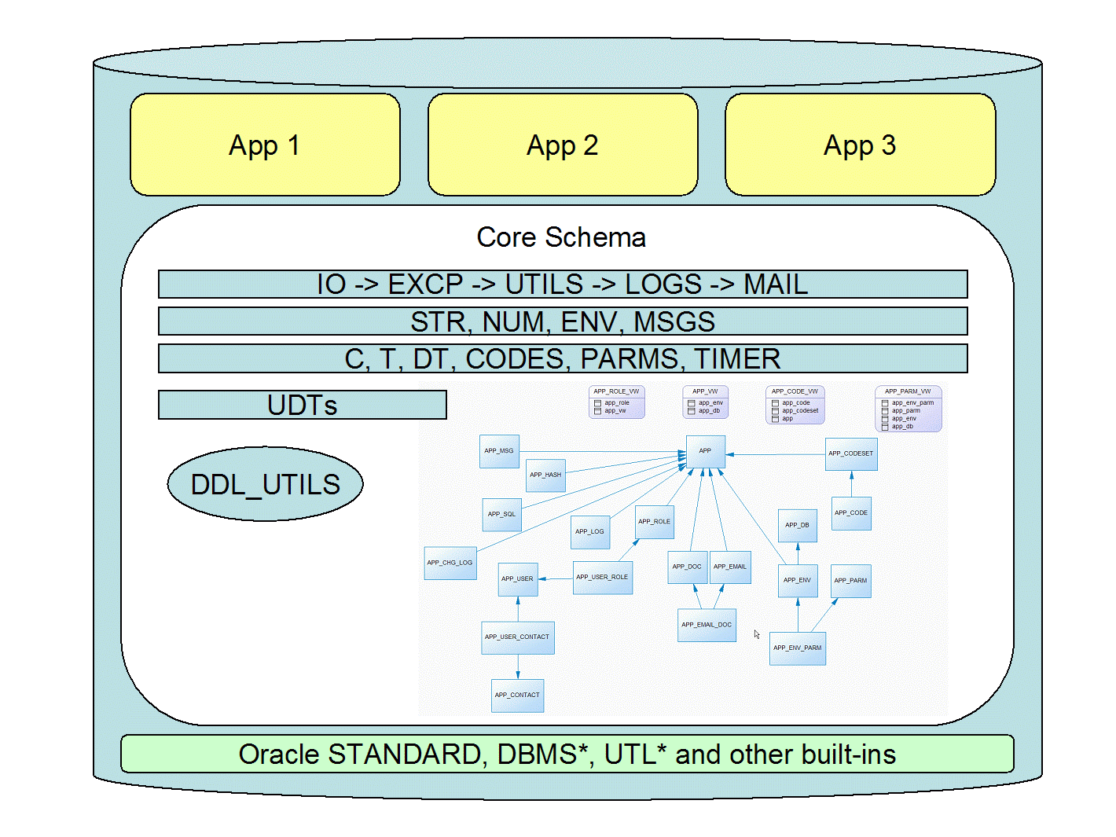
Model of Starter Framework

Slide 28
Recap
Frameworks are a critical part of any application infrastructure.
Infrastructure cannot be ignored without consequence.
Many factors play in determining whether you build or adopt a framework and what it contains.
Best practices must be followed in building a framework.
Expect great improvements across the SDLC once the initial learning curve is crested.

Slide 29
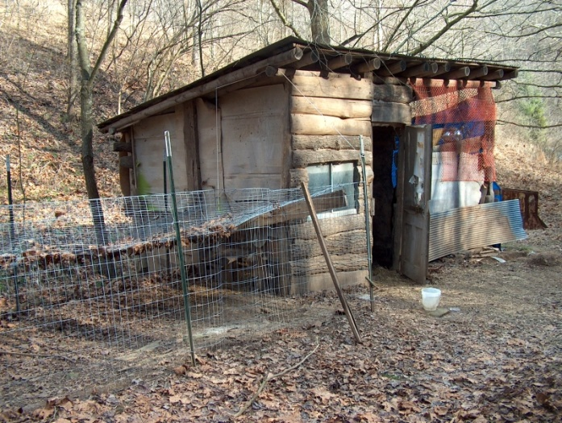

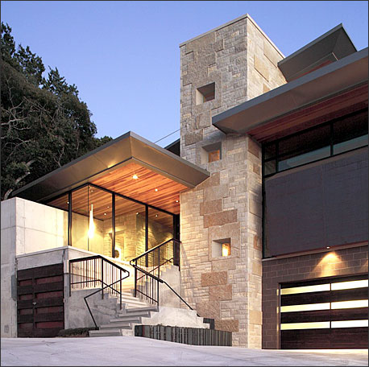
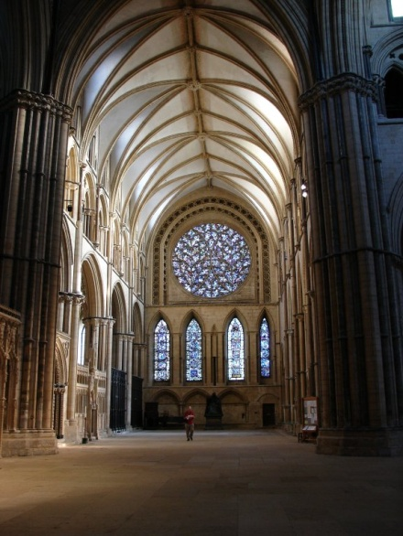
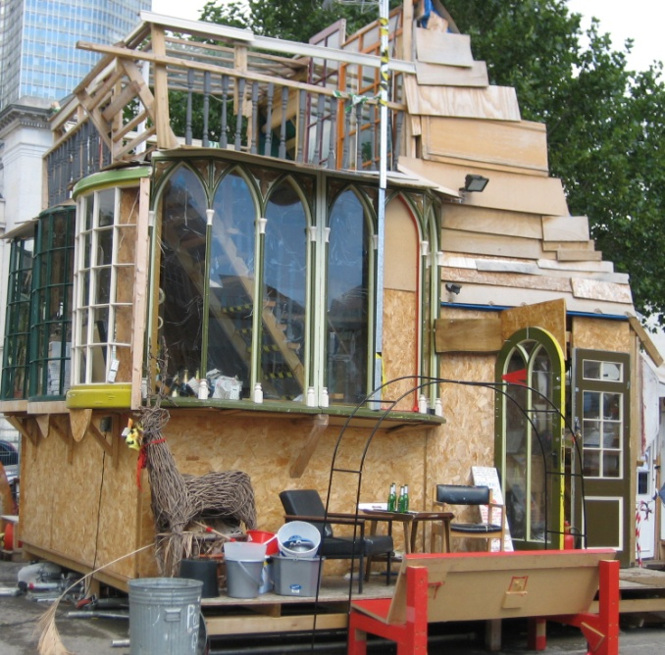


Your Design Legacy
OR

Slide 30
Questions?

Slide 31
Thank You for Attending!
Please fill out your evaluation form.
This was
  Session #465
  “PL/SQL Frameworks for Custom Systems”
  by Bill Coulam
Contact: bcoulam@yahoo.com

